Slide 1
CSE115/ENGR160 Discrete Mathematics
02/02/12
Ming-Hsuan Yang
UC Merced

Slide 2
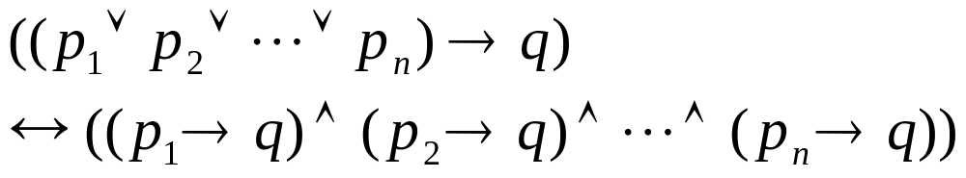
1.8 Proof methods and strategy
Proof by cases: p_{i}→q for i=1,2,…,n
When it is not possible to consider all cases at the same time
Exhaustive proof: some theorems can be proved by examining a relatively small number of examples

Slide 3
Example
Prove (n+1)³≥3^{n} if n is a positive integer with n≤4
Proof by exhaustion as we only need to verify n=1,2,3 and 4.
For n=1, (n+1)³=8 ≥3¹=3
For n=2, (n+1)³=27 ≥3²=9
For n=3, (n+1)³=64 ≥3³=27
For n=4, (n+1)³=125≥4³=64

Slide 4
Example
An integer is a perfect power if it equals nª, where a is an integer greater than 1
Prove that the only consecutive positive integers not exceeding 100 that are perfect powers are 8 and 9
Can prove this fact by examining positive integers n not exceeding 100
  First check whether n is a perfect power, and then check whether n+1 is a perfect power

Slide 5
Example
For positive integers
  The squares ≤ 100: 1, 4, 9, 16, 25, 36, 49, 64, 81, and 100
  The cubes ≤ 100: 1, 8, 27, and 64
  The 4th powers n⁴ ≤ 100: 1, 16, and 81
  The 5th powers n⁵ ≤ 100: 1 and 32
  The 6th powers n⁶ ≤ 100: 1 and 64
  Look at the list of perfect powers, we see that the pair of n=8 and n+1=9 is the only two consecutive powers ≤ 100

Slide 6
Proof by cases
Prove that if n is an integer, then n²≥ n
We prove this by 3 cases:
  n=0: trivial case as 0²≥ 0
  n≥1: If n≥1 then n∙n ≥ n∙1 and thus n²≥ n
  n≤-1: If n ≤ -1 then n² ≥ 0>n and thus n²≥ n
n=-1
n=0
n=1

Slide 7
Example
Show that |xy|=|x||y| for real numbers
x≥0, y≥0: xy ≥0 |xy|=xy=|x||y|
x≥0, y<0: xy<0 |xy|=-xy=x(-y)=|x||y|
x<0, y ≥0:xy<0 |xy|=-xy=(-x)y=|x||y|
x<0, y<0: xy>0 |xy|=xy=(-x)(-y)=|x||y|

Slide 8
Example
Formulate a conjecture about the decimal digits that occur at the final digit of the squares of an integer and prove the result
The smallest perfect squares are: 1, 4, 9, 16, 25, 36, 49, 64, 81, 100, 121, 144, 169, 196, 225 and so on
Note that the digits that occur at the final digit of a squares are: 0, 1, 4, 5, 6, and 9 (and no 2, 3, 7, and 8) → conjecture

Slide 9
Example
We can express an integer n as 10a+b were a and b are positive integers and 0≤b≤9
n²=(10a+b)²=100a²+20ab+b²=10(10a² +2b)+b², so the final digit is the final digit of b²
Note also that the final digit of (10-b)²=100-20b+b². Thus, we only consider 6 cases
Case 1: if final digit of n is 1 or 9 (or b), then the last digit of n² is 1

Slide 10
Example
Case 2: if the final digit of n is 2 or 8, then the final digit of n² is 4
Case 3: if the final digit of n is 3 or 7, then the final digit of n² is 9
Case 4: if the final digit of n is 4 or 6, then the final digit of n² is 6
Case 5: if the final digit of n is 5, then the final digit of n² is 5
Case 6: if the final digit of n is 0, then the final digit of n² is 0

Slide 11
Example
Show that there are no solutions in integers x and y of x²+3y²=8
x²>8 when |x|≥3, and 3y²>8 when |y|≥2. The only values for x are -2,-1,0,1,2 and for y are -1, 0, 1
So, possible values for x² are, 0, 1, and 4. The possible values for 3y² are 0 and 3
No pair of x and y can be solution

