Slide 1
CSE511- Mid Project Evaluation
Group 9

Slide 2
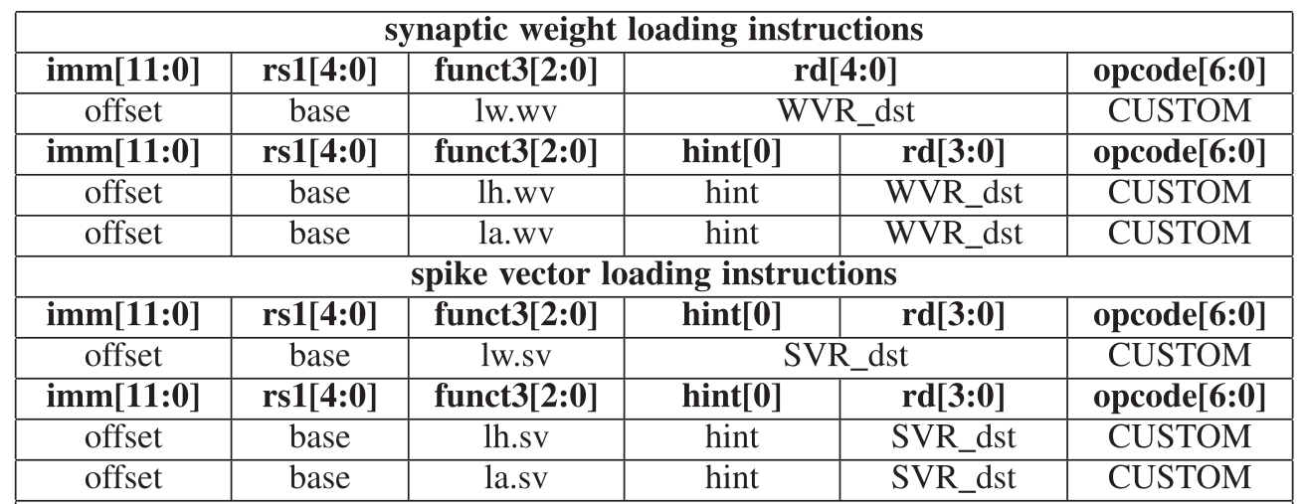
ISA to implement

Slide 3
Assumptions
Vector signal / D signal has a width of 512 bits
‘A’ signal: 8 bits - 5 bits for rd and 3 bits for funct3
1 WVR register holds 8 weights => 1 weight = 4 bits
1 SVR register holds 32 spikes => 1 spike = 1 bit (future)
lw = 1, lh = 4, la = 16 (rd sets the starting register)
funct3 | rd
7:5 | 4:0

Slide 4
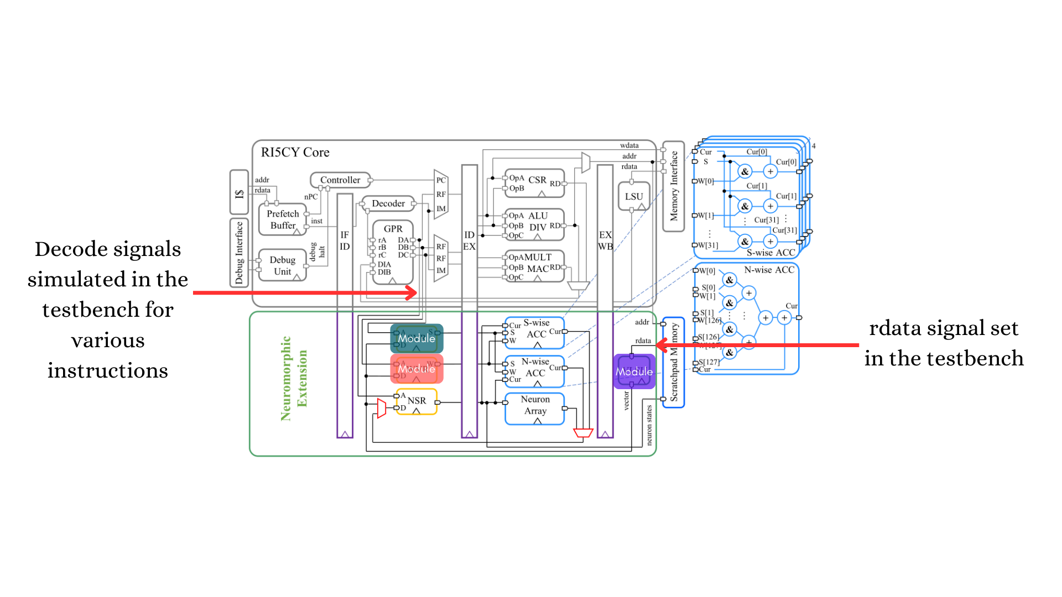
Approach

Slide 5
Demo

