Slide 1
SHABLEY SHUBIK FOR INDIAN ELECTIONS
Noel Abraham Tiju
Muthuraj Vairamuthu
Rayyan Hussain

Slide 2
INTRODUCTION

Slide 3
Introduction
Our project aims to address the pivotal issue of equitable political representation in Indian National Elections through the utilization of Shapley-Shubik Power Index.
We analyze the impact of varying the sequence in which each state is addressed, considering the number seats and required number of permutations.
Incorporating the Shapley-Shubik index, we average these observations to determine a power index. This index identifies the influence each state holds in the electoral process.

Slide 4
shABLEY SHUBIK POWER INDEX

Slide 5
Shabley shubik power index
The Shapley-Shubik Power Index measures the relative influence or power of each participant in a coalition or group.
Sequential Coalition: It considers all possible orders in which participants could join a coalition, calculating the average marginal contribution of each member across different joining sequences.
Particularly relevant in scenarios where decisions or benefits depend on the collaborative efforts of multiple agents, such as political alliances, corporate partnerships, or international negotiations.

Slide 6
mathematical representation

Slide 7
mathematical representation
The Shapley Shubik value, where the sum is taken over all coalitions of i, is given by:
ϕi(v) = Σ (((s − 1)!(n − s)!) / n!) * (v(s) − v(s − i))

Slide 8
PIVOTAL PLAYER

Slide 9
PIVOTAL PLAYER
Definition “A pivotal player is an individual whose addition to a sequential coalition transforms it from a losing to a winning configuration”

Slide 10
STEPS FOR SHABLEY SHUBIK

Slide 11
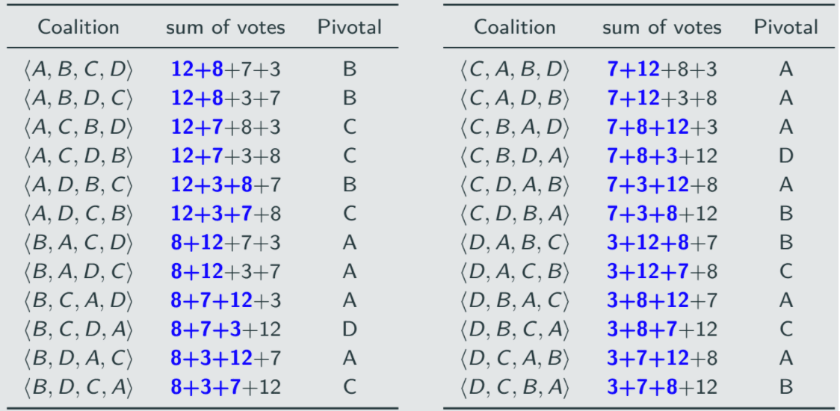

Slide 12
Implementing this for general elections

Slide 13
Implementing this for general elections
Step 1: Generate all possible permutations of candidates or constituencies in the context of Indian elections.
Step 2: Calculate the Shapley-Shubik Power Index for each permutation to identify pivotal players—those individuals whose inclusion can turn a losing coalition into a winning one.
Step 3: Keep a detailed record of the pivotal players identified in each permutation, noting their respective impact on coalition outcomes. Based on this, plot a pie chart.

Slide 14
Problem

Slide 15
Problem
Calculating the permutations for 36 constituencies posed a significant challenge due to the enormity of the number 36 factorial, making the computation task exceptionally difficult.

Slide 16
SOLUTION

Slide 17
SOLUTION
To handle the computational complexity of calculating all 36 factorial permutations for the Shapley-Shubik Power Index, consider using randomized sampling using Fisher-Yates shuffling.

Slide 18
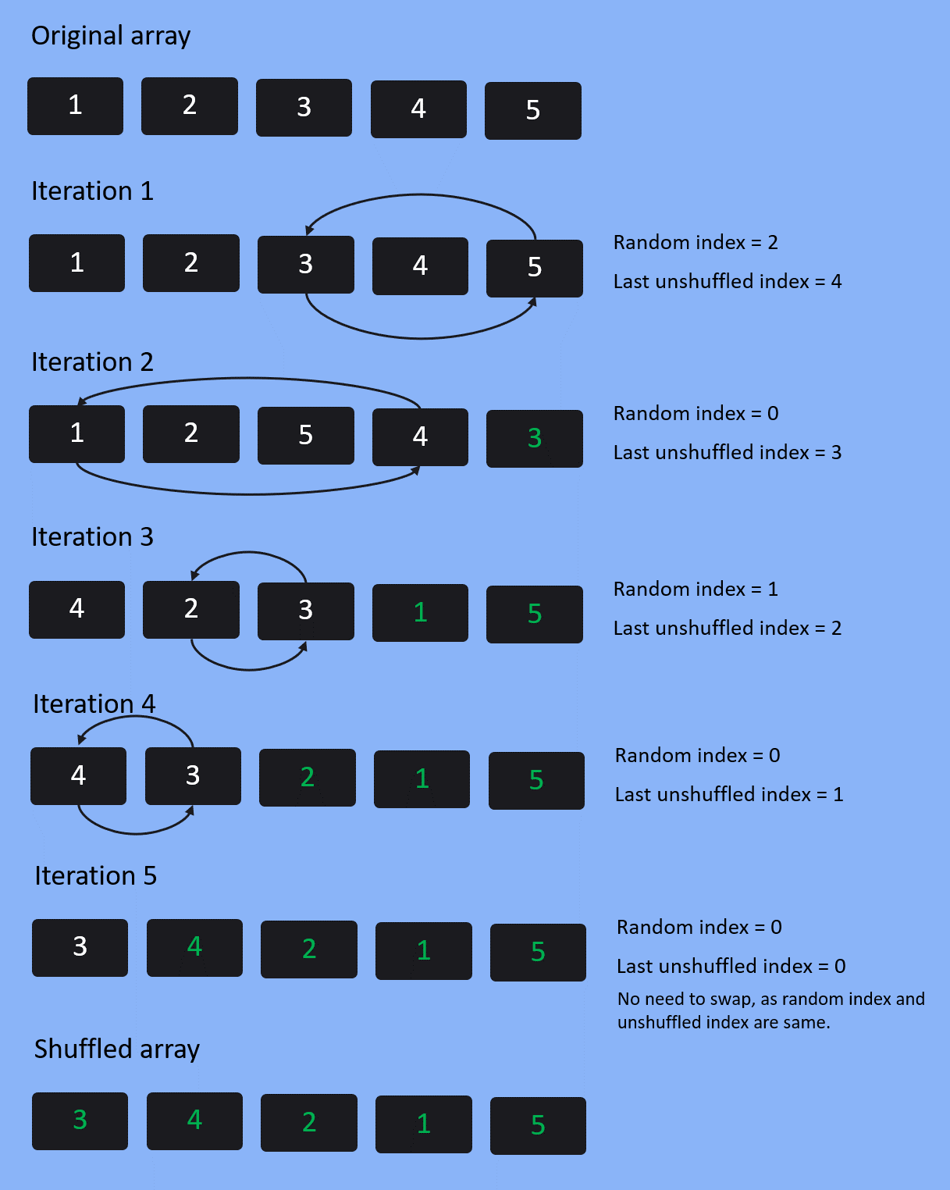
FISHER YATES shuffle

Slide 19
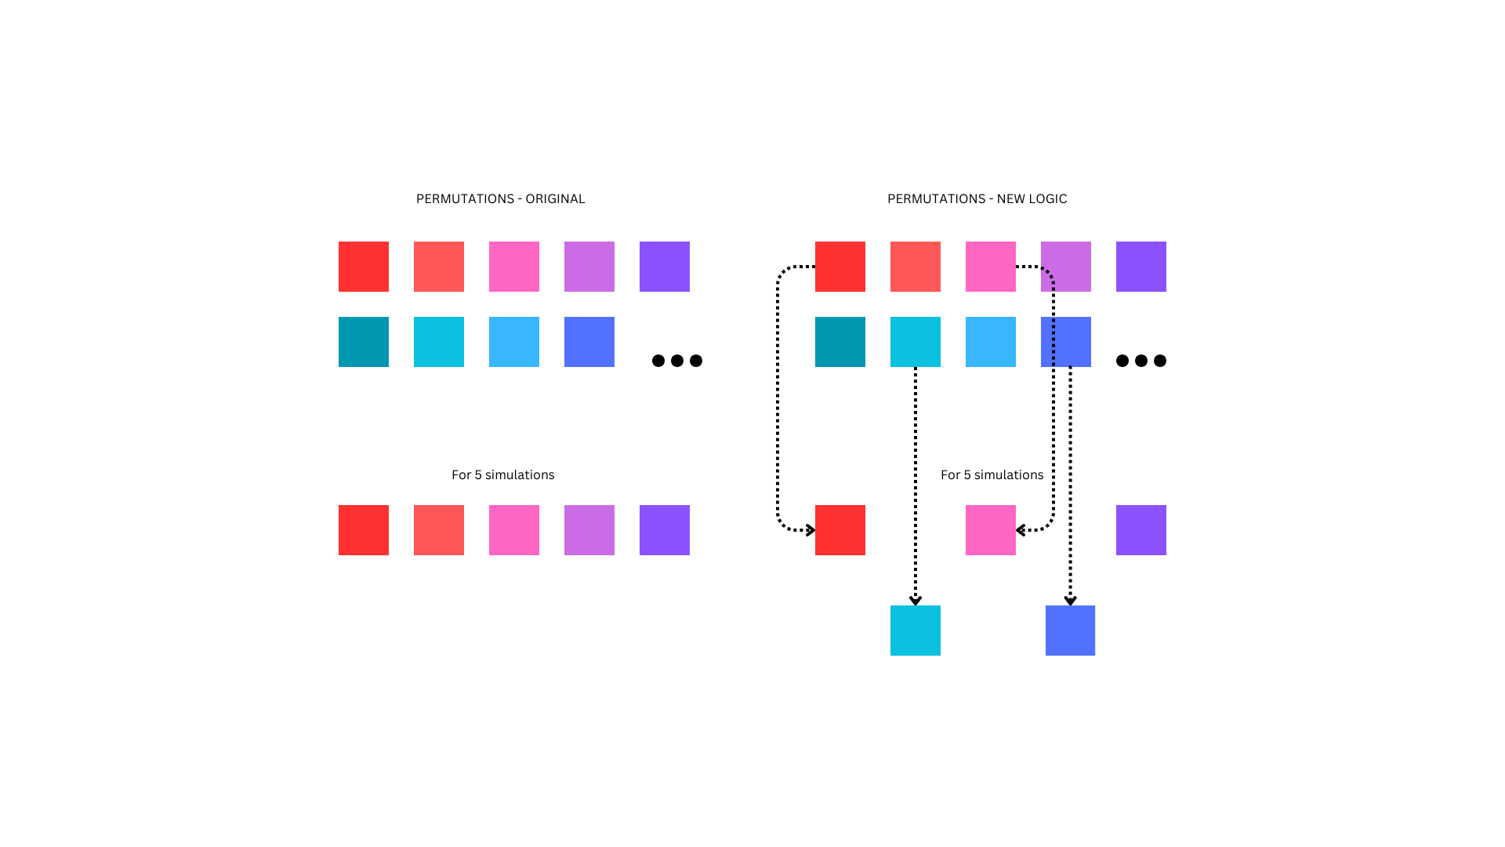
Old solution without randomization

Slide 20
new solution with randomization

Slide 21
results

Slide 22
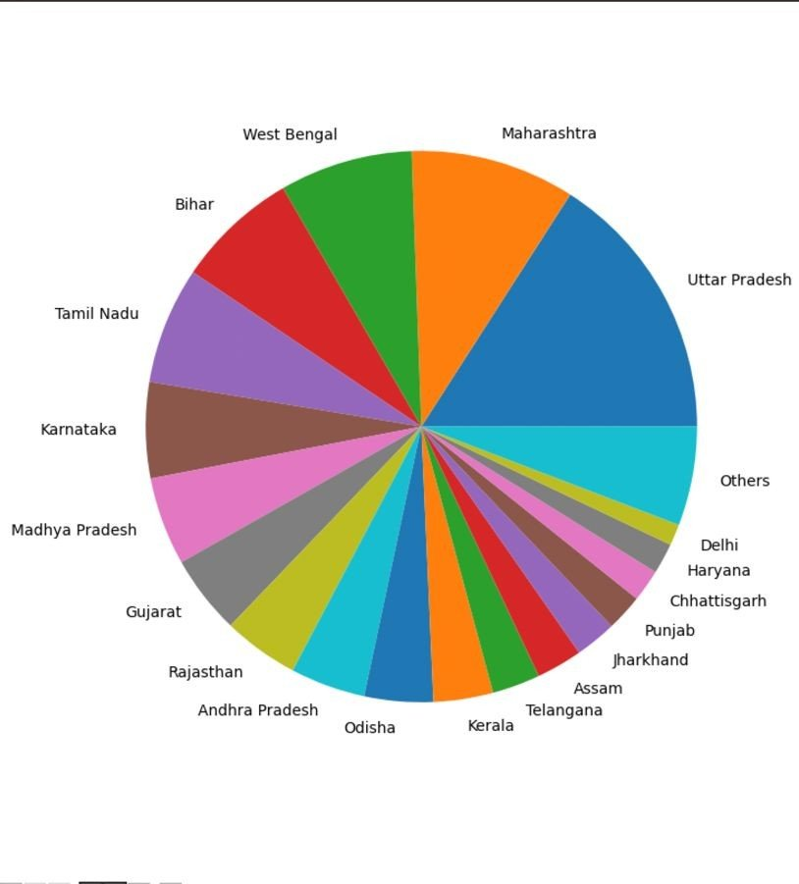
Pie chart

Slide 23
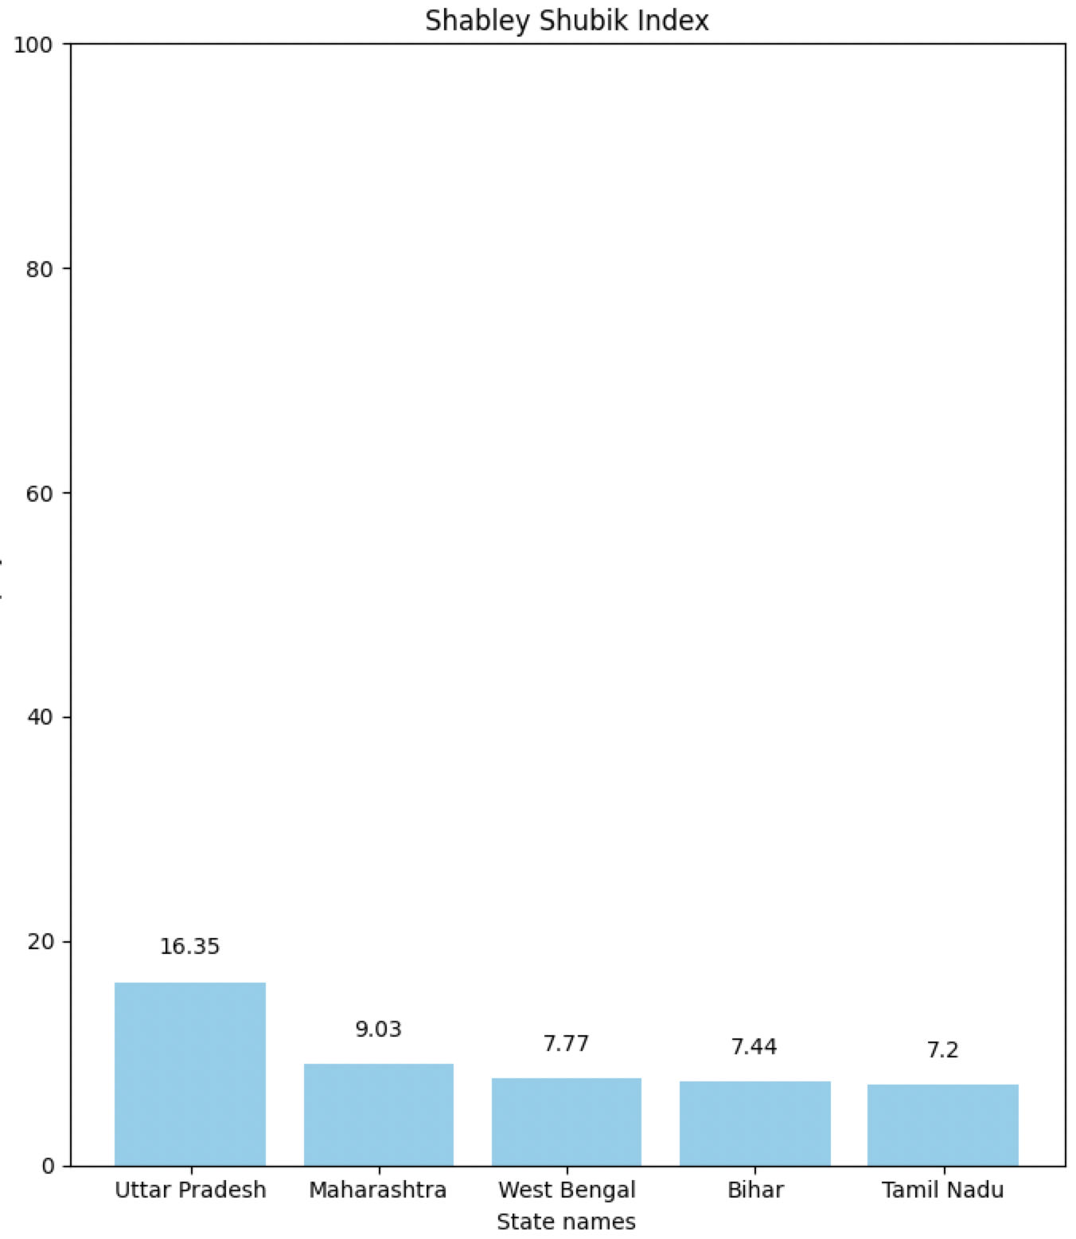
Top 5 states

Slide 24
statistics

Slide 25
statistics

Slide 26
CONclusion

Slide 27
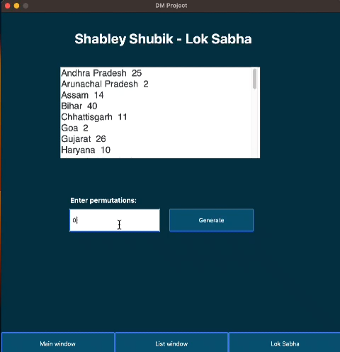
CONCLUSION
The project's results offer insights into various election outcomes based on different state arrangements. The simulation tool provides users with a clear understanding of each state's impact on election results, aiding informed decision-making and strategic planning.

Slide 28
DM TOPICS USED

Slide 29
DM TOPICS USED
Game Theory
Heap based permutations
Weighted Nodes
Randomization

Slide 30
THANKYOU

