Slide 1


INTERNSHIP PRESENTATION · YEAR 3 · 2026
Elysian
Celebrations
Building a multi-brand event platform at TIPS Founder's Desk.
PRESENTED BY
ROLE
Mohammed Rayyan Pasha
Founder's Desk Associate
AU23UG-015 · Atria University, Bengaluru
Digital Transformation & Venture Development
ORGANISATION
ENGAGEMENT
TIPS Founder's Desk
01 April 2025 – 30 December 2026
The Indian Public School, Bengaluru
Hybrid, project-based · ongoing
Notes:
[~13s] Good morning. I'm Rayyan Pasha, third year, Digital Transformation at Atria. I intern at TIPS Founder's Desk, and today I'm showing you what I built there — Elysian Celebrations.

Slide 2

01 · THE ROLE
My mandate was wider than one product.
THE ENGAGEMENT
Founder's Desk & strategy support
Digital transformation of operations
A
B
Role
Founder's Desk Associate — Digital Transformation, Venture Development & Strategic Initiatives
Elysian & multi-brand venture building
EdTech & AI/chatbot prototypes
Reporting to
C
D
Padmini Raghavendra — Director & CEO
Period
01 April 2025 – 30 December 2026 (ongoing)
Hospitality, events & real estate
Data, research & reporting
Work mode
E
F
Hybrid, project-based
Across the other areas I shipped SOPs, dashboards and trackers, AI-chatbot prototypes, market research and founder-level decision decks. Elysian is where most of my build work went — so that is what I'll show you.
Notes:
[~29s] My role is Founder's Desk Associate, reporting to Padmini Raghavendra, the Director. The mandate covers six areas — strategy support, digitising operations, venture building, EdTech and chatbot prototypes, hospitality and events, and research. Across those I've delivered SOPs, dashboards, trackers, chatbot prototypes and business decks. But area C — Elysian — is where most of my build work went. So that's what I'll focus on today.

Slide 3
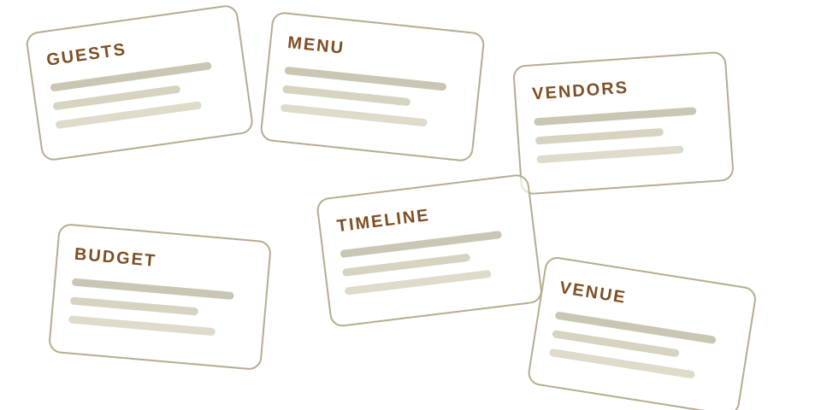
02 · THE PROBLEM
A five-day celebration runs on
spreadsheets, chats and memory.
1
Nothing is connected
Guest count in a sheet, menu in a chat, budget in someone's head. Change one and the rest go stale.
2
Everything is free text
Vendors are typed, not chosen — so no system can price, book or report on them.
3
No one can see readiness
“Are we ready for Day 3?” has no answer short of calling six people.
Six tools that never speak to each other — and one client expected to be the integration layer.
Notes:
[~24s] Here's the problem. Planning a five-day celebration means twenty-plus functions. Right now that runs on spreadsheets, WhatsApp and memory. Nothing is connected — change the guest count and the menu quietly goes stale. Everything is typed by hand, so no system can price it or book it. And nobody can answer a simple question: are we ready for Day Three?

Slide 4
03 · WHAT I BUILT
Define the event, map every function, prove it's ready.
01
DEFINE
02
MAP
03
FINALIZE
Event type, days, time blocks and needs — chosen, not typed.
A visual flow map: event hub → days → functions → steps, with venue and vendor pickers inside each need.
Readiness checks that expose gaps and link back to the exact function.
61,000+
62
59
27
4
lines of TypeScript
application routes
API endpoints
Postgres tables
role-based portals
Client · Vendor · Manager · Admin — one shared event spine, four different views of it.
Notes:
[~33s] Elysian answers that in three layers. DEFINE shapes the event — type, days, time blocks. MAP is the core. It's a visual flow map where you drill from the event down to one day, one function, one step — so the form that finally opens is small enough to actually finish. FINALIZE proves readiness. It's sixty-one thousand lines of TypeScript, sixty-two routes, fifty-nine API endpoints, twenty-seven database tables, and four separate portals — client, vendor, manager and admin.

Slide 5

04 · LIVE DEMO
Let me show you
the real thing.
The flow map
1
Drill from the event hub down to a single step of one function.
Vendor catalogue
elysiancelebrations.com
2
Selection happens inside the need — real offerings, never typed names.
Three beats, then straight back to the deck.
Readiness gate
3
The client total only appears once the function is genuinely complete.
Notes:
[~50s] DEMO — site already open, already logged in, tab on the flow map. SAY: Let me show you the real thing. (1) FLOW MAP — This is the flow map. I start at the event, open a day, then a function — and notice the editor only opens once I pick a step. (2) CATALOGUE — Vendors are selected from a real catalogue, inside the need they belong to. Never typed. That's what makes them priceable and bookable. (3) READINESS — And this is the readiness gate: the client's final price only appears once the function is genuinely complete. SAY: Let me come back to the deck. IF IT FAILS: say 'Looks like the connection's not cooperating — let me carry on', once, and move on. Do not debug.

Slide 6
05 · TECHNOLOGIES USED
A production stack, not a student stack.
FRONTEND
DATA
AUTH & SECURITY
DELIVERY
Next.js 16 App Router
Supabase Postgres
Clerk authentication
Vercel CI/CD
React 19
27 tables, 25 migrations
Webhook role sync
Git branch workflow
TypeScript (strict)
Supabase Storage
Row Level Security
ESLint + tsc gates
Tailwind CSS v4
Generated DB types
Server-side ownership
Scripted migrations
Framer Motion
SQL constraints
Self-audited routes
AI-assisted development
Notes:
[~21s] The stack is deliberately production-grade. Next.js sixteen and React nineteen on the front end. Supabase Postgres behind it, with twenty-seven tables and twenty-five migrations — every schema change is in version control, none of it typed into a dashboard. Clerk handles authentication. And it ships continuously through Vercel.

Slide 7
06 · SKILLS GAINED & CHALLENGES FACED
What the work taught me — and what fought back.
SKILLS I GAINED
CHALLENGES I FACED
Full-stack product engineering
Two rules guarding one price
from schema to interface, alone
Readiness was computed in the browser and again on the server, with different logic — and one copy decided whether a client could see a price.
Relational data modelling
27 tables and a versioned migration habit
→ Collapsed it into a single server-side contract.
Authorisation design
four roles, each seeing different truths
Three roles, three truths
Vendors, clients and Elysian must each see a different part of the same number.
Security auditing
reading my own code adversarially
→ Enforced in Postgres with generated columns, not in the UI.
Design systems
one palette and one component language
Building solo on a live venture
AI-assisted development
Product, design, backend and security with no team to hand work to.
directing tools without losing the architecture
→ Wrote my own audits to catch what a reviewer would.
Notes:
[~35s] What I gained: I went from writing features to owning a system — data modelling, authorisation design, and auditing my own code. The hardest challenge was this. Readiness was being calculated twice — once in the browser, once on the server — with different rules. And one of those copies decided whether a client could see a price. I collapsed it into a single server-side contract. The lesson stuck with me: duplicated logic near money isn't untidy — it's a security bug.

Slide 8

07 · ACADEMIC LEARNING APPLIED & FUTURE GOALS
Digital Transformation, applied literally.
FROM THE CLASSROOM TO THE FOUNDER'S DESK
WHERE THIS GOES NEXT
Process mapping & systems thinking
1
Still building — through December 2026
became the flow map — the event modelled as days, functions and steps.
The engagement is ongoing; Elysian is not a finished submission.
Database & data modelling
2
Next: architecture, not features
became 27 normalised tables with constraints that encode business rules.
Transaction boundaries in Postgres, a split client/vendor ledger, and server-side decomposition of the planner.
Data-driven decision making
3
Scale Elysian past events
became readiness scoring and spend intelligence instead of guesswork.
Extend the same spine to hospitality, education and real estate as a true multi-brand platform.
Product thinking
4
My own goal
became the rule that users tap first and type only when they must.
Grow into an engineer who owns systems end to end — and keeps auditing his own work.
Notes:
[~29s] My programme is Digital Transformation, and this internship was exactly that. Process mapping became the flow map. Database modelling became twenty-seven tables with the business rules enforced in SQL. Data-driven decision making became readiness scoring instead of guesswork. And I'm not finished. I'm with TIPS through December twenty twenty-six. Next is architecture rather than features — and extending Elysian beyond events into hospitality, education and real estate.

Slide 9
THANK YOU
Questions are
welcome.
Happy to go deeper on the flow map, the pricing model, or the audit.
STUDENT
Mohammed Rayyan Pasha · AU23UG-015
PROGRAMME
Undergraduate Programme in Digital Transformation
MENTOR
Padmini Raghavendra — Director & CEO
ORGANISATION
TIPS Founder's Desk · The Indian Public School, Bengaluru
Notes:
[~9s] That's Elysian — built over the last year, and still being built. Thank you. I'm happy to take questions.

