Slide 1

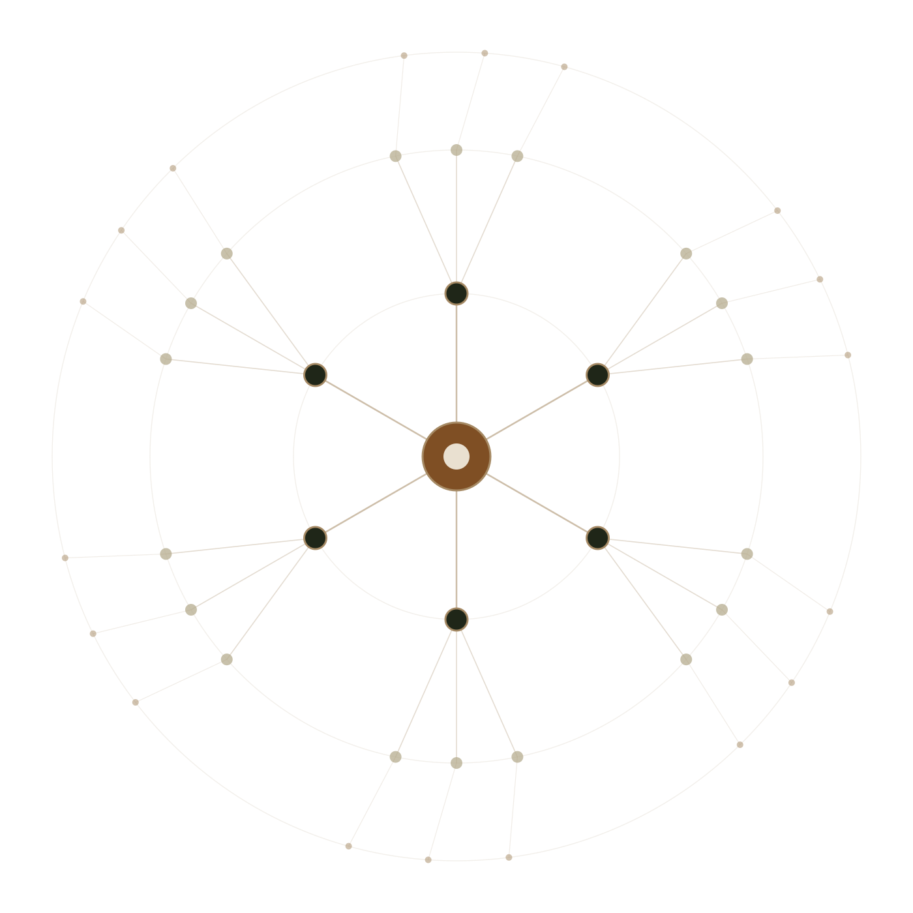
INTERNSHIP PROJECT PRESENTATION
Elysian
Celebrations
Turning a wedding website into an event-planning platform.
PRESENTED BY
ORGANISATION
DURATION
Mohammed Rayyan Pasha
TIPS Founder's Desk
01 Apr 2025 – 30 Dec 2026
Next.js 16 · React 19 · TypeScript · Supabase Postgres · Clerk · Vercel
Notes:
Good morning. Over my internship at TIPS Founder's Desk I built Elysian Celebrations. It started as a wedding website brief, and the most important thing I did was recognise it shouldn't stay one. Today I'll show you what I built, the architecture underneath it, and — honestly — what's still unfinished.

Slide 2

01 · SCOPE OF WORK
One codebase, every layer of a real product.
Not a prototype and not a tutorial build — a deployed, role-aware platform with its own schema, security model and commercial rules.
61,000+
62
59
27
lines of
TypeScript
application
routes
API route
handlers
Postgres
tables
strict mode, zero `any`
across 4 role portals
the full security boundary
via 25 reviewed migrations
The brief was “build a wedding website”.
What the users actually needed was an operating system for multi-day events.
Notes:
To frame the scale: 61,000 lines of strict TypeScript, 62 routes, 59 API handlers, 27 tables. But the number that matters is none of those — it's the gap between the brief I was given and the problem I found.

Slide 3
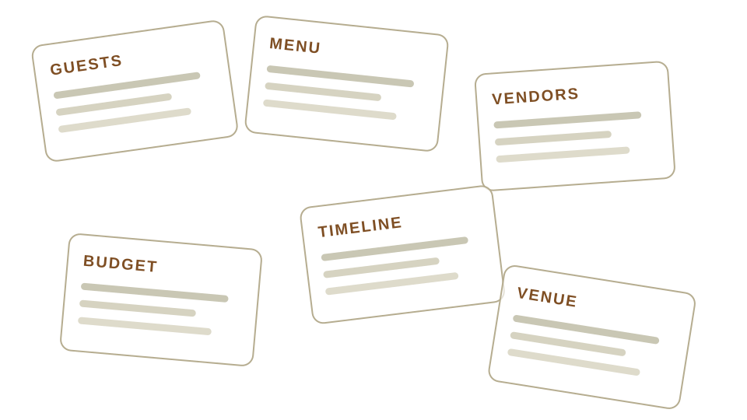
02 · THE PROBLEM
A five-day celebration still runs on
spreadsheets, phone calls and memory.
1
Nothing is connected
The guest count lives in a sheet, the menu in a chat, the budget in someone's head. Change one and the rest silently go stale.
2
Everything is free text
Vendor names are typed, not chosen. Two spellings of one caterer become two vendors, and no system can price either.
3
Cost arrives last
Clients are asked for a budget before anyone knows what the event even contains — so the number is fiction from day one.
4
No one can see readiness
“Are we ready for Day 3?” has no answer short of calling six people.
Six tools that never speak to each other — and one client expected to be the integration layer.
Notes:
Planning a multi-day Indian celebration means twenty-plus functions across five days. Today that's coordinated across six disconnected tools, and the client is the integration layer. Every one of these four problems became a design constraint.

Slide 4

03 · PRODUCT THESIS
Tap first.
Type only when you must.
Every free-text field is a place the system stops understanding the user. So I removed them wherever a real catalogue could take their place.
1
Curated over blank
2
Vendors are chosen, never typed
3
Estimates admit uncertainty
Event types, time blocks and requirement categories are presets. The user recognises, they don't recall.
Selection happens inside the need it belongs to, from a real catalogue of what that vendor actually offers.
Custom requests are quarantined as “manual pricing needed” instead of being silently guessed.
Notes:
This one sentence drove every screen. If the user is typing, the system has stopped understanding them. A typed vendor name is a dead end — it can't be priced, booked or reported on. A chosen one is a foreign key.

Slide 5
04 · THE MODEL
One flow, three layers: define, map, finalize.
Each layer only asks for what the previous one has already made knowable.
01
DEFINITION
02
FLOW MAP
03
FINALIZATION
Shape the event before any form appears.
Edit one scoped part of the event at a time.
Expose the gaps instead of summarising them.
Event type, number of days, dates
Morning / afternoon / evening blocks
Requirement needs per function
Event hub → days → functions → steps
Venue and vendor pickers per need
Six nodes per page, so 14 days stay legible
Definition, requirements, vendors
Budget, guests, hotels
Run-of-show readiness
No budget field here — Elysian estimates cost after the plan exists, not before.
The board is the product. Open a step, and exactly one editor mounts.
Every gap links back to the exact function that caused it.
Notes:
Three layers. Definition shapes the event. The flow map is where the real work happens. Finalization checks readiness. The rule that ties them together: each layer only asks for what the previous one has made knowable — which is why there's no budget question in Definition.

Slide 6
05 · LAYER 2 IN DETAIL
The flow map replaced the form.
Drilling down narrows the scope — so the editor that finally opens is small enough to finish.
STEPS OF THIS FUNCTION
Day 1
Haldi
Basics
Food
14 Mar · Fri
10:00 · Garden Lawn · 120
Design
Vendors
EVENT HUB
Day 2
Lunch
Logistics
Notes
Reception
& Sangeet
15 Mar · Sat
13:00 · Banquet · 240
Readiness is scored server-side
Day 3
Sangeet
One contract scores every function and decides whether a price may be shown at all — the UI never gets its own opinion.
16 Mar · Sun
19:30 · Ballroom · 300
Notes:
This is the screen I'm proudest of. Instead of one enormous form, the user drills: hub, day, function, step. By the time an editor opens it's scoped to one step of one function of one day — small enough to actually finish. The highlighted path is the drill-down.

Slide 7
06 · SYSTEM SHAPE
Four audiences, one source of truth.
Same event, four different questions — and four different sets of facts each role is allowed to see.
CLIENT
11 routes
VENDOR
11 routes
Define the event, map functions, choose venues and vendors, track spend and guests.
Build real catalogue offerings with media, manage bookings, calendar and reviews.
ONE EVENT SPINE
27 tables · 59 endpoints
Roles are enforced server-side, not in the UI
MANAGER
10 routes
ADMIN
15 routes
Operate live events across clients — bookings, inquiries, destinations, configurator.
Own pricing, venues, vendors, packages, revenue and every published commercial total.
Notes:
Four portals, 62 routes, one shared spine. The design decision worth noting: none of these portals is a separate application. They read the same tables through the same handlers — the difference is purely what each role is authorised to see.

Slide 8
07 · ARCHITECTURE
Every API route is the security boundary — on purpose.
The browser can never reach Postgres. That is a deliberate trade, and it comes with a cost I had to own.
CLIENT
THE TRADE-OFF
Next.js 16 App Router · React 19 · Tailwind v4
62 pages across marketing, auth and four dashboards
There is no second line of defence.
IDENTITY
Because every handler uses the service role, RLS cannot catch a mistake. One missing ownership filter would be a cross-tenant leak.
So ownership is re-queried from the database on every scoped read and write, and I audited all 59 handlers specifically for that filter.
Clerk authentication + webhook role sync
Supabase role state is authoritative; Clerk metadata follows
BOUNDARY
59 server route handlers
Ownership re-queried server-side — client IDs are never trusted
DATA
Supabase Postgres + Storage
RLS enabled with zero policies; all anon/authenticated grants revoked
Notes:
Architecturally the most consequential decision: the browser holds no database credentials at all. RLS is on with zero policies and public grants revoked, so Postgres is reachable only through my 59 handlers. The honest cost is that RLS can no longer catch my mistakes — which is exactly why I audited for it.

Slide 9
08 · DATA MODEL
The schema changed 25 times — every change reviewed.
Migrations in version control, applied through a scripted remote workflow. No fixes typed into a dashboard.
MIGRATIONS SHIPPED PER MONTH
25
tracked migrations
27
tables under version control
6
months of continuous schema evolution
1
Baseline & roles
Core schema, plus a manager role added without a rewrite.
0
schema changes made outside a migration
2
Event platform layer
Days, time blocks and requirement payloads.
3
Commercial model
Vendor payout, flat fee and a generated final price.
4
Hardening wave
Query-path indexes, identity history, payment validation.
Notes:
25 migrations over six months. June is the spike — that's when the event-platform layer and the commercial model both landed. The discipline point: not one schema change was typed into the Supabase dashboard. Everything is a reviewed file in git.

Slide 10
09 · COMMERCIAL LOGIC
Three roles, three different truths about one price.
Vendors never negotiate in-app. The rule is enforced by database constraints, not by hiding a button.
1
Agreed offline
2
Admin records it
3
Postgres derives
4
Publish gate
Elysian and the vendor settle the event-specific price outside the product.
One agreed vendor payout plus one flat Elysian fee, entered in /admin/pricing.
final_price = vendor_amount + service_fee, as a generated column.
The client total appears only when the function reaches 100% readiness.
WHO IS ALLOWED TO SEE WHAT
VENDOR
CLIENT
ELYSIAN
Their agreed payout — and nothing else.
The published final price only.
Payout, fee and final together.
Never sees the fee or the client total.
Never sees the payout or the fee split.
The only role with the full breakdown.
Notes:
This was the hardest business logic. Three roles need three different truths about the same number. The service fee is a generated column — final minus payout — so it cannot drift. And the client total is gated behind 100% readiness, so nobody is quoted a price for a plan that isn't finished.

Slide 11
10 · ENGINEERING RIGOUR
I audited my own code, then shipped the fixes.
Two written audits — security and design — reviewed as evidence, not as a checklist to tick.
WHAT THE AUDIT COVERED
3 of 4
0
All 59 route handlers
read individually for ownership and authorisation gaps
HIGH findings closed
npm vulnerabilities
Dependency surface
payout leak, CVE surface, role authority
after upgrading Next, PostCSS and Sharp
npm audit across the full production tree
Schema & RLS migrations
grants, policies, constraints and cascade behaviour
1
6
Secret handling
env layout, publishable vs service-role key separation
HIGH still open
dead dependencies removed
Accessibility
labels, focus management, keyboard paths, contrast
server-rendered role checks on dashboards
GSAP, Zustand, dnd-kit, CVA and more
Notes:
I want to be straight about this slide. I wrote two audits against my own code and I'm showing you the open finding as well as the closed ones. One HIGH is still open — dashboards need a server-rendered role check as defence in depth. The data is protected by the API checks today, but it isn't layered yet.

Slide 12
11 · THE HARD BUG
Two readiness rules disagreed — and one of them controlled money.
BEFORE
AFTER
Readiness was computed twice.
One server-side contract, no UI opinion.
The planner scored a function in the browser. The pricing gate scored it again on the server, with different rules.
So the progress ring could read 100% while the server disagreed — or worse, agree when it shouldn't have. The gate that decides whether a client may see a final price was resting on a number the UI had computed for itself.
Readiness and price visibility now come from a single server contract. The planner renders the score; it never derives it.
The same pass removed the divergence in vendor discovery, which had been reading a hardcoded wedding-only list instead of the plan's real requirement rows.
THE LESSON
Duplicated business logic isn't a code smell. When one copy guards money, it's a security bug waiting for a rounding difference.
Notes:
If you ask me one technical question, ask about this. Readiness was calculated in two places with divergent rules, and one of those copies decided whether a client could see a price. I collapsed it to a single server-side contract. The lesson generalises: duplicated logic near money is a security problem, not a tidiness problem.

Slide 13
12 · WHAT'S NEXT
The next wave is architecture, not features.
These are deliberately unfinished — each needs a data migration, not a patch. Shipping them as “done” would have been the real failure.
1
2
3
Transaction boundaries
Split the money ledger
Decompose the planner
Event creation writes to several tables with no transaction. A failure halfway through is compensated in application code, not rolled back.
One paid_amount column currently serves two opposite flows — what the client pays in, and what the vendor is paid out.
The client planner is a single 6,244-line client component; 42 of 62 pages fetch through useEffect.
Move the full save into reviewed Postgres RPCs so rollback is guaranteed.
Separate client receipts from vendor payouts before the data gets harder to untangle.
Move stable reads server-side without losing the radial interaction model.
Notes:
Three things I chose not to fake. Each needs a data migration rather than a patch, and shipping chrome that implied they worked would have been worse than leaving them open. That judgement — knowing when not to ship — is probably the most useful thing I learned.

Slide 14

13 · WHAT I LEARNED
Three lessons I'll carry into every codebase.
I shipped surfaces that looked plan-aware over logic that never read the plan. A convincing empty state is worse than an honest error — it costs the user trust they can't get back.
1
Chrome that lies is a bug.
Generated columns, partial unique indexes and check constraints enforce the commercial model even if my React code is wrong. Rules in components are suggestions.
2
Constraints belong in the database.
Reading all 59 of my own handlers for a single missing filter changed how I write the next one. Reviewing your own work adversarially is a skill, and it is learnable.
3
Writing the audit taught me more than writing the feature.
Notes:
Three lessons. The first is the one that stings — I built surfaces that implied features worked when the logic behind them didn't. The second changed how I think about where rules live. The third is the habit I'll keep: read your own code the way an attacker would.

Slide 15
THANK YOU
Questions are
welcome.
Happy to walk through the flow map, the pricing constraints, or anything in the audit.
STUDENT
Mohammed Rayyan Pasha
MENTOR
Padmini Raghavendra — Director & CEO
INSTITUTION
Atria University, Bengaluru
Notes:
Thank you. Happy to take questions — and I'd particularly welcome ones about the open items.

