Slide 1
F1 Race Strategist
F1 RACE
STRATEGIST
Interim project review
Rayyan / 9 September 2026
Notes:
Interim review prepared on 9 September 2026. Presenter: Rayyan. Explain that this is an evidence-backed progress report, not the final completion presentation. The app combines historical F1 analytics, podium modelling and grounded natural-language questions.

Slide 2
Current implementation status
Workstream | Status | Evidence
Data and API | Verified locally | 14 tables, SQLite and PostgreSQL
React dashboard and chat | Verified locally | Real API data and browser checks
ML and explanations | Verified | Temporal evaluation and SHAP
Testing and CI | Passing | Python, frontend and Terraform
AWS public deployment | In progress | Account restrictions, Lightsail alternative
This review separates completed engineering from remaining deployment work.
Notes:
Source: repository at commit 328b9b7 and docs/worklog.md. Do not state an invented completion percentage. The local core is verified, while AWS deployment remains in progress. Lightsail provisioning has started after the user authorized an alternative to CloudFront.

Slide 3
Verified dataset coverage
701,433 rows across 14 relational tables
Coverage | Verified result
Historical archive | 1950–2024, 75 seasons
Core entities | 1,125 races, 861 drivers, 212 constructors
Timing detail | Lap data begins 1996, pit stops begin 2011
Sprint coverage | Sprint results begin 2021
Unavailable inputs | Weather, tyres, fuel and telemetry
Notes:
Sources: reports/data_audit.json and docs/data_audit.md. Open https://github.com/rayyanpasha89/F1/blob/main/docs/data_audit.md . The supplied CSV package is not redistributed because no license receipt accompanied it. Audit code verifies hashes, keys, missingness and foreign keys.

Slide 4
Data and application architecture
CSV audit and transactional ingestion establish the relational source.
FastAPI services expose standings, races and competitor profiles.
A chronological feature pipeline supplies the frozen podium model.
Bedrock routes questions to read-only SQL or model inference.
React displays actual rows, probabilities and explanations.
Notes:
Open backend/database.py, scripts/load_data.py and backend/services/analytics.py on GitHub. The loader validates checksums and loads into an empty target transactionally. Local PostgreSQL integration verifies identical feature values and denies writes for the runtime reader role. Production logic resides in tested modules rather than notebooks.

Slide 5
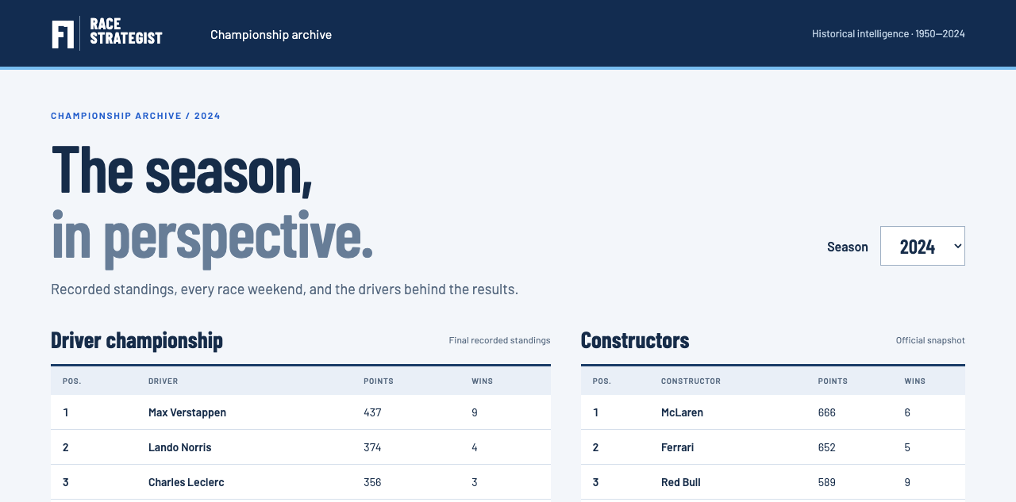
Season dashboard
Season selection, recorded standings and race navigation use the real backend.
Notes:
Actual screenshot from the running local application. Open http://127.0.0.1:5173/ . Select 2024, point to recorded driver and constructor standings, and explain that standings come from final recorded snapshots rather than simple points sums. Click Monaco in Race weekends.

Slide 6
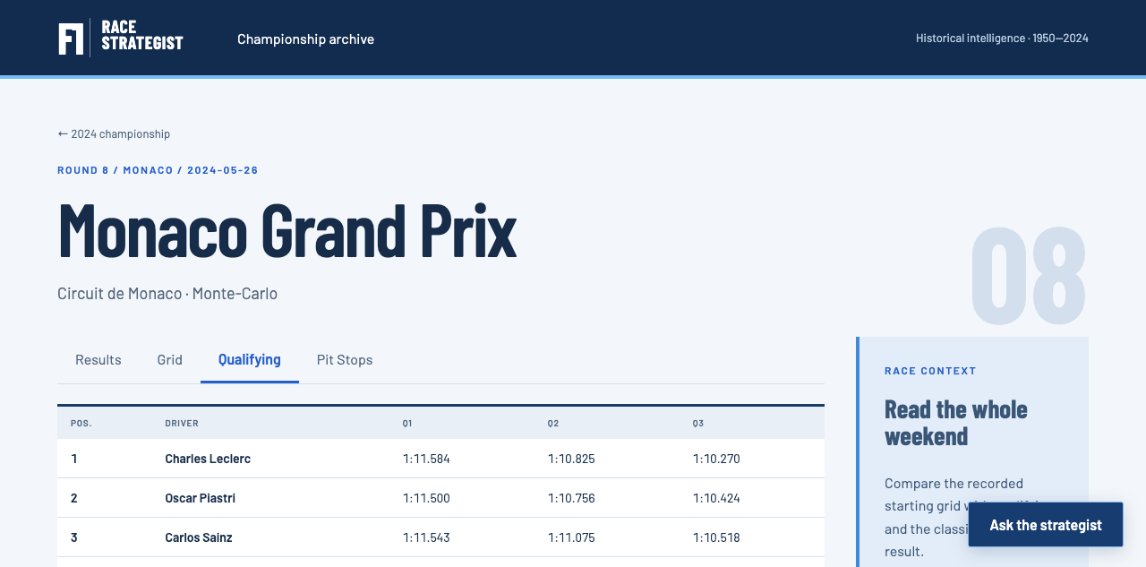
Race weekend and driver analysis
Qualifying, grid, results and profiles remain separate historical views.
Notes:
Actual local screenshot of Monaco 2024 qualifying. Open http://127.0.0.1:5173/races/1128?tab=qualifying . Switch Results, Grid, Qualifying and Pit Stops. Click Charles Leclerc to show a driver profile, season results and career statistics. Return to the race for prediction.

Slide 7
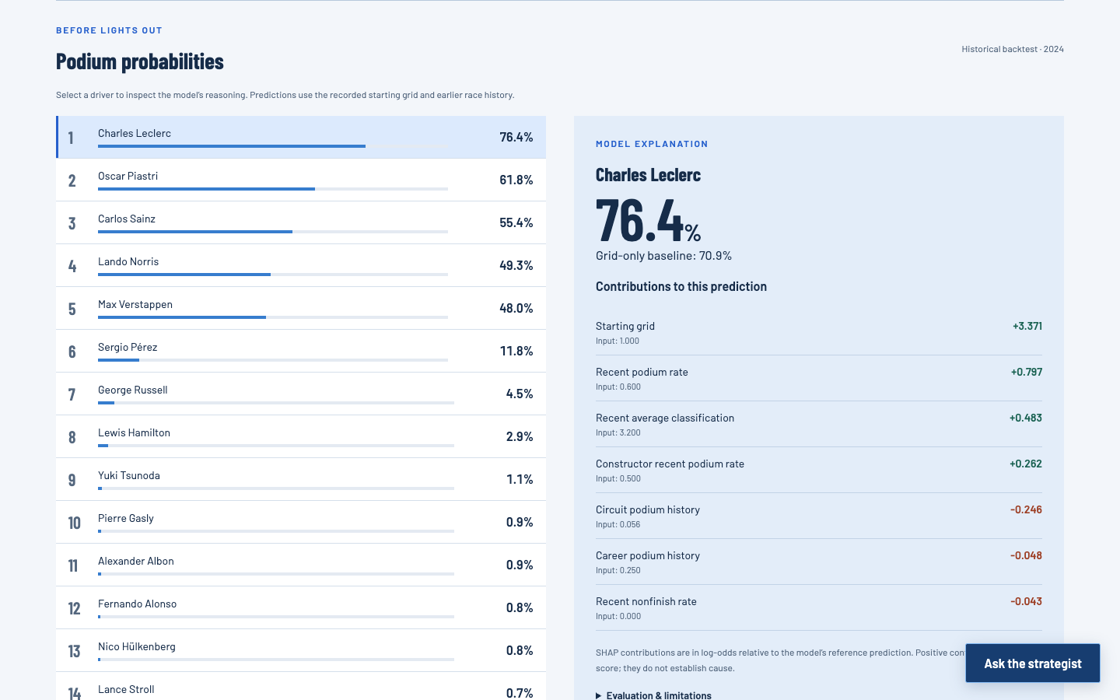
Podium probabilities and explanations
76.4%
Leclerc
podium probability
70.9%
grid baseline
Historical 2024 backtest
Notes:
Actual model output for Monaco 2024. Scroll to Podium probabilities in race 1128. Leclerc 76.4%, grid-only baseline 70.9%. These probabilities come from the frozen calibrated gradient boosting model. The SHAP factors add in calibrated log-odds and reconstruct the probability within 1e-7. The model uses starting grid and earlier race history.

Slide 8
Temporal evaluation and leakage controls
Partition | Seasons | Purpose
Training | 2010–2018 | Fit models and training-only calibration
Validation | 2019–2021 | Choose features, model and calibration
Final test | 2022–2024 | Evaluate the frozen selection
Features use earlier driver, constructor and circuit history.
Mutation tests check same-race, future and teammate leakage.
Notes:
Sources: backend/ml/features.py, tests/test_ml.py, EXPERIMENTS.md and docs/evaluation.md. The original snapshot does not provide pre-event publication timestamps. Historical grids can reflect later corrections, so call this retrospective evaluation, not verified live forecasting. Same-date inputs are emitted before any history update. Completed earlier test races can inform later features, but never refit parameters.

Slide 9
Final model evaluation
Metric, 2022–2024 | Grid baseline | Selected model
Log loss, lower is better | 0.249898 | 0.219846
Brier score, lower is better | 0.073811 | 0.069285
ROC-AUC, higher is better | 0.913827 | 0.935364
Top-three hit rate | 0.651961 | 0.647059
Probability quality improved. Top-three selection did not improve.
Notes:
Source: reports/final_test_metrics.json or the final evaluation report named in docs/evaluation.md. Open https://github.com/rayyanpasha89/F1/blob/main/docs/evaluation.md . Final test contains 68 races and 1,359 driver-race entries. Lower log loss and Brier score are better, higher AUC is better. Top-three hit rate declines slightly, so do not claim universal superiority.

Slide 10

Grounded strategist chat
Statistics use executed SQL and database rows.
Generated SQL is visible for inspection.
Prediction questions call the real ML model.
Unsupported weather questions receive a refusal.
Notes:
Actual mobile screenshot of local chat. Ask “Who won the most races for Red Bull?” and expand Inspect generated SQL. The executed result is Max Verstappen, 63 wins in this snapshot. Ask “Who performs best at Monaco in wet races?” to demonstrate the dataset refusal. Then ask for podium predictions while on a 2022–2024 race. LLM assumptions remain labeled as assumptions.

Slide 11
Live NL2SQL benchmark
40 / 40
30 analytics
10 safe refusals
3.707 s
mean latency
*Run 01 is diagnostic. This reused development suite does not measure unseen accuracy.
Notes:
Sources: reports/nl2sql_run_01.json through reports/nl2sql_run_05.json and tests/nl2sql/questions.json. All 40 cases were executed against Bedrock openai.gpt-oss-120b. Run 01 was diagnostic because a validator bug also blocked reference SQL. Preserve its value as a diagnostic outcome, not a clean accuracy estimate. The suite was reused during development. Row ordering is not scored and join checks are structural proxies. Final run: 30 analytics and 10 refusals pass, average latency 3.707 seconds across all cases.

Slide 12
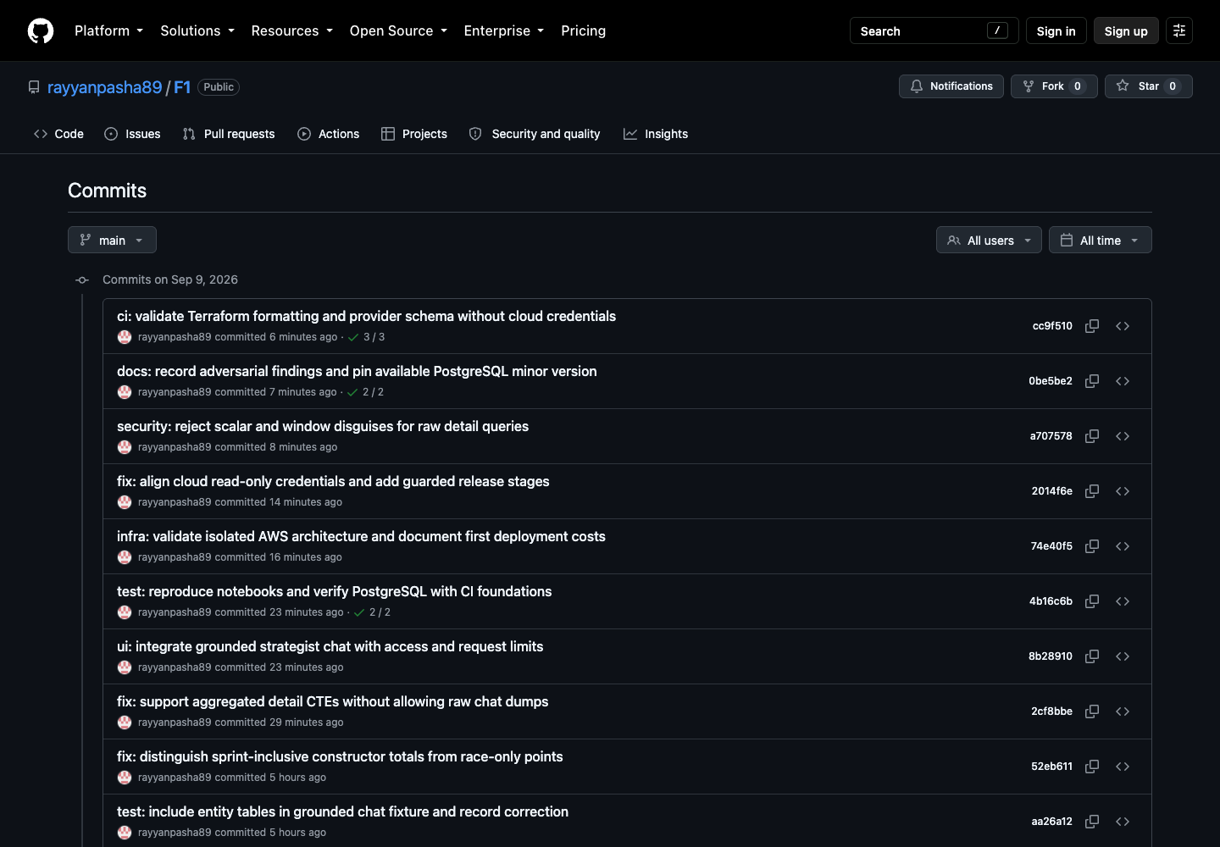
Genuine engineering history
Commits preserve implementation, corrections, experiment evidence and review findings.
Notes:
Actual screenshot from https://github.com/rayyanpasha89/F1/commits/main/ captured on 9 September 2026. Open this URL and scroll through commits. Earlier milestones start with data audit and schema, then API, UI, baseline, model comparison, chat and infrastructure. No backdating or force-push. The worklog honestly records one test-command fall-through and its later corrective commit.

Slide 13
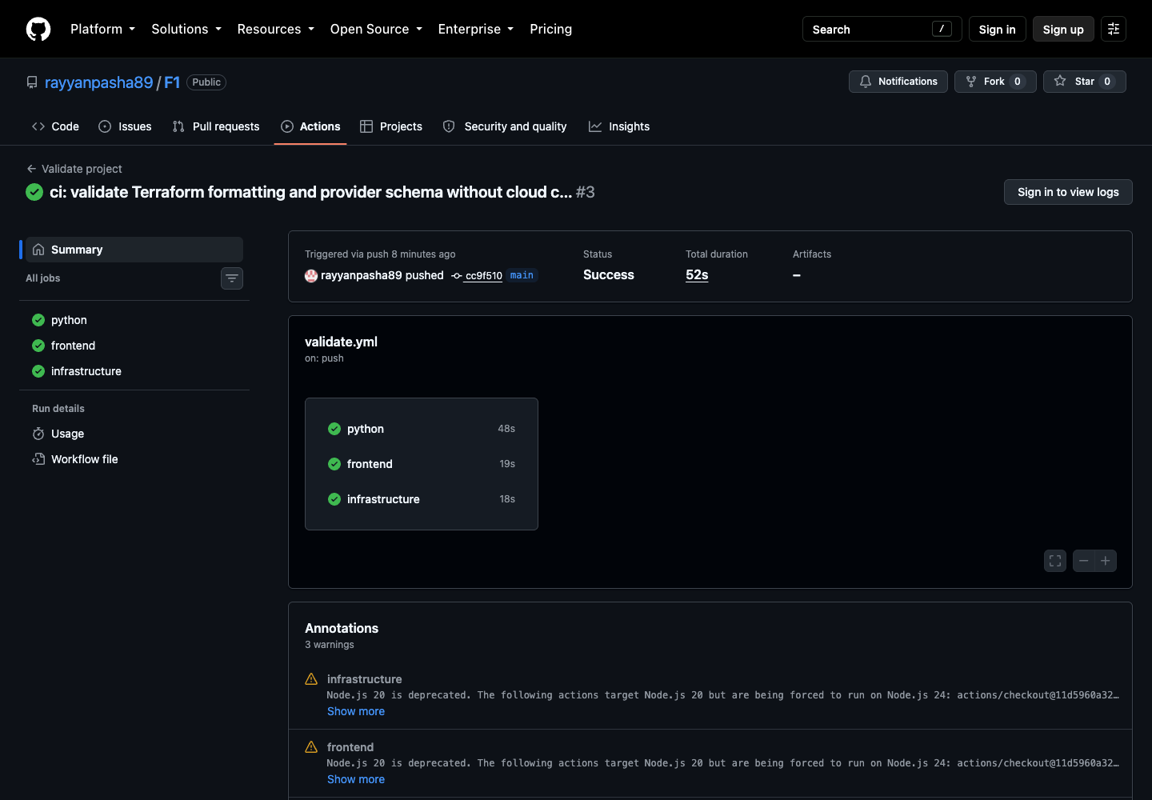
Tests and continuous integration
73
Python tests passed
3 PostgreSQL tests
verified separately
5 frontend tests
3 passing CI jobs
The clone-only CI run has a smaller scope than full source and model verification.
Notes:
Actual GitHub screenshot of run 34343384677 at commit cc9f510. Open https://github.com/rayyanpasha89/F1/actions/runs/34343384677 . Python, frontend and infrastructure jobs pass. Current local suite after same-origin hosting: 73 passed, 3 opt-in PostgreSQL skips; separately all 3 PostgreSQL tests passed. Five frontend tests pass. CI lacks the private source/model artifacts and covers less than the complete local integration run.

Slide 14
AWS deployment checkpoint
Verified: two AWS container builds and model loading in Linux.
Blocked: CloudFront account verification and RDS backup-plan limits.
In progress: Lightsail HTTPS container and persistent PostgreSQL.
Remaining: database bootstrap, public demo and cloud flow verification.
Lightsail estimate: $30/month plus usage. Earlier infrastructure still incurs some charges.
Notes:
Status snapshot on 9 September 2026. Sources: docs/worklog.md and local Terraform execution logs. Both AWS CodeBuild runs succeeded and pushed tested images. Initial plan was 49 additions. Partial apply created 44 managed resources but CloudFront demanded account verification and RDS rejected seven-day backup retention under the Free Tier account plan. The user authorized a Lightsail alternative. Its plan adds a $15/month small container service and $15/month persistent PostgreSQL database. Provisioning is in progress, not a verified public deployment. Earlier ALB remains billable. No cleanup is authorized.

Slide 15
Interim demonstration and next milestones
1. Show the 2024 standings and Monaco race weekend.
2. Open a driver profile, then explain a podium probability.
3. Ask a statistics question and inspect its SQL.
4. Ask the unsupported wet-weather question.
5. Show Git history, CI and the preserved experiment reports.
Next: finish cloud verification and update the final deployment evidence.
AI-assisted engineering. All reported results come from executed project code.
Notes:
Demo guide accompanies this deck. Open local app, the repository commits, GitHub Actions, EXPERIMENTS.md and docs/evaluation.md in separate tabs. Follow the guide for the exact sequence and expected results. AI disclosure: OpenAI Codex assisted implementation and review. Evidence comes from executed code, genuine tests and live benchmark calls. The implementing agent review is not an independent faculty review. Final delivery still requires a verified public cloud flow and complete deployment documentation.

