Slide 1
F1 RACE
STRATEGIST
Final engineering review
Historical analytics, explainable predictions and grounded agentic chat
Rayyan / 10 September 2026
Notes:
Final engineering review. Open the live product at https://f1-strategist-demo.ys85rp5g9ncdj.eu-north-1.cs.amazonlightsail.com/ . This deck reports executed evidence through Git commit 4b3946451986f09fdd11d880a2de757366947989.

Slide 2
End-to-end product status
Workstream | State | Evidence
Data foundation | Verified | 701,433 rows, 14 tables, SQLite and PostgreSQL
Web product | Live | Responsive React views backed by FastAPI
Prediction model | Frozen and measured | Chronological test, calibrated probabilities, SHAP
Agentic chat | Live | Augmentation, reranking, bounded repair and audit trace
Release | Verified | GitHub CI, CodeBuild, ECR and Lightsail deployment 9
Final artifacts include machine-readable reports, screenshots, this deck and a demo guide.
Notes:
Sources: README.md, docs/worklog.md, reports/agentic_local_verification.json and reports/aws_agentic_cloud_verification.json. Explain that every listed workstream has executable or cloud evidence. Avoid inventing a completion percentage.

Slide 3
Historical data foundation
701,433
14
75
audited source rows
relational tables
seasons, 1950–2024
Coverage | Verified result
Core entities | 1,125 races, 861 drivers, 212 constructors
Timing detail | Lap timing begins in 1996; pit stops begin in 2011
Sprint data | Recorded sprint results begin in 2021
Excluded inputs | No dependable weather, tyres, fuel or telemetry
Notes:
Sources: reports/data_audit.json and docs/data_audit.md. The supplied CSV package is not redistributed because no license receipt accompanied it. Audit code verifies hashes, keys, missingness, yearly coverage and referential integrity.

Slide 4
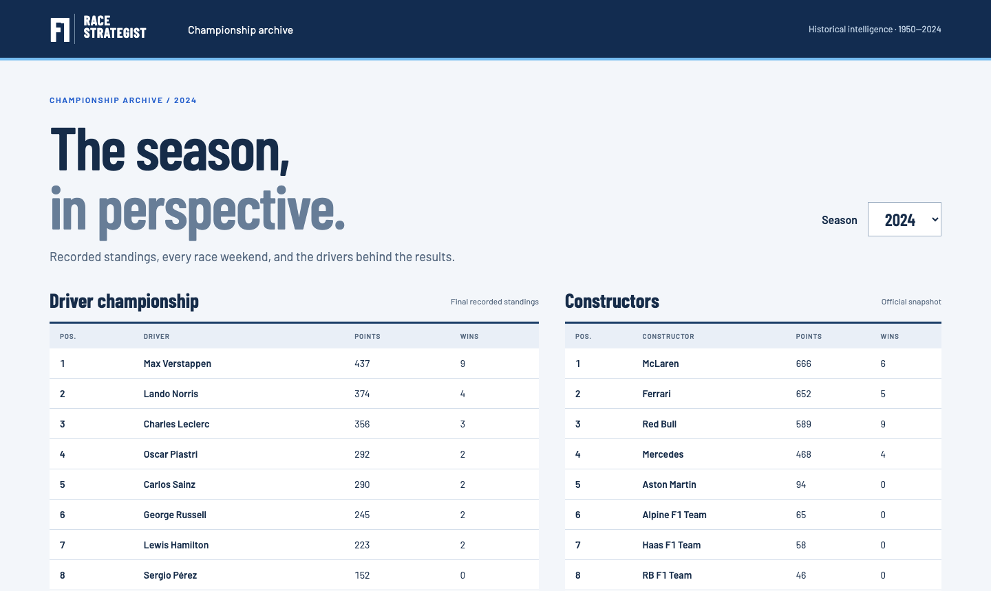
Live championship dashboard
Recorded standings and race navigation come from the private PostgreSQL archive.
Notes:
Actual screenshot from the public AWS application on 10 September 2026. Open the live root URL. Select 2024 and point out final recorded driver and constructor standings, then open Monaco from the race calendar.

Slide 5
Agentic question flow
01
Interpret
Preserve the question and apply conservative spelling correction
02
Retrieve
Rank stored entities and select a relationship-closed schema
03
Route
Choose statistics, prediction, explanation, clarification or refusal
04
Execute
Validate one SELECT and use the independent read-only role
05
Explain
Render rows or model output with an allowlisted trace
Notes:
Sources: backend/ai/chat.py, backend/ai/retrieval.py and backend/ai/sql_safety.py. The flow has a hard three-provider-call budget. Statistics can use route, plan and one repair. Deterministic refusals and name clarifications can use zero calls.

Slide 6
Query augmentation and reranking
Original
How many race wins does Lewis Hamliton have?
Corrected
Lewis Hamilton
stored driver ID 1
Ranked schema
drivers, races, results
Join closure keeps the prompt compact and preserves the path to season results.
Final browser assertion
Trace entity: Lewis Hamilton only
Full-name evidence suppresses overlapping reference and component matches.
Notes:
Sources: backend/ai/retrieval.py and tests/test_retrieval.py. Use this example to explain that correction is database-derived and visible. Browser QA found and fixed an overlapping Jackie Lewis reference; the final trace contains only Lewis Hamilton.

Slide 7
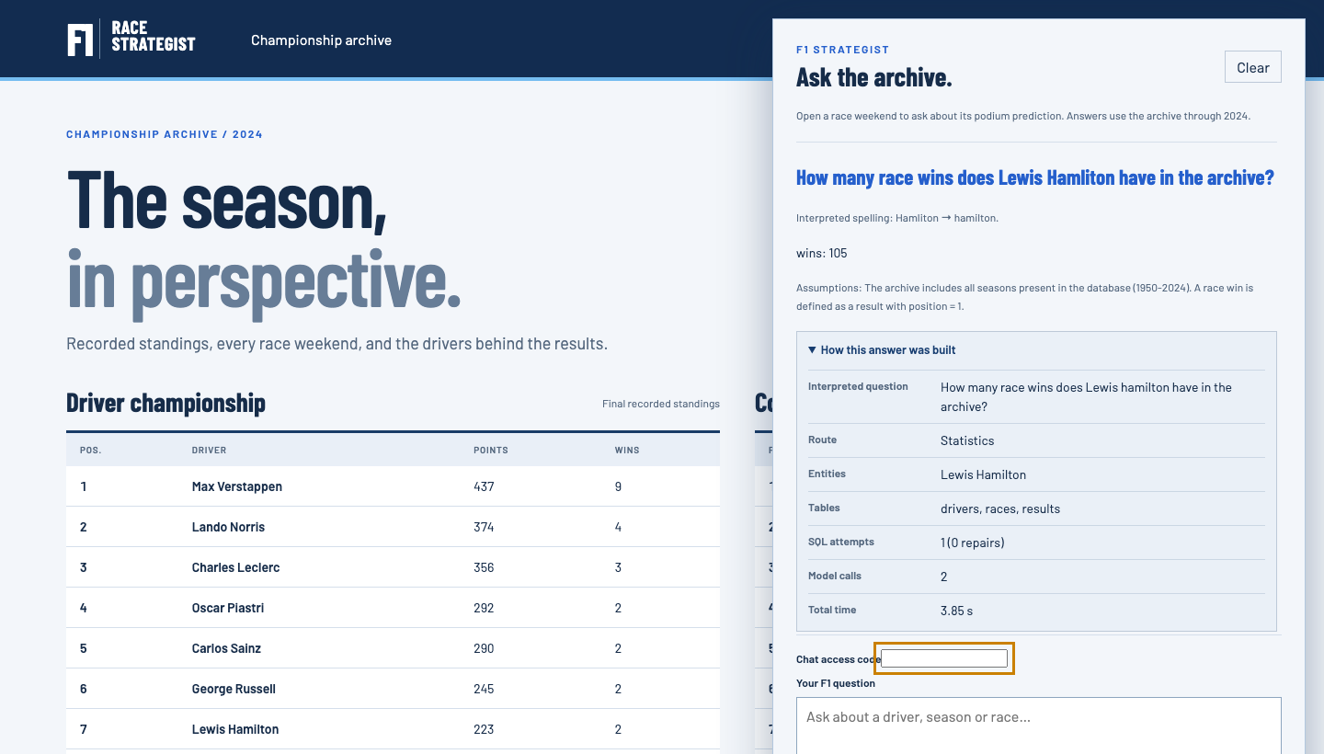
The answer trace is visible
The trace omits prompts, provider payloads, raw errors, connection strings and credentials.
Notes:
Actual public browser screenshot from deployment 9. The question contains Hamliton, the UI displays the correction, returns 105 wins and expands the safe trace. Point out Statistics, Lewis Hamilton, drivers/races/results, one executed SQL attempt, zero repairs and two model calls. The access field is blank in the screenshot.

Slide 8
Read-only SQL and bounded repair
SQLGlot accepts one SELECT over known tables and functions.
Result caps, statement timeouts and aggregate-scope checks limit expensive or raw output.
A separate PostgreSQL role denies DELETE, CREATE and other mutations.
One rejected plan can receive one repair; a request cannot exceed three model calls.
4 / 4
0
3
PostgreSQL integration checks passed
live repairs in final evaluation
maximum provider calls per request
Notes:
Sources: backend/ai/sql_safety.py, backend/ai/chat.py, tests/test_sql_safety.py, tests/test_agentic_chat.py and tests/test_postgres.py. A repair receives only a coarse category. No generated query needed repair in Run 09, Agentic Run 01 or the final cloud smoke, so do not imply that live repair occurred.

Slide 9
Prediction methodology
Partition | Seasons | Purpose
Training | 2010–2018 | Fit candidate models and training-only calibration
Selection | 2019–2021 | Choose features, model family and calibration
Final test | 2022–2024 | Evaluate the frozen selection once
Features are emitted before any same-date history update.
Earlier completed races can inform later features, but test outcomes never refit parameters.
Notes:
Sources: backend/ml/features.py, scripts/compare_models.py, scripts/evaluate_final.py, EXPERIMENTS.md and docs/evaluation.md. The snapshot lacks original pre-event publication timestamps, so describe the result as retrospective pre-race-feature evaluation rather than a verified historical live forecast archive.

Slide 10
Final model evaluation
Metric, 2022–2024 | Grid baseline | Selected model
Log loss | 0.249898 | 0.219846
Brier score | 0.073811 | 0.069285
ROC-AUC | 0.913827 | 0.935364
Top-three hit rate | 0.651961 | 0.647059
Probability quality improved
Top-three selection did not improve
SHAP factors reconstruct calibrated log-odds and describe associations, not causes.
Notes:
Source: reports/final_test_metrics.json and docs/evaluation.md. Final test covers 68 races and 1,359 driver-race entries. Lower log loss and Brier are better. Higher AUC is better. Top-three hit rate declines slightly, so the project does not claim universal superiority.

Slide 11
Live Bedrock evaluation
22 / 22
Agentic Run 01
14 statistics
7 safe clarify/refuse
1 race explanation
3.013 s mean latency
29 total Bedrock calls
0 live repairs
Run 09: 40/40 at 3.651 s mean latency, about 8.5% faster than Run 06 in that execution.
Notes:
Sources: reports/nl2sql_run_06.json through reports/nl2sql_run_09.json and reports/agentic_run_01.json. Runs 07 and 08 preserve failures that led to relationship-path fixes. Both suites were used during development and do not estimate unseen generalization. Provider and network variation affects latency.

Slide 12
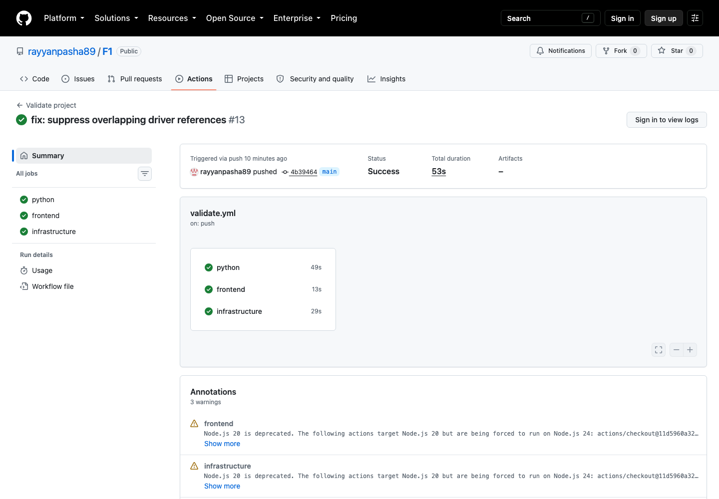
Engineering quality gates
113
Python tests
9
frontend tests
4 / 4
PostgreSQL checks
Ruff, ESLint, Prettier, Vite and both Terraform roots passed.
Notes:
Actual GitHub Actions screenshot for run 34456776706 at commit 4b394645. Open https://github.com/rayyanpasha89/F1/actions/runs/34456776706 . The workflow passed Python, frontend and infrastructure. The standard Python count excludes four opt-in PostgreSQL tests, which passed separately against the isolated database.

Slide 13
Verified AWS release
01
02
03
04
05
GitHub
CodeBuild
ECR
Lightsail
PostgreSQL
Run 34456776706
passed
cce52796…
succeeded
Immutable tag
4b394645…
Deployment 9
active
Private and
SELECT-only
Public HTTPS
8 routes and 5 agentic chat checks passed
Audit logging
5 safe completion lines exported to CloudWatch
Estimated Lightsail baseline: about $30/month plus Bedrock and incidental usage. Earlier ALB resources still incur charges.
Notes:
Sources: reports/aws_agentic_release.json, reports/aws_agentic_cloud_verification.json and docs/deployment.md. AWS account 148356747273, default profile, eu-north-1. Never touch Naaz. The database stayed private and the runtime role stayed read-only.

Slide 14
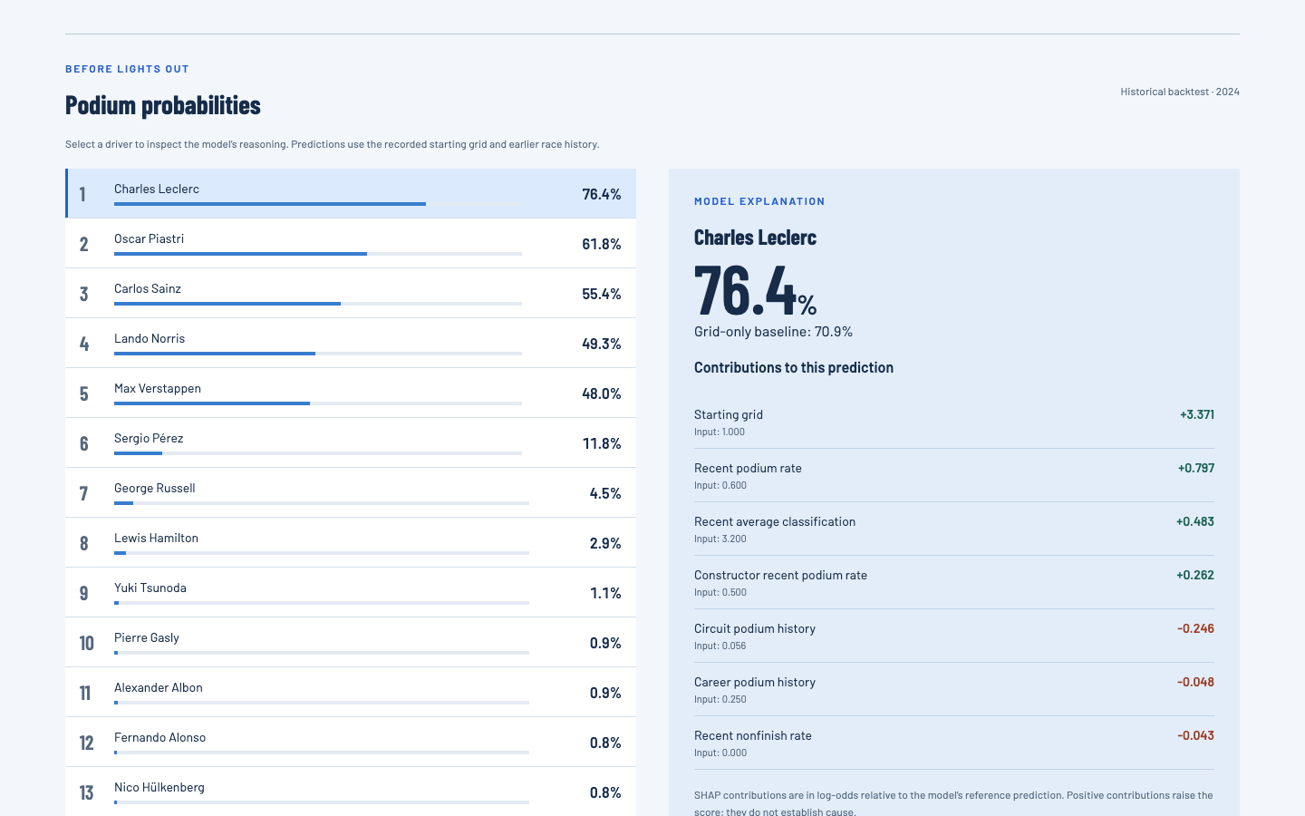
Live Monaco prediction
76.4%
Leclerc podium probability
70.9% grid-only baseline
20 drivers
real model output
actual SHAP factors
Notes:
Actual public screenshot from race 1128. Scroll to Podium probabilities. Charles Leclerc is 76.4% versus the 70.9% grid-only baseline. Select another driver to change the explanation. The contributions are calibrated log-odds, not causal effects.

Slide 15
Final demonstration
1. Open the 2024 dashboard and the Monaco race weekend.
2. Compare drivers and inspect the 76.4% Leclerc prediction.
3. Ask the misspelled Hamilton question and expand the answer trace.
4. Ask the structured follow-up, then show ambiguity and weather refusals.
5. Open GitHub Actions, release reports and the preserved benchmark runs.
Scope limits
Archive ends in 2024. No weather, tyres, telemetry, betting or live feed. Demo access and quotas are process-level.
Live: f1-strategist-demo.ys85rp5g9ncdj.eu-north-1.cs.amazonlightsail.com
Notes:
Use docs/final_demo_guide.md for the exact live path, questions and expected results. AI disclosure: OpenAI Codex assisted implementation, testing and review. Evidence comes from executed project code, AWS resources and live Bedrock calls. The implementing agent's review is not independent faculty review.

