Slide 1



E-Waste Generation Classification

Slide 2

Learning Objectives
The primary objective of this project is to understand the growing challenge of electronic waste (E-Waste) and how modern technologies like Machine Learning can help address it. Through this project, the aim is to explore the classification of E-Waste generation based on relevant data. The project focuses on applying data preprocessing, analysis, and visualization techniques to extract meaningful insights from the dataset. Furthermore, the objective includes building and evaluating machine learning models capable of accurately classifying E-Waste generation patterns. By achieving these objectives, the project contributes towards promoting efficient waste management and raising awareness about the environmental impact of E-Waste.
GOAL
Source :
www.freepik.com/

Slide 3
Tools and Technology used
In this project, several tools and technologies were utilized to successfully implement and analyze the classification of E-Waste generation. The Python programming language served as the core technology due to its simplicity and extensive support for data science and machine learning tasks. Jupyter Notebook was used as the development environment for writing, executing, and documenting the project code in an interactive manner. Various Python libraries such as Pandas and NumPy were used for data manipulation and preprocessing, while Matplotlib and Seaborn were employed for effective data visualization. For building and evaluating classification models, popular machine learning libraries like Scikit-learn were used, offering a wide range of algorithms and performance metrics. These tools collectively helped in handling data, performing exploratory analysis, building models, and generating insights effectively.

Slide 4
Methodology
The methodology followed in this project involves a systematic approach to classify E-Waste generation using machine learning techniques. The first step was data collection, where relevant datasets related to E-Waste generation were obtained. This was followed by data preprocessing, which included handling missing values, encoding categorical variables, and normalizing the data to ensure it was suitable for model building. Exploratory Data Analysis (EDA) was then performed to understand the patterns, trends, and distributions within the dataset using various visualization techniques. After that, machine learning models were developed using classification algorithms such as Decision Trees, Random Forest, or Logistic Regression. These models were trained on the prepared dataset and their performance was evaluated using standard metrics like accuracy, precision, recall, and F1-score. The model providing the best results was selected for final predictions. This methodology ensured a structured, reliable, and efficient approach to classify E-Waste generation and extract meaningful insights from the data.

Slide 5
Problem Statement:
The increasing use of electronic devices has resulted in a rapid rise in E-Waste generation, leading to serious environmental concerns. Proper classification of E-Waste generation patterns is essential for effective waste management and policy development. This project aims to apply machine learning techniques to accurately classify E-Waste generation, thereby supporting sustainable waste management efforts.

Slide 6
Solution:
To address the rising concerns related to E-Waste, this project proposes a data-driven solution using machine learning techniques for the classification of E-Waste generation. The solution begins with collecting and analyzing relevant datasets containing information about E-Waste production. The raw data undergoes preprocessing, including handling missing values, encoding categorical data, and normalization, to ensure it is ready for analysis. Following this, exploratory data analysis (EDA) is performed to understand underlying patterns and correlations in the data. Machine learning algorithms such as Decision Trees, Random Forest, and Logistic Regression are then applied to classify the data based on E-Waste generation categories. The model with the best performance is selected based on evaluation metrics such as accuracy, precision, recall, and F1-score. This solution helps identify areas with high E-Waste generation, predict future trends, and assist stakeholders in developing effective waste management strategies. Ultimately, this approach supports responsible disposal, efficient resource planning, and contributes to environmental sustainability.

Slide 7

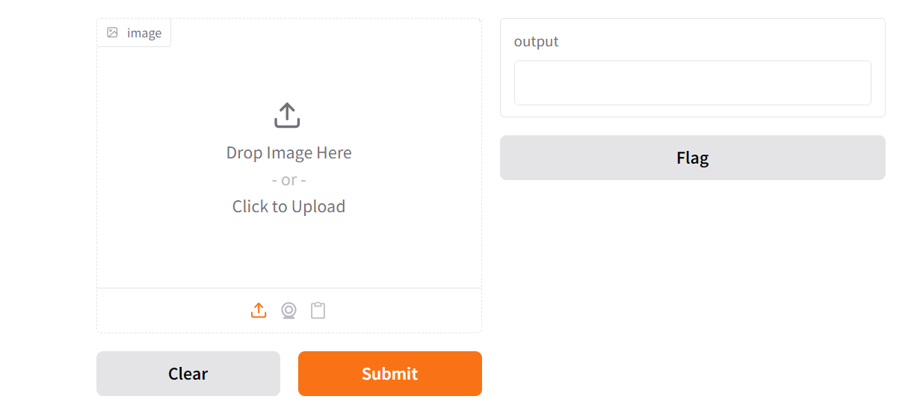
Screenshot of Output:

Slide 8
Conclusion:
In conclusion, this project demonstrates how machine learning techniques can effectively be applied to classify E-Waste generation patterns. By analyzing relevant data and building classification models, the project successfully provides insights that can support better waste management and decision-making. The ability to accurately predict and categorize E-Waste generation is a crucial step towards addressing environmental challenges caused by improper electronic waste disposal. This project highlights the potential of data-driven approaches in promoting sustainable practices and contributing to a cleaner, healthier environment.

