Slide 1
ERROR-FIXING ATTEMPT · TECHNICAL POST-MORTEM
Re-deriving the Argon Ionization
Rate Coefficient Kᵢₓ
Why we attempted the fix — and why we deliberately reverted it
6 → 4
0.15%
REVERTED
AI-Assisted Plasma Process Experimentation & Digital Twin Analytics Platform
Sub-Module 1.2 (Physics Engine) · Sub-Module 1.6 (Physics Validation) · COMSATS University Islamabad
of 9 checks passing
fit error vs source
engine unchanged
Notes:
This is a side-presentation for the viva, covering one specific engineering decision: we tried to fix the ionization rate coefficient, it made things worse, and we reverted it on purpose. The headline is that the engine is unchanged, but we gained a documented physics constraint.

Slide 2
The starting point: 6 of 9 validation checks pass
Sub-Module 1.6 benchmarks the 0D global model against independently published argon reference values.
6 / 9
3
1
checks inside their pre-stated tolerance band
failing checks
shared root cause behind all three
Every tolerance band was fixed BEFORE the comparison was run, and never adjusted afterwards — the project’s validation principle requires results be reported honestly, whatever they are.
The three failures
Not a bug — a documented limitation. The rate coefficient was an unattributed “representative” fit. The deviation was already recorded in the code before anyone asked about it.
Kᵢₓ(3 eV) vs Turner (2014): −39.2% against ±30%
Kᵢₓ(3 eV) vs Jiménez-Redondo (2014): −30.2% — marginal
Plasma density vs PIC line-average: +41.7%
!
Notes:
Open with the honest position. Six of nine pass. The three that fail all trace to one cause. Crucially the tolerances were fixed in advance and never loosened - that is what makes the number meaningful.

Slide 3
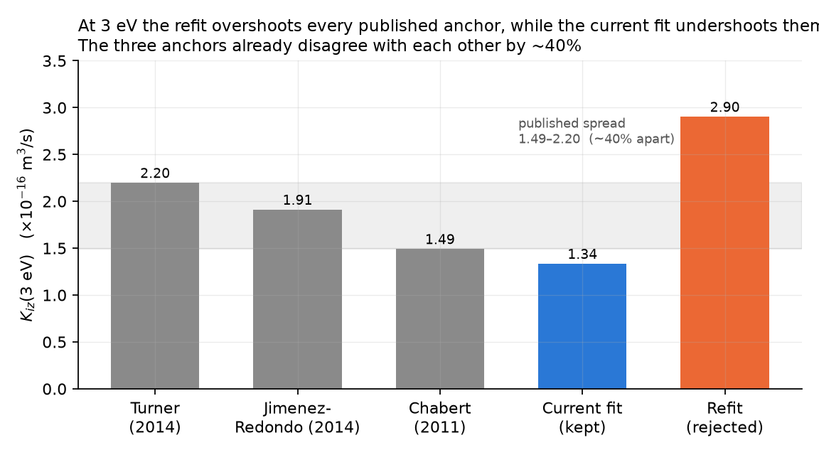
All three failures share one origin
The argon ionization rate coefficient Kᵢₓ(Tₑ) was low relative to published data — and that bias propagates.
Why one cause gives three failures
Two checks compare Kᵢₓ itself, against two different sources.
The third is density — which depends on the energy-loss term, which depends on Kᵢₓ. The same bias flows through.
Density lands almost exactly on the PIC centre value (+4.4%) but misses the line-average. Expected: a 0D model has no spatial structure.
Note the spread. The three published anchors disagree with each other by ~40%, so no single formula can satisfy all three at once.
!
Kᵢₓ(3 eV): the engine’s fit against the three published benchmark anchors.
Notes:
Make the point that three failures is not three problems. Two are direct comparisons of the coefficient; the third is density inheriting the same bias through the energy-loss term. Also flag that the references themselves disagree by 40 percent.

Slide 4
Why we chose to attempt a fix at all
Leaving it alone was defensible — so the motive for acting needs stating explicitly.
1
A coefficient with no traceable source is a defensibility weakness
3
Provenance is improvable without touching the model’s structure
The docstring credited Lieberman & Lichtenberg loosely, but the constants transcribe no specific published table. “Where did these three numbers come from?” had no good answer.
Re-deriving constants from published data is a legitimate input-side correction — categorically different from tuning the model until its output matches.
2
It was the single shared cause behind all three failures
4
The cost of being wrong was near zero
A correction here could move three of the nine checks at once, rather than patching them piecemeal.
Done in an isolated worktree, with agreement beforehand that it would be reverted if it did not clearly help. A cheap experiment, not a risky change.
The intent was never to make more checks pass. It was to give the coefficient a verifiable origin — and to find out honestly what that did to the model.
!
That distinction matters: an attempt aimed at a better score would have been tuning. An attempt aimed at provenance is legitimate regardless of the outcome.
Notes:
If asked why we touched a working engine at all: the coefficient had no citable origin, which is a weakness under examination regardless of accuracy. It was also the one cause behind all three failures, and the experiment was free because it lived in an isolated worktree. Note the intent was provenance, not a better score.

Slide 5
What was never in question
Electron temperature Tₑ — the rigorously solved unknown from which every other output derives — passes BOTH of its checks.
+9.6%
−8.7%
Both PASS
the physically decisive quantity is sound
Tₑ vs Turner global model (±30%)
Tₑ vs PIC ground truth (±30%)
Because Tₑ is obtained by a root-find on an exponential balance equation, a biased Kᵢₓ partially self-corrects in the solved temperature. The failures are therefore confined to the rate coefficient and to density — not to the core solve.
Notes:
This is the slide that defuses the obvious follow-up question. Even with a biased rate coefficient, the temperature - the quantity the whole model is built on - agrees with both references, because the root-find on the exponential partially cancels the bias.

Slide 6
Step 1 — a verified, genuinely independent source
Non-negotiable rule: every reference value must be read from the actual document, never recalled from memory.
G. S. Voronov, “A practical fit formula for ionization rate coefficients of atoms and ions by electron impact: Z = 1–28,” Atomic Data and Nuclear Data Tables 65, 1 (1997). DOI 10.1006/adnd.1997.0732
Ar 18 18 dE = 15.8 eV A = 5.99e-8 cm3/s P = 1 X = 0.1360 K = 0.26 (1 eV - 20 keV)
Independence was verified, not assumed
1
Predates all three anchors
2
Different literature lineage
3
Transcription cross-checked
Published 1997 — before Turner (2014), Jiménez-Redondo (2014) and Chabert (2011).
Atomic-data / astrophysics, calibrated on Belfast (Bell-group) data — not the Lieberman & Lichtenberg line the engine descends from.
Parameters read first-hand from the machine-readable table, and confirmed against an unrelated publication.
!
Train / test separation: the three benchmark anchors were excluded as refit targets — fitting to a source then testing against it would be circular.
Notes:
Stress the sourcing discipline. The project had previously been bitten by an unverified derivation, so every number here was read out of the actual document. And the three sources already used for grading were deliberately excluded as fit targets to avoid training and testing on the same data.

Slide 7
Step 2 — methodology fixed in advance
Pre-registered before a single number was computed, so the result could not be quietly steered.
1
Fit window fixed at Tₑ = 1–10 eV, before fitting
3
No post-hoc tuning, under any circumstances
Chosen on physical grounds: it spans the engine’s real argon CCP operating range with headroom, and sits inside the source’s stated validity band.
Adjusting constants after seeing pass/fail would fit the model to the very test meant to validate it — the exact circularity the design rules forbid.
2
Fitted once, in log space
4
Benchmark and tests left untouched
Kᵢₓ spans ~5 orders of magnitude across the window; a linear fit would be dominated by the high-Tₑ end and misfit the low-Tₑ tail where the particle balance operates.
Tolerances, reference values and every test assertion were off-limits, so the comparison stayed honest.
Isolation: the work was done in a separate Git worktree, so the main line of the project never contained the experimental change — making “revert if it does not help” genuinely costless.
!
This is the part that makes the exercise defensible. A better-looking score obtained by tuning would have been worthless.
Notes:
If an examiner suspects we fiddled with numbers until they looked good, this slide is the answer. The window was fixed on physical grounds first, we fit once, and we never touched the constants afterwards.

Slide 8
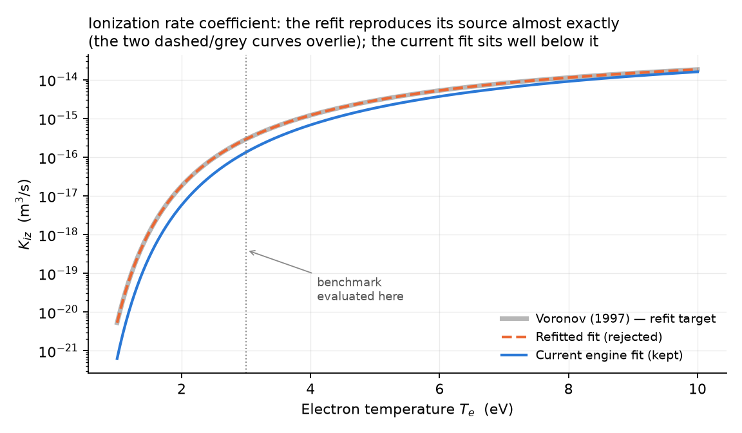
The fit itself was excellent
The refitted curve is indistinguishable from its source across the whole fit window.
0.148%
0.9999 9999
15.7288
0.2%
max relative error vs source
R² in the fitted log space
fitted threshold (V)
from argon’s true 15.76 V — not imposed
The refitted curve overlies the Voronov reference; the engine’s current fit sits well below it.
Notes:
The fit was not the problem. It reproduces the source to a sixth of a percent, and the exponential threshold it recovered on its own lands within 0.2 percent of argon’s real ionization potential - strong evidence the fitting procedure was sound.

Slide 9
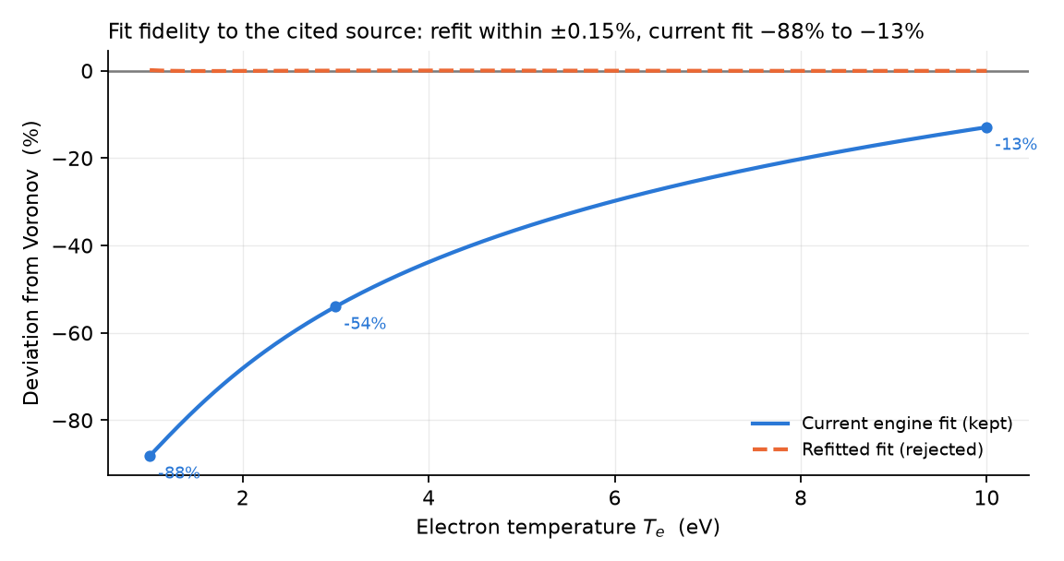
Fidelity to the cited source, quantified
The old constants were not merely unattributed — they were far from the source they vaguely claimed.
Reading the chart
Refitted fit: flat on zero — within ±0.15% everywhere.
Current fit: −88% at 1 eV, −54% at 3 eV, −13% at 10 eV.
The discrepancy is worst exactly where the discharge operates.
So far, so good. On provenance alone, the refit was a clear improvement. The problem appears only downstream.
!
Relative deviation of each candidate fit from the Voronov reference across the fit window.
Notes:
At this point in the story everything looks positive. The new fit is faithful, the old one demonstrably is not, and the worst disagreement is right in the operating range. The trouble only shows up when we look at what depends on this coefficient.

Slide 10
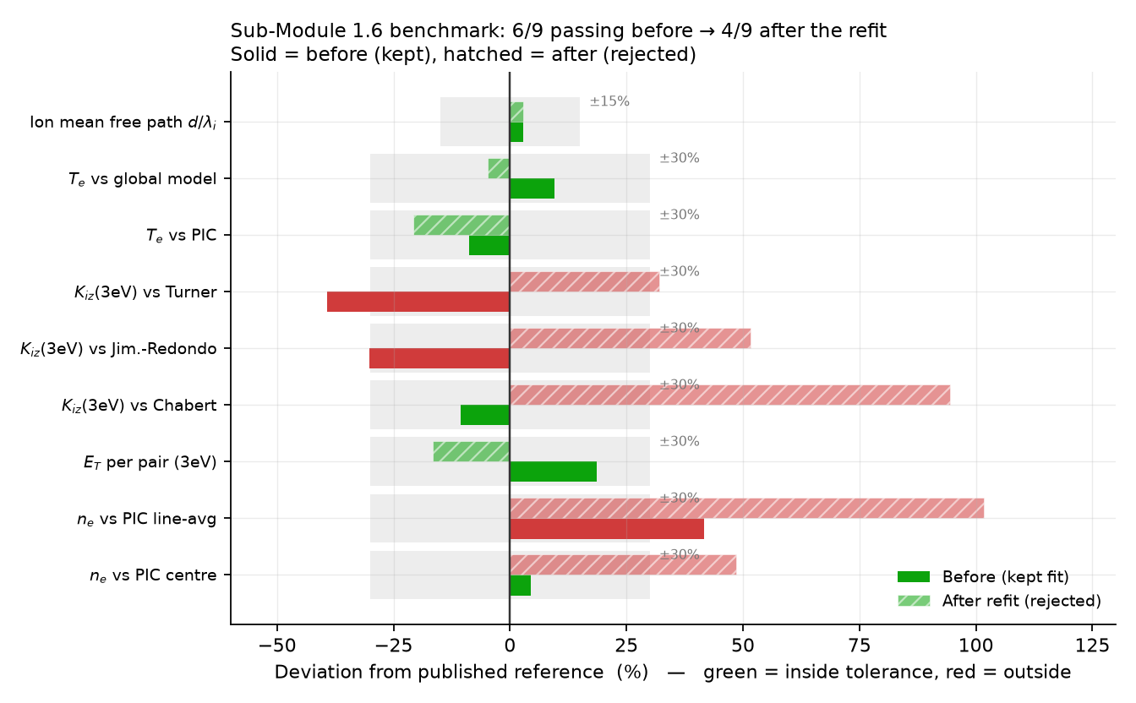
But the validation benchmark got worse
6 → 4
of 9 checks passing
Two checks flipped PASS → FAIL
Kᵢₓ vs Chabert: −10.5% → +94.5%
Density vs PIC centre: +4.4% → +48.6%
Not yet conclusive. This benchmark is semi-quantitative and its anchors mutually disagree — so this alone did not settle the decision.
!
Solid bars = retained fit · hatched = rejected refit · grey band = each check’s tolerance.
Notes:
Be careful here: a drop from six to four is bad but not by itself decisive, because this benchmark is deliberately semi-quantitative and its three anchors disagree with each other. The decisive evidence is on the next slide.

Slide 11
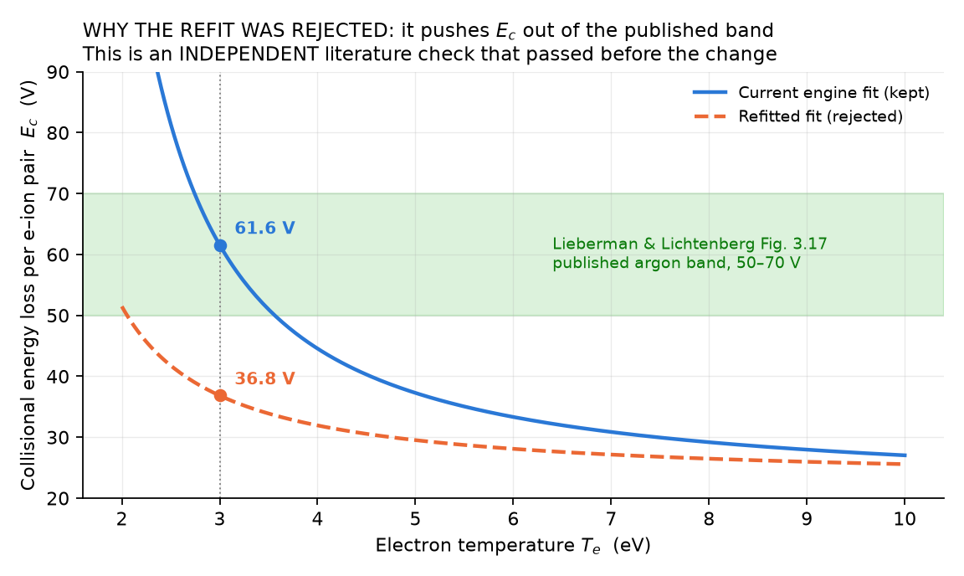
The deciding evidence: an independent check broke
Regression. E_c(3 eV) fell 61.5 V → 36.8 V, outside the 50–70 V band published in Lieberman & Lichtenberg Fig. 3.17.
!
Why this settled it
It is a separate literature check, not part of the nine-point benchmark.
It PASSED before the change.
Breaking it is a loss of physical fidelity — not a matter of interpretation.
Collisional energy loss per electron–ion pair against the published argon band.
Notes:
This is the crux of the whole presentation. We did not reject the refit because a score went down. We rejected it because it broke an independent published check that was passing before - which means the engine became less physically faithful, not more.

Slide 12
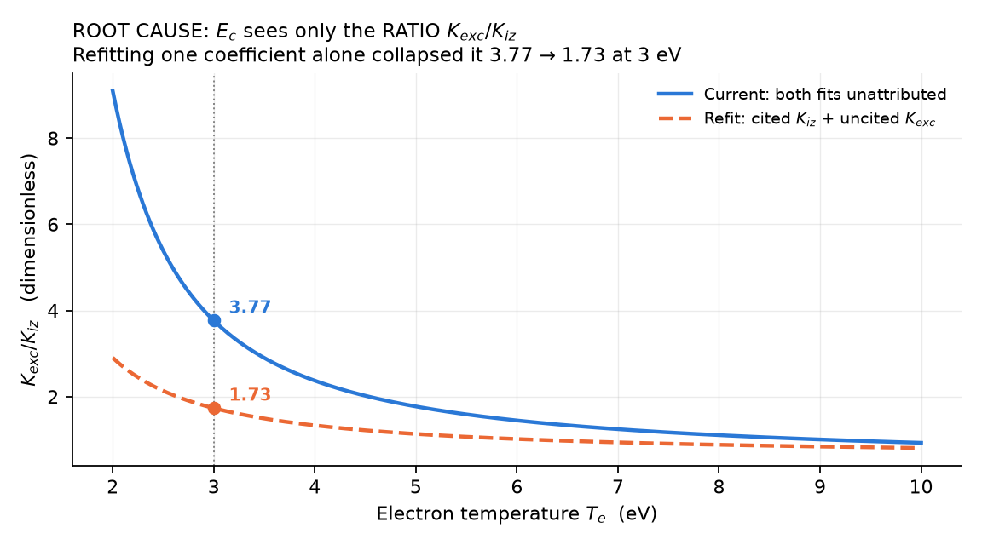
Root cause: the two coefficients are ratio-coupled
The energy-loss term depends only on the RATIO of excitation to ionization — never on either alone.
E_c = E_IZ + E_EXC * (K_exc / K_iz) + (3 m_e / M) * Te * (K_el / K_iz)
What went wrong
Refitting Kᵢₓ alone collapsed the ratio 3.77 → 1.73 at 3 eV.
E_T fell 83 → 58 eV; density is proportional to 1/E_T, so both density checks blew out.
A larger Kᵢₓ also means a lower Tₑ suffices to balance ionization — Tₑ shifted 3.29 → 2.86 eV, away from PIC.
The masking effect: both original fits are wrong in the SAME direction, so their ratio — and E_c — came out plausible for the wrong reasons.
!
Notes:
The mechanism is structural, not numerical. E_c only ever sees the ratio of the two coefficients. The two original fits were both off in the same direction, so the ratio was roughly right by accident. Fixing one of them destroyed that accidental cancellation.

Slide 13
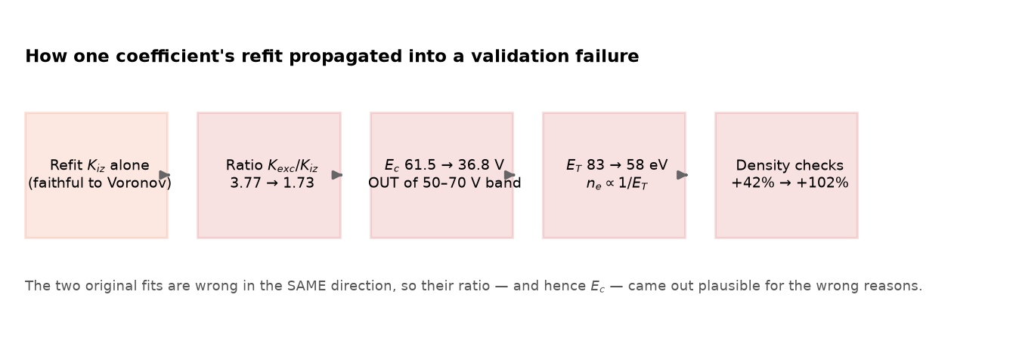
How one coefficient propagated into a validation failure
!
Consequence: a cited Kᵢₓ beside an uncited Kₑₓᶜ is internally inconsistent — and measurably worse, in validation terms, than two consistently inaccurate fits.
Notes:
Walk left to right. A faithful refit of one coefficient, a collapsed ratio, an energy loss outside the published band, a halved energy per pair, and finally density errors that double. One local improvement, five downstream consequences.

Slide 14
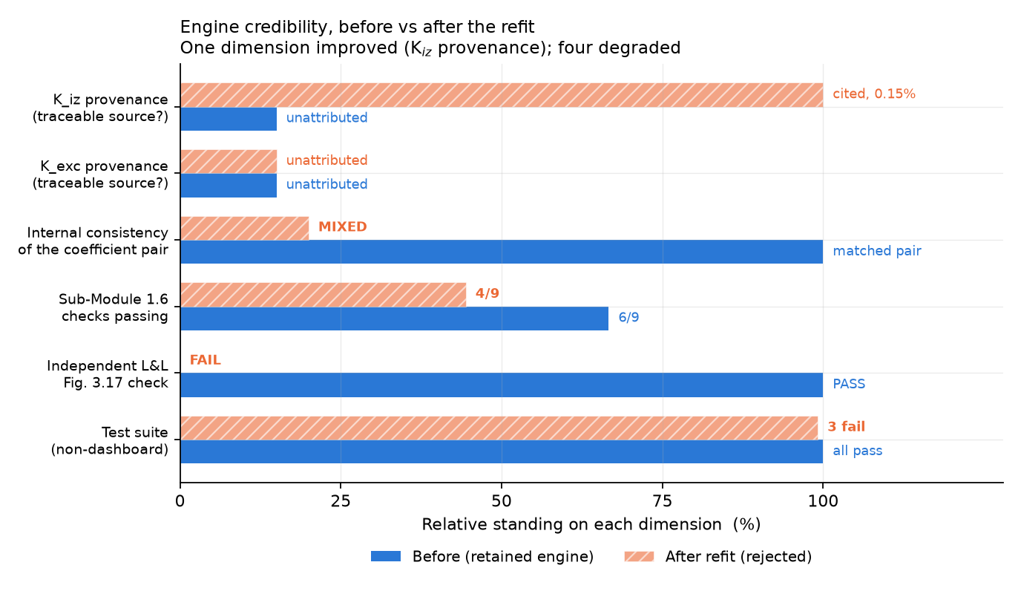
Engine credibility: before vs after
The bottom line, across every dimension that constitutes credibility — not the 1.6 score alone.
1
4
improved
degraded
The decisive asymmetry
Provenance is a property of the DOCUMENTATION — how well the code cites its sources.
Agreement with Lieberman & Lichtenberg is a property of the PHYSICS — whether it behaves like a real discharge.
Trading the second for the first is the wrong trade for a physics engine.
Consistency won. Two matched unattributed fits beat one cited + one uncited, because the physics depends on their ratio.
!
Green = improved · red = degraded · the rest unchanged.
Notes:
This is the summary slide an examiner will care about. Exactly one dimension improved - the thing we set out to fix. Four degraded. The key line is the asymmetry: provenance is about documentation, agreement with published physics is about the model actually being right. We would not trade the second for the first.

Slide 15
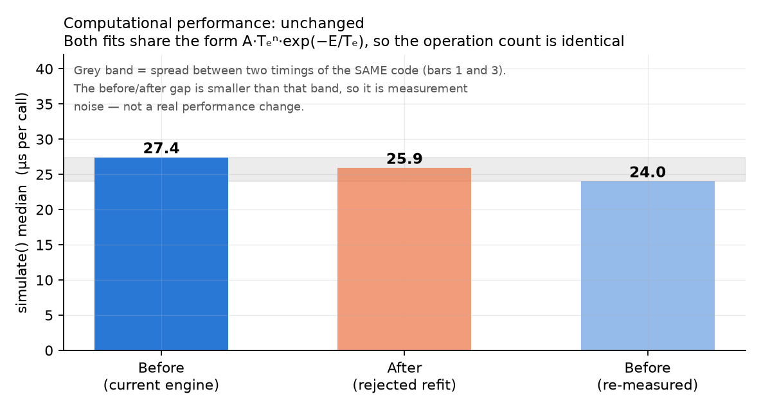
Computational performance: unchanged
Measured, not assumed — and the result is honestly a null one.
Why no change was expected
Both fits share the identical form A·Tₑⁿ·exp(−E/Tₑ), so the operation count per call is the same.
All timings land in 24–27 µs per simulate() call.
The before/after gap is smaller than the spread between two timings of identical code.
Measurement caveat, recorded: solve_electron_temperature is LRU-cached. An early benchmark reported a spurious 2× difference — and an unchanged Tₑ — by timing a cold cache. Fixed by clearing it on each swap.
!
Median simulate() time; the third bar re-measures unchanged code to establish the noise floor.
Notes:
Performance is a null result and we report it as such. The two fits have identical operation counts, so no difference was expected and none was measured. Worth mentioning the caching gotcha: it initially made the temperature look unchanged, which would have been a wrong number in the report had we not checked.

Slide 16
Decision: reverted in full
The change existed only in an isolated worktree, which was discarded with its branch. Restoration was verified: original constants present, benchmark back to 6/9, energy-loss check passing again.
1
It broke an independent published check that previously passed.
Trading genuine agreement with Lieberman & Lichtenberg for marginally better provenance is a net loss in fidelity.
2
The source is the wrong family for this operating window.
A general-purpose fit spanning 1 eV–20 keV across 28 elements is not the right reference for a 2–6 eV argon capacitive discharge.
3
The resulting engine would be internally inconsistent.
One cited coefficient beside one uncited coefficient is harder to defend than a matched pair — because the physics depends on their ratio.
What we did NOT do: nudge the constants after seeing the results. That would have produced a better score while rendering the whole validation meaningless.
Notes:
Three independent grounds, and the last line is the one to say out loud: we never tuned the constants after seeing the benchmark. That is the difference between validation and self-deception.

Slide 17
What we kept: the effort became permanent knowledge
The code change was discarded, but three durable artefacts remain.
1
A warning at the point of danger
2
A documented constraint in the backlog
3
This report, deck, and figure script
A comment block above the rate coefficients records the coupling, this attempt, and the gate a future attempt must clear. Verified comment-only — all values byte-identical.
FUTURE.md item 1 carries the full reasoning, the verified citation, and the procedure to follow if revisited.
Every plotted value is computed live from the engine, so the analysis is reproducible rather than transcribed.
Acceptance gate for any future attempt: refit Kᵢₓ AND Kₑₓᶜ together from comparable sources, and confirm E_c(3 eV) lands inside 50–70 V BEFORE consulting the Sub-Module 1.6 benchmark at all.
!
Also recorded
Voronov can serve either as a refit target or as a fourth benchmark anchor — never both. The same train/test separation applies.
Excitation needs its own verified source: Voronov covers ionization only.
Prefer low-temperature plasma-processing literature over general-purpose astrophysical compilations for the 2–6 eV window.
Notes:
Frame the failed experiment as a net gain. We now have a constraint written where someone would trip over it, a documented procedure, and a reproducible analysis. That is worth more than two passing checks.

Slide 18
If you are asked in one sentence
“We attempted a properly-sourced refit of the ionization rate coefficient using a pre-registered method. It degraded validation because the rate coefficients are ratio-coupled through the energy-loss term — so we documented the constraint and reverted, rather than ship an internally inconsistent engine.”
6 / 9
0 tuned
1 constraint
checks passing — honestly reported
constants changed to pass a test
documented for future work
Notes:
Close on the one-sentence answer. It shows we understand the model’s internal structure rather than just its outputs, and that we chose defensibility over a nicer-looking number.

