Slide 1
Lightweight AdaFace
via AdaDistill
A Novel Approach to Knowledge Distillation for Face Recognition
Based on the work of AdaFace (CVPR 2022)
and AdaDistill (ECCV 2024)
M11402161, M11402151, M11402152

Slide 2
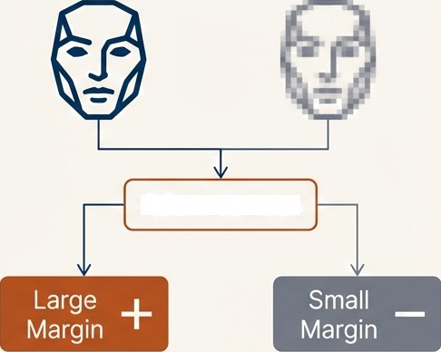
The Journey So Far: Recapping the Mid-Term Work
on AdaFace
The Core Problem
Face recognition models struggle with varying image quality (e.g., blur, pose, lighting). Standard losses like ArcFace treat all images equally, leading to instability with low-quality samples.
AdaFace: Adaptive Difficulty
The AdaFace Solution
Introduce an adaptive margin mechanism that accounts for sample quality.
Uses the feature norm (||z||) as a proxy for image quality.
Dynamically scales the margin: larger for high-quality
images, smaller for low-quality images.
AdaFace Loss
Key Takeaway: AdaFace stabilizes training and improves robustness by adapting the learning difficulty to the quality of the input face.

Slide 3
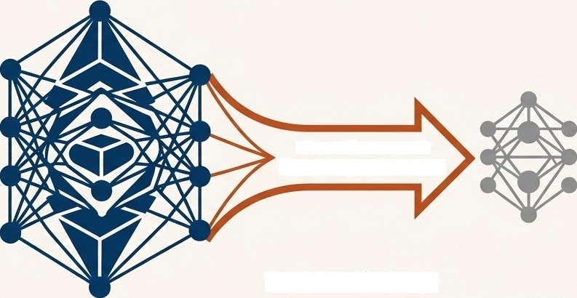
The Next Frontier: Making Quality-Aware Recognition Efficient
Teacher Model (IR-101)
Powerful but computation ally expensive
Student Model (MobileFaceNet)
Lightweight and fa st
The Path Forward:
Knowledge Distillation
The New Challenge
While powerful, models like IR-101 with AdaFace are computationally expensive. How can we transfer this nuanced, quality-aware knowledge to a much smaller, faster 'student' model like MobileFaceNet?
The Guiding Question: Can we design a distillation process that doesn't just mimic the teacher‘s output, but also teaches the student how to handle images of varying quality?

Slide 4
Midterm Result: IR-101+AdaFace
Dataset​ | AdaFace Paper (%)​ | Pretained (%) / Δ (Diff.)​ | Scratch (%) / Δ (Diff.)​
LFW​ | 99.83​ | 99.80 / -0.03​ | 99.8 / -0.03​
CFP-FP​ | 98.65​ | 98.67 / +0.02​ | 98.41 / -0.14​
AgeDB-30​ | 98.27​ | 98.05 / -0.22​ | 98.23 / -0.04​
CPLFW​ | 93.46​ | 93.53 / +0.07​ | 92.83 /-0.63​
CALFW​ | 96.08​ | 96.12 / +0.04​ | 96.05/-0.03​
TinyFace (Rank-1)​ | 68.30​ | 68.11 / -0.19​ | 68.27/ -0.11​
IJBB (TPR@FPR=0.01)​ | 95.60​ | 95.59 / -0.01​ | 95.47/-0.13​
IJBC (TPR@FPR=0.01)​ | 96.80​ | 96.81 / +0.01​ | 96.78/-0.02​

Slide 5




Our Philosophy: A More Sophisticated Student-Teacher Exam System
We frame our knowledge distillation process as an adaptive educational system.
The Key Players
The Student (f_{s})
The lightweight MobileFaceNet model, providing its answer (erribedding) for a face.
The Teacher (f_{t})
The powerful IR—101/IR-50 model, providing the expert "demonstration answer."
The Standard Answer (w_{y})
The class center for an identity.
Crucially, this is no longer fixed.
The Exam Paper (Loss Function)
The set of rules for grading the student, with a difficulty level (margin) that changes dynamically.
The GoaI: The Teacher corrects the ’Standard Answer,’ and the Student strives to match it on an ’Exam Paper' of varying difficulty.

Slide 6
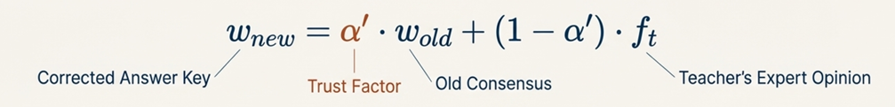
The Teacher Corrects the Answer Key: Dynamic Class Centers
The Old Way (without a Teacher)
Class centers (w_{y}) are a “consensus” formed by all student samples over time.
The AdaDistill Insight
A weak student shouldn't learn from an abstract consensus.
This is unreliable in early training when the
student is weak.
The “standard answer” itself should be guided by the teacher's expertise.
Mechanism: Exponential Moving Average (EMA)

Slide 7
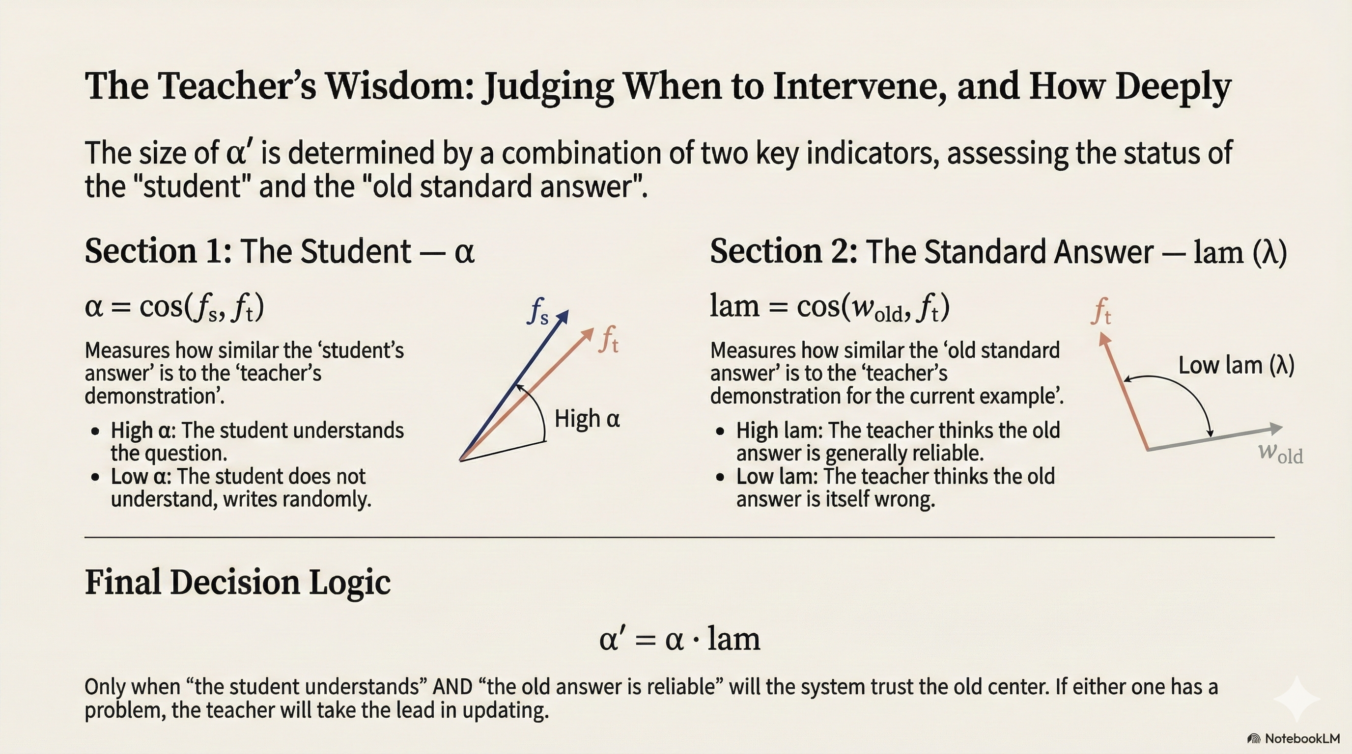

Slide 8
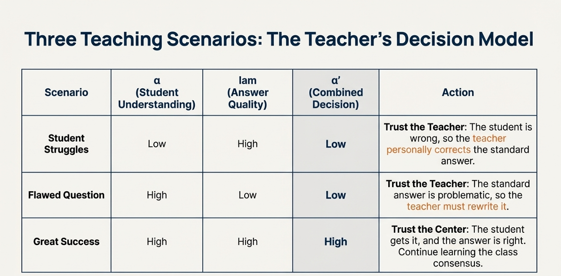


Slide 9


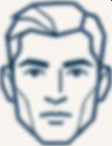
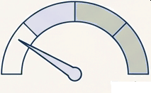
The Exam Adapts, Part 1: Difficulty Based on Question Clarity
This mechanism is inherited directly from AdaFace and focuses on the input image itself.
Quality Proxy
The L2 norm of the feature embedding (||f||) serves as an indicator of image quality.
Exam Difficulty
Dynamic Margin Logic
Harder
High-Quality Image → High Feature Norm → Larger Margin.
The exam is made harder for clear, easy questions to push for better feature separation.
Exam Difficulty
Low-Quality Image → Low Feature Norm → Smaller Margin
The exam is made easier for blurry, hard questions to prevent the model from overfitting to noise.
Easier
Impact: This only changes the difficulty of the test for the student (the logit), not the standard answover (the class center).

Slide 10
Comparison: ArcFace vs AdaFace
Method​ | LFW​ | CFPFP​ | AgeDB-30​ | CALFW​ | CPLFW​ | IJB-C (1e-4)​ | IJB-C (1e-5)​
MFN + ArcFace​ | 99.52​ | 91.66​ | 95.82​ | 95.12​ | 87.93​ | 89.13​ | 81.65​
MFN + AdaFace ​ | 99.57​ | 92.43​ | 96.07​ | 95.32​ | 88.46​ | 90.21​ | 83.78​

Slide 11

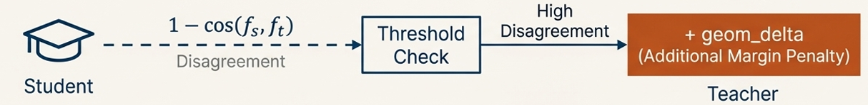
The Exam Adapts, Part 2: Getting Stricter When
the Student Falls Behind
Image quality isn't the only factor. What if the student is simply learning incorrectly?
Introducing the Geometry-Aware Margin
We add a penalty based on the student-teacher disagreement.
Impact: This provides a second layer of adaptation. Even for a medium-quality image, if the student is far off track, the learning challenge is intensified.

Slide 12
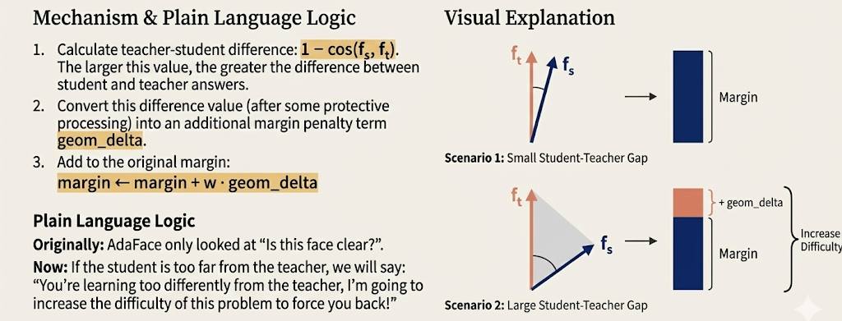
The Exam Adapts, Part 2: Getting Stricter When
the Student Falls Behind

Slide 13
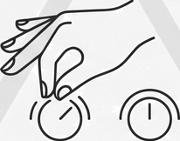
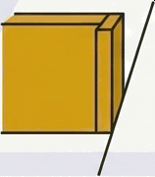
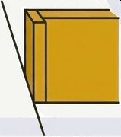
The Flaw of the Static Approach: Hard-Coded Thresholds
The Problem:
The static design required multiple protective mechanisms, which introduced manually-set hard thresholds.
The Thresholds:
Mask: ‘If cos_st › i’ (e.g., 0.8), the student is ‘close
enough’. Do not apply a penalty.’
Baseline: ‘Ignore minor deviations below a certain baseline, treating them as acceptable noise.’
T Baseline
The Consequence:
The model's performance becomes ‘highly sensitive’ to these hand-picked values, making it difficult to generalize across different datasets or teacher models.
G
NotebookLtVi

Slide 14
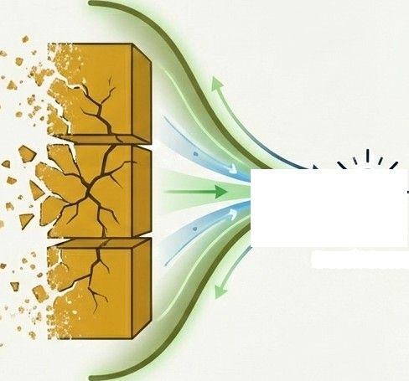



The Breakthrough: An Adaptive, Teacher-Guided Margin
The Core Insight:
Instead of relying on artificial hard thresholds, we can let the teacher model's own ‘confidence’
automatically determine the penalty conditions
and strength.
The Result:
A new adaptive geometry-aware margin that eliminates the need for manual tuning and extra hyperparameters.
Teacher
Confidence
G NotebookLtVi

Slide 15
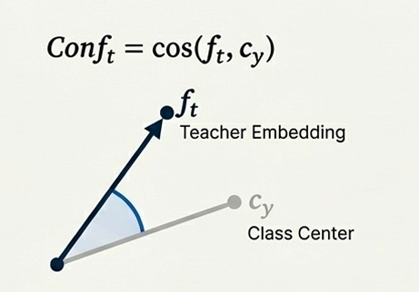
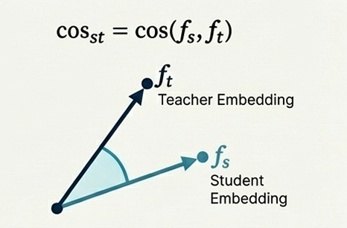
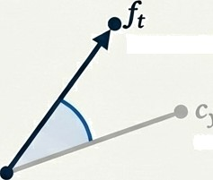
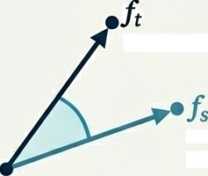
The Two Key Signals for an Adaptive System
Signal 1: Teacher Cnnfidence (Conft)
How certain is the teacher about its own embedding?
We measure this as the cosine similarity between the teacher's embedding and its own correct class center.
Signal 2: Student-Teacher Alignment (cosy. ) How well is the student following the teacher's
direction?
The cosine similarity between the student and teacher embeddings.
Conf;
cos(lb.•›)
cos„
^{cos}ts› It)
Teacher Embedding
Teacher Embedding
Class Center
Student Embedding
G
NotebookLM

Slide 16
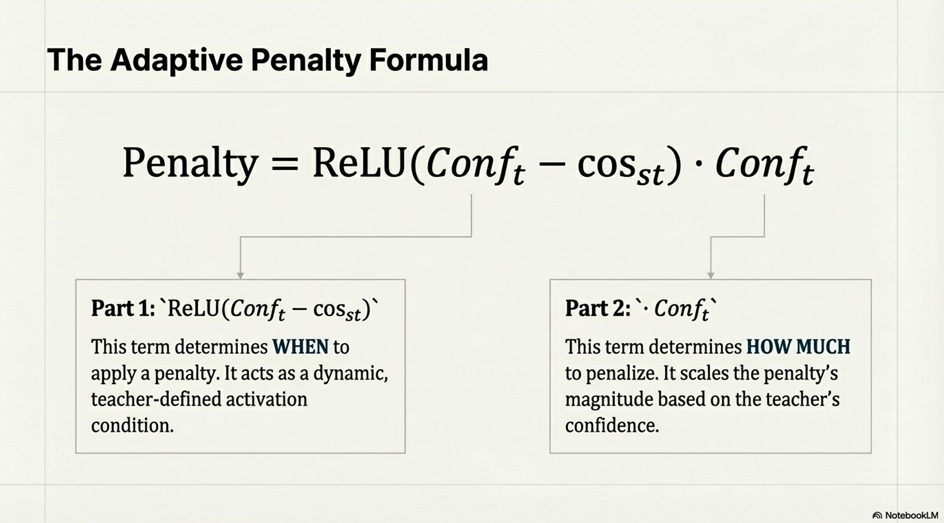

The Adaptive Penalty Formula
Penalty
ReLU(Co_{•fi}
COS_{s )}
Partl: *ReLU(Conj", — cosst)”
This term determines WHEN to apply a penalty. it acts as a dynamic, teacher-defined activation condition.
Part2: *• Conf;‘
This term determines HOW MUCH to penalize. It scales the penalty's magnitude based on the teacher's confidence.
G
NotebookLM

Slide 17
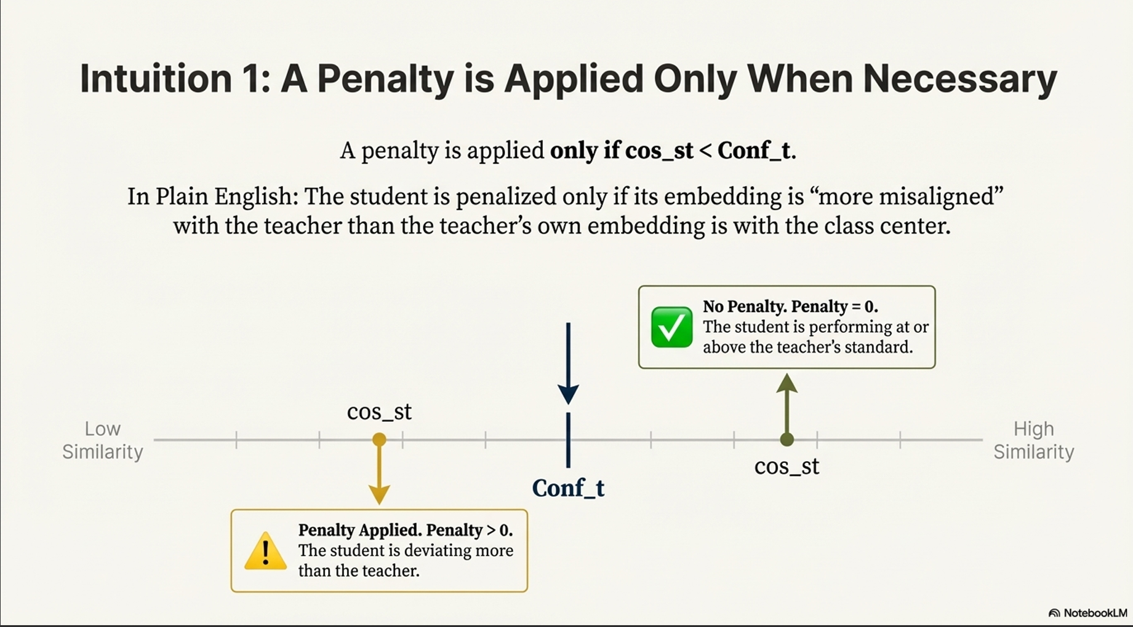
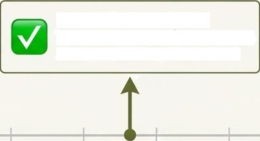




Intuition 1: A Penalty is Applied Only When Necessary
A penalty is applied only ifcos„st < Conf_t.
In Plain English: The student is penalized only if its embedding is “more misaligned” with the teacher than the teacher's own embedding is with the class center.
No Penalty. Penalty = 0.
The student is performing at or above the teacher's standard.
Low
COS_St
Hlgh
COS_St
Conf„t
Penalty Applied. Penalty 0. The student is deviating more than the teacher.
G NotebookLtVi

Slide 18
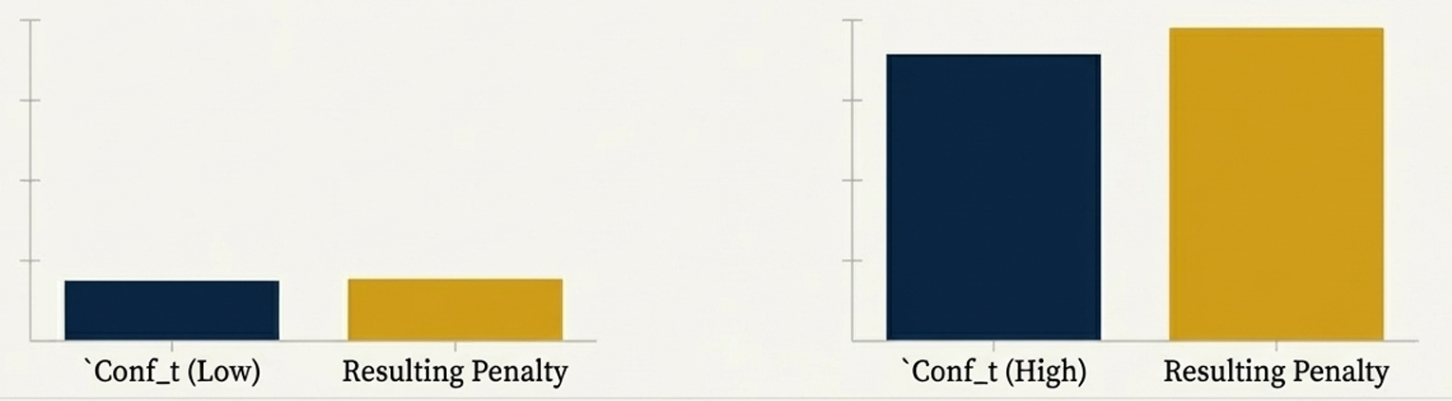


Intuition 2: Confident Teachers Are Stricter Teachers
The penalty's magnitude is scaled by the teacher's confidence (Conf_t).
Scenario A: Teacher is Uncertain
Even if the student deviates significantly, the penalty is small. The teacher doesn't punish harshly for knowledge it isn't sure about.
Scenario B: Teacher is Confident
Even a small student deviation is amplified into a significant penalty. The teacher strictly enforces its high-confidence knowledge.
Conf_t (Low)
Resulting Penalty
Conf_t (High)
Resulting Penalty
G NotebookLtVi

Slide 19
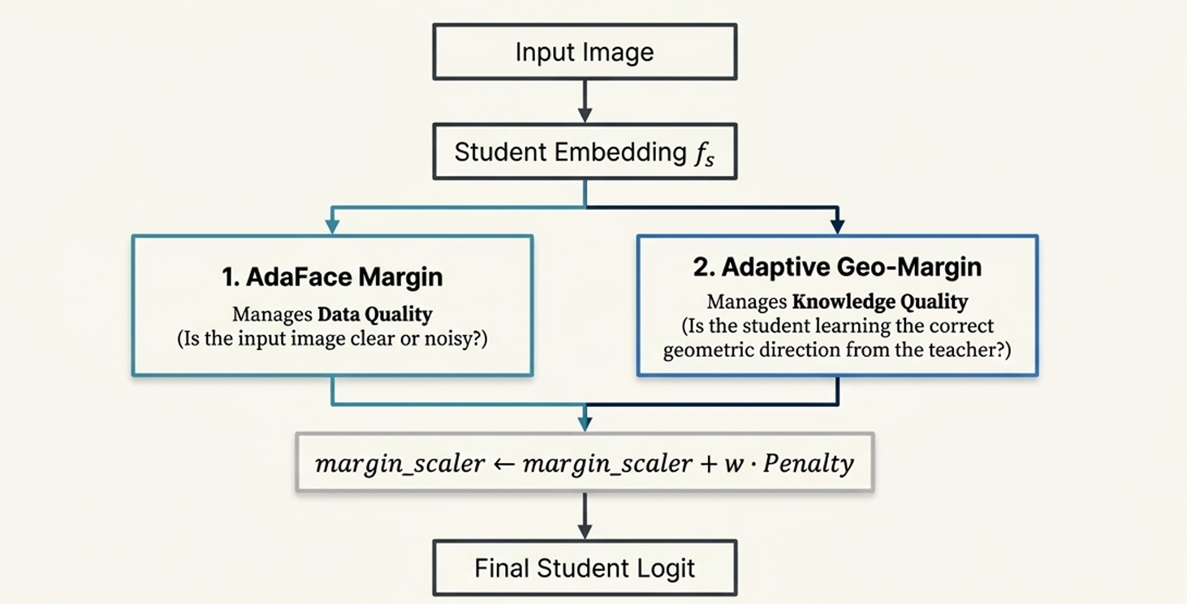
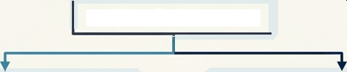

A Unified System: Two Layers of Adaptive Control
Input Image
Student Embedding f
1. AdaFace Margin
Manages Data Quality
(Is the input image clear or noisy?)
2. Adaptive Geo-Margin
Manages linowledge Quality (Is the student learning the correct
geometric direction from the teacher?)
margin_scaleY +- margin_scaleY -F w - Penalty
Final Student Logit
Critical Clarification: Both mechanisms only act on the student's logit. The class center update remains exclusively controlled by AdaFace's original quality proxy.
W NotebookLM

Slide 20
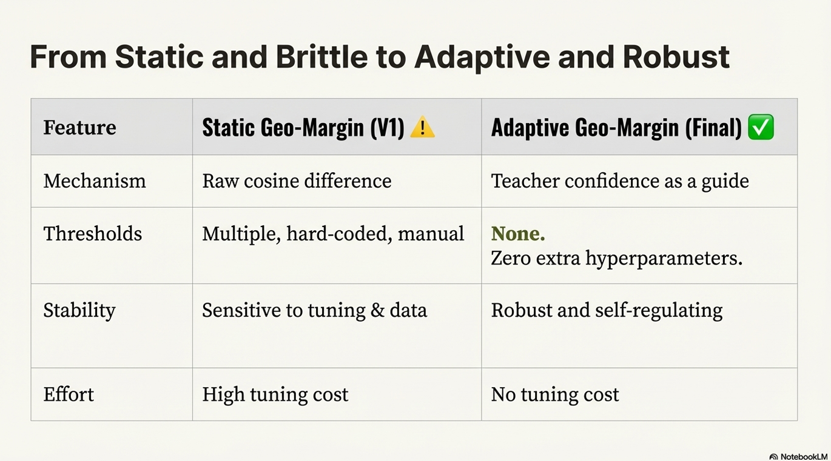

From Static and Brittle to Adaptive and Robust
Feature
Static Geo-Margin (Y]) ! Adaptive Geo-Uargin
Mechanism
Raw cosine difference
Teacher confidence as a guide
Thresholds
Multiple, hard-coded, manual
None.
Zero extra hyperparameters.
Stability
Sensitive to tuning & data
Robust and self-regulating
Effort
High tuning cost
No tuning cost
G
NotebookLM

Slide 21
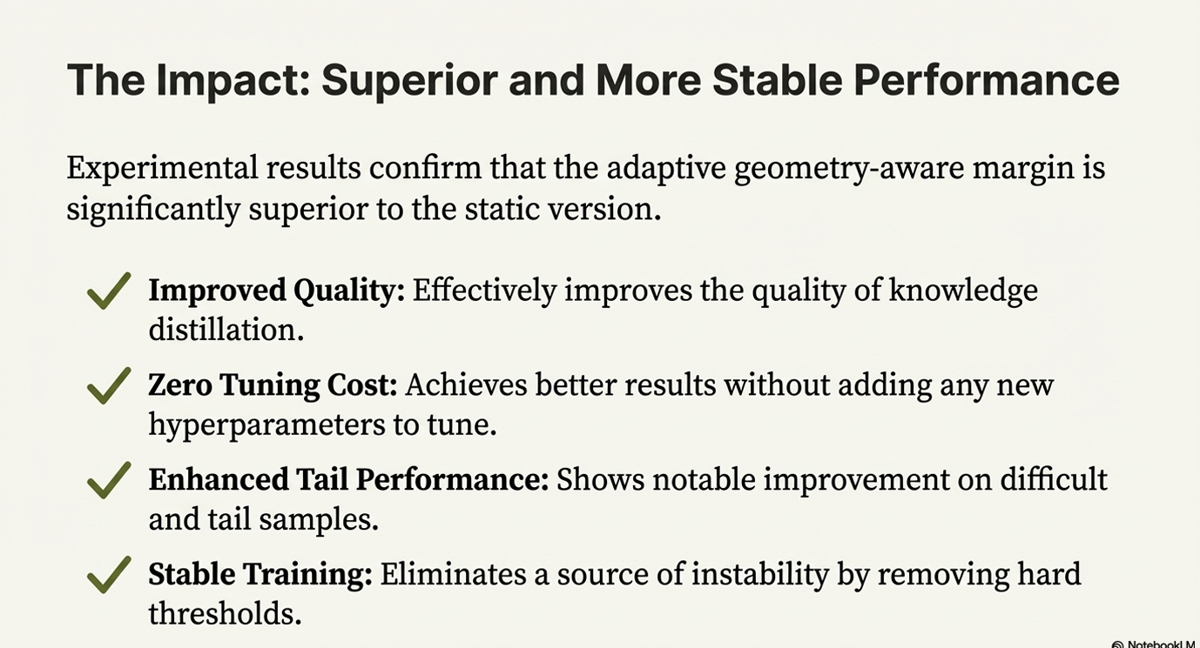
The Impact: Superior and More Stable Performance
Experimental results confirm that the adaptive geometry-aware margin is signifieantly superior to the static version.
•„„Z Improved Quality: ENectively improves the quality of knowledge distillation.
„„Z Zero Tuning Cost: Achieves better results without adding any new hyperparameters to tune.
„„€ Enhanced Tail PeNormance: Shows notable improvement on difficult and tail samples.
$,g’ Stable Training: Eliminates a source of instability by removing hard thresholds.
G
NotebookLtVi

Slide 22
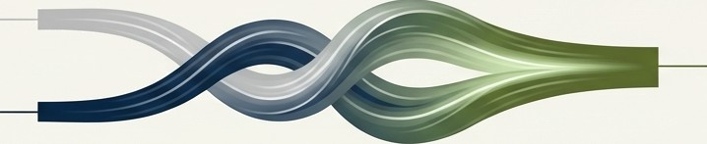
The Core Insight
By leveraging teacher confidence as a dynamic guide, we created an adaptive margin that intelligently corrects student model deviation without manual intervention.
This approach elegantly bridges the gap between managing data quality (via AdaFace) and ensuring knowledge alignment, leading to a more robust, stable, and effective knowledge distillation framework.
Data Quality
Robust & Effective Distillation
Knowledge Alignment
G
NotebookLM

Slide 23
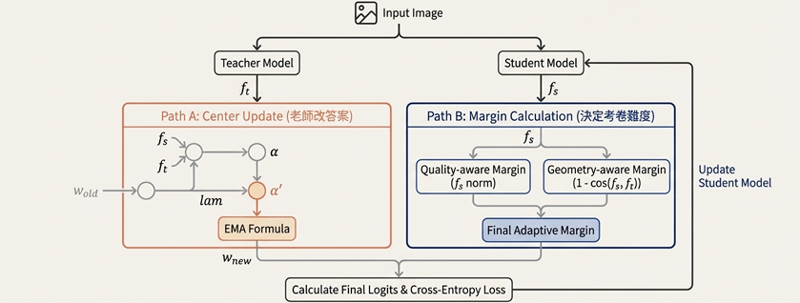
The Complete System: The AdaptiveAAdaFace Head

Slide 24
GitHub Contents
backbones/ – Backbone network architectures
config/ – Training configurations & hyperparameters
eval/ – Evaluation scripts
train/ – Core training pipeline (loss, dataloader, loops)
utils/ – Utility functions (logging, metrics, helpers)
img/ – Documentation images
output/ – Checkpoints & logs
requirements/ – Dependency files
run_AdaDistill.sh – Main distillation launcher
run_AMLDistill.sh – AML-based distillation launcher
run_standalone.sh – Standalone training/testing script
README.md – Project overview

Slide 25
The Proof: Our Smarter Teaching System Produces a Better Student
Experimental Setup:
Teacher: IR-50 Backbone
Student: MobileFaceNet
Training Data: MS1MV2 (-5.8M images)
Performance Comparison: AdaDistill + AdaFace vs. the original MobileFaceNet
Dataset | MFN (%) | Distilled (%) | Diff (%)
LFW | 99.57 | 99.567 | -0.003
CFP-FP | 92,43 | 95.329 | +2.899
AgeDB-30 | 96.07 | 95.833 | -0.237
CPLFW | 88.46 | 90.150 | +1.69
CALFW | 95.32 | 95.133 | -0.187
IJBC (TPR@FPR=1e-4) | 90.21 | 93.823 | +3.613
IJBC (TPR@FPR=1e-5) | 83.78 | 90.004 | +6.224
Observation
Significant improvements on challenging datasets like TinyFace and CPLFW demonstrate the method's effectiveness, especially for difficult, low-quality scenarios.

Slide 26
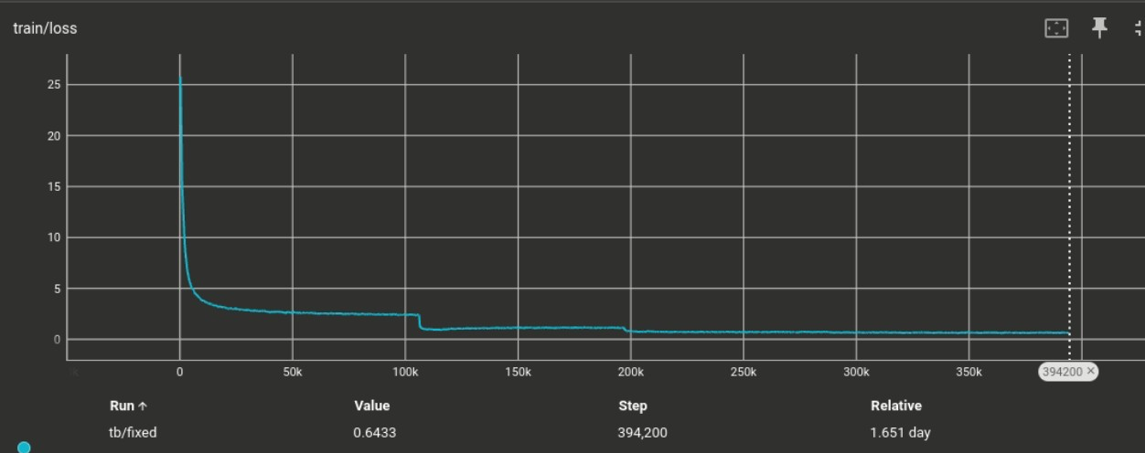
Experiment result
loss curve

Slide 27
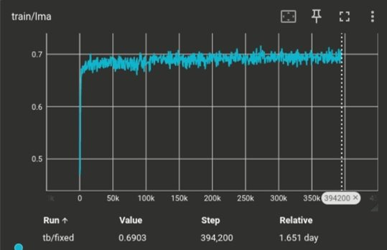
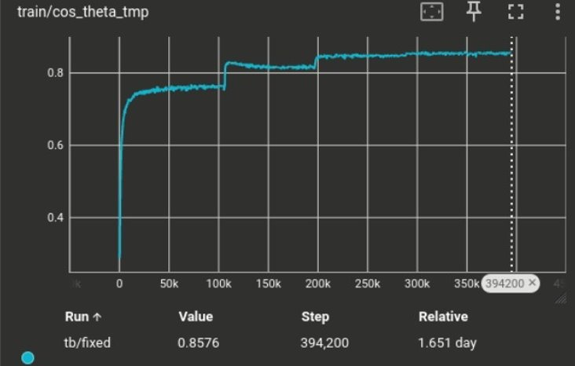
Experiment result
lma: lam mean average (α')
cos_theta_tmp (α)

Slide 28
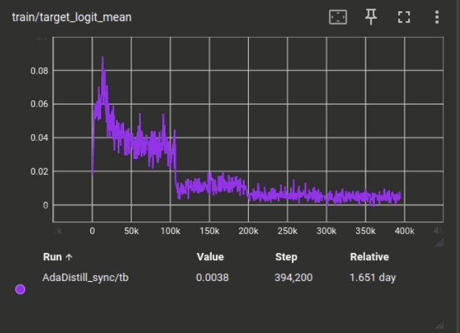
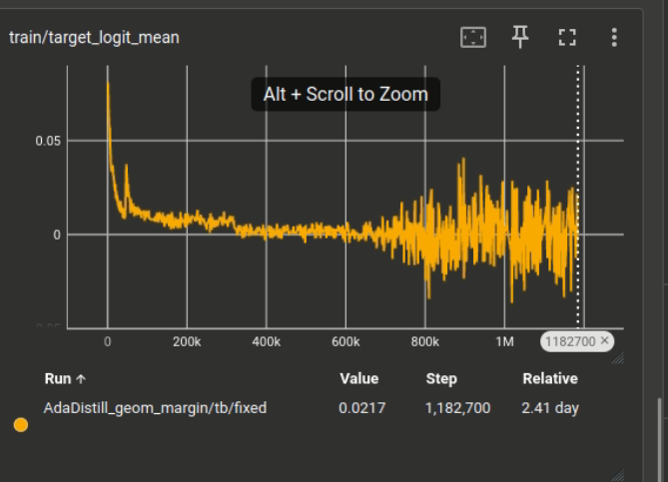
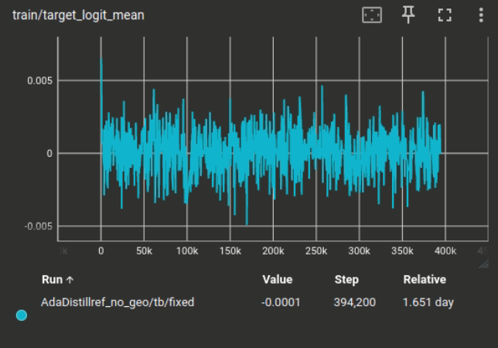
Logic Mean
Experiment result
adaptive geometry-aware
Static geometry-aware
No geometry-aware

Slide 29
Deeper Dive: Benchmarking Against a Strong Alternative
We compare our method (AdaD1sti1l + AdaFace) against the baseline student and 'AdaDistill' paired with the standard 'ArcFace' loss.
Performance on General Benchmarks
Method | LFW | CFP-FP | AgeDB-30 | CA-LFW | CP-LFW | IJBC (1e-4) | IJBC (1e-5) | Avg
Baseline MFN (Student) | 99.52 | 91.66 | 95.82 | 95.12 | 87.93 | 89.13 | 81.65 | 91.83
AdaDistill + ArcFace | 99.47 | 95.14 | 96.68 | 95.50 | 89.50 | 93.26 | 89.31 | 94.12
AdaDistill + AdaFace | 99.50 | 95.24 | 95.82 | 94.92 | 89.73 | 93.82 | 90.00 | 94.15
AdaDistill + AdaFace(Geo) 99.50 94.33 96.07 95.23 89.83 93.77 90.17 94.13
AdaDistill+AdaFace(adaptive_geo) 99.50 95.10 96.20 95.27 90.22 93.98 90.33 94.37
Performance on TinyFace (Low-Resolution)
Method Tinyface R1
Tinyface R5
AdaDistill + ArcFace
AdaDistill + AdaFace
57.21
58.69
63.12
64.03
AdaDistill + AdaFace(Geo) 58.92 63.30
AdaDistill + AdaFace(adaptive_Geo) 59.31 64.43
Our integrated approach consistently outperforms both the standalone student and the standard distillation method, achieving the highest average performance.

Slide 30
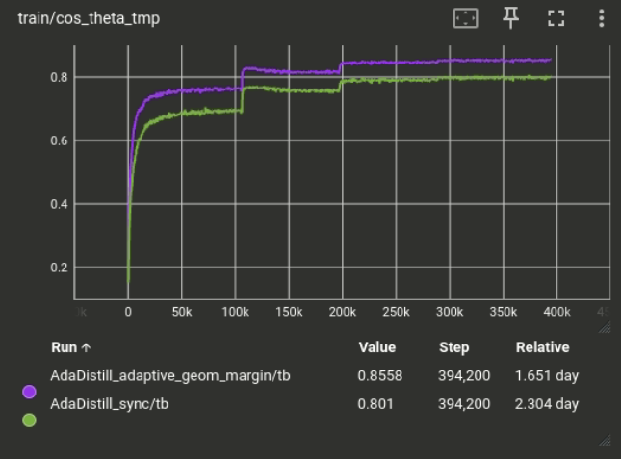
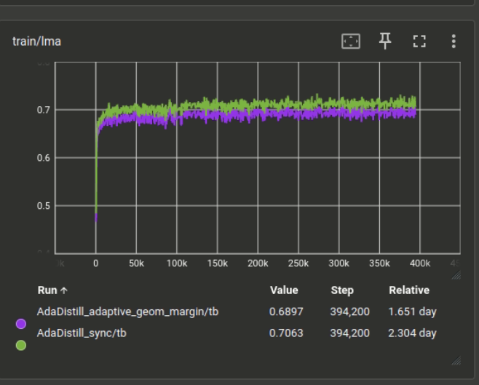
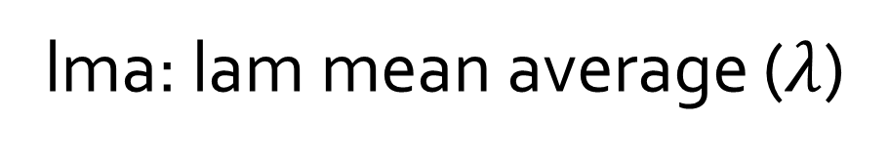
Experiment result : Different Teacher Models (IR-101 vs. IR-50)
cos_theta_tmp (α)
lma: lam mean average ($λ$)

Slide 31
Teacher Influence: Is a Stronger Teacher Always Better for the Student?
Comparison of Distillation Results Using Different Teacher Models (IR-101 vs. IR-50)
 | LFW | CFP-FP | AgeDB-30 | CP-LFW | IJBC (1e-4) | IJBC (1e-5) | Tinyface R1
IR-101 (Teacher) | 99.80 | 98.61 | 98.05 | 93.53 | 96.81 | 94.58 | 68.11
MFN (Student) | 99.64 | 94.81 | 96.12 | 89.73 | 92.21 | 88.32 | 57.47
IR-50 (Teacher) | 99.85 | 98.09 | 97.85 | 92.85 | 96.20 | 93.96 | 64.99
MFN (Student) | 99.50 | 95.24 | 95.82 | 89.73 | 93.82 | 90.00 | 58.69
The student model cannot absorb the highly complex feature distribution learned by a very large teacher, causing weaker transfer. A mid-size teacher (ResNet50) produces better distillation results.
— Based on AdaDistill authors’explanation in the paper

Slide 32
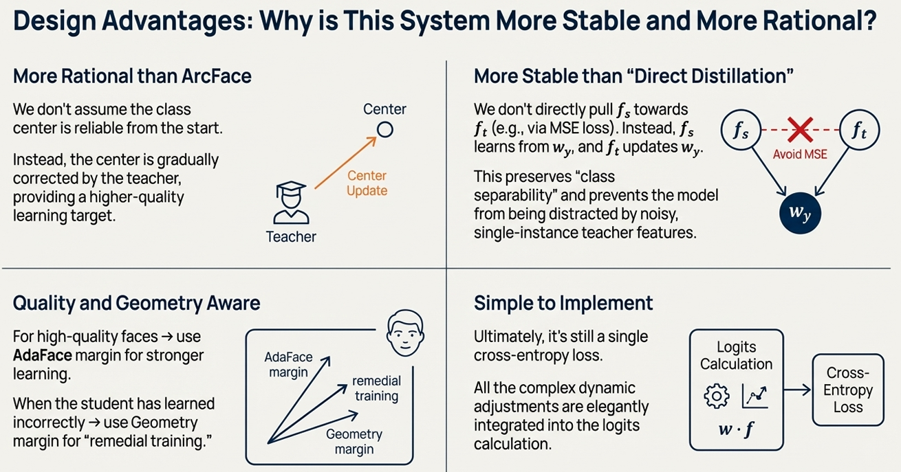

Slide 33
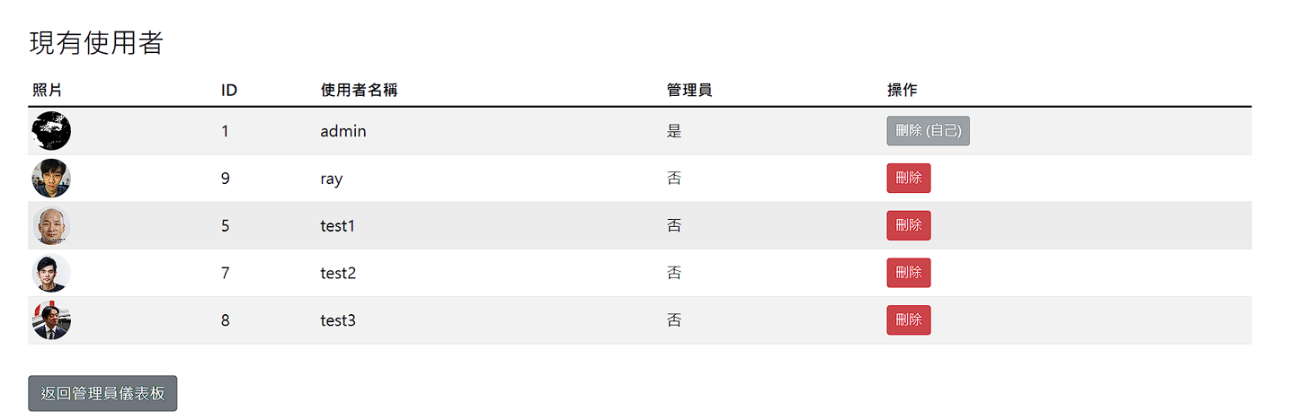
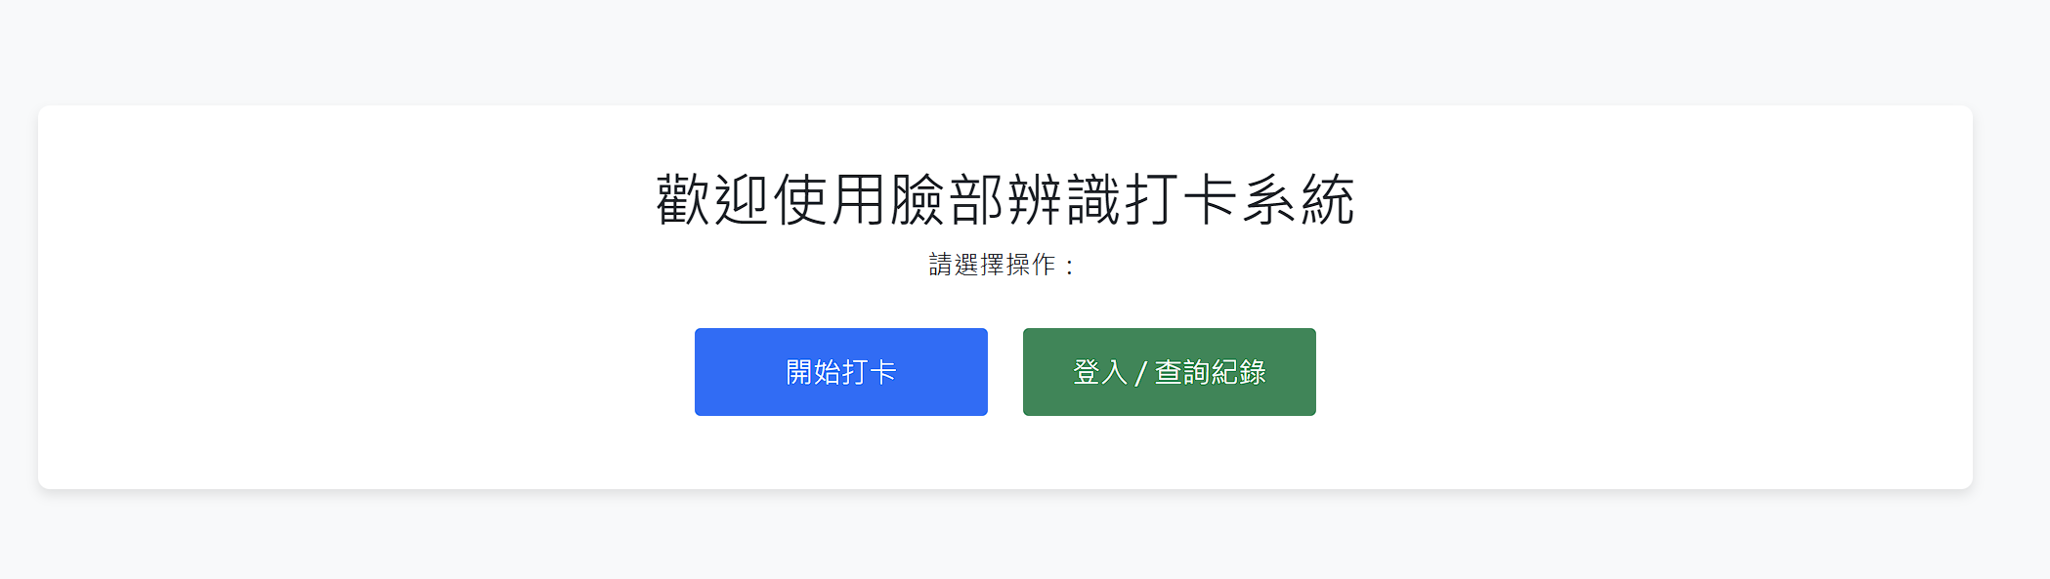
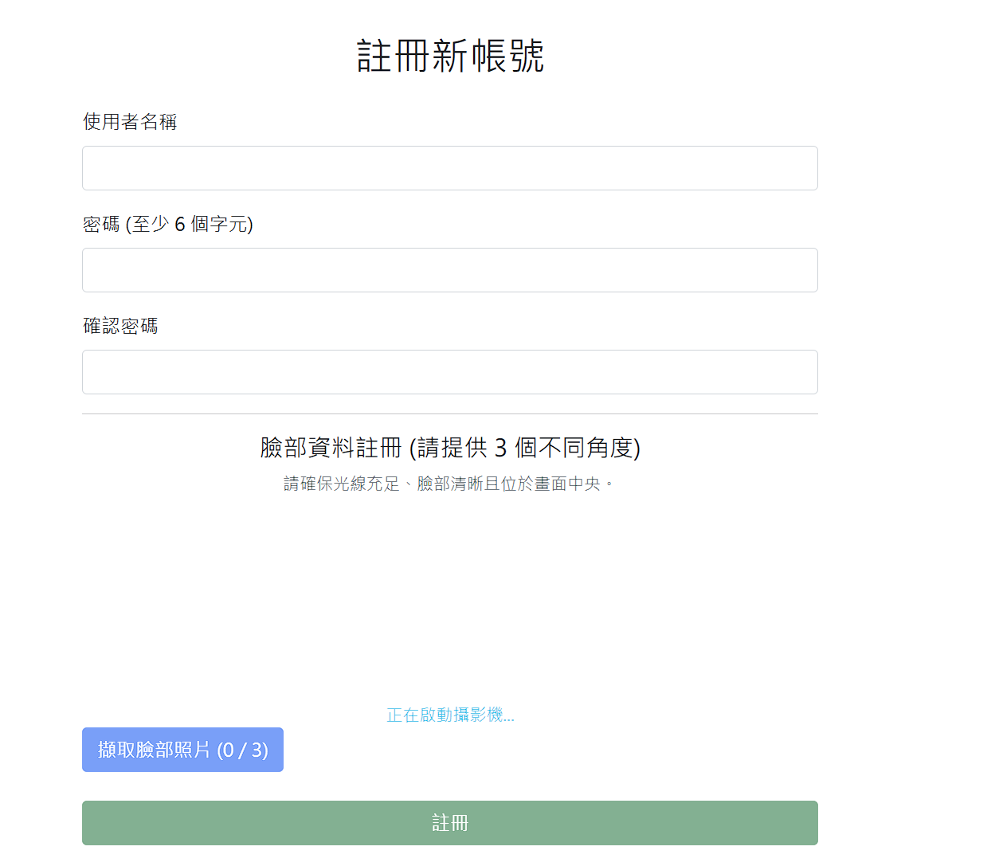
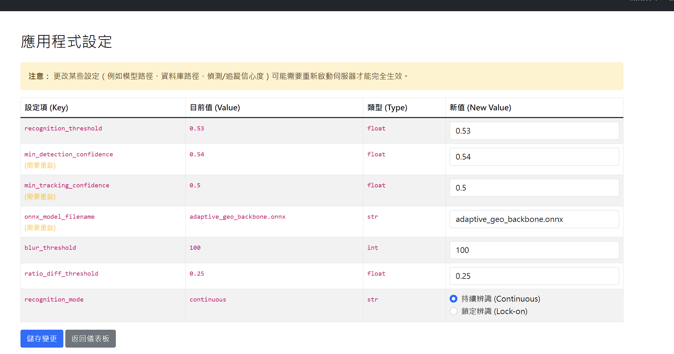
From Research to Real-World Deployment Face Recognition Check-in System
Demo website: https://checkin.rayyi-server.com/
admin Password:123456

Slide 34
GPT Interaction Summary
Mid-Term Phase
Structuring the presentation layout
and data tables.
Explaining configuration details and dataset issues (bcolz format, TinyFace path)
Summarizing CSV results and preparing performance comparisons.
Discussing the behavior of pretrained vs. from-scratch models.
Final Phase
Implementing AdaFace within the
AdaDistill repository architecture.
Generating high-level explanations of the AdaDistill methodology.
Assisting in the analysis and interpretation of final experimental results.

Slide 35
Resources and References
Code Repositories
AdaFace: https://github.com/mk-minchul/AdaFace
AdaDistill: https://github.com/fdbtrs/AdaDistill
Key Papers
Kim et al. “AdaFace: Quality Adaptive Margin for Face Recognition." (CVPR 2022)
Boutros et at. “AdaDistill: Adaptive Knowledge Distillation for Deep Face Recognition." (ECCV 2024)
Datasets Used
Training: MS1MV2
Evaluation: LFW, CFP-FP, AgeDB-30, CALFW, CPLFW, TinyFace, IJBB, IJBC

