Slide 1
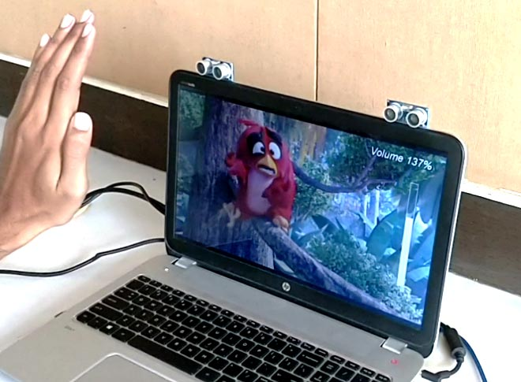
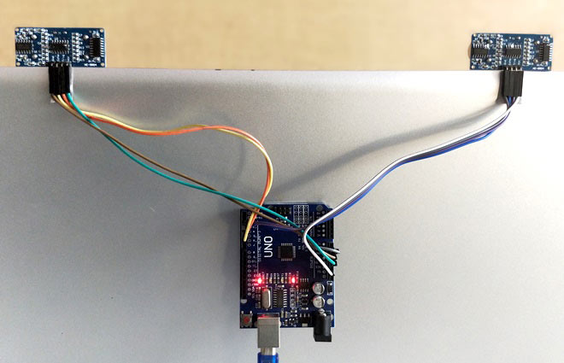
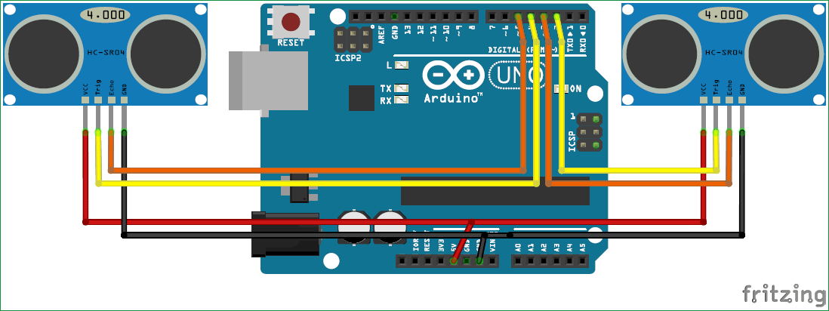
Gesture control using Arduino and Python
R. Zahan Rumon, Aminul Islam, A.S.M Rafatun Nur
Southeast University
Abstract
Concept behind the project
Arduino Programming Action
We study how a viewer can control a computer or laptop remotely by hand gestures.
We address two fundamental issues of gesture–based human–computer interaction:
How can one communicate a rich set of commands without extensive user training and memorization of gestures.
How can the computer recognize the commands in a complicated visual environment. We made a prototype of this system using a computer workstation and a laptop.
The graphical overlays appear on the computer screen, although they could be mixed with the video to appear on the television.
The computer controls the television set through serial port commands to an electronically controlled remote control. We describe knowledge we gained from building the prototype.
Recently Gesture controlled Laptops or computers are getting very famous. This technique is called Leap motion which enables us to control certain functions on our computer/Laptop by simply waving our hand in front of it. It is very cool and fun to do it, but these laptops are really priced very high. So in this project let us try building our own Gesture control Laptop/Computer by combining the Power of Arduino and Python.
By reading the value of distance we can arrive at certain actions to be controlled with gestures, for example in this program I have programmed 5 actions as a demo.
Action 1: When both the hands are placed up before the sensor at a particular far distance then the video in VLC player should Play/Pause.
Action 2: When right hand is placed up before the sensor at a particular far distance then the video should Fast Forward one step.
Action 3: When left hand is placed up before the sensor at a particular far distance then the video should Rewind one step.
Action 4: When right hand is placed up before the sensor at a particular near distance and then if moved towards the sensor the video should fast forward and if moved away the video should Rewind.
Action 5: When left hand is placed up before the sensor at a particular near distance and then if moved towards the sensor the volume of video should increase and if moved away the volume should Decrease.
Introduction
Recently Gesture controlled Laptops or computers are getting very famous. This technique is called Leap motion which enables us to control certain functions on our computer/Laptop by simply waving our hand in front of it. It is very cool and fun to do it, but these laptops are really priced very high. So in this project let us try building our own Gesture control Laptop/Computer by combining the Power of Arduino and Python
We will use two Ultrasonic sensors to determine the position of our hand and control a media player (VLC) based on the position. I have used this for demonstration, but once you have understood the project, you can do anything by just changing few lines of code and control your favorite application in your favorite way.
We will place two Ultrasonic (US) sensors on top of our monitor and will read the distance between the monitor and our hand using Arduino, based on this value of distance we will perform certain actions. Second, it can be used as a convenient computer interface to the millions of people who are unable to adequately use typical computer interaction techniques.
To perform actions on our computer we use Python pyautogui library. The commands from Arduino are sent to the computer through serial port (USB). This data will be then read by python which is running on the computer and based on the read data an action will be performed.
To control the PC with Hand Gestures, just connect the two Ultrasonic sensors with Arduino. We know US sensor work with 5V and hence they are powered by the on board Voltage regulator of Arduino. The Arduino can be connected to the PC/Laptop for powering the module and also for Serial communication. Once the connections are done place them on your monitor as shown below.
Arduino & Sensors Setting
Circuit Diagram
To control the PC with Hand Gestures, just connect the two Ultrasonic sensors with Arduino. We know US sensor work with 5V and hence they are powered by the on board Voltage regulator of Arduino. The Arduino can be connected to the PC/Laptop for powering the module and also for Serial communication. Once the connections are done place them on your monitor as shown below. I have used a double side tape to stick it on my monitor but you can use your own creativity. After securing it in a place we can proceed with the Programming.
Conclusion
In this project, we have implemented Arduino based Hand Gesture Control of Your Computer, where few hand gestures made in front of the computer will perform certain tasks in the computer without using mouse or keyboard.
Such Gesture based Control of Computers is already present and a company called Leap Motion has been implementing such technology in computers.
This type of hand gesture control of computers can be used for VR (Virtual Reality), AR (Augmented Reality), 3D Design, Reading Sign Language, etc.
Notes:
‹#›

