Slide 1
PUMP AND DUMP DETECTION IN STOCK PRICES USING NEURAL NETWORKS AND REGRESSION MODEL
M Saad Sarfraz 17L-4351
M Zarar Tariq 17L-4130
Junaid Saleem 17L-4181
Hamza Sultan 17L-6328

Slide 2
ABSTRACT
Accurate forecasting of stock market is of significant importance to investors; however, stock markets are influenced by unpredictable variables such as microblogs and news that make it impossible to estimate stock market and that is the main reason for the scammers to get the prices of stocks at a high index in order to accomplish pump and dump scams. In this research we consider outputs from various algorithms to find a reliable classifier so that the stock prices can be predicted and the actual prices can be compared with the predicted values in order to notice any drastic increase in price so that the pump and dump scam can be detected. Because the investor’s beliefs are effected due to the fluctuation of the stock market prices.

Slide 3
introduction
Algorithms are the key to understanding and predicting the basis of any analysis that one might come across. Amongst the array of analyses available to be experimented on through the usage of computing are that of trend predictions as well – a concept on which many Wall Street brokers rose to success back in the 20th Century. These trend predictions were carried out manually by analyzing graphs that a stock showed over a specified amount of time and had people manually manipulating and looking over the dips and rises to gain some sort of an idea on what the graph may look like in the future. But the 21st century is the century of technological advancements and modernization, the most famous of which is the incredible process of artificial intelligence and machine learning through communication and data feeds.

Slide 4
SCOPE OF STUDY
Stock market return forecasting is practically a complex research prediction practice that is now evolving with new financial instruments, data channels, economies, and algorithms being made available. The predictability of prices still raises significant questions at its heart. As the old stock traders are getting their hands on various techniques in order to gain maximum profit through fluctuating the stock prices that include illegal practices such as pump and dump technique. The techniques for achieving predictive precision are discussed here. To build this process, we compile the average series prices of approximately half the publicly available firms over a ten.year period and devise some trading strategies based on their forecast.

Slide 5
OBJECTIVE OF STUDY
A dependent variable relation with more than one independent variables can be modeled using linear regression model. The way we will use linear regression here is by fitting a linear regression model to the previous N values, and using this model to predict the current day value. So we are predicting the stock market prices of publically available shares of various companies by comparing the previous result charts using linear regression model and neural networking mechanism. In this way the stock prices can be predicted so for the future use if a price of some stock rapidly increase then it can be detected as a pump and dump scam so that the buyer can be warned before buying such stocks in order to lessen the loss.

Slide 6
REQUIREMENTS AND DESIGN
Usually for prediction, the main thing is the parameters that predict the trend. We used Amazon’s dataset in order to test and predict the future trends in their stock price. Firstly, the orthodox methods and the most useful models are based on the process of modeling while the self-based adjusted training techniques are used in the neural networks, so the traditional models can solve the problem by only having limited information about the surroundings of the underlying model and can predict results using a minimum amount of background knowledge. Contrary to this, neural networks are based on the relationship of the input of one layer with the output of another layer.

Slide 7
Dataset Representation
The parameters of the Amazon dataset contain fields like open, close, high and low etc. which predict the stock with the starting and ending prices in a csv file format. It contains the date and time as well. The understanding of the parameters was done using the tutorials. Since the traditional target in algorithm design lies in the prediction precision, the final goal will tackle the corresponding gain. It is not easy to link the accuracy to income. However it is more reliable to rely on the higher accuracy levels in order to achieve accurate stock prediction as it will be an ideal example of the assets with constant prices sows that it might not be always true as due to the constant nature of the dataset of some stocks the algorithms tends to predict the constant value starting from initial states as it might not change over time

Slide 8
IMPLEMENTATION
In order to implement our mechanism, we used python and its libraries in order to design a machine learning algorithm which can predict the stock prices of Amazon. We used SVR (Support Vector Regression) and linear regression in order to test the dataset. SVM has two main functions, scoring and regression. The main characteristic of SVR is that despite of minimizing the training error, SVR generalize the performance by minimizing the generalized error bound. This generalization error limit is the combination of the training error and a regularization term that governs the uncertainty of the space hypothesis. It is being investigated the possibility of applying SVM to financial forecasting by contrasting it to back propagation neural networks and case based reasoning. In this study a new approach is proposed to combine SVR and windowing function together.

Slide 9
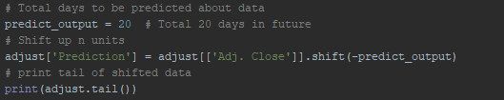
Training the model
Now the total of 20 days are being set so that the next 20 days of the sample data can be predicted using the variable that is named as forecast out. This value will be used in the program and we will easily adjust the numerical value and refer the remaining parts of function. And if we decide we only want to look into the future for 20 days, we can easily adjust the variable for different time periods, and the system can estimate 20 days into the future now.

Slide 10
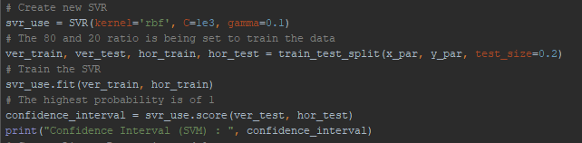
Create and Train SVR
We are creating an SVR model for future predictions and training it to predict the prices by evaluating the dataset.

Slide 11
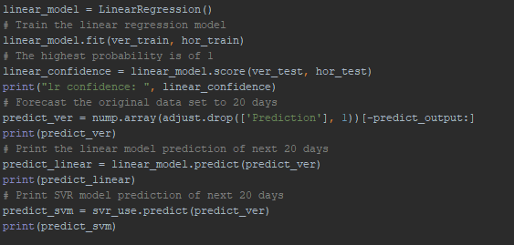
Create and Train Linear Regression model
Also we are creating a Linear Regression model for future predictions and training it to predict the prices by evaluating the dataset.

Slide 12
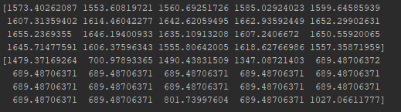
RESULTS
In order to predict the results we used two methods. The first one was to predict the upcoming day’s trends as numpy and the other was to test fitness of the solution using the accuracy. As the data shown below is the predicted version of the current stock prices for the upcoming 20 days. In this way a closely monitored chart can be developed so that the sudden and drastic change in stock can be detected in order to avoid scams and prevail the actual percentage of increment in the stock prices.

Slide 13
CONCLUSION
As from the above results it is found that the models being used produced nearly expected results but the results of Linear regression outperformed the models as it produces higher accuracy in predicting stock market prices using previous data and surrounding market conditions in order to train the dataset by assigning hyper parametric values to the variables which in turns shown future predictions with more accuracy and efficiency. So for future researches and predictions according to the results, Linear is better approach as the dataset is sensitive information which can only be trusted with models having higher accuracy. In this way in future if the price of stock go drastically higher than the predicted value then it can be investigated seriously in order to save the investors from considerable loss. As the predicted values are 99.3% accurate so there will be no room for drastic change so in this way the pump and dump scam can be detected if the prices go rapidly higher than the predicted outcomes.

Slide 14
Thank you !

