Slide 1
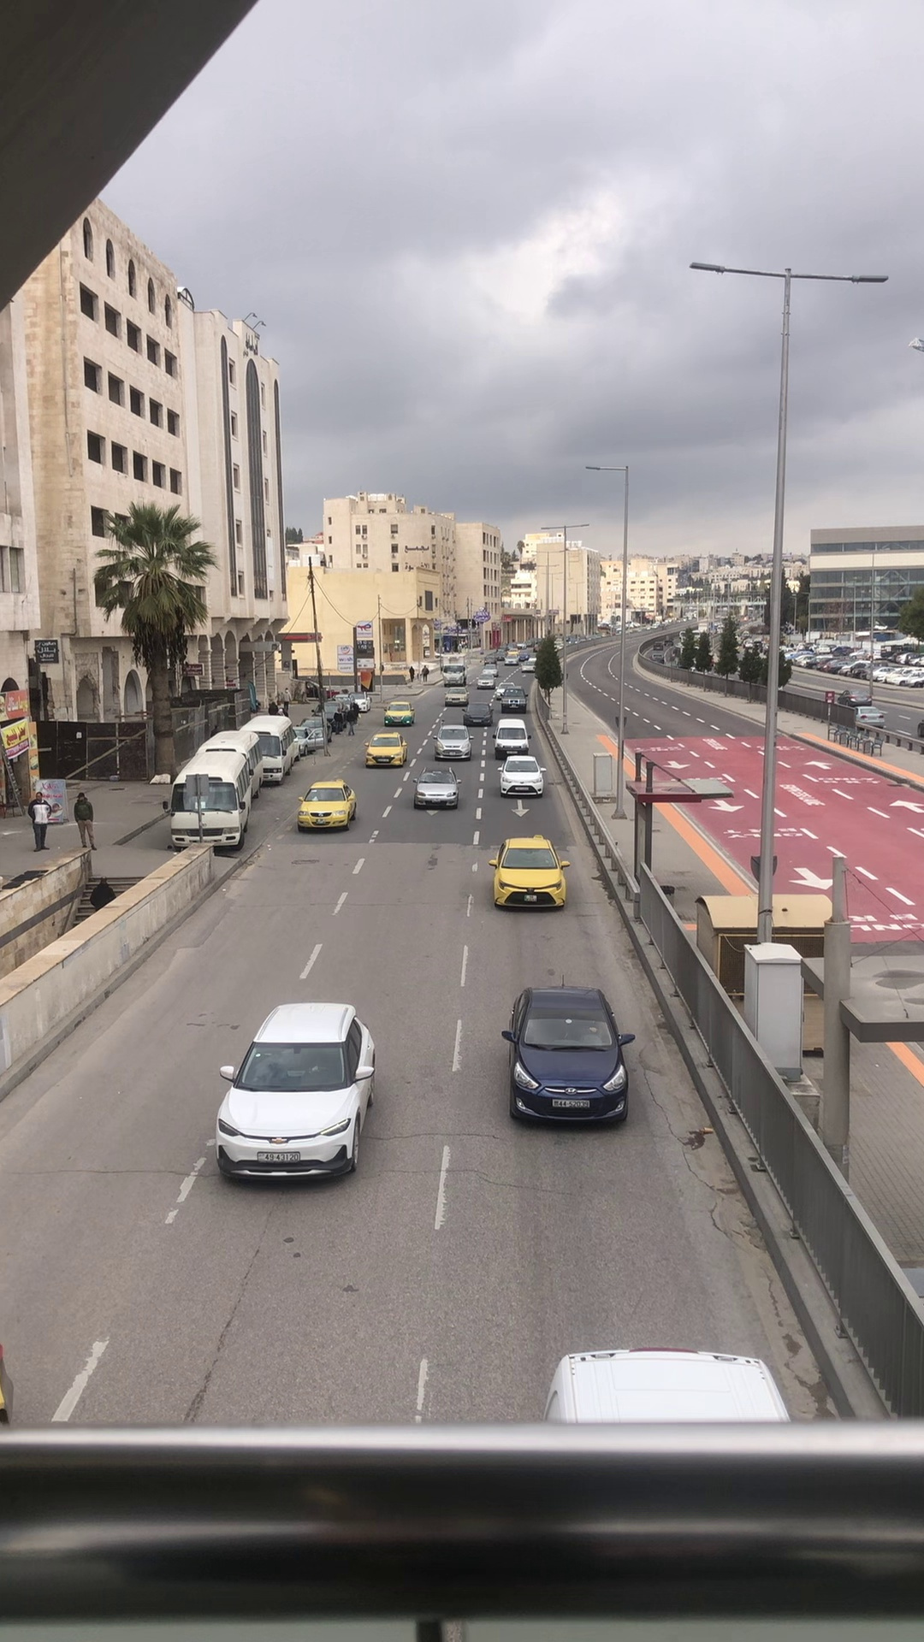

The University of Jordan
School of Engineering
Department of Computer Engineering
Traffic Classification In Hazy Conditions
Supervisor: Prof. Gheith Abandah
Authors: Razan Al-Durbee & Noor Al-Khudair

Slide 2
Table of Contents
Introduction
Related Work
Solution Description and Implementation
Results and Discussion
Conclusion and Future Work

Slide 3
Introduction
Problem Definition
Tackling urban traffic congestion, worsened by haze, leads to longer travel times and higher fuel consumption.
Proposed Solution
Developing a deep learning model to accurately categorize street congestion severity in hazy conditions.
Project Impact
Using pre-trained models and transfer learning to classify street density in bad weather improves traffic management and safety.

Slide 4
Related Work
Pretrained Models and Transfer Learning
“Automated ASPECTS Classification in Acute Ischemic Stroke using EfficientNetV2 “ [1].
Pre-trained Model | Accuracy | Loss
VGG16 | 85.32% | 0.48
ResNet50 | 66.30% | 8.39
InceptionV3 | 94.11% | 0.18
EfficientNet-B0 | 89.25% | 0.88
EfficientNetV2 | 97.48% | 0.11

Slide 5
Related Work
Traffic Analysis and Congestion Classification Technologies
“Image-Based Learning to Measure Traffic Density Using a Deep Convolutional Neural Network” [2].
“Real-Time Prediction of Traffic Density with Deep Learning Using Computer Vision and Traffic Event Information” [3].

Slide 6

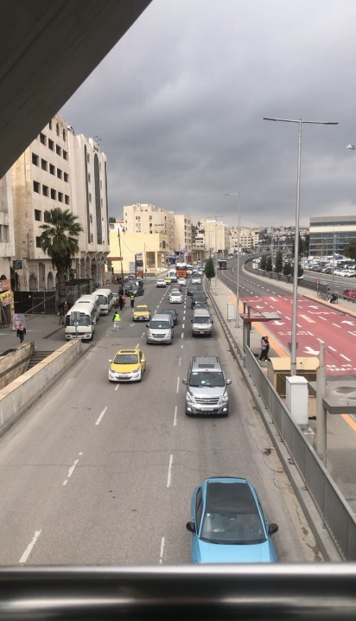




Solution Description and Implementation
Data Collection and Preparation
1. Videos Recording, Splitting, and preprocessing.
Low Traffic Density | Medium Traffic Density | High Traffic Density

Slide 7
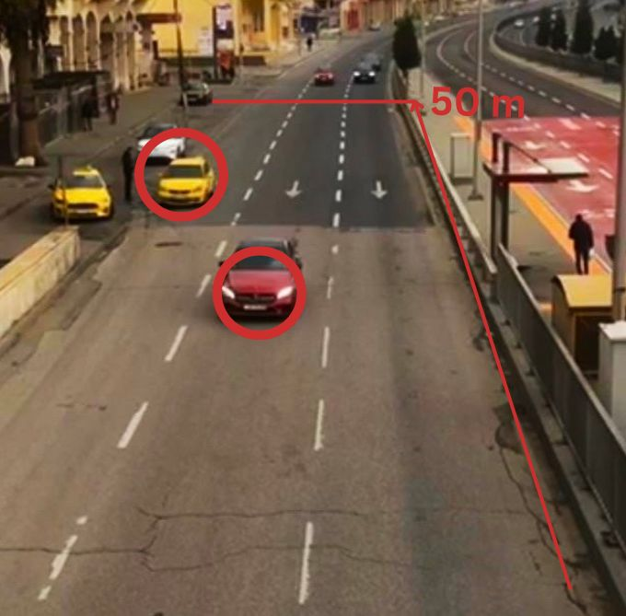
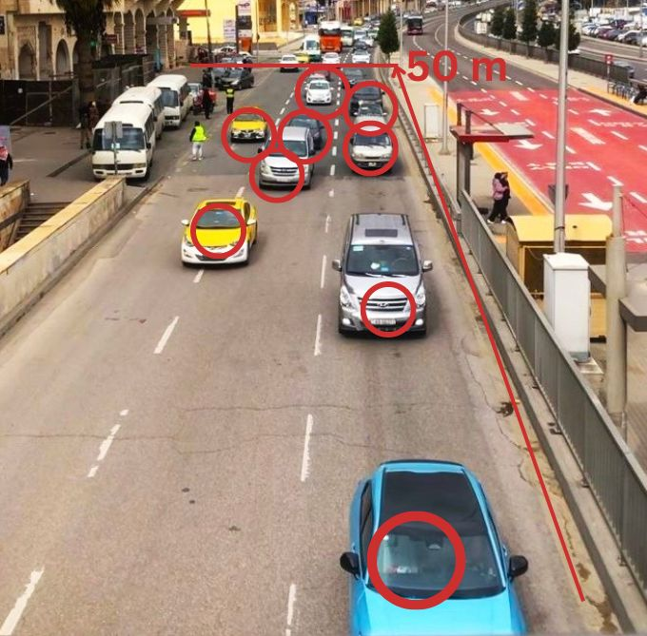
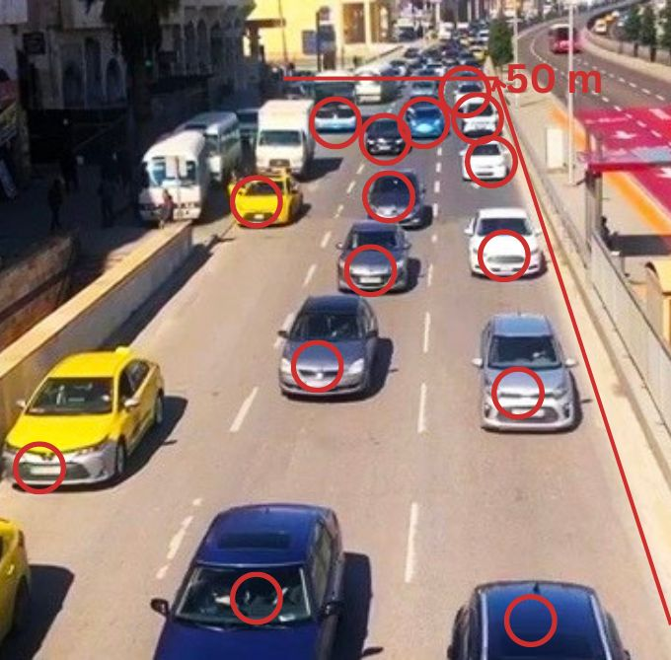
Solution Description and Implementation
Data Collection and Preparation
2. Images Extraction, Enhancement, Labeling, and class balancing.
Saturation and contrast adjusting
-
+
60
Low Traffic Density | Medium Traffic Density | High Traffic Density

Slide 8
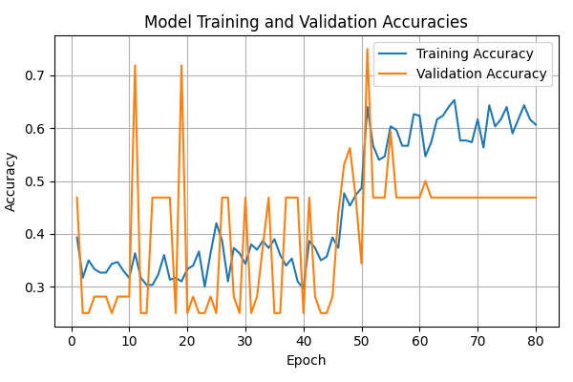
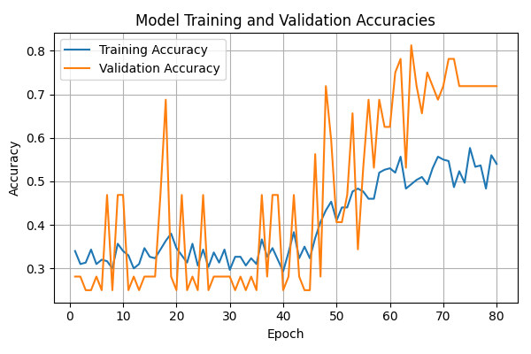
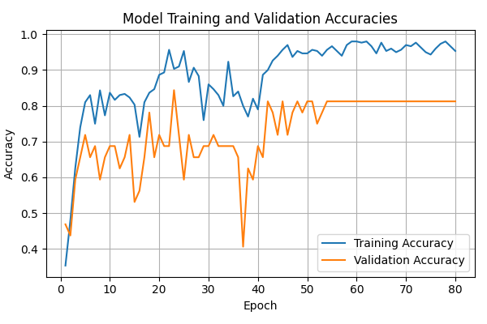
Solution Description and Implementation
Images preprocessing
Normalizing
One-hot encoding
Resizing
480x480
Shuffling
Model Selection and Tuning
EfficientNet models were fine-tuned to find the most accurate and stable one.
EfficientNetB5 | EfficientNetB7 | EfficientNetV2L

Slide 9
Solution Description and Implementation
Batch Size Optimization
Batch Size | Time Per Epoch | Test Accuracy
8 | 893s | 86.40%
16 | 564s | 87.20%
32 | 197s | 88.00%
64 | 204s | 85.60%

Slide 10
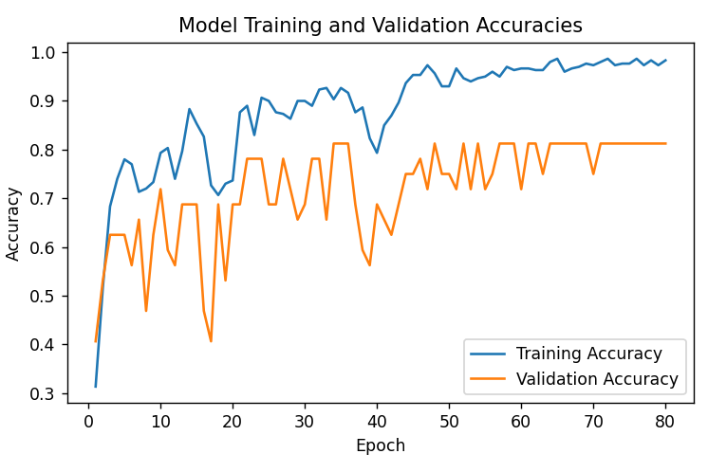
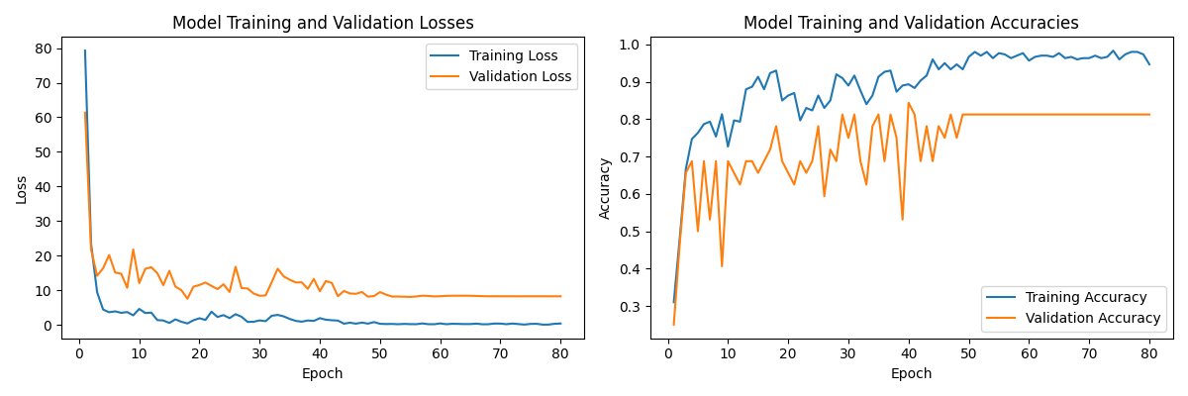
Solution Description and Implementation
Learning Rate Optimization
Exponential Decay Schedule | Multiplicative Decay Schedule
lr41 = lr40* exp(-0.1)
lr41 = lr40* 0.8

Slide 11
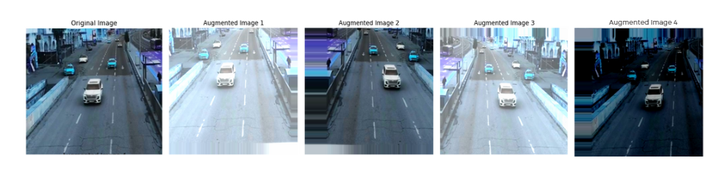
Solution Description and Implementation
Data Augmentation
Width Shift
Horizontal Flip
Height Shift
Channel Shift
 | Test Accuracy | Test Loss
Without Augmentation | 88.00% | 5.98
With Augmentation | 88.00% | 3.82

Slide 12
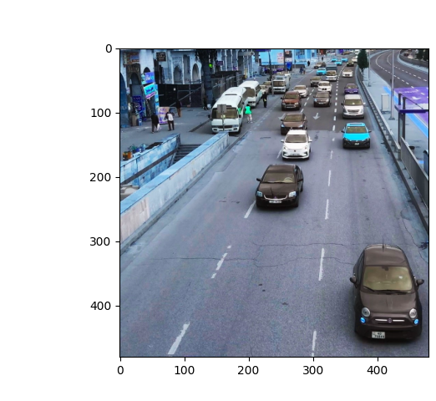
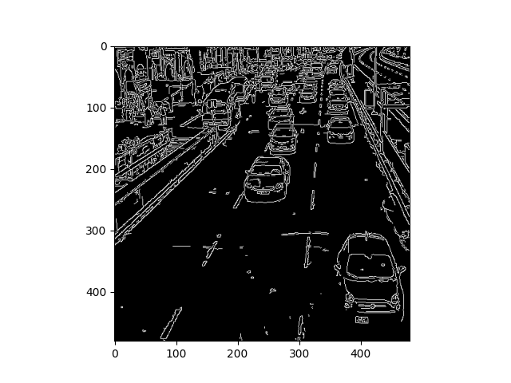
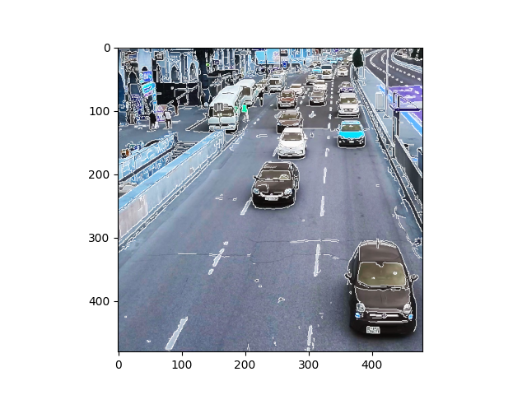
Solution Description and Implementation
Image Segmentation
OR
 | Test Accuracy | Test Loss
Without Segmentation | 88.00% | 5.98
With Segmentation | 83.3% | 9.61

Slide 13
Solution Description and Implementation
Improving Model Accuracy Using Regression
We reimplemented our model to predict continuous values, achieving a test MSE of 0.15, MAE of 0.27, and an R-squared of 0.80.
Density Class | Low (-0.5,0.5) | Medium (0.5, 1.5) | High (1.5, 2.5)
Misclassified images by classification | 13 | 3 | 0
Misclassified images by regression | 11 | 3 | 2

Slide 14
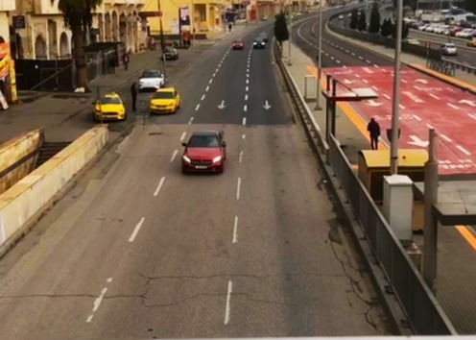
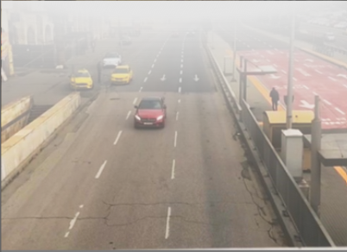
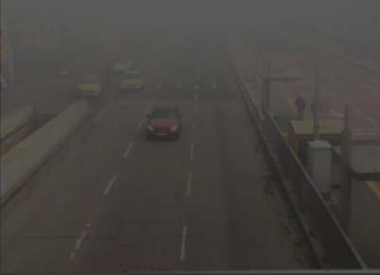
Solution Description and Implementation
Image Editing for Simulating Hazy Conditions
Original Image | Image with Graphic Element | Image After Adjustment
Brightness adjusting
Exposure adjusting
Contrast adjusting
-
68
+
90
58

Slide 15
Results and Discussion
Results of the Model Evaluated on Clear Images
The model achieved an accuracy of 97.00%, 81.00%, and 88.00% on the training, validation, and test datasets, respectively.

Slide 16
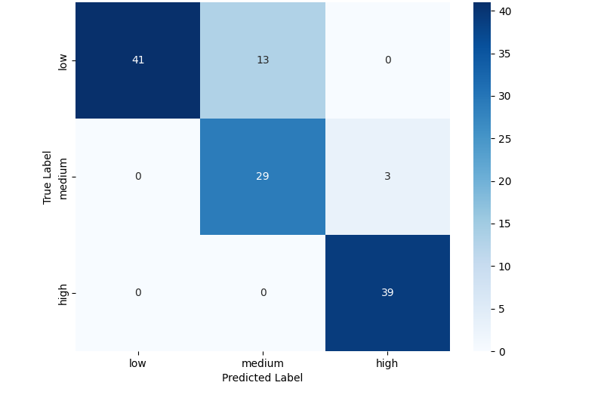
Results and Discussion
Results of the Model Evaluated on Clear Images
41
13
0
0
29
3
0
0
39

Slide 17
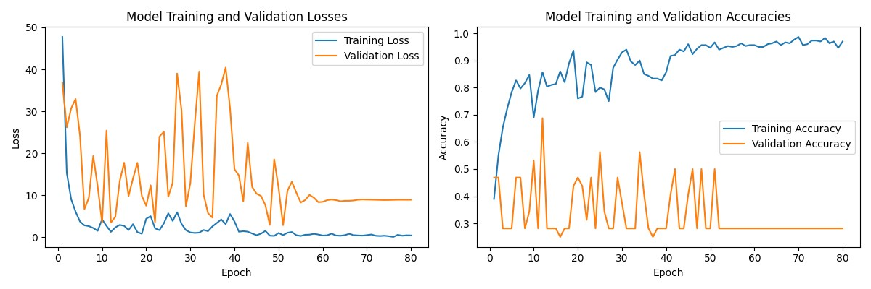
Results and Discussion
Results of the Model Evaluated on Hazy Images
When the model was trained solely on clear images, it achieved an accuracy of 31% on the test dataset.

Slide 18
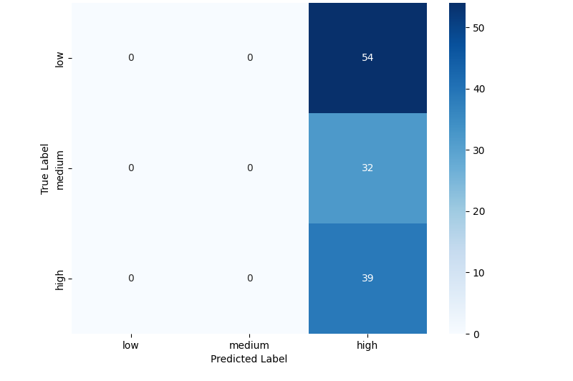
Results and Discussion
Results of the Model Evaluated on Hazy Images
0
0
54
0
0
32
0
0
39

Slide 19
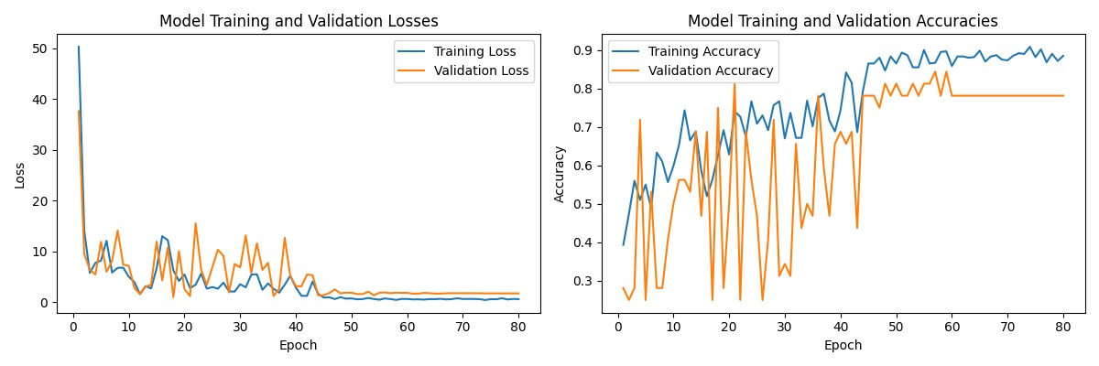
Results and Discussion
Results of the Model Evaluated on Hazy Images
When the model was trained on clear and hazy images, it achieved an accuracy of 78.4% on the test dataset.

Slide 20
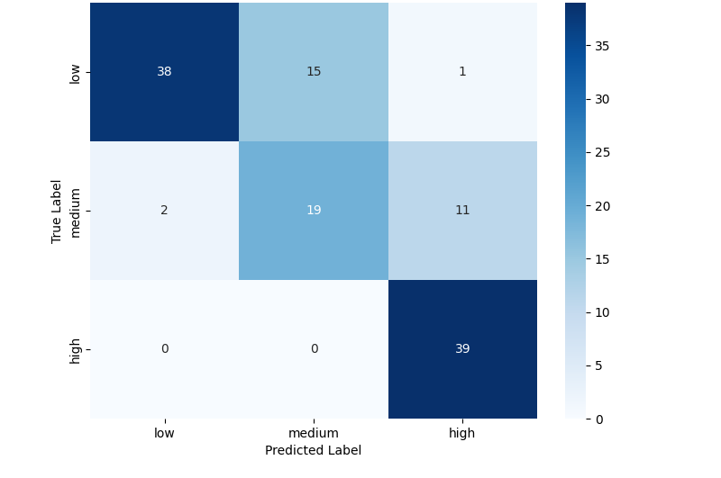
Results and Discussion
Results of the Model Evaluated on Hazy Images
38
15
1
2
19
11
0
0
39

Slide 21
Conclusion and Future Work
Conclusion
The project classifies traffic congestion (Low, Medium, High) in clear and hazy weather using data from Queen Rania Street, Amman.
Clear image training achieved 88% accuracy, dropping to 78% with hazy images included. Testing on unseen hazy conditions further reduced accuracy to 31%.
Limited data, complex architecture, and unclear class boundaries hindered pattern recognition, especially in haze.

Slide 22
Conclusion and Future Work
Future Work
Future efforts will expand and diversify the dataset, enable real-time video classification, and enhance the model for challenging conditions like rain or low light, broadening its applicability.

Slide 23
Thank you

