Slide 1
Dynamic programming: Floyd-Warshall Algorithm
Dimah Alolayan
Majd Gezan
Razan Aljuhani
CPCS324 PROJECT PHASE ONE

Slide 2
Contents
1
2
3
4
Introduction
Screenshots for the outputs
Difficulties faced during the phase design
Conclusion

Slide 3
Introduction
Algorithms is a step-by-step procedure to solve problems.
Dynamic Programming is one of the most powerful design techniques it is mainly used for solving optimization problems. especially, when the subproblems are not independent, but how does it work?
It works as a Bottom-up approach where it solves all possible sub-problems and then combines them to achieve the best solutions for bigger problems so that it can be re-used whenever needed.
one of the dynamic programming algorithms is Floyd-Warshall algorithm, the main idea behind this algorithm is finding the shortest path between all the pairs of vertices in a direct and indirect weighted graph, keeping in mind that it does not work for the graphs with negative cycles.

Slide 4
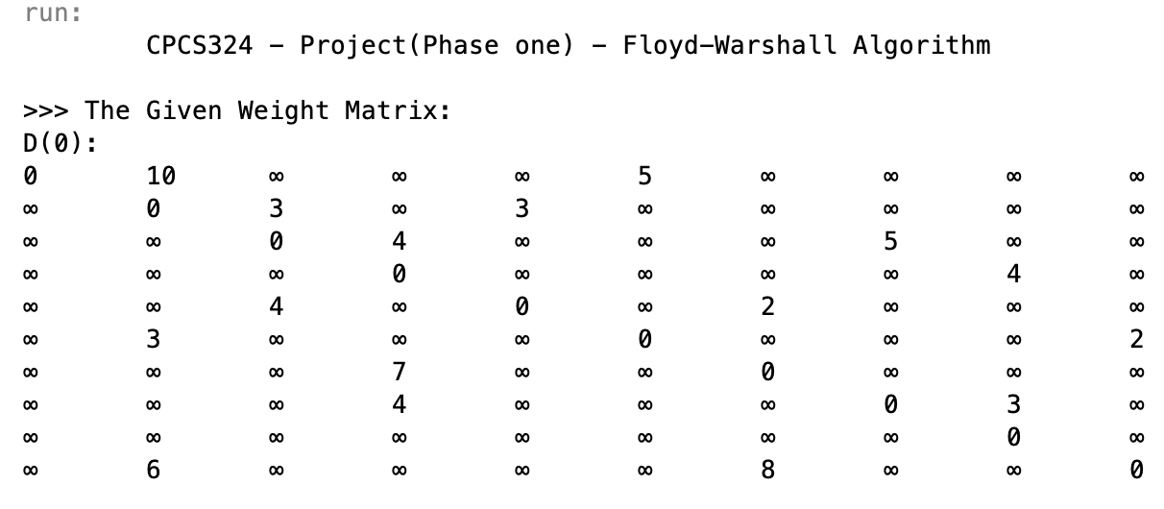
Screenshots for the outputs
On the k^{th} iteration, the algorithm determines shortest paths between every pair of vertices i, j that use only vertices among 1,..,k as intermediate, using the equation:
D^{k}[i,j] = min{D^{k-1}[i,j], D^{k-1}[i,k] + D^{k-1}[k,j]}
Comparing it with the index
If the index is larger, it will change
Otherwise, it remains the same.

Slide 5
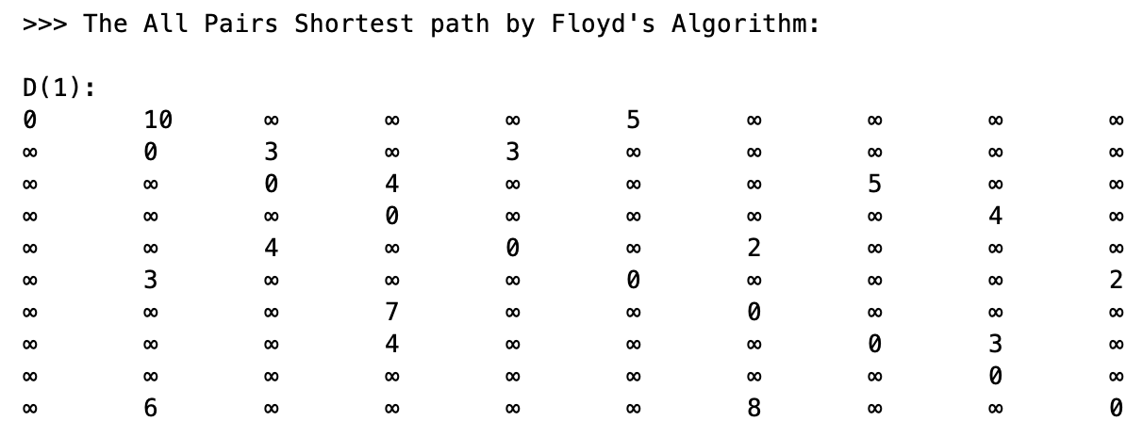
Screenshots for the outputs
The red highlight ( ) refers to the changed number.
Take the 1st row and 1st column from D(0) then use the equation to calculate D(1)

Slide 6
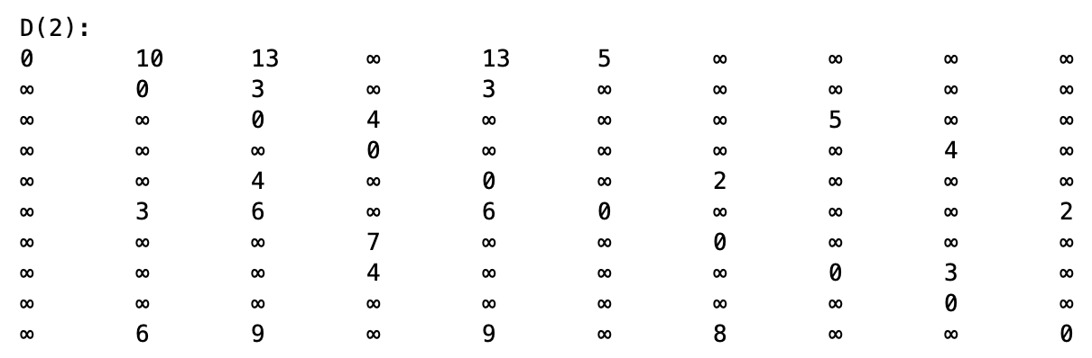
Screenshots for the outputs
Take the 2nd row and 2nd column from D(1) then use the equation to calculate D(2)

Slide 7

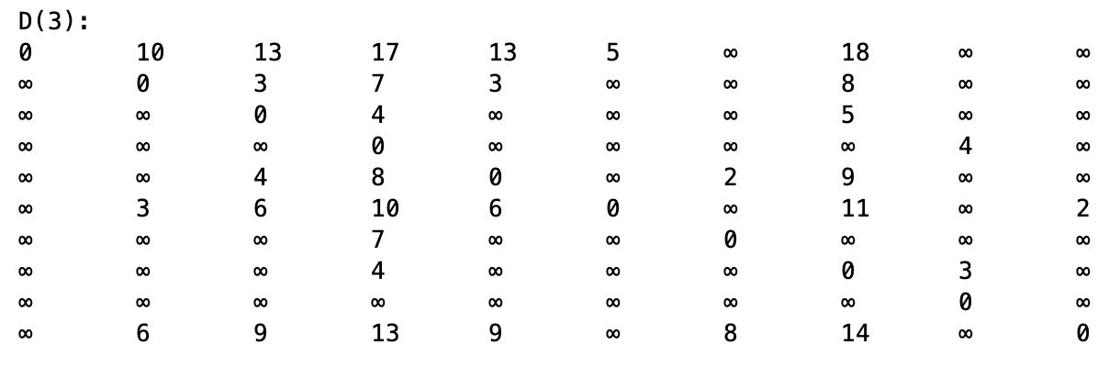
Screenshots for the outputs
Take the 3rd row and 3rd column from D(2) then use the equation to calculate D(3)

Slide 8
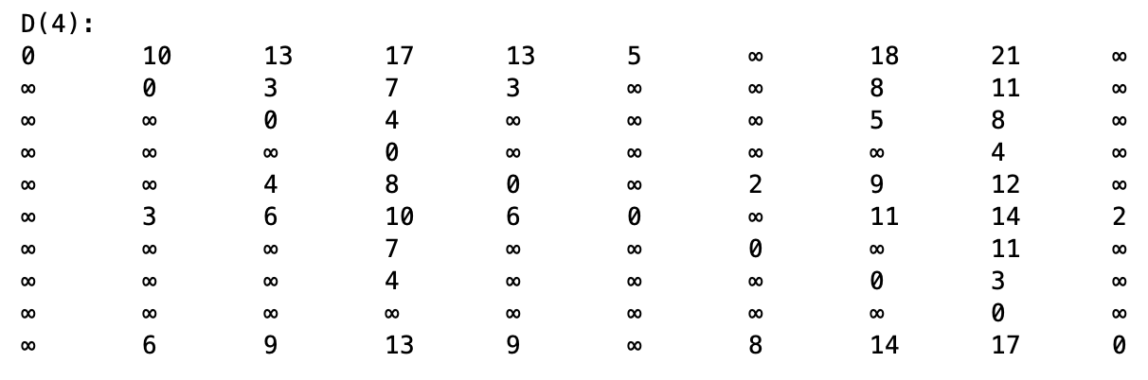
Screenshots for the outputs
Take the 4th row and 4th column from D(3) then use the equation to calculate D(4)

Slide 9
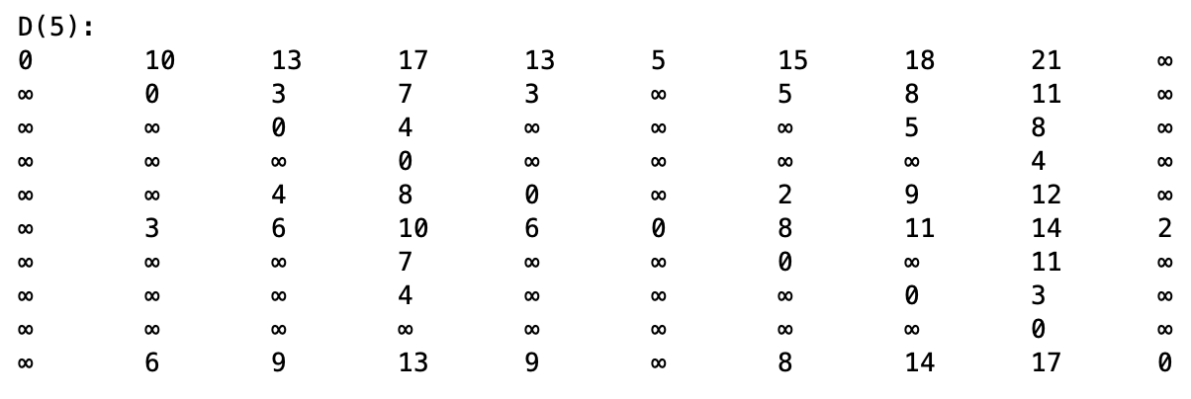
Screenshots for the outputs
Take the 5th row and 5th column from D(4) then use the equation to calculate D(5)

Slide 10
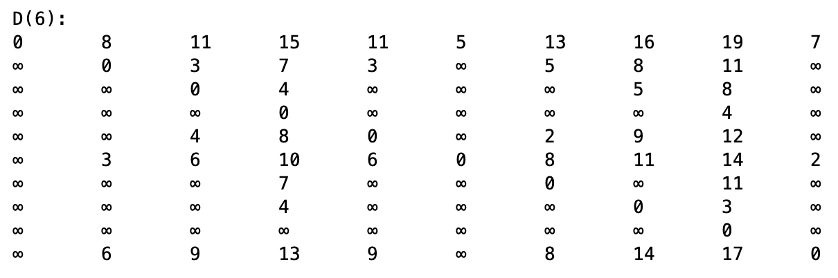
Screenshots for the outputs
Take the 6th row and 6th column from D(5) then use the equation to calculate D(6)

Slide 11
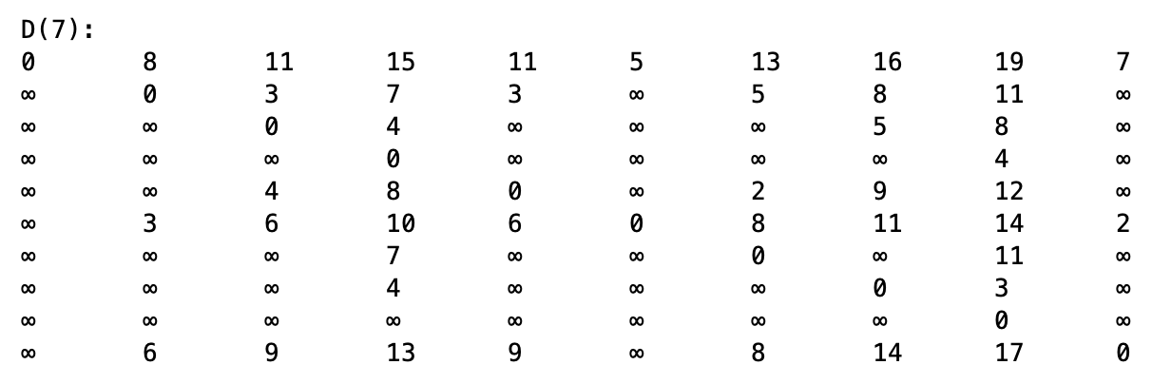
Screenshots for the outputs
Take the 7th row and 7th column from D(6) then use the equation to calculate D(7)

Slide 12
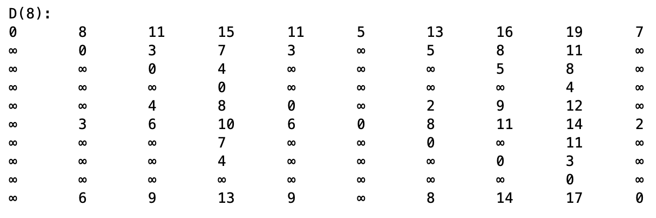
Screenshots for the outputs
Take the 8th row and 8th column from D(7) then use the equation to calculate D(8)

Slide 13
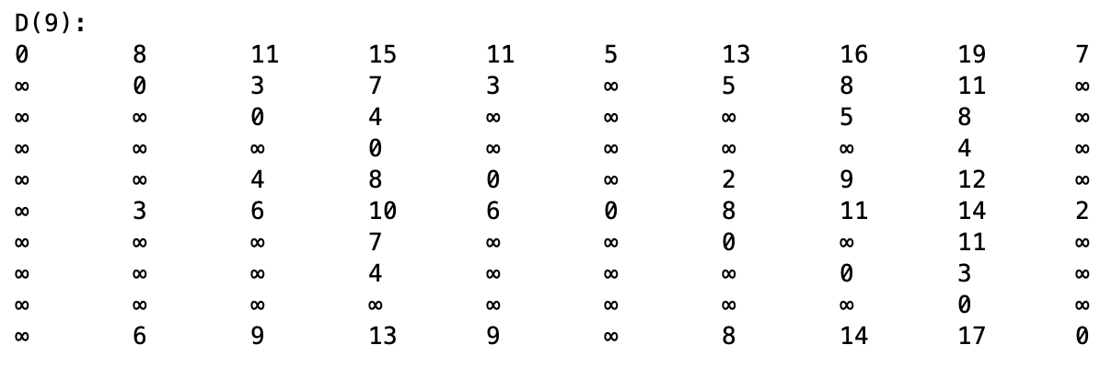
Screenshots for the outputs
Take the 9th row and 9th column from D(8) then use the equation to calculate D(9)

Slide 14
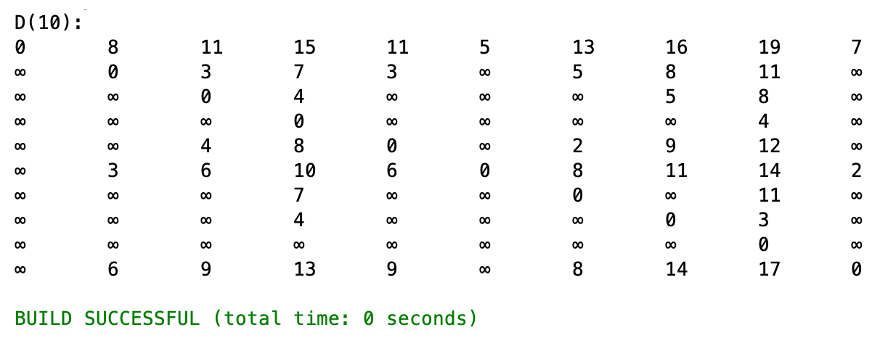
Screenshots for the outputs
Take the 10th row and 10th column from D(9) then use the equation to calculate D(10) and it is the final result

Slide 15
Difficulties faced during the phase design
The difficulties that faced us during this project phase are:
Coding a new concept and implementing it, we overcame it by researching and investigating more on it.
Tracing the matrix due to its large size which made it a little bit complex to trace
Meeting in-person due to COVID-19, we overcame it by staying in contact regularly with online meetings, we used screen sharing and annotation to enable everyone to stay focused and learn everything we needed to.

Slide 16
Conclusion
we used Floyd-Warshall algorithm that uses dynamic programming to get the optimized solution.
However, we had a brief discussion about dynamic programming and the main purpose of Floyd-Warshall algorithm which is finding the shortest path between all the pairs of vertices in a direct and indirect weighted graph.

Slide 17
Thank You!

