Slide 1
The prediction of a car price
Razan Aljuhani

Slide 2

Introduction
Companies try to produce cars with special
features to take attention in the market and
compete with other competitors. They need to
understand the dynamic changes of pricing in the
market through the years, and the factors
affecting the pricing
The project will help in clarify the features has a
direct impact on the target variable (Selling
Price), by build an effective model using Linear
regression.

Slide 3
Tools
1
2
3
4
Language
Data processing
Visualization
Modeling and evaluation
Python
Numpy
Pandas
Seaborn
Matplotlib
Plotly
Scikit-learn

Slide 4
Stages
01
02
03
04
Data cleaning
EDA
Preprocessing
Modeling and Evaluation

Slide 5
Original Data
 | Name | Year | Selling_price | Km_ driven | Fuel | Seller_ Type | transmission | Owner | Mileage | Engine | Max_ Power | Torque | Seats
0 | Maruti Swift Dzire VDI | 2014 | 450000 | 145500 | Diesel | Individual | Manual | First Owner | 23.4 kmpl | 1248 CC | 74 bhp | 190Nm@ 2000rpm | 5.0
1 | Skoda Rapid 1.5 TDI Ambition | 2014 | 370000 | 120000 | Diesel | Individual | Manual | Second Owner | 21.14 kmpl | 1498 CC | 103.52 bhp | 250Nm@ 1500-2500rpm | 5.0

Slide 6
Data after cleaning
 | Selling_Price | Kms_Driven | Fuel_Type | Seller_Type | Transmission_Type | Owner_Number | Mileage | Engine | Max_Power | Seats_Number | Car_Age | Car_Brand
0 | 13.017003 | 145500 | Diesel | Individual | Manual | First Owner | 23.40 | 1248.0 | 4.304065 | 5.0 | 1.945910 | Maruti
1 | 12.821258 | 120000 | Diesel | Individual | Manual | Second Owner | 21.14 | 1498.0 | 4.639765 | 5.0 | 1.945910 | Skoda

Slide 7
Stages
01
02
03
04
Data cleaning
EDA
Preprocessing
Modeling and Evaluation

Slide 8
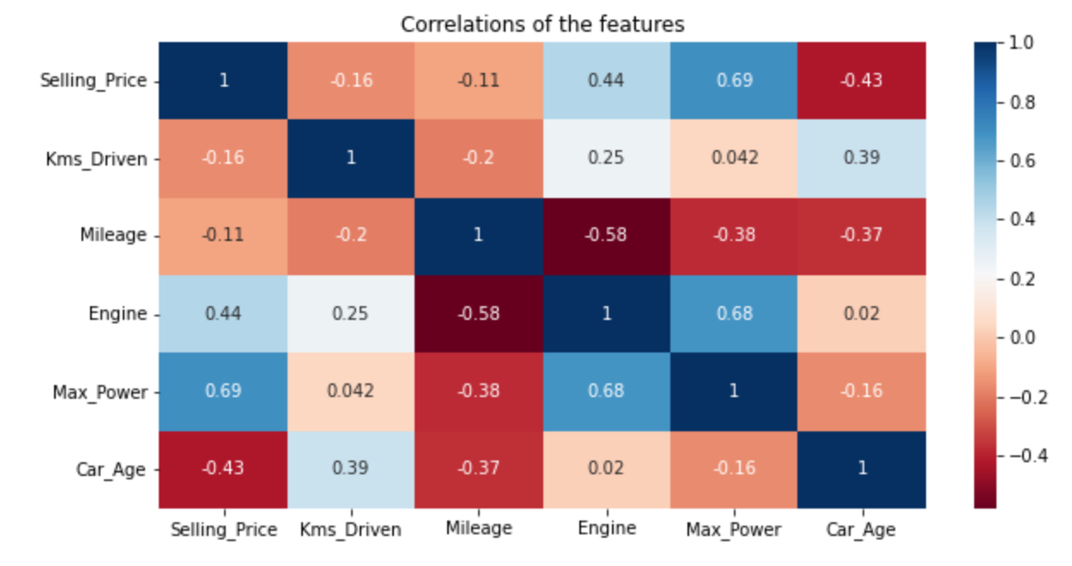
Correlation of the features

Slide 9
Distribution of the numerical data

Slide 10
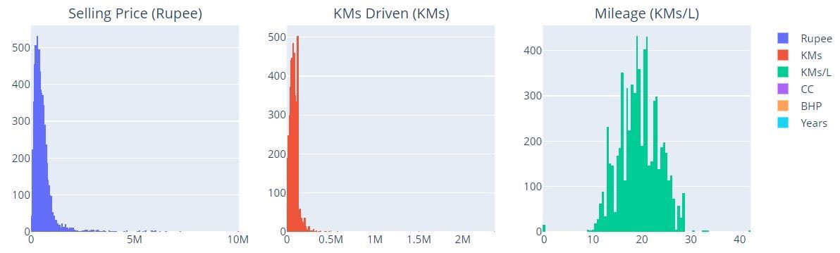
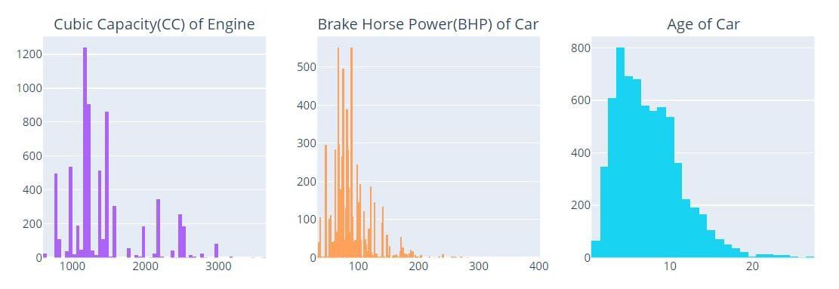

Slide 11
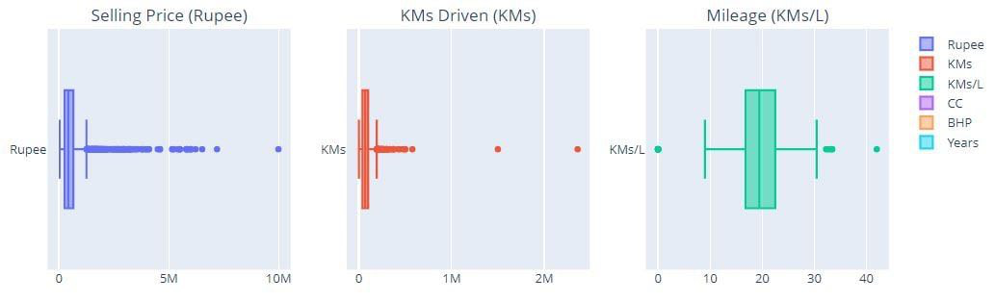
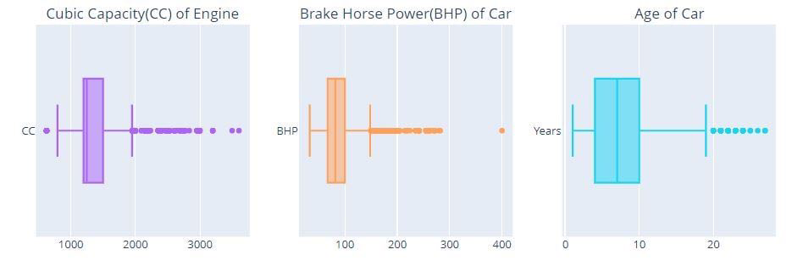

Slide 12
Distribution of the categorical data

Slide 13
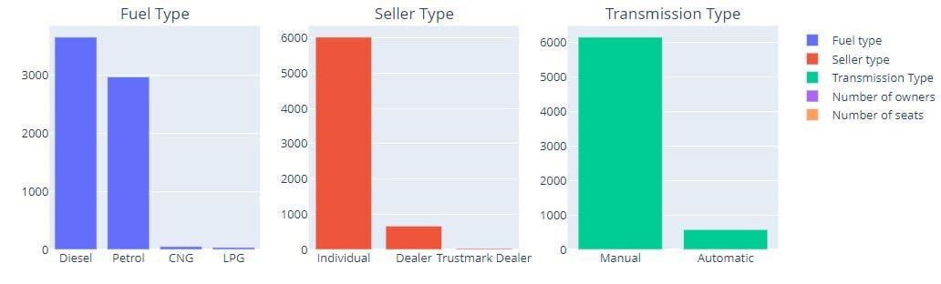
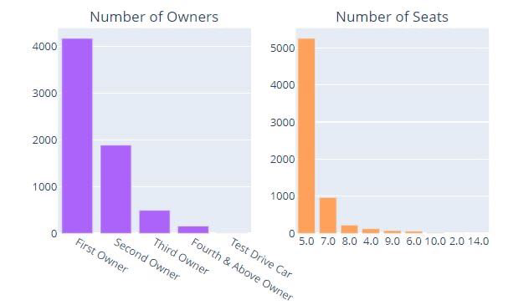

Slide 14
Stages
01
02
03
04
Data cleaning
EDA
Preprocessing
Modeling and Evaluation

Slide 15
Feature engineering and data scaling

Slide 16
Data for modeling
 | Selling_Price | Kms_Driven | Fuel_Type | Seller_Type | Transmission_Type | Owner_Number | Mileage | Engine | Max_Power | Seats_Number | Car_Age | Car_Brand
0 | 13.017003 | 145500 | Diesel | Individual | Manual | First Owner | 23.40 | 1248.0 | 4.304065 | 5.0 | 1.945910 | Maruti
1 | 12.821258 | 120000 | Diesel | Individual | Manual | Second Owner | 21.14 | 1498.0 | 4.639765 | 5.0 | 1.945910 | Skoda

Slide 17
Stages
01
02
03
04
Data cleaning
EDA
Preprocessing
Modeling and Evaluation

Slide 18
Models
Lasso
Ridge
Random Forest
01
03
05
02
04
Ordinary Least Square
XGBoost

Slide 19
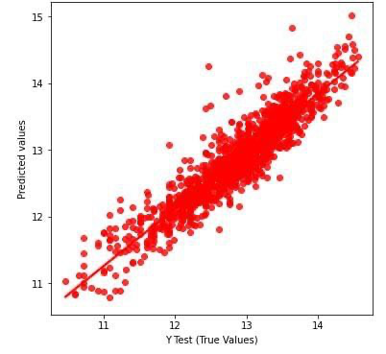
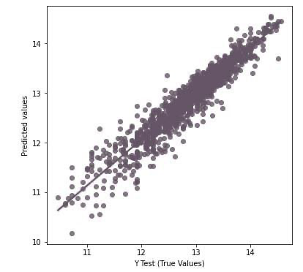
Comparing
Ordinary Least Square
XGBoost

Slide 20
Accuracy
Linear regression (Lasso) and (Ordinary Least Square)
82%
85%
Linear regression (Radge)
91%
Random Forest regression
99%
XGBoost regression

Slide 21
Evaluation
Mean Absolute Error
Root Mean Squared Error
Mean Squared Error
R Squared Error
16%
22%
5%
90%

Slide 22
Thanks!
Any questions?

