Slide 1
ML project
COVID-19 Diagnosis.
Group members:
Razan Abdalrahman.
Lana Hamayel.
Under the supervision of:
Dr. Adnan Yahya.

Slide 2
Project description.
The main objective of this project was to create software that could accurately diagnose Covid-19 by utilizing available information. The initial phase involved organizing medical data, and then we delved into computer techniques such as decision trees and artificial neural networks (ANN). To assess the performance of the method, specific datasets were used, presented in a standardized tabular format with established metrics. We carefully selected a Python-compatible tool for this purpose, and the effectiveness of the system was tested using different amounts of data or for diagnosing other diseases, which served as an added contribution.

Slide 3
Source data.
Despite making several attempts, it was not possible to obtain a dataset from the medical center in Ramallah due to concerns about patient privacy. Consequently, inquiries were made to understand the procedures they follow in determining whether a patient has COVID or not. As an alternative, a dataset was generated, incorporating information gathered from the medical center. This dataset comprises details such as:
Patient_ID
Gender
Fever
Age
Location
Hypertension
Cough
Fatigue
Shortness_of_Breath
Loss_of_Taste_or_Smell
Diabetes
COVID_Test_Result

Slide 4
Patient_ID | Age | Gender | Location | Fever | Cough | Shortness_of_ Breath | Fatigue | Loss_of_Taste_or_ Smell | Diabetes | Hypertension | COVID_ Test_Result
1200044 | 43 | Male | Ramallah | Yes | Yes | Yes | No | Yes | Yes | Yes | Negative
1200045 | 21 | Female | Al_Bireh | Yes | Yes | Yes | Yes | No | Yes | Yes | Positive
1200046 | 32 | Male | Beituni | Yes | Yes | Yes | Yes | Yes | Yes | No | Negaive

Slide 5
Algorithms utilized.
In our effort to predict Covid-19 result, we employed both Artificial Neural Networks (ANN) and Decision Trees.
The Artificial Neural Network algorithm, inspired by the human brain's neural structure, is a powerful machine learning model capable of complex pattern recognition. It consists of interconnected nodes (neurons) organized in layers, enabling it to learn intricate relationships in data.
On the other hand, Decision Trees are a tree-like model that makes decisions based on features at each node. It recursively splits the data into subsets, making it particularly effective for classification tasks. By combining these two approaches, we aimed to enhance the accuracy and robustness of our Covid-19 prediction model.

Slide 6
Code implementation.
This Python script integrates machine learning models for COVID-19 analysis and prediction using Decision Trees and Artificial Neural Networks (ANN). It begins by importing necessary libraries, such as pandas and scikit-learn, and sets up functions for data preprocessing and model evaluation. The dataset is loaded from a CSV file, categorical columns are encoded numerically, and the data is split into training and testing sets. Two classifiers, a Decision Tree (decision_tree_classifier) and an ANN (ann_classifier), are then created and trained on the respective datasets.
As further step: The script includes machine learning models using Decision Trees and Artificial Neural Networks (ANN) for COVID-19 analysis. It employs a graphical user interface (GUI) to predict COVID-19 results based on user-input data. The entered information is processed, and predictions are generated using both the ANN algorithm and Decision Tree model. The results are then displayed in the GUI, enhancing user interaction and providing insights into the COVID-19 prediction outcomes.

Slide 7
As an additional step, we utilized the WEKA learning tool to perform calculations on the dataset, including measures like accuracy and precision , etc..

Slide 8
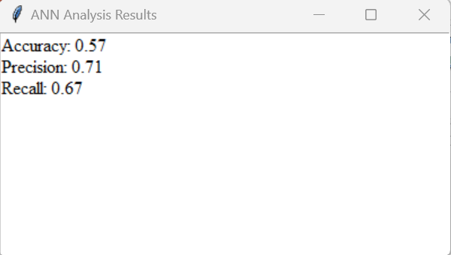
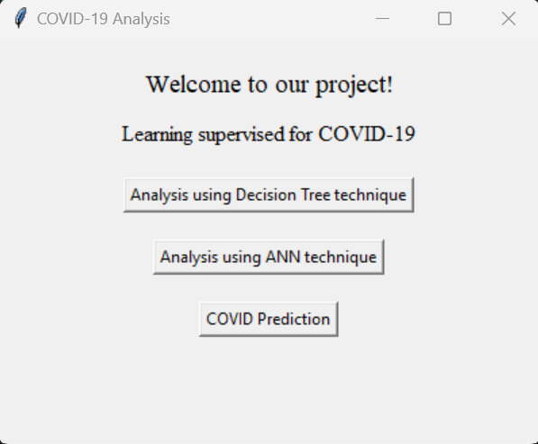
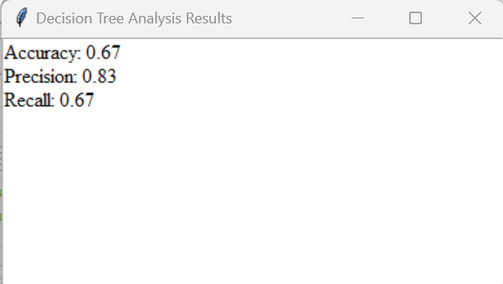
Results.
Results from the python code:

Slide 9
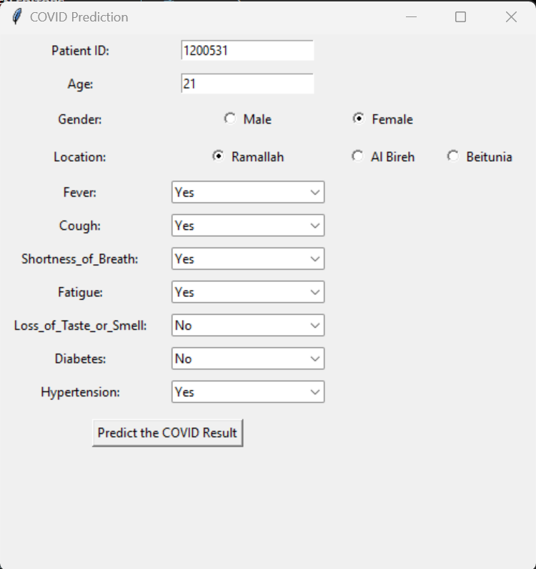
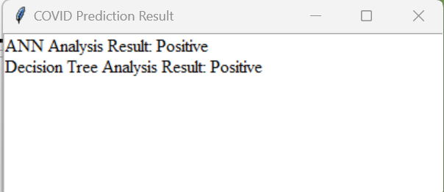
Predict result for new patient:

Slide 10
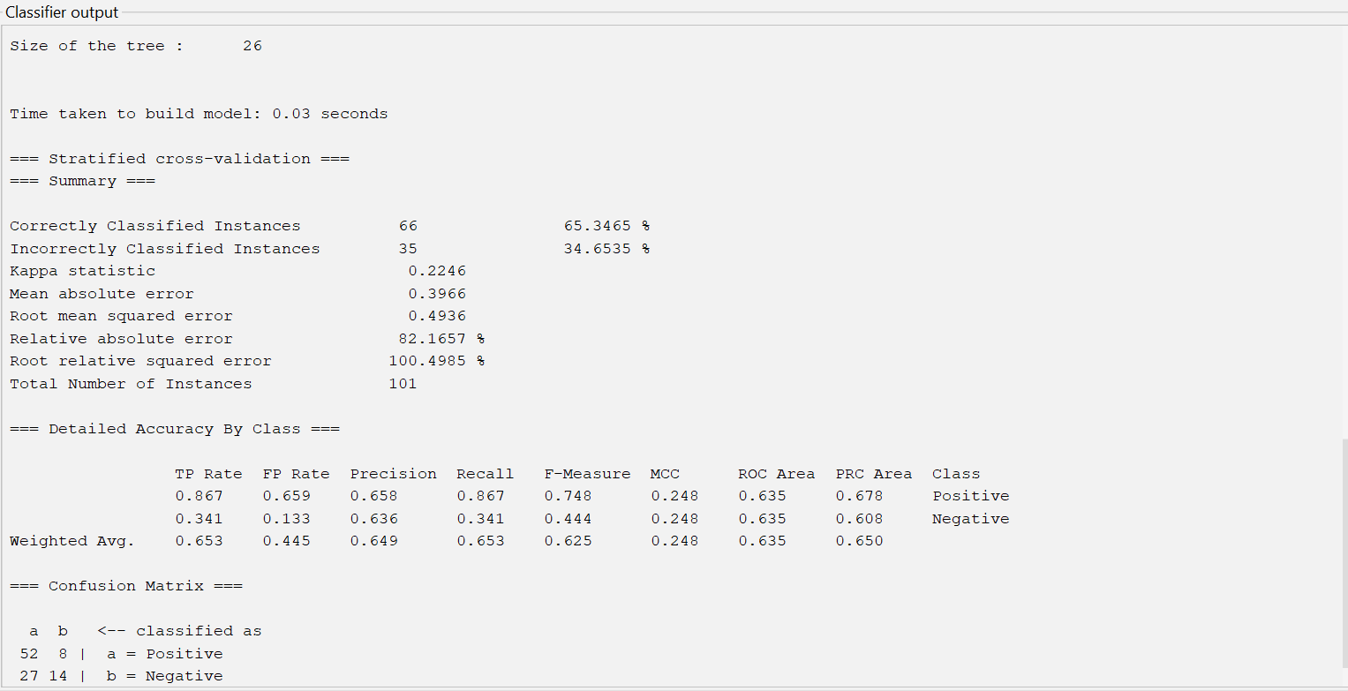
Results from WEKA tool:
Decision tree results

Slide 11
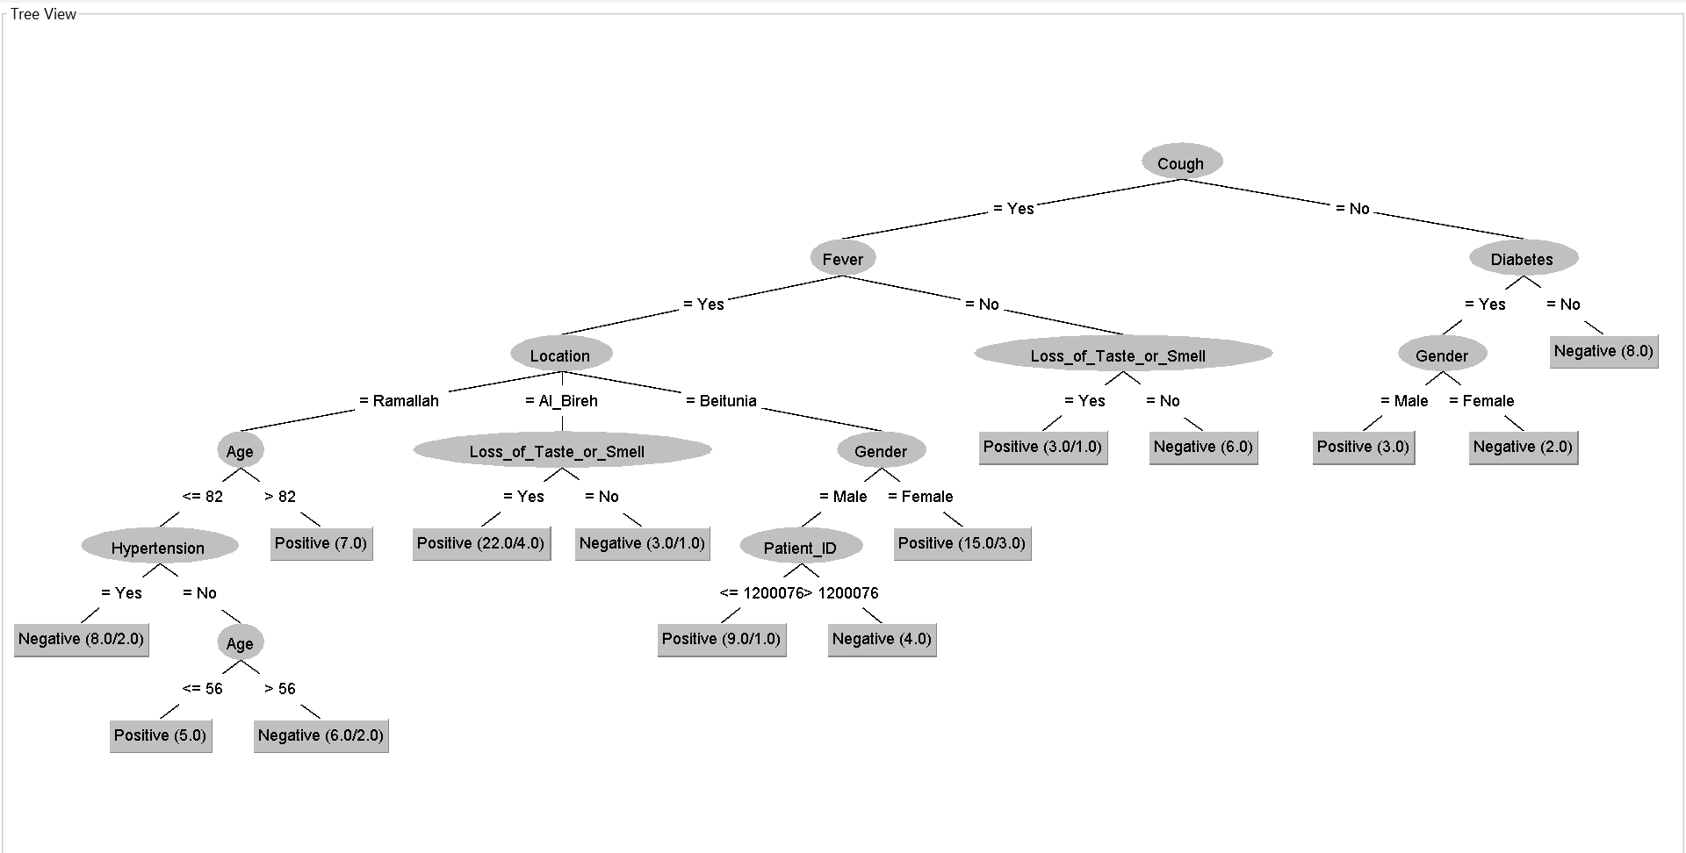

Slide 12
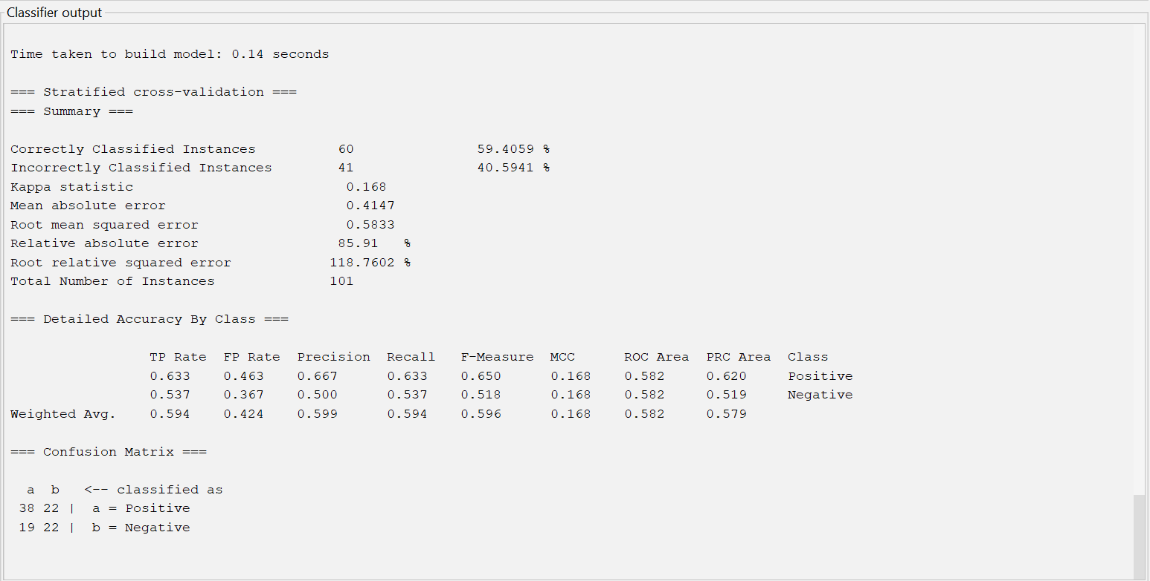
ANN results

Slide 13
Thanks for listening
Hope you enjoy

