Slide 1

Introduction to ML and MLOPS
By Ehtisham Raza -05-March

Slide 2

About Speaker
AI/ML Engineer working in a FinTech over the experience of 3+ years. Developing Machine Learning solutions for business. Providing Tech trainings to people around the world.

Slide 3
AGENDA
Introduction to Machine Learning
Types of Machine Learning
Applications of Machine Learning
Implementation of Machine Learning
Introduction to MLOPS
Applications of MLOPS

Slide 4
What is Machine Learning
Machine Learning is the science (and art) of programming computers so that they can learn from data.
For example a spam filter in a Machine Learning program that can learn to flag the spam given examples of spam emails(e.g flagged by users) and examples of regular (nonspam also called “ham”)emails. The examples that the system uses to learn are called the training set. Each training example is called a training instance. In this case the task T is to flag spam for new emails, the experience E is the training data, and performance measure need P to be defined; for example, you can use the ratio to define the correctly classified emails. The particular performance measure is called accuracy and it is often used is classification tasks.

Slide 5
Why Use Machine Learning?
Consider how would you write a spam filter using traditional programming techniques:
First, you would look at what spam typically looks like. You might notice that some words or phrases (such as “4U”, “credit card” , “free” and “amazing”) tend to come up a lot in the subject. Perhaps you also notice a few other patterns in the sender’s name, the email body, and so on.
You would write a detection algorithm for each of the patterns that you noticed and your program would flag emails as spam if a number of these patterns are detected.
You would test your program and repeats the above steps until the spam is detected.

Slide 6
Types of Machine Learning
System learns from labeled data
01
SUPERVISED LEARNING
02
System learns from unlabeled data
UNSUPERVISED LEARNING
System learns from partial labeled data
03
SEMI SUPERVISED LEARNING
System learns by interacting with environment
04
REINFORCEMENT LEARNING

Slide 7
Supervised Learning
In supervised learning, the training data you feed to the algorithm includes the desired solution called labels.
First, you would look at what spam typically looks like. You might notice that some words or phrases (such as “4U”, “credit card” , “free” and “amazing”) tend to come up a lot in the subject. Perhaps you also notice a few other patterns in the sender’s name, the email body, and so on.
You would write a detection algorithm for each of the patterns that you noticed and your program would flag emails as spam if a number of these patterns are detected.
You would test your program and repeats the above steps until the spam is detected.

Slide 8
Un-Supervised Learning
In unsupervised learning, as you might guess the data is unlabeled and the system tries to learn without a teacher
For example, you have a lot of data about blog visitors. You may want to run a clustering algorithm to try to predict the group of similar readers. At no point do you tell the algorithm which group a visitor belongs. It finds the connection between similar readers without your help. For example, it might notice 40% of your visitors are male who loves the comic books and generally read about your blog in the evening, while 20% are young sci-fi lovers who visit during the weekends and so on. If you use a hierarchical clustering algorithm you can easily divide the sub-groups.

Slide 9
Semi-supervised learning
Some algorithms can deal with partially labeled training data, usually a lot of unlabeled data and a little bit labeled data. This is called semisupervised learning.
Some photo-hosting services such as Google Photos are a good example of this. Once you upload all your family photos to the service, it automatically recognizes that the same person A shown up in photos 1, 5, and 11, while another person B shows up in photos 2,5 and 7. This is unsupervised part of the algorithm clustering. Now all the systems need is for you to tell it who these people are. Just label on photo per person and it is able to name everyone in the photo which is useful for searching for photos.

Slide 10
Reinforcement Learning
Reinforcement Learning is a very different beast. The learning system called an agent in this context, can observe the environment, select and perform actions and get rewards in return or penalties in the form of the negative rewards. It must learn then by itself what is the best strategy called a policy, to get the most reward over time. A policy defines what action the agent should choose when it is in a given solution.

Slide 11
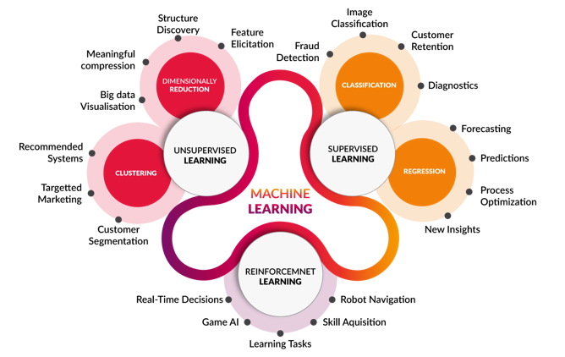
Applications of ML

Slide 12
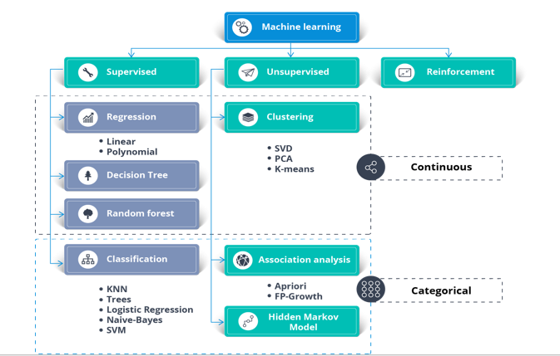
Layout of ML

Slide 13
What is MLOps?
Machine Learning Operations involves a set of processes or rather a sequence of steps implemented to deploy an ML model to the production environment. There are several steps to be undertaken before an ML Model is production-ready. These processes ensure that your model can be scaled for a large user base and perform accurately.

Slide 14
Why do we need MLOps?
Creating an ML model that can predict what you want it to predict from the data you have fed is easy. However, creating an ML model that is reliable, fast, accurate, and can be used by a large number of users is difficult.

Slide 15
Importance of MLOPs
The necessity of MLOps can be summarized as follows:
ML models rely on a huge amount of data, difficult for a single person to keep track of.
Difficult to keep track of parameters we tweak in ML models. Small changes can lead to enormous differences in the results.
We have to keep track of the features the model works with, feature engineering is a separate task that contributes largely to model accuracy.
Monitoring an ML model isn’t like monitoring a deployed software or web app.
Debugging an ML model is an extremely complicated art
Models rely on real-world data for predicting, as real-world data changes, so should the model. This means we have to keep track of new data changes and make sure the model learns accordingly.

Slide 16
ANY QUESTIONS?

Slide 17
THANK YOU

