Slide 1

Industrial Applications of Machine Learning and Future Trends
The Rising Science

Slide 2
Agenda
01
Introduction to Machine Learning
02
Types of Machine Learning
03
Industrial Applications of Machine Learning
04
Future Trends of Machine Learning

Slide 3




Ehtisham Raza
I am AI/ML Engineer working in a FinTech having 3+ years of experience and solving financial problems using artificial intelligence and machine learning.
Ehtisham Raza
AI/ML Engineer at Finja
Data Trainer & Coach at AnalystsHQ
Ehtisham Raza

Slide 4
What is Machine Learning?

Slide 5
What is Machine Learning?

Slide 6

Machine Learning A set of automatic learning methods
Machine Learning
Scientific study of algorithms and statistical models that computer systems use to effectively perform a specific task without using explicit instructions, relying on patterns and inference instead

Slide 7
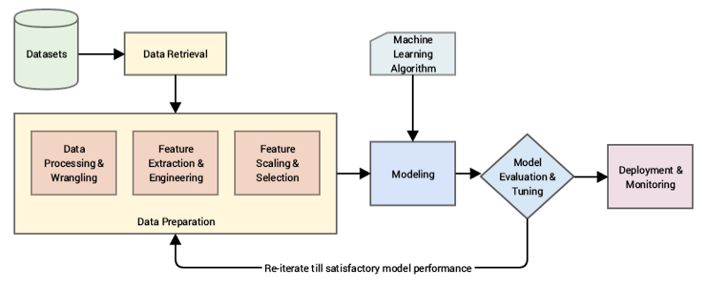
Machine Learning - ML
Instead of writing code, you feed data to the generic algorithm, and it builds logic based on the data given
Machine Learning can do:
Classification tasks: Dividing the given data into predefined groups
Regression tasks: Prediction of target value based on input values
Clustering: Making unspecified groups of data

Slide 8
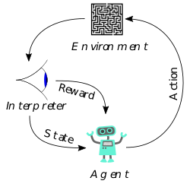
Types of machine learning
Interpreter
Supervised ML
Unsupervised ML
Reinforcement Learning
Give input to designed algorithm
Give required output to algorithm
Define the way to extract features
Predict the output based on features
Compare the predicted output with actual output
Fine tune the model
Give input to designed algorithm
Give required output to algorithm
Define the way to extract features
Predict the output based on features
Compare the predicted output with actual output
Fine tune the model
Agent learns how to behave
By performing actions
Getting rewards to decide about further actions

Slide 9
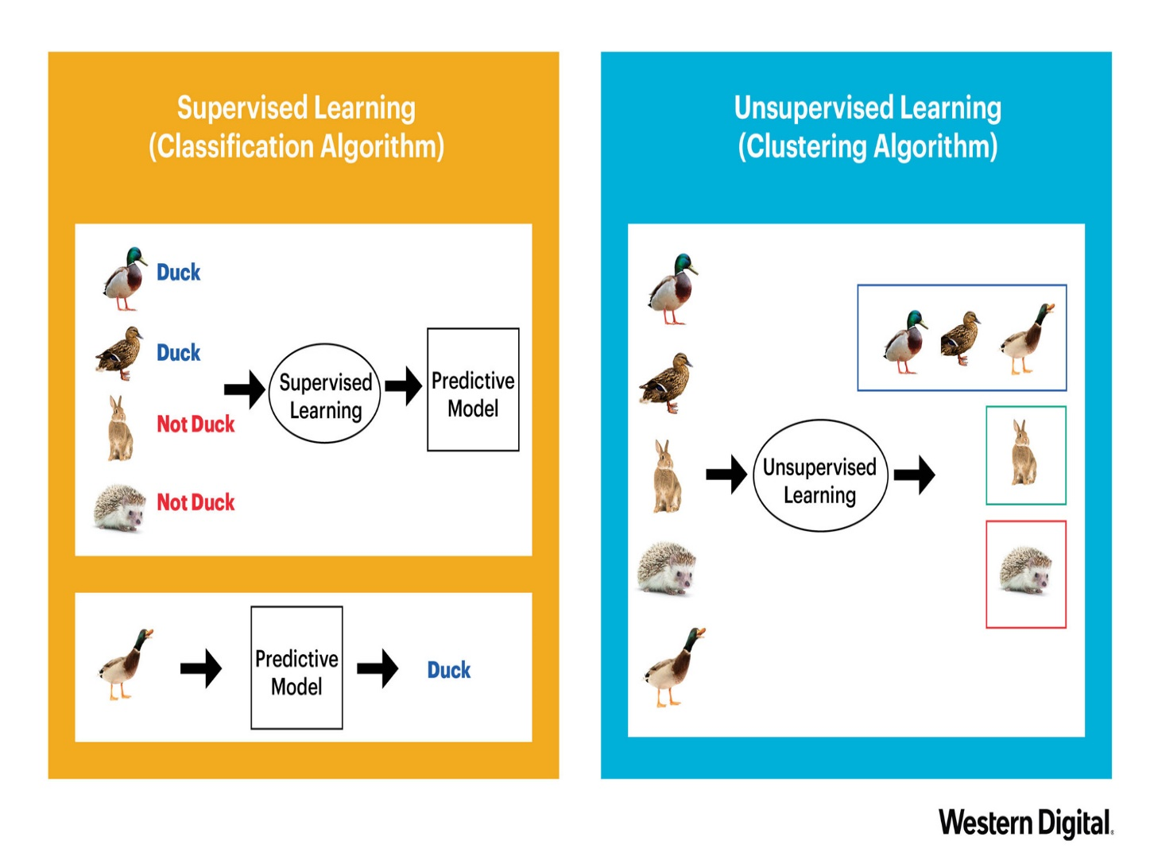
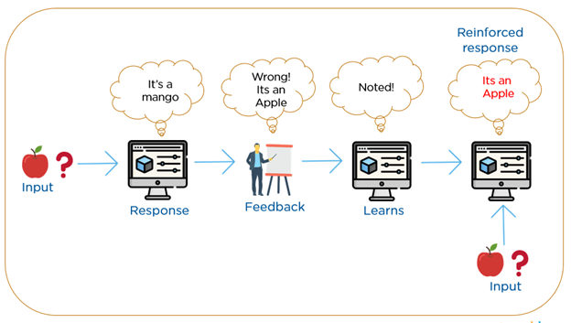
Types of Machine Learning

Slide 10
Machine Learning Phases
Training:
Algorithm is given training data to find patterns and values of parameters
Match the predicted output with actual output and find loss
Tune itself to minimize the loss
Once algorithm parameters are found, algorithm is trained
Validation:
Algorithm is given validation data to find patterns and values of parameters
Match the predicted output with actual output and find loss
Tune itself to minimize the loss
Once algorithm parameters are found, algorithm is trained
Test:
Algorithm is given test data to find patterns and values of parameters and find predictions
Match the predicted output with actual output and find loss
Tune itself to minimize the loss
Once algorithm parameters are found, algorithm is trained

Slide 11
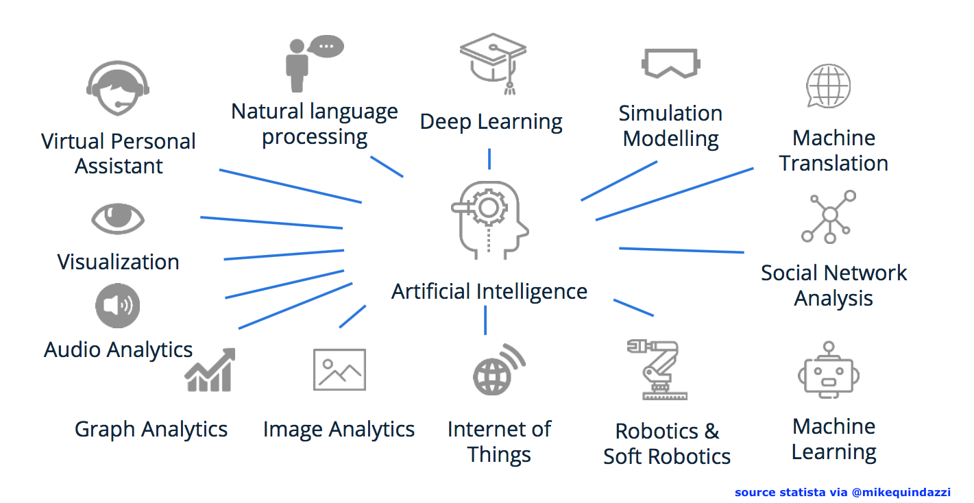
Applications of Machine Learning

Slide 12
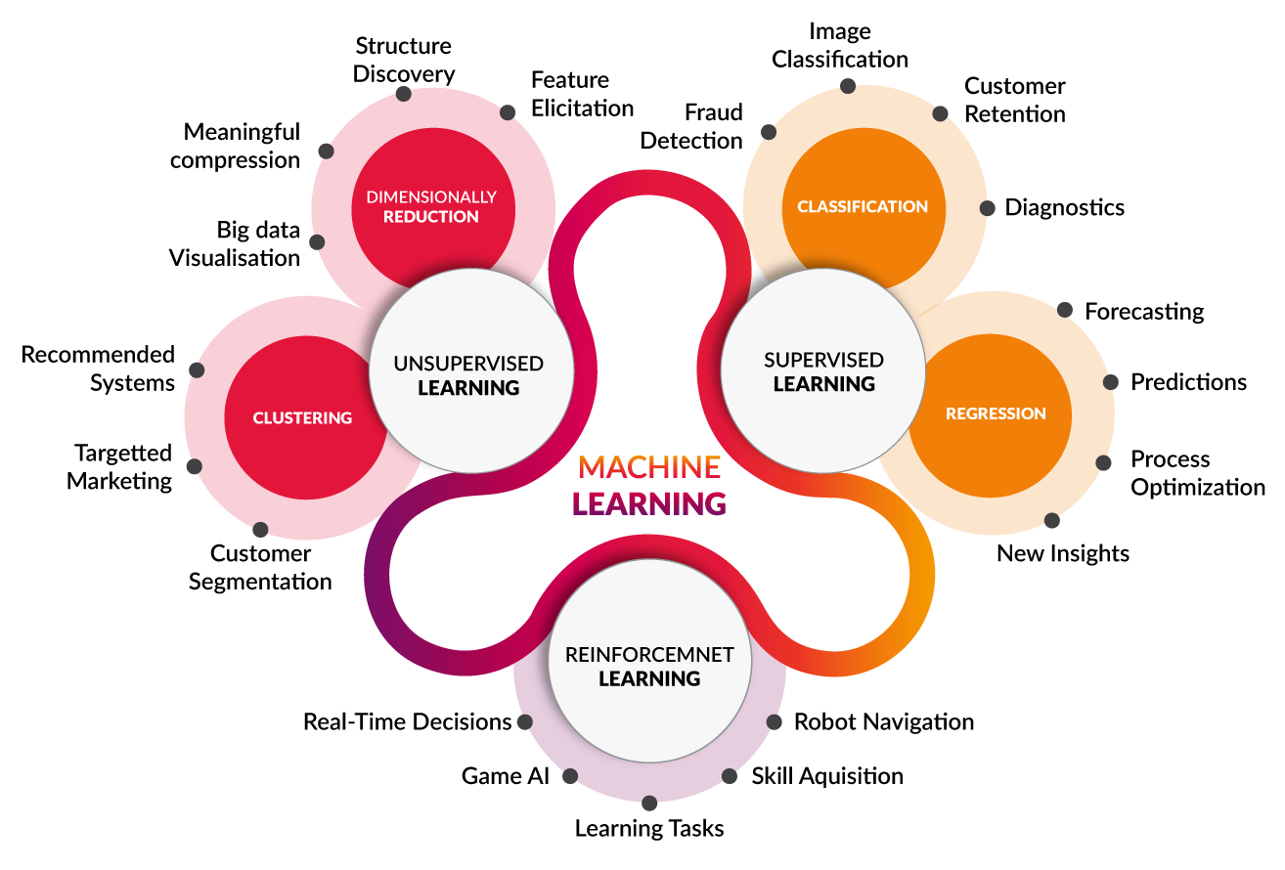
Application Areas of ML

Slide 13
Industrial Applications of ML
Supply Chain Optimization
Autonomous Vehicles and Robotics
Fraud Detection
Customer Support and Chatbots
Predictive Analytics
Healthcare System
Agriculture Sector

Slide 14
ML In Supply Chain
Demand Prediction: Machine learning models can analyze historical sales data, market trends, and external factors to predict future demand for products. This helps in optimizing stock levels to meet demand without overstocking or understocking.
Inventory Management: ML Algorithms can optimize inventory levels by considering factors like lead times, supplier performance and production schedules. This ensure the right amount of stock is available at the right time.
Seasonal and Trend Analysis: Machine learning can identify seasonal patterns and trends in sales data, helping businesses adjust their stock levels accordingly to avoid shortages during peak demand periods.
Risk Management: ML models can assess the risks associated with stock optimization decisions, considering factors like economic conditions, geopolitical events, and supplier reliability.
Customer Segmentation: By employing ML techniques, businesses can segment their customer base and adjust stock levels to cater to the varying demands of different customer groups.

Slide 15
ML In Robotics and Vehicles
Robotics
Perception and Sensing: Machine learning is used to process sensor data from cameras, LiDAR (Light Detection and Ranging), ultrasonic sensors, and other sources to perceive and understand the robot's environment. This helps the robot navigate, avoid obstacles, and interact with objects in its surroundings.
Object Recognition and Manipulation: ML algorithms enable robots to recognize and classify objects, making it possible for them to pick up, manipulate, and interact with various items in complex and unstructured environments.
Simultaneous Localization and Mapping (SLAM): ML algorithms help robots build maps of unknown environments while simultaneously determining their own position within these maps, allowing them to navigate in unfamiliar surroundings.
Task and Motion Planning: ML algorithms enable robots to plan and execute sequences of actions to complete complex tasks efficiently.

Slide 16
ML In Robotics and Vehicles
Autonomous Vehicles
Perception and Object Detection: ML algorithms process data from cameras, LiDAR, radar, and other sensors to detect and recognize objects on the road, such as vehicles, pedestrians, and traffic signs.
Semantic Segmentation: ML is used for semantic segmentation to categorize different regions in the scene, allowing the vehicle to better understand its environment.
Path Planning and Decision-Making: Machine learning is used to plan safe and efficient routes for autonomous vehicles and make real-time driving decisions based on the environment and traffic conditions.

Slide 17
ML In Fraud Detection
Anomaly Detection: Machine learning algorithms can identify unusual patterns and outliers in transaction data, account activities, or user behavior, flagging them as potential fraud cases.
Transaction Monitoring: ML models continuously analyze transaction data, looking for suspicious activities based on historical patterns and customer behavior.
Identity Verification: ML techniques can verify the identity of users through various methods, such as biometrics, device fingerprinting, and behavioral analysis, to prevent account takeover fraud.
Pattern Recognition: Machine learning algorithms can detect specific patterns associated with known fraud cases, enabling early detection and prevention of similar fraudulent activities.
Credit Card Fraud Detection: ML is widely used in credit card fraud detection to identify unauthorized transactions or abnormal spending patterns.

Slide 18
ML In Customer Support
Chatbots and Virtual Assistants: ML-powered chatbots and virtual assistants can handle customer inquiries 24/7, providing instant responses to common questions, guiding users through troubleshooting processes, and escalating complex issues to human agents when necessary.
Natural Language Processing (NLP): NLP-based ML models analyze customer queries to understand the intent, sentiment, and context behind the messages, enabling more accurate and relevant responses.
Automated Ticket Routing: Machine learning can automatically categorize and route support tickets to the most appropriate department or agent based on the content of the ticket, reducing response times and ensuring faster issue resolution.
Customer Churn Prediction: ML models can predict which customers are at a higher risk of churning based on their behavior and interactions, enabling companies to take proactive measures to retain valuable customers.
Speech Recognition: ML-based speech recognition systems can transcribe and analyze phone calls or voicemails, assisting agents in understanding customer issues more effectively.

Slide 19
ML In Predictive Analytics
Sales Forecasting: ML models can analyze historical sales data, market trends, and other relevant factors to predict future sales, enabling businesses to plan inventory, production, and marketing strategies accordingly.
Customer Churn Prediction: Machine learning can analyze customer behavior and engagement patterns to predict which customers are likely to churn, allowing companies to take proactive measures to retain them.
Financial Market Predictions: ML algorithms can analyze historical market data and economic indicators to predict stock prices, currency exchange rates, and other financial trends.
Maintenance and Downtime Prediction: ML can analyze sensor data from industrial equipment and machinery to predict potential failures or maintenance needs, allowing companies to schedule maintenance proactively and reduce downtime.
Marketing Campaign Effectiveness: ML models can predict the success of marketing campaigns by analyzing historical campaign data, customer behavior, and market trends.

Slide 20
ML In Predictive Analytics
Sales Forecasting: ML models can analyze historical sales data, market trends, and other relevant factors to predict future sales, enabling businesses to plan inventory, production, and marketing strategies accordingly.
Customer Churn Prediction: Machine learning can analyze customer behavior and engagement patterns to predict which customers are likely to churn, allowing companies to take proactive measures to retain them.
Financial Market Predictions: ML algorithms can analyze historical market data and economic indicators to predict stock prices, currency exchange rates, and other financial trends.
Maintenance and Downtime Prediction: ML can analyze sensor data from industrial equipment and machinery to predict potential failures or maintenance needs, allowing companies to schedule maintenance proactively and reduce downtime.
Marketing Campaign Effectiveness: ML models can predict the success of marketing campaigns by analyzing historical campaign data, customer behavior, and market trends.

Slide 21
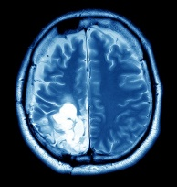

ML In Healthcare
Medical Image Analysis: ML algorithms can analyze medical images such as X-rays, MRI scans, and CT scans to assist in diagnosing diseases, identifying tumors, and detecting anomalies.
Image Acquisition & Data Collection
Preprocessing
Segmentation and Classification
ML Model Definition
Optimization
Performance Evaluation

Slide 22
ML In Healthcare
Medical Image Analysis: ML algorithms can analyze medical images such as X-rays, MRI scans, and CT scans to assist in diagnosing diseases, identifying tumors, and detecting anomalies.
Disease Diagnosis and Prognosis: Machine learning models can analyze patient data and medical records to aid in the early diagnosis of diseases and predict disease progression and outcomes.
Drug Discovery and Development: ML is used to analyze chemical compounds and identify potential drug candidates, expediting the drug discovery process and reducing development costs.
Healthcare Chatbots: ML-powered chatbots and virtual assistants can provide personalized healthcare information, answer patient questions, and offer medical advice.

Slide 23
ML In Agriculture Sector
Crop Yield Prediction: ML models can analyze historical and real-time data on weather, soil conditions, and farming practices to predict crop yields. This helps farmers optimize resource allocation and plan for efficient harvests.
Precision Agriculture: ML-powered sensors and drones can collect data on soil moisture, nutrient levels, and crop health, enabling farmers to apply fertilizers and irrigation precisely where needed, reducing waste and improving crop yield.
Crop Disease Detection: ML algorithms can analyze images of crops to identify signs of diseases, pests, or nutrient deficiencies, allowing farmers to take timely actions and prevent potential crop losses.
Automated Pest Detection and Management: ML can identify and classify pests and insects based on images, enabling farmers to implement targeted and eco-friendly pest control strategies.

Slide 24
Thank You

