Slide 1


S C H O O L O F E N G I N E E R I N G & T E C H N O L O G Y
D E P A R T M E N T O F C O M P U T E R S C I E N C E A N D APPLICATIONS
MCA Final Year Project
IMAGE-TRUTH
Presented By
RISHI KUMAR SAINI
RISHAB SHUKLA
Under Supervision of
Mr. Arshad Ali

Slide 2
S C H O O L O F E N G I N E E R I N G & T E C H N O L O G Y
D E P A R T M E N T O F C O M P U T E R S C I E N C E A N D APPLICATIONS
INTRODUCTION
Image truth is said to be a project which is generally based on the concepts of key technologies and methods which makes it reach to a perfect accomplishment.
It generally uses artificial intelligence techniques and deep learning concepts. As it runs with machine learning.
According to the given features ‘Image-Truth’ helps to provide the real image of the image if it is edited or having the shifts that says fraud generally people do scams over the social media platforms by giving fake images of the things which got viral and make many kinds of situationary act.
Our project helps to provide the detection of image and then it also consist the ability to provide the real face of image without a glitch.

Slide 3
S C H O O L O F E N G I N E E R I N G & T E C H N O L O G Y
D E P A R T M E N T O F C O M P U T E R S C I E N C E A N D APPLICATIONS
MOTIVATION
We got motivated with the social media terms like Instagram,facebook,YouTube etc.
As they represents many things which seems to be unreal or fake even some edits are such effective that makes people believe on it so as per the seen what’s the real face is all about we need a platform that can help to provide reality and let people aware of fake news and scams.
This mentality lead to us make a featured thing which we have given a name IMAGE-TRUTH.

Slide 4
S C H O O L O F E N G I N E E R I N G & T E C H N O L O G Y
D E P A R T M E N T O F C O M P U T E R S C I E N C E A N D APPLICATIONS
OBJECTIVES
Here are five key objectives for IMAGE-TRUTH as follows:-
Develop Robust Detection Algorithms
Create AI-driven models that can accurately differentiate between real and manipulated images by analyzing inconsistencies in textures, lighting, facial distortions, and metadata.
Enhance Generalization Across Deepfake Techniques
Train machine learning models to recognize various deepfake generation methods, ensuring adaptability to new and evolving deepfake techniques.
Improve Real-Time Detection Capabilities
Optimize detection algorithms to work in real-time, enabling platforms and individuals to quickly identify and flag deepfake images before they spread.
Integrate AI-Based Watermarking and Authentication
Develop AI-driven watermarking and authentication methods to embed and verify the authenticity of images, preventing unauthorized manipulation.
Increase Public Awareness and Defense Strategies
Utilize AI to assist in educating users about deepfake threats, improving digital literacy, and providing tools for individuals and organizations to verify image authenticity.

Slide 5
S C H O O L O F E N G I N E E R I N G & T E C H N O L O G Y
D E P A R T M E N T O F C O M P U T E R S C I E N C E A N D APPLICATIONS
OBJECTIVES
Here are five key objectives for IMAGE-TRUTH as follows:-
Develop Robust Detection Algorithms
Create AI-driven models that can accurately differentiate between real and manipulated images by analyzing inconsistencies in textures, lighting, facial distortions, and metadata.
Enhance Generalization Across Deepfake Techniques
Train machine learning models to recognize various deepfake generation methods, ensuring adaptability to new and evolving deepfake techniques.
Improve Real-Time Detection Capabilities
Optimize detection algorithms to work in real-time, enabling platforms and individuals to quickly identify and flag deepfake images before they spread.
Integrate AI-Based Watermarking and Authentication
Develop AI-driven watermarking and authentication methods to embed and verify the authenticity of images, preventing unauthorized manipulation.
Increase Public Awareness and Defense Strategies
Utilize AI to assist in educating users about deepfake threats, improving digital literacy, and providing tools for individuals and organizations to verify image authenticity.

Slide 6
S C H O O L O F E N G I N E E R I N G & T E C H N O L O G Y
D E P A R T M E N T O F C O M P U T E R S C I E N C E A N D APPLICATIONS
EXPECTED OUTCOMES
in Our ImageTruth project, several key technologies and methods are being used:1. Deep Learning & AI : - TensorFlow framework - Keras for model loading - Pre-trained deep learning model for image analysis
2. Image Processing : - PIL (Python Imaging Library) for image handling - OpenCV (cv2) for image processing - Image preprocessing techniques: - Resizing (96x96 pixels) - Normalization (scaling pixel values to 0-1) - Array manipulation with NumPy
3. Web Application Framework : - Streamlit for the user interface - Interactive components: - File uploader - Progress bars - Dynamic tables - Sliders and checkboxes - Download buttons
4. Data Handling : - NumPy for numerical operations - Binary classification (Real/Fake) - Confidence score calculation - Report generation
5. User Interface Features : - Responsive layout - Real-time analysis - Visual feedback (progress bars, colored alerts) - Interactive components - Downloadable reports6. Model Architecture : - Binary classification model - Confidence threshold settings - Pre-trained weights (stored in .h5 format)
This whole procedures are our predictions about the expectation we can consume over the running of IMAGE-TRUTH.

Slide 7
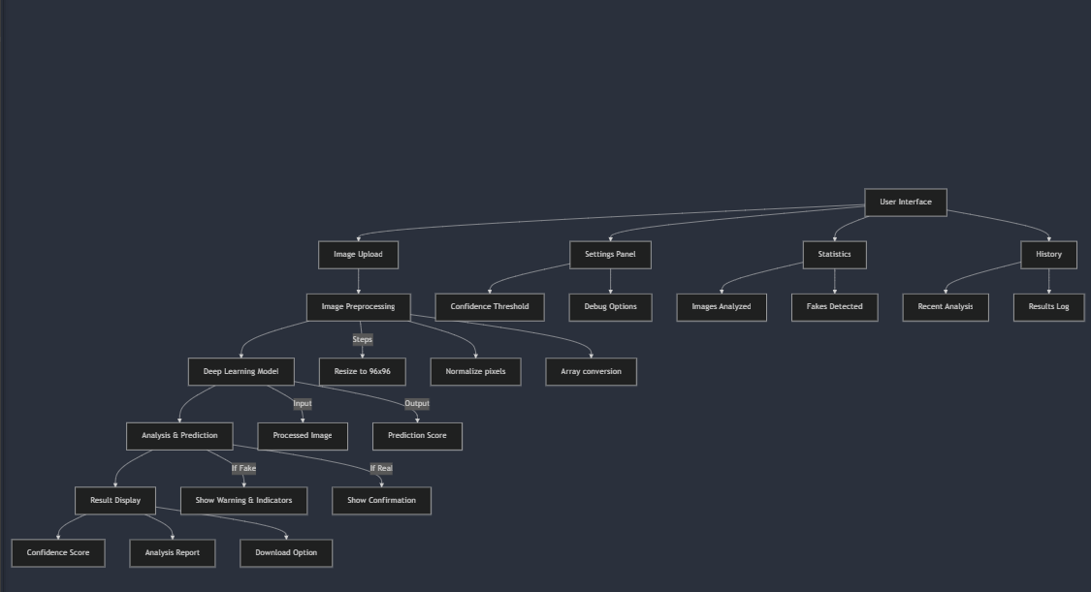
S C H O O L O F E N G I N E E R I N G & T E C H N O L O G Y
D E P A R T M E N T O F C O M P U T E R S C I E N C E A N D APPLICATIONS
PROGRESS

Slide 8
S C H O O L O F E N G I N E E R I N G & T E C H N O L O G Y
D E P A R T M E N T O F C O M P U T E R S C I E N C E A N D APPLICATIONS
REFERENCES
Deep Learning & AI Frameworks-
TensorFlow: https://www.tensorflow.org/-
Keras: https://keras.io/-
OpenCV: https://opencv.org/-
Web Application Framework- Streamlit: https://streamlit.io/-
Streamlit Documentation: https://docs.streamlit.io/-
Image Processing Libraries- PIL (Python Imaging Library): https://python-pillow.org/-
NumPy: https://numpy.org/-
Research Papers on Deepfake Detection- "MesoNet: a Compact Facial Video Forgery Detection Network"- "DeepFake Detection Using Spatiotemporal Convolutional Networks"- "FaceForensics++: Learning to Detect Manipulated Facial Images"- Development Tools- Git
: https://git-scm.com/-
Python: https://www.python.org/-
Additional Resources- Face Detection: https://github.com/opencv/opencv/wiki/Face-Detection-using-OpenCV- Image Preprocessing: https://scikit-image.org/-

Slide 9
S C H O O L O F E N G I N E E R I N G & T E C H N O L O G Y
D E P A R T M E N T O F C O M P U T E R S C I E N C E A N D APPLICATIONS
THANK YOU

