Slide 1
Little Intro
Raza Ul Mustafa, PhD - Computer Engineering
Research areas: NLP, Video, Quality of Experience, Quality of Service, Machine & Deep Learning
Publications - 20 + → Languages used in my papers: Python :)
Main Courses of Interests: Programming
Python, Web-programming, C/C++, Linux
Worked & Working on Research Projects: 3+

Slide 2
Books
The primary text for this course is a freely available online textbook called Think Python: How to Think like a Computer Scientist.
We will be using the interactive version of the text that is available through Runestone Academy at https://runestone.academy.

Slide 3
Outline of course - Main topics
Variables & Operations
Strings & Numbers
Functions
Conditions / If/Elif/Else
Iterations – Very Important
Lists, Dictionaries, Tuples – Important in Python
Recursion, Sorting
OOP – Very important in all languages

Slide 4
Chapter 1

Slide 5
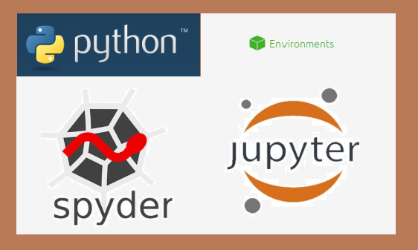
Software to Install
Anaconda & Spyder
Windows Installation - https://docs.anaconda.com/free/anaconda/install/windows/
Mac Installation - https://docs.anaconda.com/free/anaconda/install/mac-os/
Linux - https://docs.anaconda.com/free/anaconda/install/linux/

Slide 6
First program
print("Hello, World!")

Slide 7

The way of program
The single most important skill for a computer scientist is problem solving
A program is a sequence of instructions that specifies how to perform a computation.

Slide 8
Algorithms
If problem solving is a central part of computer science, then the solutions that you create through the problem solving process are also important.
In computer science, we refer to these solutions as algorithms.
An algorithm is a step by step list of instructions that if followed exactly will solve the problem under consideration.
Our goal in computer science is to take a problem and develop an algorithm that can serve as a general solution

Slide 9
The python programming languages
Python is an example of a high-level language; other high-level languages you might have heard of are C++, PHP, and Java.
High Level Languages: and is designed to reflect the requirements of a problem
Low Level Languages: They are also called machine-level languages. 0101

Slide 10
Advantages of high level languages
First, it is much easier to program in a high-level language.
Programs written in a high-level language take less time to write, they are shorter and easier to read, and they are more likely to be correct.
High-level languages are portable, meaning that they can run on different kinds of computers with few or no modifications.

Slide 11
Then who process the codes?
Two kinds of programs process high-level languages into low-level languages: interpreters and compilers.
Interpreters: An interpreter reads a high-level program and executes it, meaning that it does what the program says.
Compiler: A compiler reads the program and translates it completely before the program starts running.
In this case, the high-level program is called the source code, and the translated program is called the object code or the executable.

Slide 12
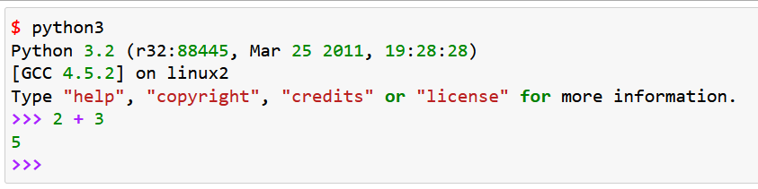
Python Interpreter (1/2)
There are two ways to use the Python interpreter: shell mode and program mode.
In shell mode, you type Python expressions into the Python shell, and the interpreter immediately shows the result. The example below shows the Python shell at work.

Slide 13
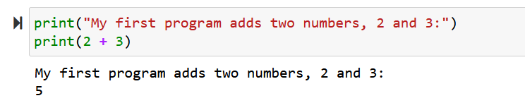
Python Interpreter (2/2)
Program mode: Alternatively, you can write an entire program by placing lines of Python instructions in a file and then use the interpreter to execute the contents of the file as a whole. Such a file is often referred to as source code.

Slide 14
Saving and extension
By convention, files that contain Python programs have names that end with .py.
Following this convention will help your operating system and other programs identify a file as containing python code.

Slide 15
What is debugging
Programming is a complex process. Since it is done by human beings, errors may often occur.
Programming errors are called bugs and the process of tracking them down and correcting them is called debugging.
syntax errors,
runtime errors,
semantic errors.

Slide 16
Syntax errors
Python can only execute a program if the program is syntactically correct; otherwise, the process fails and returns an error message.
Syntax refers to the structure of a program and the rules about that structure
Example – Next slide

Slide 17
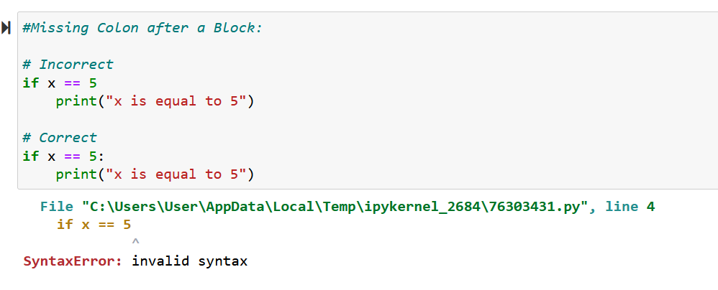
Syntax errors example

Slide 18
Runtime errors
The second type of error is a runtime error, so called because the error does not appear until you run the program.
These errors are also called exceptions because they usually indicate that something exceptional (and bad) has happened.

Slide 19
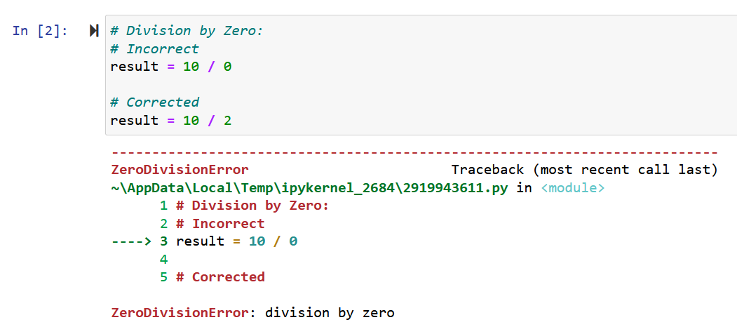
Runtime errors example

Slide 20
Semantic errors
The third type of error is the semantic error.
If there is a semantic error in your program, it will run successfully in the sense that the computer will not generate any error messages.
However, your program will not do the right thing. It will do something else. Specifically, it will do what you told it to do.

Slide 21
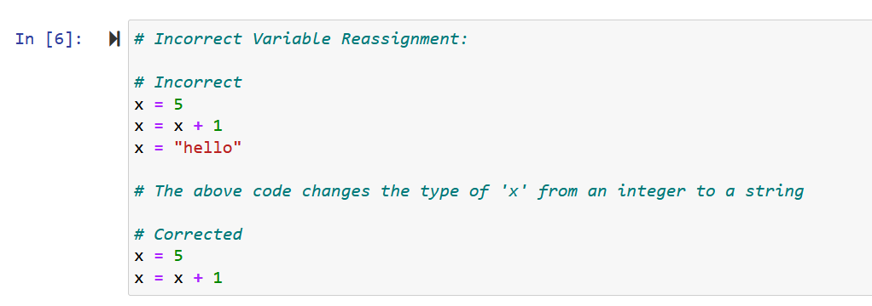
Semantic errors example

Slide 22
Experimental debugging
One of the most important skills you will acquire is debugging. Although it can be frustrating, debugging is one of the most intellectually rich, challenging, and interesting parts of programming.
Advice: Visualize

Slide 23
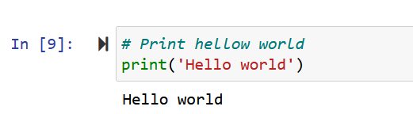
Comments in python
A comment in a computer program is text that is intended only for the human reader - it is completely ignored by the interpreter. In Python, the # token starts a comment. The rest of the line is ignored. Here is a new version of Hello, World!.

Slide 24
Chapter python notebook:
All material available on Canvas

