Slide 1
Chapter 10
Dr. Raza Ul Mustafa Khokhar
Dr. Raza Ul Mustafa Khokhar
American University
Computer Science Department - CSC-148

Slide 2
Lists
A list is a sequential collection of Python data values, where each value is identified by an index. The values that make up a list are called its elements
[10, 20, 30, 40] ["spam", "bungee", "swallow"]
["hello", 2.0, 5, [10, 20]]

Slide 3
Lists examples
vocabulary = ["iteration", "selection", "control"] numbers = [17, 123] empty = [] mixedlist = ["hello", 2.0, 5*2, [10, 20]] print(numbers) print(mixedlist) newlist = [ numbers, vocabulary ] print(newlist)

Slide 4
List length
As with strings, the function len returns the length of a list (the number of items in the list).
However, since lists can have items which are themselves lists, it important to note that len only returns the top-most length. In other words, sublists are considered to be a single item when counting the length of the list.
alist = ["hello", 2.0, 5, [10, 20]] print(len(alist)) print(len(['spam!', 1, ['Brie', 'Roquefort', 'Pol le Veq'], [1, 2, 3]]))

Slide 5
Accessing elements
numbers = [17, 123, 87, 34, 66, 8398, 44] print(numbers[2]) print(numbers[9 - 8]) print(numbers[-2]) print(numbers[len(numbers) - 1])

Slide 6
List membership
in and not in are boolean operators that test membership in a sequence. We used them previously with strings and they also work here.
fruit = ["apple", "orange", "banana", "cherry"] print("apple" in fruit) print("pear" in fruit)

Slide 7
Concatenation and Repetition
fruit = ["apple", "orange", "banana", "cherry"] print([1, 2] + [3, 4]) print(fruit + [6, 7, 8, 9]) print([0] * 4) print([1, 2, ["hello", "goodbye"]] * 2)

Slide 8
List slices
a_list = ['a', 'b', 'c', 'd', 'e', 'f'] print(a_list[1:3]) print(a_list[:4]) print(a_list[3:]) print(a_list[:])

Slide 9
Lists are mutable
fruit = ["banana", "apple", "cherry"] print(fruit) fruit[0] = "pear" fruit[-1] = "orange" print(fruit)

Slide 10
List deletion
The del statement removes an element from a list by using its position.
a = ['one', 'two', 'three'] del a[1] print(a) alist = ['a', 'b', 'c', 'd', 'e', 'f'] del alist[1:5] print(alist)

Slide 11
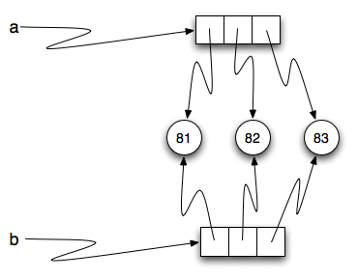
Object and references
a = [81, 82, 83] b = [81, 82, 83] print(a is b) print(a == b)
Notes:
a = [81, 82, 83] b = [81, 82, 83] print(a is b) print(a == b)
a= banna
b=banna
Here strings are immutable thats why same, but lists are mutable

Slide 12
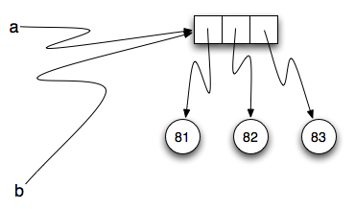
Aliasing
Since variables refer to objects, if we assign one variable to another, both variables refer to the same object:
a = [81, 82, 83] b = a print(a is b)

Slide 13
Repetitions and references
With a list, the repetition operator creates copies of the references.
origlist = [45, 76, 34, 55] print(origlist * 3)

Slide 14
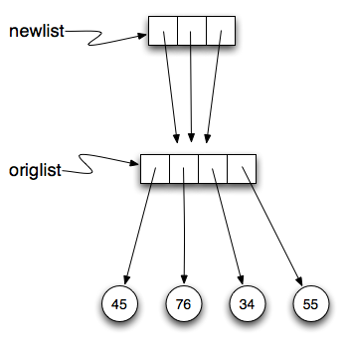
Repetitions and references cont…
origlist = [45, 76, 34, 55] print(origlist * 3) newlist = [origlist] * 3 print(newlist)
newlist is a list of three references to origlist that were created by the repetition operator.

Slide 15
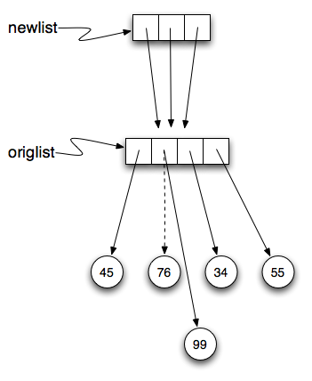
Repetitions and references cont…
origlist = [45, 76, 34, 55] newlist = [origlist] * 3 print(newlist) origlist[1] = 99 print(newlist)

Slide 16
List methods
mylist = [] mylist.append(5) mylist.append(27) mylist.append(3) mylist.append(12) print(mylist) mylist.insert(1, 12) # Insert 12 at pos 1, shift other items up print(mylist) print(mylist.count(12)) # How many times is 12 in mylist? print(mylist.index(3)) # Find index of first 3 in mylist print(mylist.count(5)) mylist.reverse() print(mylist) mylist.sort() print(mylist) mylist.remove(12) # Removes the first 12 in the list print(mylist) lastitem = mylist.pop() # Removes and returns the last item of the list print(lastitem) print(mylist)

Slide 17
Important to note !!!
It is important to remember that methods like append, sort, and reverse all return None. This means that re-assigning mylist to the result of sorting mylist will result in losing the entire list.
mylist = [] mylist.append(5) mylist.append(27) mylist.append(3) mylist.append(12) print(mylist) mylist = mylist.sort() #probably an error print(mylist)

Slide 18
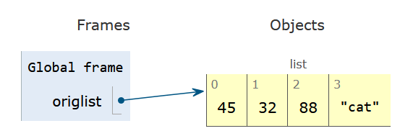
Append versus Concatenate
It is also important to realize that with append, the original list is simply modified. On the other hand, with concatenation, an entirely new list is created.
In order to use concatenation, we need to write an assignment statement that uses the accumulator pattern:
origlist = origlist + ["cat"]

Slide 19
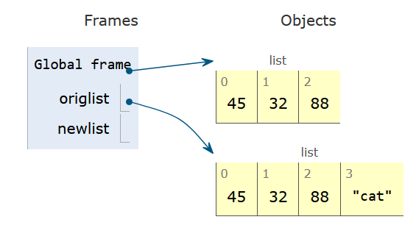
A new list in concatenation
newlist refers to a list which is a copy of the original list, origlist, with the new item “cat” added to the end. origlist still contains the three values it did before the concatenation. This is why the assignment operation is necessary as part of the accumulator pattern.

Slide 20
Lists and for loops
fruits = ["apple", "orange", "banana", "cherry"] for afruit in fruits: # by item print(afruit)
fruits = ["apple", "orange", "banana", "cherry"] for position in range(len(fruits)): # by index print(fruits[position])
Range

Slide 21
numbers = [1, 2, 3, 4, 5] print(numbers) for i in range(len(numbers)): numbers[i] = numbers[i] ** 2 print(numbers)
[1, 2, 3, 4, 5]
[1, 4, 9, 16, 25]

Slide 22
Names with length greater than 3?
long_names = 0 for name in ["Joe", "Sally", "Amy", "Brad"]: if len(name) > 3: long_names += 1 print(long_names)
https://shorturl.at/deirS

Slide 23
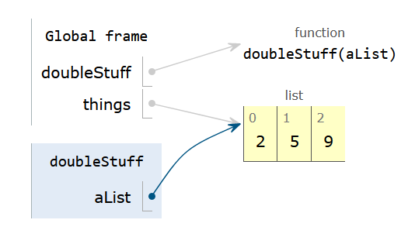
Very important ! Using list as a parameters
Passing a list as an argument actually passes a reference to the list, not a copy of the list. Since lists are mutable, changes made to the elements referenced by the parameter change the same list that the argument is referencing.
def doubleStuff(aList): """ Overwrite each element in aList with double its value. """ for position in range(len(aList)): aList[position] = 2 * aList[position] things = [2, 5, 9] print(things) doubleStuff(things) print(things)

Slide 24
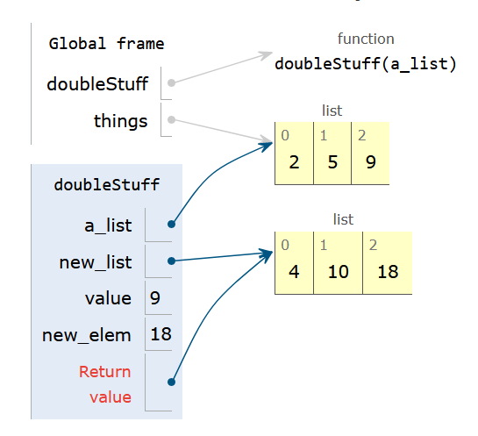
Pure function
def doubleStuff(a_list): """ Return a new list in which contains doubles of the elements in a_list. """ new_list = [] for value in a_list: new_elem = 2 * value new_list.append(new_elem) return new_list things = [2, 5, 9] print(things) things = doubleStuff(things) print(things)

Slide 25
List Comprehensions
[<expression> for <item> in <sequence> if <condition>]
mylist = [1,2,3,4,5] yourlist = [item ** 2 for item in mylist] print(yourlist)

Slide 26
Nested lists
nested = ["hello", 2.0, 5, [10, 20]] innerlist = nested[3] print(innerlist) item = innerlist[1] print(item) print(nested[3][1])

Slide 27
String & Lists
song = "The rain in Spain..." wds = song.split() print(wds)
song = "The rain in Spain..." wds = song.split() print(wds)

Slide 28
Inverse of split is join
The inverse of the split method is join
wds = ["red", "blue", "green"] glue = ';' s = glue.join(wds) print(s) print(wds) print("***".join(wds)) print("".join(wds))

Slide 29
list Type Conversion Function
Python has a built-in type conversion function called list that tries to turn whatever you give it into a list. For example, try the following:
xs = list("Crunchy Frog") print(xs)

Slide 30
Tuples and Mutability
In other words, strings are immutable and lists are mutable.
A tuple, like a list, is a sequence of items of any type. Unlike lists, however, tuples are immutable. Syntactically, a tuple is a comma-separated sequence of values. Although it is not necessary, it is conventional to enclose tuples in parentheses
julia = ("Julia", "Roberts", 1967, "Duplicity", 2009, "Actress", "Atlanta, Georgia")
julia[0] = 'X' TypeError: 'tuple' object does not support item assignment

Slide 31
Slice – New Tuple
julia = ("Julia", "Roberts", 1967, "Duplicity", 2009, "Actress", "Atlanta, Georgia") print(julia[2]) print(julia[2:6]) print(len(julia)) for field in julia: print(field) julia = julia[:3] + ("Eat Pray Love", 2010) + julia[5:] print(julia)

Slide 32
Important to note !
To create a tuple with a single element (but you’re probably not likely to do that too often), we have to include the final comma, because without the final comma, Python treats the (5) below as an integer in parentheses:
tup = (5,) print(type(tup)) x = (5) print(type(x))

Slide 33
Tuple Assignment
Python has a very powerful tuple assignment feature that allows a tuple of variables on the left of an assignment to be assigned values from a tuple on the right of the assignment.
(name, surname, birth_year, movie, movie_year, profession, birth_place) = julia
Naturally, the number of variables on the left and the number of values on the right have to be the same.
(a, b, c, d) = (1, 2, 3) ValueError: need more than 3 values to unpack

Slide 34
Tuples as a return value
Functions can return tuples as a return value
def circleInfo(r): """ Return (circumference, area) of a circle of radius r """ c = 2 * 3.14159 * r a = 3.14159 * r * r return (c, a) print(circleInfo(10))

Slide 35
Quiz 2:
→ Create a function that first sorts the list into two separate lists: integers and strings.
→ Then, it finds even numbers in the integers list and records their indices.
→ Finally, it returns the sorted integers, int list, strings list, even numbers, and their indices list with tuples.
For example: If you pass this list to your function:
my_list = [2, 8, 9, 1, 99, 101, 'CSC', 'BSC', 'Apple']
The output should be:
Sorted Integers: [1, 2, 8, 9, 99, 101]
([2, 8, 9, 1, 99, 101], ['CSC', 'BSC', 'Apple'], [(1, 2), (2, 8)]) → Even Number 2 and 8 is on Index 1 and 2
Hint: isinstance(j,int) or isinstance(j,str) is a function that return boolean result: True or False : Here j is your element in the list

Slide 36
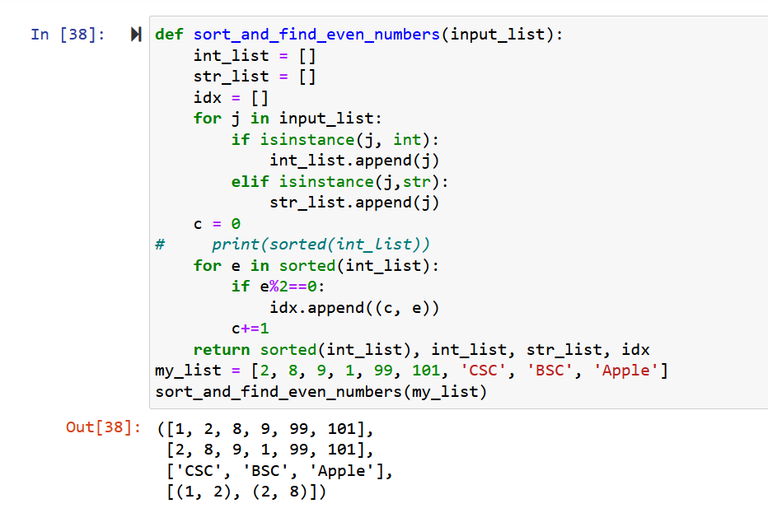
Solution Quiz 2:

Slide 37
Slides & Material
razaulmustafa.us/cs148/

