Slide 1
Chapter 11
Dr. Raza Ul Mustafa
American University
Computer Science Department - CSC-148

Slide 2
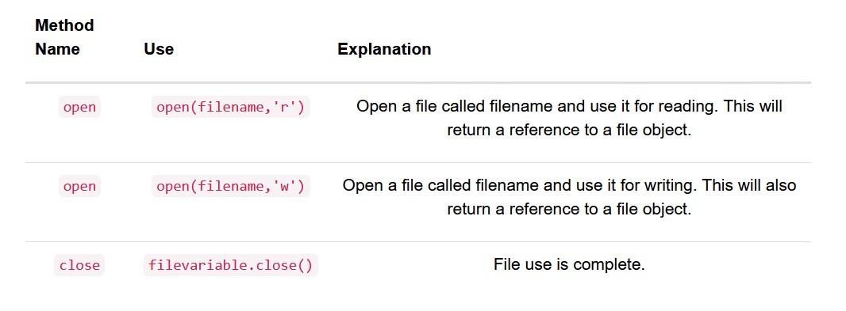
Working with Data Files
In Python, we must open files before we can use them and close them when we are done with them. As you might expect, once a file is opened it becomes a Python object just like all other data

Slide 3
Finding file in your disk
The way that files are located on disk is by their path You can think of the filename as the short name for a file, and the path as the full name.
For example on a Mac if you save the file hello.txt in your home directory the path to that file is /Users/yourname/hello.txt
On a Windows machine the path looks a bit different but the same principles are in use. For example on windows the path might be C:\Users\yourname\My Documents\hello.txt

Slide 4
Absolute path
if you had a file called hello.py in a folder called CS150 that is inside a folder called PyCharmProjects under your home directory, then the full name for the file hello.py is /Users/yourname/PyCharmProjects/CS150/hello.py. This is called an absolute file path.
A relative file path starts from the folder that contains your python program and follows a computer’s file hierarchy. A file hierarchy contains folders which contains files and other sub-folders.

Slide 5
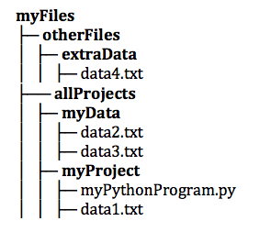
Example of relative paths
Using the example file hierarchy above, the program, myPythonProgram.py could access each of the data files using the following relative file paths:
data1.txt
../myData/data2.txt
../myData/data3.txt
../../otherFiles/extraData/data4.txt

Slide 6
Reading a file
Suppose we have a text file called ccdata.txt that contains the following data representing statistics about climate change
To open this file, we would call the open function. The variable, fileref, now holds a reference to the file object returned by open
fileref = open("ccdata.txt", "r") fileref.close()

Slide 7
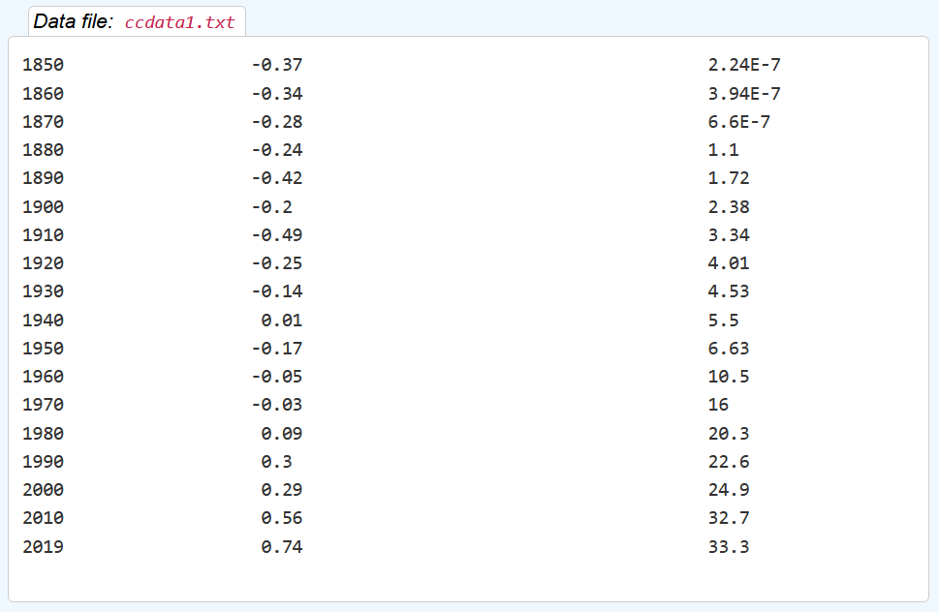
Text file content, download from online material

Slide 8
Read text file line by line
ccfile = open("ccdata.txt", "r") for aline in ccfile: values = aline.split() print('In', values[0], 'the average temp. was', values[1], '°C and CO2 emmisions were', values[2], 'gigatons.') ccfile.close()

Slide 9
Readfile using while loop?
infile = open("ccdata.txt", "r") line = infile.readline() while line: values = line.split() print('In', values[0], 'the average temp. was', values[1], '°C and CO2 emmisions were', values[2], 'gigatons.') line = infile.readline() infile.close()

Slide 10
Few other methods - What do you think they will do?
infile = open("ccdata.txt", "r") aline = infile.readline() print(aline) infile = open("ccdata.txt", "r") linelist = infile.readlines() print(len(linelist)) print(linelist[0:4]) infile = open("ccdata.txt", "r") filestring = infile.read() print(len(filestring))

Slide 11
Explanation of few methods
In addition to the for loop, Python provides three methods to read data from the input file.
The readline method reads one line from the file and returns it as a string. The string returned by readline will contain the newline character at the end. This method returns the empty string when it reaches the end of the file.
The readlines method returns the contents of the entire file as a list of strings, where each item in the list represents one line of the file.
It is also possible to read the entire file into a single string with read.

Slide 12
Writing text file
The only difference between opening a file for writing and opening a file for reading is the use of the 'w' flag instead of the 'r' flag as the second parameter.
infile = open("ccdata.txt", "r") outfile = open("emissiondata.txt", "w") aline = infile.readline() outfile.write("Year \tEmmision\n") while aline: items = aline.split() dataline = items[0] + '\t' + items[2] outfile.write(dataline + '\n') aline = infile.readline() infile.close() outfile.close()
Only taking two columns of the original txt file and then writing it to new file.

