Slide 1
Chapter 12
Dr. Raza Ul Mustafa Khokhar
Dr. Raza Ul Mustafa Khokhar
American University
Computer Science Department - CSC-148

Slide 2
Dictionaries
Strings, lists, and tuples — are sequential collections
This means that the items in the collection are ordered from left to right and they use integers as indices to access the values they contain
Dictionaries are a different kind of collection. They are Python’s built-in mapping type. A map is an unordered, associative collection. The association, or mapping, is from a key, which can be any immutable type, to a value, which can be any Python data object.

Slide 3
Examples
As an example, we will create a dictionary to translate English words into Spanish. For this dictionary, the keys are strings and the values will also be strings.
eng2sp = {} eng2sp['one'] = 'uno' eng2sp['two'] = 'dos' eng2sp['three'] = 'tres'
eng2sp = {'three': 'tres', 'one': 'uno', 'two': 'dos'}

Slide 4
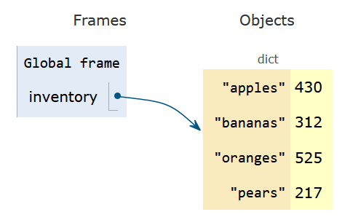
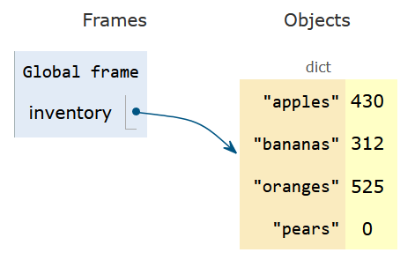
Mutable
Dictionaries are also mutable
inventory = {'apples': 430, 'bananas': 312, 'oranges': 525, 'pears': 217} inventory['pears'] = 0

Slide 5
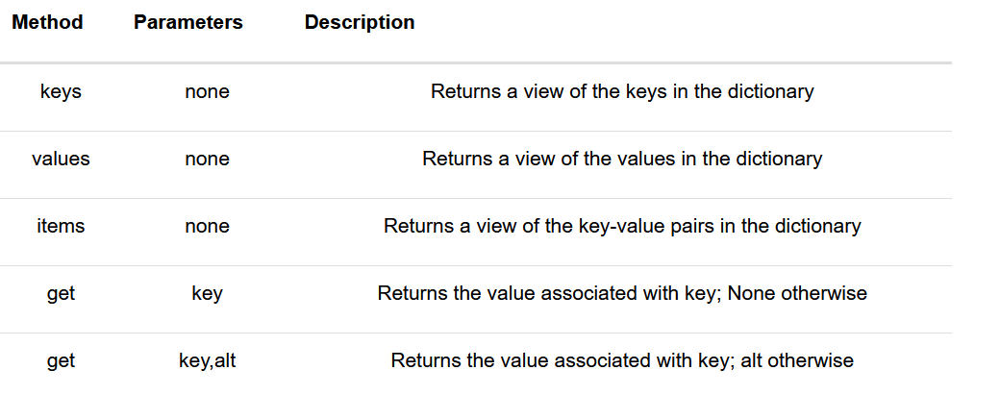
Dictionary Methods

Slide 6
Get keys – Make keys a list - Loop on Keys
inventory = {'apples': 430, 'bananas': 312, 'oranges': 525, 'pears': 217} for akey in inventory.keys(): print("Got key", akey, "which maps to value", inventory[akey]) ks = list(inventory.keys()) print(ks)

Slide 7
Values, Items and Keys
The values and items methods are similar to keys. They return view objects which can be turned into lists or iterated over directly. Note that the items are shown as tuples containing the key and the associated value.
inventory = {'apples': 430, 'bananas': 312, 'oranges': 525, 'pears': 217} print(list(inventory.values())) print(list(inventory.items())) for (k,v) in inventory.items(): print("Got", k, "that maps to", v) for k in inventory: print("Got", k, "that maps to", inventory[k])

Slide 8
The in and not in operators
The in and not in operators can test if a key is in the dictionary:
inventory = {'apples': 430, 'bananas': 312, 'oranges': 525, 'pears': 217} print('apples' in inventory) print('cherries' in inventory) if 'bananas' in inventory: print(inventory['bananas']) else: print("We have no bananas")

Slide 9
Get method - When there is no error if key is not present
The get method allows us to access the value associated with a key, similar to the [ ] operator.
The important difference is that get will not cause a runtime error if the key is not present. It will instead return None.
However, a variation is there for return. In this case, since “cherries” is not a key, return 0 (instead of None).
inventory = {'apples': 430, 'bananas': 312, 'oranges': 525, 'pears': 217} print(inventory.get("apples")) print(inventory.get("cherries")) print(inventory.get("cherries", 0))

Slide 10
Slides & Material
razaulmustafa.us/cs148/

