Slide 1
Chapter 13 - Exceptions/Recursion
Dr. Raza Ul Mustafa Khokhar
American University
Computer Science Department - CSC-148

Slide 2
Exceptions
An exception is a signal that a condition has occurred that can’t be easily handled using the normal flow-of-control of a Python program.
Exceptions are often defined as being “errors” but this is not always the case. All errors in Python are dealt with using exceptions, but not all exceptions are errors.

Slide 3
Try and except
Try to execute a block of code, the “try” clause.
If the whole block of code executes without any run-time errors, just carry on with the rest of the program after the try/except statement.
If a run-time error does occur during execution of the block of code:
skip the rest of that block of code (but don’t exit the whole program)
execute a block of code in the “except” clause
then carry on with the rest of the program after the try/except statement

Slide 4
Syntax
try: <try clause code block> except <ErrorType>: <exception handler code block>

Slide 5
Example of try and except
try: items = ['a', 'b'] third = items[2] print("This won't print") except Exception: print("got an error") print("continuing")

Slide 6
Another example
try: items = ['a', 'b'] for i in range(5): print(items[i]) #third = items[2] print("This won't print") except Exception as e: print("got an error") print(e) print("continuing")

Slide 7
Different Types of Exceptions
https://runestone.academy/ns/books/published/americanuniversity_thinkcspy_summer23/Exceptions/03_standard_exceptions.html

Slide 8
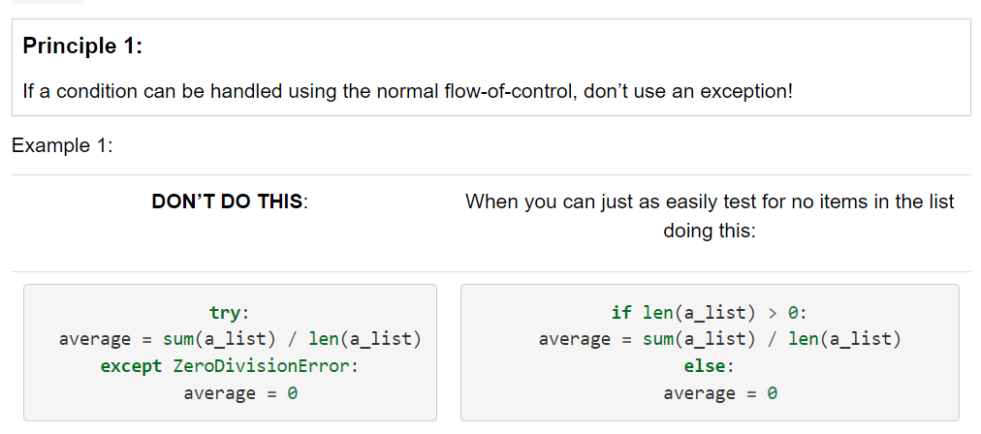
Principles of Exceptions

Slide 9
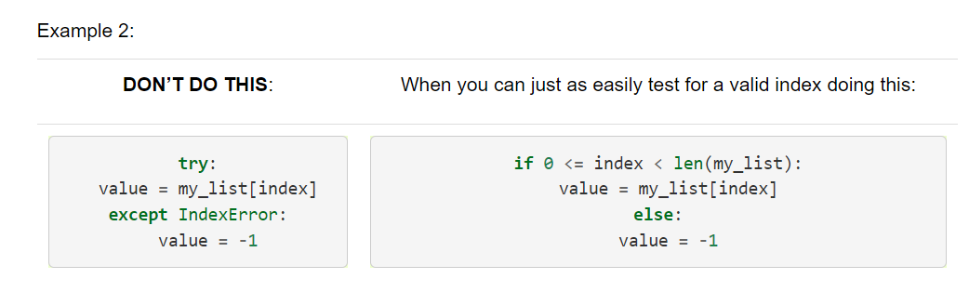
Principles / 2

Slide 10
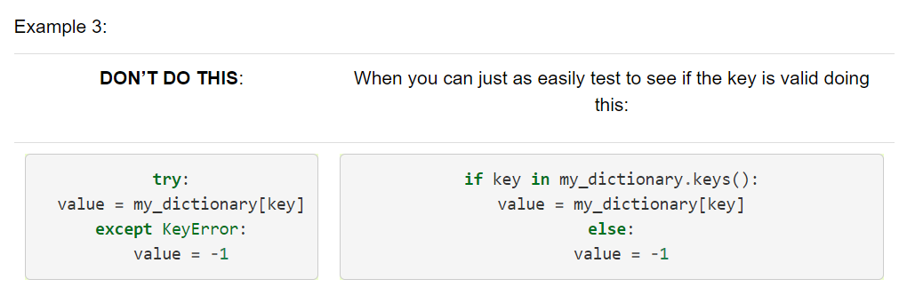
Principles / 3

Slide 11
Chapter / 16

Slide 12
Recursion
Recursion is a method of solving problems that involves breaking a problem down into smaller and smaller subproblems until you get to a small enough problem that it can be solved trivially.
Usually recursion involves a function calling itself

Slide 13
Example of list
def listsum(numList): theSum = 0 for i in numList: theSum = theSum + i return theSum print(listsum([1,3,5,7,9]))

Slide 14
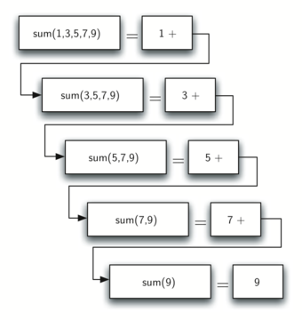
def listsum(numList): if len(numList) == 1: return numList[0] else: return numList[0] + listsum(numList[1:]) print(listsum([1,3,5,7,9]))

Slide 15
Factorial Example
def factorial(n): if n == 0 or n == 1: return 1 else: return n * factorial(n - 1) # Example usage: number = 5 result = factorial(number) print(f"The factorial of {number} is: {result}")

