Slide 1
Chapter 17 - OOP
Dr. Raza Ul Mustafa Khokhar
American University
Computer Science Department - CSC-148

Slide 2
OOP
Python is an object-oriented programming language. That means it provides features that support object-oriented programming (OOP).
In Python, every value is actually an object. Whether it be a turtle, a list, or even an integer, they are all objects.

Slide 3
An example
An object is any entity that has attributes and behaviors. For example, a parrot is an object. It has
attributes - name, age, color, etc.
behavior - dancing, singing, etc.
Similarly, a class is a blueprint for that object.

Slide 4
Syntax
class ClassName: # Statement-1 . . . # Statement-N

Slide 5
Parrot example
class Parrot:
# class attribute
name = ""
age = 0
# create parrot1 object
parrot1 = Parrot()
parrot1.name = "Blu"
parrot1.age = 10
# create another object parrot2
parrot2 = Parrot()
parrot2.name = "Woo"
parrot2.age = 15
# access attributes
print(f"{parrot1.name} is {parrot1.age} years old")
print(f"{parrot2.name} is {parrot2.age} years old")

Slide 6
The Python __init__ Method
The __init__ method is similar to constructors in C++ and Java.
It is run as soon as an object of a class is instantiated.
The method is useful to do any initialization you want to do with your object
class Dog: # class attribute attr1 = "mammal" # Instance attribute def __init__(self, name): self.name = name # Driver code # Object instantiation Rodger = Dog("Rodger") # Accessing instance attributes print("My name is {}".format(Rodger.name))

Slide 7
Class Dog - Methods
class Dog: # class attribute default_name = "ABC dog" default_sound = "Some sound ABC" # Instance attribute def __init__(self): self.name = 'Tommy' self.sound= 'Tommy sounds like poodle' def speak(self): print(f"My name is {self.name} and sound is {self.sound}") obj = Dog() # Accessing class methods obj.speak() print(obj.default_name)

Slide 8
Inheritance - Parent Class
Inheritance is the capability of one class to derive or inherit the properties from another class. The class that derives properties is called the derived class or child class and the class from which the properties are being derived is called the base class or parent class.
class Person(): def __init__(self, name, idnumber): self.name = name self.idnumber = idnumber def display(self): print(self.name) print(self.idnumber) def details(self): print("My name is {}".format(self.name)) print("IdNumber: {}".format(self.idnumber))

Slide 9
Child class - Employee
class Employee(Person): def __init__(self, name, idnumber, salary, post): self.salary = salary self.post = post # invoking the __init__ of the parent class Person.__init__(self, name, idnumber) def details(self): print("My name is {}".format(self.name)) print("IdNumber: {}".format(self.idnumber)) print("Post: {}".format(self.post))

Slide 10
Instantiating both Classes
main_class_obj = Person('Khokhar','852') main_class_obj.display() print('----') # creation of an object variable or an instance a = Employee('Raza', 886012, 200000, "Teacher") # calling a function of the class Person using its instance a.display() a.details()

Slide 11
Method overloading
Function overloading in Python works differently from some other programming languages like C++ or Java.
In Python, you cannot create multiple functions with the same name but different parameter lists like you would in those languages.
However, you can achieve similar behavior using default argument values and variable-length argument lists.

Slide 12
Example to get concept of overloading
class MathOperations: def add(self, a, b=None): if b is None: return a return a + b # Create an instance of the MathOperations class math_ops = MathOperations() # Test the add() method with different numbers of arguments print(math_ops.add(5)) # Output: 5 print(math_ops.add(5, 10)) # Output: 15

Slide 13
Polymorphism
Polymorphism simply means having many forms
Consider class Bird
Two inherited classes are: Sparrow and Ostrich
In Python, Polymorphism lets us define methods in the child class that have the same name as the methods in the parent class. In inheritance, the child class inherits the methods from the parent class. However, it is possible to modify a method in a child class that it has inherited from the parent class.

Slide 14
Bird class
Important where: This is particularly useful in cases where the method inherited from the parent class doesn’t quite fit the child class. It has special name, see next slide )
class Bird: def intro(self): print("There are many types of birds.") def flight(self): print("Most of the birds can fly but some cannot.")

Slide 15
Inherited classes But! Many forms
This process of re-implementing a method in the child class is known as Method Overriding
class sparrow(Bird): def flight(self): print("Sparrows can fly.") class ostrich(Bird): def flight(self): print("Ostriches cannot fly.")

Slide 16
Now let’s instantiate
obj_bird = Bird() obj_spr = sparrow() obj_ost = ostrich() obj_bird.intro() obj_bird.flight() obj_spr.intro() obj_spr.flight() obj_ost.intro() obj_ost.flight()

Slide 17
Another example - polymorphism in Python using inheritance and method overriding:
class Animal: def speak(self): return "Sound" class Dog(Animal): def speak(self): return "Woof!" class Cat(Animal): def speak(self): return "Meow!" # Create a list of Animal objects animals = [Animal(), Dog(), Cat()] # Call the speak method on each object for animal in animals: print(animal.speak())

Slide 18
Encapsulation
It describes the idea of wrapping data and the methods that work on data within one unit.
This puts restrictions on accessing variables and methods directly and can prevent the accidental modification of data.
Those types of variables are known as private variables.
Let’s see an example

Slide 19
Protected Members
In Python, protected members are class attributes or methods that are intended for internal use within the class and its subclasses.
These members are conventionally indicated by a single underscore (_) prefix. The use of a single underscore is a signal to other developers that these members are part of the internal implementation and should not be accessed directly from outside the class.
See example in Jupyter Notebook: https://shorturl.at/aoIN9

Slide 20
Private members
Private members are similar to protected members, the difference is that the class members declared private should neither be accessed outside the class nor by any base class.
However, to define a private member prefix the member name with double underscore “__”.
class Base: def __init__(self): self.a = "Nazim" self.__c = "Khokhar But! Private"

Slide 21
Calling private member in base class
class Derived(Base): def __init__(self): # Calling constructor of # Base class Base.__init__(self) print("Calling private member of base class: ") print(self.__c)

Slide 22
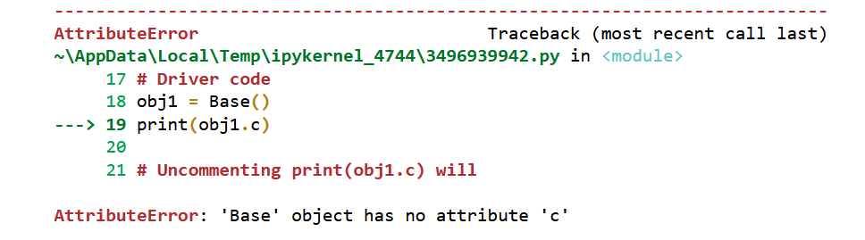
Instantiating
# Driver code obj1 = Base() print(obj1.a) # Uncommenting print(obj1.c) will # raise an AttributeError

Slide 23
Slides & Material
Canvas
Email: rmustafa@american.edu

