Slide 1
Chapter 2
Dr. Nazim
Computer Science Department - CSC-148

Slide 2
Values and Data Types (1/3)
A value is one of the fundamental things — like a word or a number — that a program manipulates.
The result when we added 2 + 3=5), and "Hello, World!".
We often refer to these values as objects and we will use the words value and object interchangeably
→ 2+3 = 5

Slide 3
Values and Data Types (2/3)
These objects are classified into different classes, or data types:
4 is an integer, and
"Hello, World!" is a string, so-called because it contains a string or sequence of letters.
You (and the interpreter) can identify strings because they are enclosed in quotation marks

Slide 4
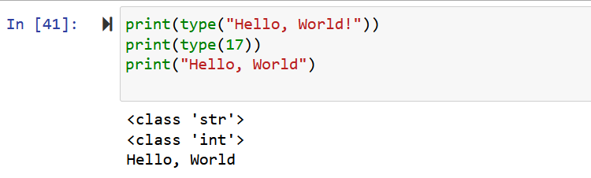
Values and Data Types (3/3)

Slide 5
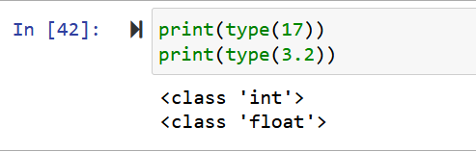
Floats & Int
Continuing with our discussion of data types, numbers with a decimal point belong to a class called float, because these numbers are represented in a format called floating-point

Slide 6
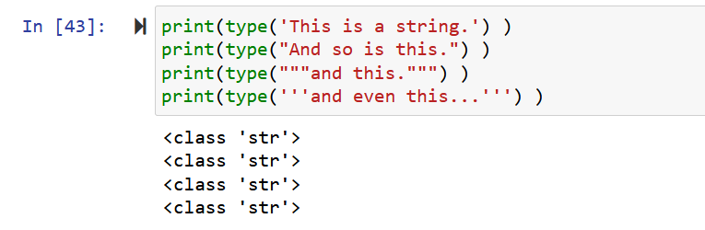
Strings in python (1/2)
Strings in Python can be enclosed in either single quotes (') or double quotes (" - the double quote character), or three of the same separate quote characters (''' or """).

Slide 7
Strings in python (2/2) - Rules
Note: Double quoted strings can contain single quotes inside them, as in "Bruce's beard",
Single quoted strings can have double quotes inside them, as in 'The knights who say "Ni!"'.
Strings enclosed with three occurrences of either quote symbol are called triple quoted strings. They can contain either single or double quotes:

Slide 8
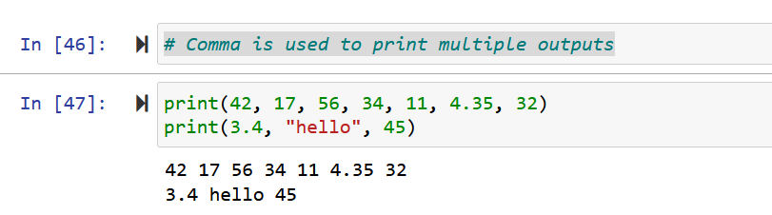
Printing in python

Slide 9
Type conversion functions
Sometimes it is necessary to convert values from one type to another.
The functions int, float and str will (attempt to) convert their arguments into types int, float and str respectively. We call these type conversion functions.
See example next page: Think what type of error we have ?

Slide 10
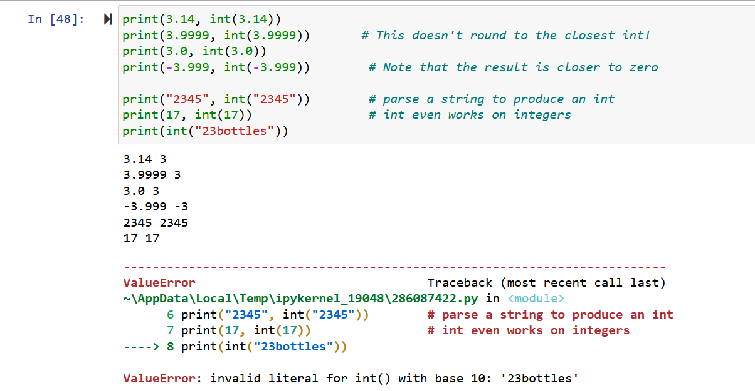
Type conversions example

Slide 11
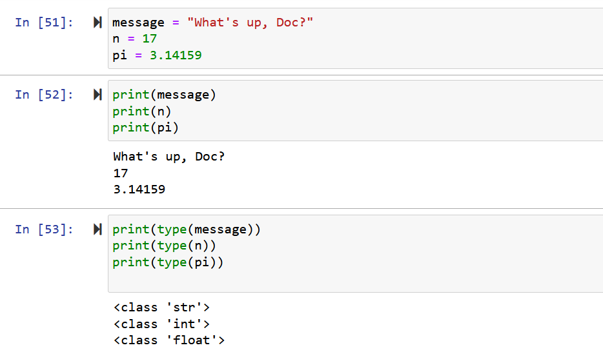
Variables
One of the most powerful features of a programming language is the ability to manipulate variables. A variable is a name that refers to a value.

Slide 12
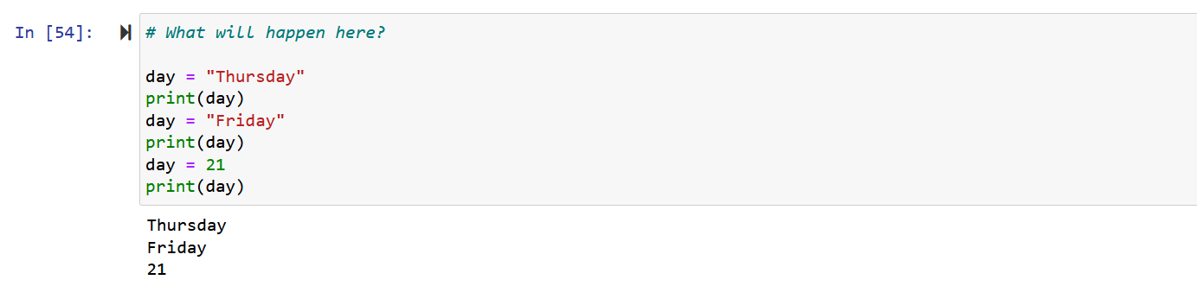
Flow of variables

Slide 13
Variable names and Keywords
Variable names can be arbitrarily long. They can contain both letters and digits, but they have to begin with a letter or an underscore.
Note: Variable names can never contain spaces.

Slide 14
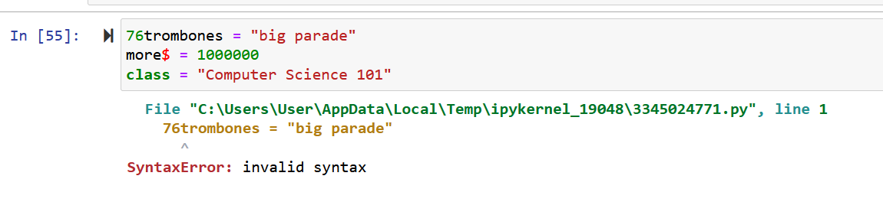
Invalid variable names
The underscore character ( _) can also appear in a name. It is often used in names with multiple words, such as my_name or price_of_tea_in_china.
There are some situations in which names beginning with an underscore have special meaning, so a safe rule for beginners is to start all names with a letter.

Slide 15
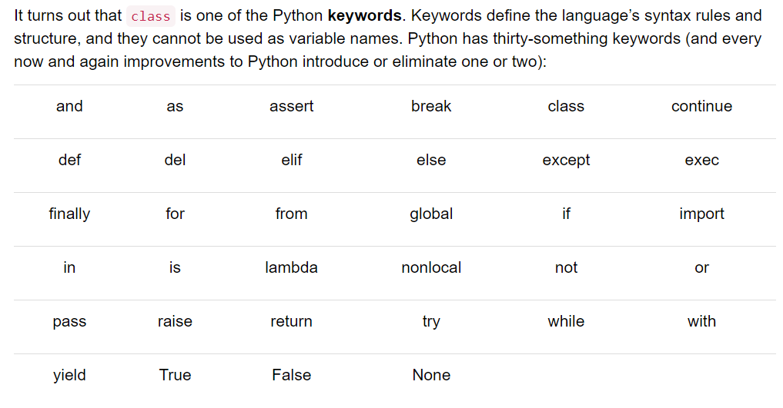
Python keywords – Not used as a variables

Slide 16
Statements and Expressions
A statement is an instruction that the Python interpreter can execute.
We have only seen the assignment statement so far.
Some other kinds of statements that we’ll see shortly are while statements, for statements, if statements, and import statements.
An expression is a combination of values, variables, operators, and calls to functions. Expressions need to be evaluated. If you ask Python to print an expression, the interpreter evaluates the expression and displays the result.

Slide 17
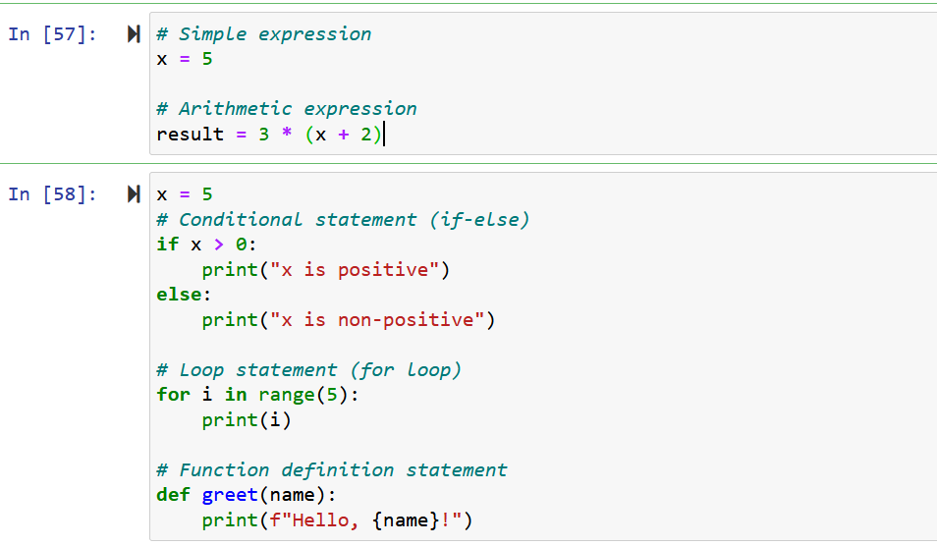
Example of expression and statement

Slide 18
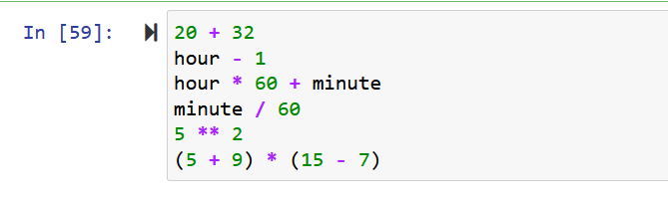
Operators and Operands
Operators are special tokens that represent computations like addition, multiplication and division. The values the operator works on are called operands

Slide 19
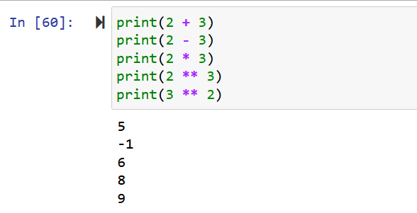
Operators and Operands
The tokens +, -, and *, and the use of parentheses for grouping, mean in Python what they mean in mathematics.
The asterisk (*) is the token for multiplication, and ** is the token for exponentiation. Addition, subtraction, multiplication, and exponentiation all do what you expect.

Slide 20
Arithmetic Operators:
a = 10 b = 5 # Addition result_add = a + b # 10 + 5 = 15 # Subtraction result_sub = a - b # 10 - 5 = 5 # Multiplication result_mul = a * b # 10 * 5 = 50 # Division result_div = a / b # 10 / 5 = 2.0 # Modulus (Remainder) result_mod = a % b # 10 % 5 = 0 # Exponentiation result_exp = a ** b # 10^5 = 100000

Slide 21
Comparison Operators:
x = 10 y = 20 # Equal to result_eq = x == y # False # Not equal to result_neq = x != y # True # Greater than result_gt = x > y # False # Less than result_lt = x < y # True # Greater than or equal to result_ge = x >= y # False # Less than or equal to result_le = x <= y # True

Slide 22
Logical Operators:
p = True q = False # Logical AND result_and = p and q # False # Logical OR result_or = p or q # True # Logical NOT result_not_p = not p # False result_not_q = not q # True

Slide 23
Assignment Operators:
x = 10 y = 5 # Addition assignment x += y # x = x + y = 15 # Subtraction assignment x -= y # x = x - y = 5 # Multiplication assignment x *= y # x = x * y = 50 # Division assignment x /= y # x = x / y = 2.0

Slide 24
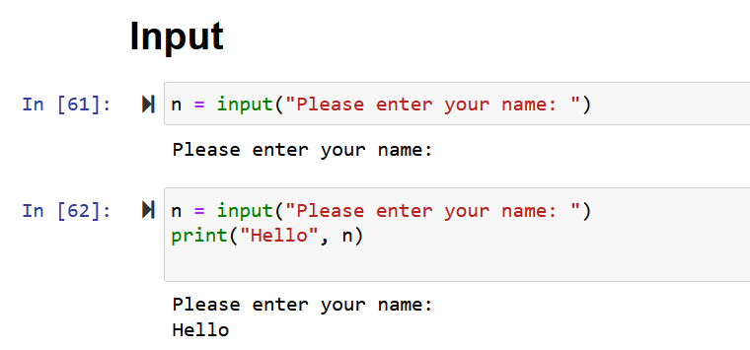
Inputs from users

Slide 25
Order of Operations
- Parentheses have the highest precedence and can be used to force an expression to evaluate in the order you want. Since expressions in parentheses are evaluated first, 2 * (3-1) is 4, and (1+1)**(5-2) is 8. You can also use parentheses to make an expression easier to read, as in (minute * 100) / 60, even though it doesn’t change the result.
- Exponentiation has the next highest precedence, so 2**1+1 is 3 and not 4, and 3*1**3 is 3 and not 27.
- Multiplication and both division operators have the same precedence, which is higher than addition and subtraction, which also have the same precedence. So 2*3-1 yields 5 rather than 4, and 5-2*2 is 1, not 6.
- Operators with the same precedence (except for **) are evaluated from left-to-right. In algebra we say they are left-associative. So in the expression 6-3+2, the subtraction happens first, yielding 3. We then add 2 to get the result 5. If the operations had been evaluated from right to left, the result would have been 6-(3+2), which is 1.

Slide 26
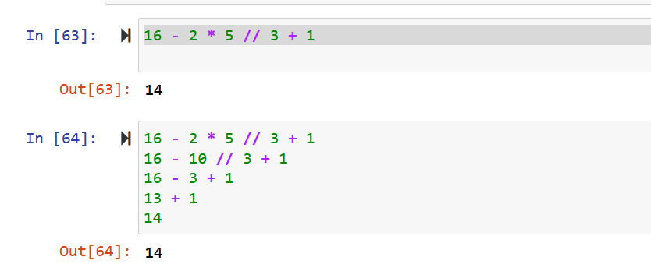
Example - Order
floor function returns the integer value just lesser than the given rational value. ceil function returns the integer value just greater than the given rational value
Notes:
When the result of floor division (//) is positive, it is as though the fractional portion is truncated off, leaving only the integer portion. When the result is negative, the result is rounded down to the next smallest (greater negative) integer:

Slide 27
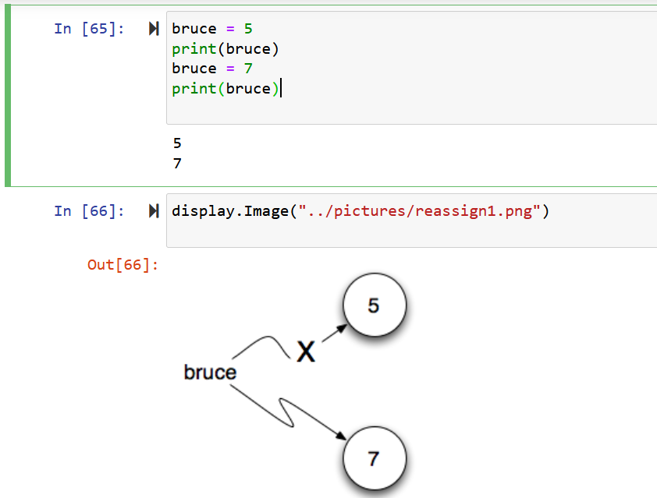
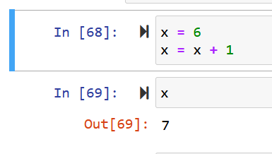
Reassignment / Updating variables

