Slide 1
Chapter 4
Dr. Nazim
American University
Computer Science Department - CSC-148

Slide 2
Turtle example
In this chapter we will introduce a module that allows us to create a data object called a turtle that can be used to draw pictures
Wait: There are other modules and functionality also there, for example numpy for mathematical calculations

Slide 3
Example
Turtle graphics, as it is known, is based on a very simple metaphor.
Imagine that you have a turtle that understands English. You can tell your turtle to do simple commands such as go forward and turn right.
As the turtle moves around, if its tail is down touching the ground, it will draw a line (leave a trail behind) as it moves.
If you tell your turtle to lift up its tail it can still move around but will not leave a trail. As you will see, you can make some pretty amazing drawings with this simple capability.

Slide 4
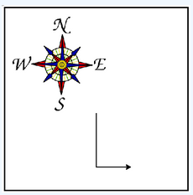
Few functions
import turtle # allows us to use the turtles library wn = turtle.Screen() # creates a graphics window alex = turtle.Turtle() # create a turtle named alex alex.forward(150) # tell alex to move forward by 150 units alex.left(90) # turn by 90 degrees alex.forward(75) # complete the second side of a rectangle
The first line tells Python to load a module named turtle
Remember that Python is case sensitive, so the module name, turtle, with a lowercase t, is different from the type Turtle because of the uppercase T.

Slide 5
Few more functionality
import turtle wn = turtle.Screen() wn.bgcolor("lightgreen") # set the window background color tess = turtle.Turtle() tess.color("blue") # make tess blue tess.pensize(3) # set the width of her pen tess.forward(50) tess.left(120) tess.forward(50) wn.exitonclick() # wait for a user click on the canvas

Slide 6
Few more functions
import turtle wn = turtle.Screen() # Set up the window and its attributes wn.bgcolor("lightgreen") tess = turtle.Turtle() # create tess and set some attributes tess.color("hotpink") tess.pensize(5) alex = turtle.Turtle() # create alex tess.forward(80) # Let tess draw an equilateral triangle tess.left(120) tess.forward(80) tess.left(120) tess.forward(80) tess.left(120) # complete the triangle tess.right(180) # turn tess around tess.forward(80) # move her away from the origin alex.forward(50) # make alex draw a square alex.left(90) alex.forward(50) alex.left(90) alex.forward(50) alex.left(90) alex.forward(50) alex.left(90) wn.exitonclick()

Slide 7
Output of previous code…
We will run live to see how it works

Slide 8
The for loop
A basic building block of all programs is to be able to repeat some code over and over again. In computer science, we refer to this repetitive idea as iteration.
for name in ["Joe", "Amy", "Brad", "Angelina", "Zuki", "Thandi", "Paris"]: print("Hi", name, "Please come to my party on Saturday!")

Slide 9
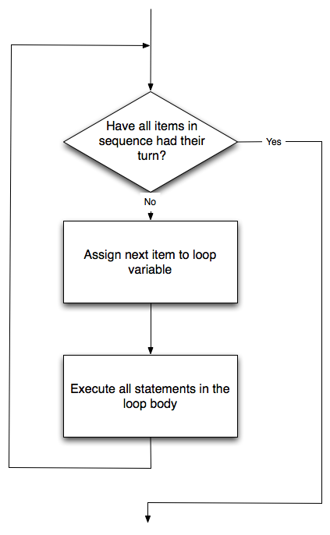
Flow of for loop

Slide 10
Turtle example
import turtle # set up alex wn = turtle.Screen() alex = turtle.Turtle() for i in [0, 1, 2, 3]: # repeat four times alex.forward(50) alex.left(90) wn.exitonclick()

Slide 11
Change the color
import turtle # set up alex wn = turtle.Screen() alex = turtle.Turtle() for i in [yellow, red, green, blue]: # repeat four times alex.forward(50) alex.left(90) wn.exitonclick()

Slide 12
Let see how it looks now!
import turtle # set up alex wn = turtle.Screen() alex = turtle.Turtle() for aColor in ["yellow", "red", "purple", "blue"]: alex.color(aColor) alex.forward(50) alex.left(90) wn.exitonclick()

Slide 13
The range function
This is how we doing before? How to use range function here?
import turtle # set up alex wn = turtle.Screen() alex = turtle.Turtle() for i in [0, 1, 2, 3]: # repeat four times alex.forward(50) alex.left(90) wn.exitonclick()

Slide 14
Range function in action!
for i in range(4): # Executes the body with i = 0, then 1, then 2, then 3 for x in range(10): # sets x to each of ... [0, 1, 2, 3, 4, 5, 6, 7, 8, 9]

Slide 15
More things to do with range!
range(start, beyondLast, step)
print(list(range(0, 18, 2))) print(list(range(0, 20, 2))) print(list(range(10, 0, -1)))

Slide 16
More on range… Turtle
import turtle wn = turtle.Screen() wn.bgcolor("lightgreen") tess = turtle.Turtle() tess.color("blue") tess.shape("turtle") print(list(range(5, 60, 2))) tess.up() # this is new for size in range(5, 60, 2): # start with size = 5 and grow by 2 tess.stamp() # leave an impression on the canvas tess.forward(size) # move tess along tess.right(24) # and turn her wn.exitonclick()

Slide 17
Many more methods of Turtle use-case
Less priorities, More on syntax and logic building, OK!
https://shorturl.at/fIJW4

Slide 18
Let’s start little more practice … which is important
Open your IDE
Let’s start playing with Nested loops
Few shapes
Dry run … Very important ! ! !

