Slide 1
Chapter 5
Dr. Raza Ul Mustafa Khokhar
Dr. Raza Ul Mustafa Khokhar
American University
Computer Science Department - CSC-148

Slide 2
Modules
A module is a file containing Python definitions and statements intended for use in other Python programs.
For example: turtle
import turtle wn = turtle.Screen() wn.bgcolor("lightgreen") tess = turtle.Turtle() tess.color("blue")

Slide 3
Modules import
The first thing we need to do when we wish to use a module is perform an import.
In the example above, the statement import turtle creates a new name, turtle, and makes it refer to a module object.

Slide 4
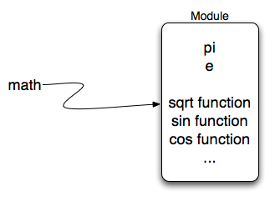
Math modules
The math module contains the kinds of mathematical functions you would typically find on your calculator and some mathematical constants like pi and e.
As we noted above, when we import math, we create a reference to a module object that contains these elements

Slide 5
Few modules math functionality
import math print(math.pi) print(math.sqrt(2.0)) print(math.sin(math.radians(90))) # sin of 90 degrees

Slide 6
The random modules
import random prob = random.random() print(prob) diceThrow = random.randrange(1, 7) # return an int, one of 1,2,3,4,5,6 print(diceThrow)
The random() function returns a floating point number in the range [0.0, 1.0)

Slide 7
More to do with random
import random prob = random.random() result = prob * 5 print(result)

Slide 8
Creating a module
""" The coffee shop module contains functions and contains variables important to implementing a coffee shop. """ # Set some variables shop_name = "Runestone Brew House" coffee_sizes = ["small", "medium", "large"] coffee_roasts = ["hot chocolate", "light", "medium", "dark", "espresso"]
This is a Python script named coffee_shop.py that contains three variables: shop_name, coffee_sizes, and coffee_roasts. The shop_name is a string, coffee_sizes is a list containing strings, and coffee_roasts is also a list containing strings.

Slide 9
Calling modules
How can we use the coffee_shop module? We can import it and use it in other Python source code files. Let’s consider the Python file shown below.
import coffee_shop # Output the information we know from the module print("Welcome to", coffee_shop.shop_name) print("Available sizes:", coffee_shop.coffee_sizes) print("Available roasts:", coffee_shop.coffee_roasts)

Slide 10
Very nice example of modules, let's start coding
https://shorturl.at/ftuwV

