Slide 1
Chapter 7
Dr. Raza Ul Mustafa Khokhar
Dr. Raza Ul Mustafa Khokhar
American University
Computer Science Department - CSC-148

Slide 2
Boolean Values and Boolean Expressions
print(True) print(type(True)) print(type(False))
The Python type for storing true and false values is called bool, named after the British mathematician, George Boole. George Boole created Boolean Algebra, which is the basis of all modern computer arithmetic.

Slide 3
Boolean
print(5 == 5) print(5 == 6) j = "hel" print(j + "lo" == "hello")

Slide 4
Six common comparison operators
x != y # x is not equal to y x > y # x is greater than y x < y # x is less than y x >= y # x is greater than or equal to y x <= y # x is less than or equal to y

Slide 5
Logical operators
x = 5 print(x > 0 and x < 10) n = 25 print(n % 2 == 0 or n % 3 == 0)

Slide 6
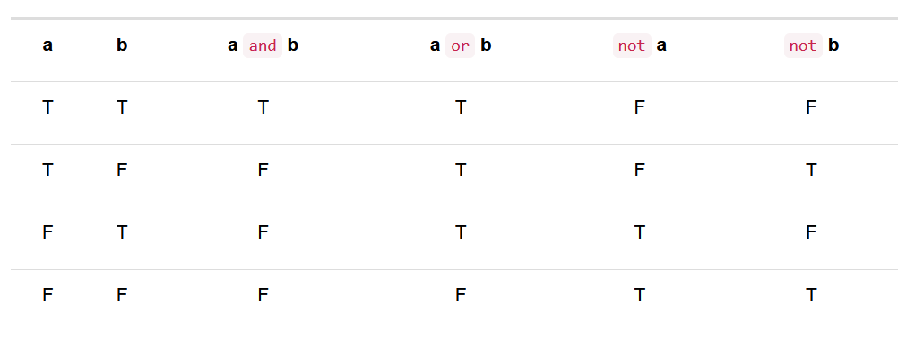
Logical operators

Slide 7
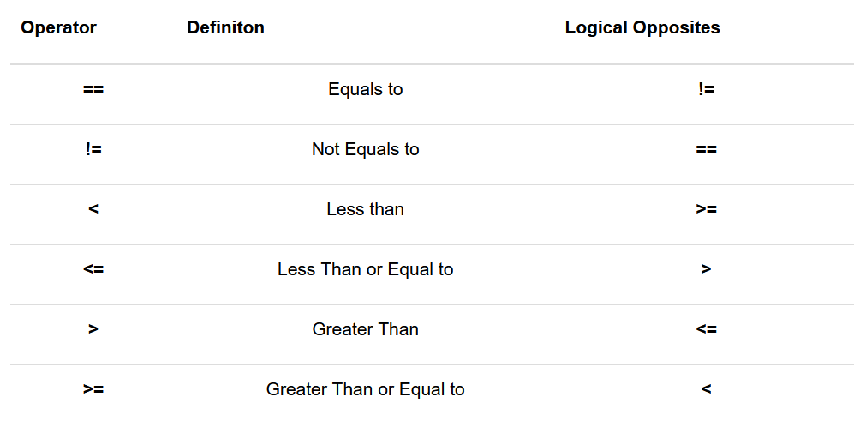
Logical opposites

Slide 8
Let’s look at some examples – AND
if not ((phone_charge >= 0.50) and (phone_storage >= .15)): print("You cannot restart your phone. Battery too low or not enough free space.") else: print("Updating now...Several restarts may be required.")

Slide 9
OR
if (phone_charge < 0.50) or (phone_storage < .15): print("You cannot restart your phone. Battery too low or not enough free space.") else: print("Updating now...Several restarts may be required.")

Slide 10
Precedence of Operators
Python will always evaluate the arithmetic operators first (** is highest, then multiplication/division, then addition/subtraction)
Next comes the relational operators. Finally, the logical operators are done last
6*5 >= 10 and 8-6 <= 20
first perform the arithmetic and then check the relationships
The and will be done last

Slide 11
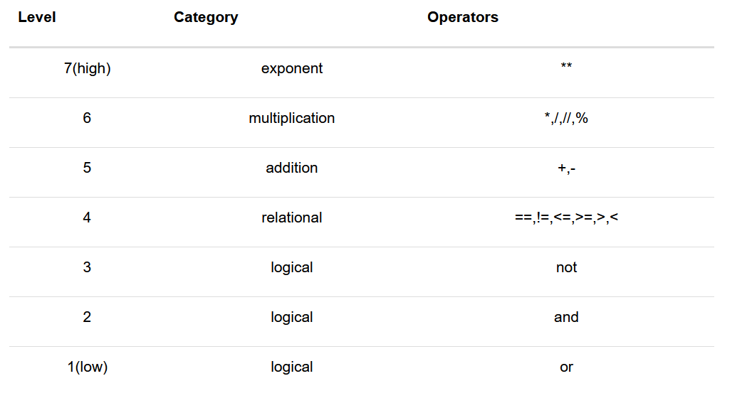
Operator precedence table

Slide 12
Conditional Execution: Binary Selection
Selection statements, sometimes also referred to as conditional statements, give us this ability. The simplest form of selection is the if statement. This is sometimes referred to as binary selection since there are two possible paths of execution
x = 15 if x % 2 == 0: print(x, "is even") else: print(x, "is odd")

Slide 13
Nested conditionals
One conditional can also be nested within another. For example, assume we have two integer variables, x and y. The following pattern of selection shows how we might decide how they are related to each other.
x = 10 y = 10 if x < y: print("x is less than y") else: if x > y: print("x is greater than y") else: print("x and y must be equal")

Slide 14
Chained conditionals
x = 10 y = 10 if x < y: print("x is less than y") elif x > y: print("x is greater than y") else: print("x and y must be equal")

Slide 15
Nested-if, elif else
score = 85 if score >= 90: print("A") elif score >= 80: print("B") elif score >= 70: print("C") elif score >= 60: print("D") else: print("F")

Slide 16
Boolean Functions
We have already seen that boolean values result from the evaluation of boolean expressions.
Since the result of any expression evaluation can be returned by a function (using the return statement), functions can return boolean values.
def isDivisible(x, y): if x % y == 0: result = True else: result = False return result print(isDivisible(10, 5))

Slide 17
Slides & Material
razaulmustafa.us/cs148/

