Slide 1
Chapter 8
Dr. Raza Ul Mustafa Khokhar
Dr. Raza Ul Mustafa Khokhar
American University
Computer Science Department - CSC-148

Slide 2
More about iterations
Repeated execution of a sequence of statements is called iteration.
For and while loops
For revisited:
for f in ["Joe", "Amy", "Brad", "Angelina", "Zuki", "Thandi", "Paris"]: print("Hi", f, "Please come to my party on Saturday")

Slide 3
Functions - Loops
def sumTo(aBound): theSum = 0 for aNumber in range(1, aBound + 1): theSum = theSum + aNumber return theSum print(sumTo(4)) print(sumTo(1000))

Slide 4
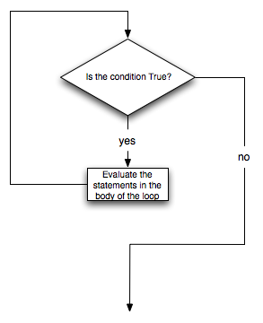
While loop
The while statement provides a much more general mechanism for iterating. Similar to the if statement, it uses a boolean expression to control the flow of execution. The body of while will be repeated as long as the controlling boolean expression evaluates to True

Slide 5
While loop example
def sumTo(aBound): """ Return the sum of 1+2+3 ... n """ theSum = 0 aNumber = 1 while aNumber <= aBound: theSum = theSum + aNumber aNumber = aNumber + 1 return theSum print(sumTo(4)) print(sumTo(1000))

Slide 6
Uses of while
def checkout(): total = 0 count = 0 moreItems = True while moreItems: price = float(input('Enter price of item (0 when done): ')) if price != 0: count = count + 1 total = total + price print('Subtotal: $', total) else: moreItems = False average = total / count print('Total items:', count) print('Total $', total) print('Average price per item: $', average) checkout()

Slide 7
Use of NOT, While & String upper() method
def get_yes_or_no(message): valid_input = False answer = input(message) while not valid_input: answer = answer.upper() # convert to upper case if answer == 'Y' or answer == 'N': valid_input = True else: answer = input('Please enter Y for yes or N for no. \n' + message) return answer response = get_yes_or_no('Do you like lima beans? Y)es or N)o: ') if response == 'Y': print('Great! They are very healthy.') else: print('Too bad. If cooked right, they are quite tasty.')

Slide 8
Loops are good for generating tabular data
print("n", '\t', "2**n") #table column headings print("---", '\t', "-----") for x in range(13): # generate values for columns print(x, '\t', 2 ** x)

Slide 9
Slides & Material
razaulmustafa.us/cs148/

