Slide 1
Event in a Box - Transgourmet Prodega BärnHäckt 2026
Team Chilaquiles
Eduard Anderegg
Rodrigo Arca Zimmermann

Slide 2



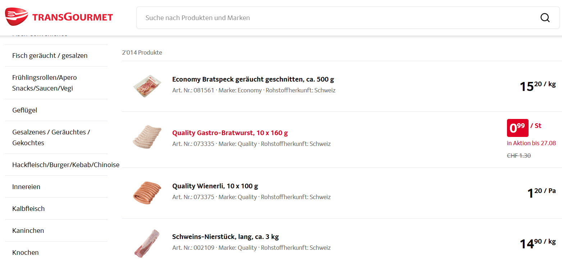


Slide 3
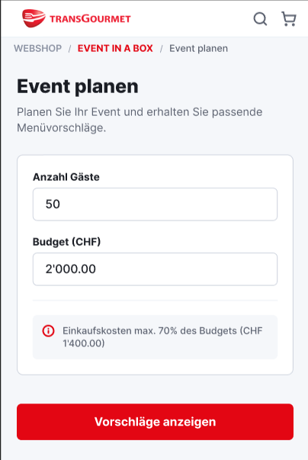


Slide 4

Eduard Anderegg @EdiAnderegg
Rodrigo Arca Zimmermann
@razec3
razec3/chilaquiles-in-a-box

