Slide 1
AEM ENERGY SOLUTIONS
Quality Plus
Your data, trusted. Every check, every time.
6
90s
General
Cinematic
SCENES
DURATION
AUDIENCE
STYLE
Promotional Video Script & Storyboard

Slide 2
01
Cold Open — The Cost of Bad Data
HOOK
0:00 – 0:12
VOICEOVER / SCRIPT
VISUAL DIRECTION
"Every day, decisions get made on data no one can trust. Missed values. Silent errors. Inconsistencies buried in thousands of rows."
Dark screen, blinking cursor
Spreadsheet with red errors
Clock ticking on data
Cinematic push-in shot
MOTION & GRADE
Slow dramatic zoom. Desaturated cold grade. Tension music builds steadily.
Scene 1 of 6 · 0:00 – 0:12 · Quality Plus Promo Video

Slide 3
02
Problem Statement
PROBLEM
0:12 – 0:22
VOICEOVER / SCRIPT
VISUAL DIRECTION
"For Oil & Gas teams, a single data error doesn't just slow you down — it affects production decisions, reporting, and stakeholder trust."
Analyst frustrated at screen
Multiple tabs open, checking
Red error badges multiply
Team in confused meeting
MOTION & GRADE
ON-SCREEN TEXT
Quick cuts, handheld-style movement. Heartbeat sound design. Urgency.
"Manual QC takes hours. Errors slip through anyway."
Scene 2 of 6 · 0:12 – 0:22 · Quality Plus Promo Video

Slide 4
03
Product Reveal — Quality Plus
SOLUTION
0:22 – 0:35
VOICEOVER / SCRIPT
VISUAL DIRECTION
"Introducing Quality Plus — your data, trusted. Every check, every time."
Dark dashboard fades in
AEM teal glow — logo reveal
Dashboard slides into frame
Teal particle data flow
MOTION & GRADE
ON-SCREEN TEXT
Slow dramatic reveal. Colour grade shifts to AEM teal. Orchestral swell.
"Quality Plus" — large cinematic title card
Scene 3 of 6 · 0:22 – 0:35 · Quality Plus Promo Video

Slide 5
04
Feature Showcase — AI-Powered Checks
FEATURES
0:35 – 1:00
VOICEOVER / SCRIPT
VISUAL DIRECTION
"Upload your dataset. Run AI Rule Check — it reads your columns and auto-applies O&G domain rules. Completeness, Uniqueness, Validity, Consistency. Then the AI Summary writes itself — plain language, key issues, ready to share."
Dataset upload animation
AI Rule Check — rules populate
4 dimension cards light up
AI Summary types on screen
MOTION & GRADE
ON-SCREEN TEXT
Smooth product UI walkthrough. Screen recordings with cinematic overlays. Feature callouts animate in.
Labels: "AI Rule Check", "4 Dimensions", "AI Summary", "PDF Report"
KEY FEATURES HIGHLIGHTED
AI Rule Check
4 Dimensions
AI Summary
PDF Report Export
Scene 4 of 6 · 0:35 – 1:00 · Quality Plus Promo Video

Slide 6
05
Social Proof / Results
VALUE
1:00 – 1:10
VOICEOVER / SCRIPT
VISUAL DIRECTION
"Built for AEM Energy Solutions. Trusted across Well Intervention, production, and operations teams."
96.4% score animates up
Result history trend line
Team sharing PDF on tablet
AEM logo lockup
MOTION & GRADE
ON-SCREEN TEXT
Confident, clean cuts. Score counter animates. Warm teal grade throughout.
"Multi-dimension quality. One platform."
KEY FEATURES HIGHLIGHTED
Result Scores
Score History
Team Sharing
Scene 5 of 6 · 1:00 – 1:10 · Quality Plus Promo Video

Slide 7
06
Call to Action
CTA
1:10 – 1:30
VOICEOVER / SCRIPT
VISUAL DIRECTION
"Stop guessing. Start trusting your data. Quality Plus — built for the teams who can't afford to be wrong."
Full dark background
Logo fades in — centred
Tagline appears on screen
URL & Book a Demo button
MOTION & GRADE
ON-SCREEN TEXT
Slow epic fade. Final orchestral chord. Logo holds 3 seconds. Clean and confident.
"Quality Plus" · qualityplus.aem.com · "Book a Demo →"
Scene 6 of 6 · 1:10 – 1:30 · Quality Plus Promo Video

Slide 8
Production Notes
DURATION
90 seconds total (6 scenes)
AUDIENCE
Data engineers & analysts — Oil & Gas industry
PRIMARY COLOUR
#03AD9A (AEM teal) — hero accent throughout
BACKGROUND GRADE
Dark cinema (#0A0F1A) — enterprise premium feel
TYPOGRAPHY STYLE
Bold display headers + clean body — Trebuchet MS / Calibri
MUSIC ARC
Tension (S1–2) → Reveal swell (S3) → Confident waltz (S4–5) → Epic close (S6)
CTA
Book a Demo — qualityplus.aem.com
INSPIRATION
AWS & OpenAI product commercials — cinematic, data-forward
AEM COLOUR PALETTE
#8BC977
#63BF81
#28B98F
#03AD9A
#008192
#064B77
#1D275A

Slide 9


Slide 10
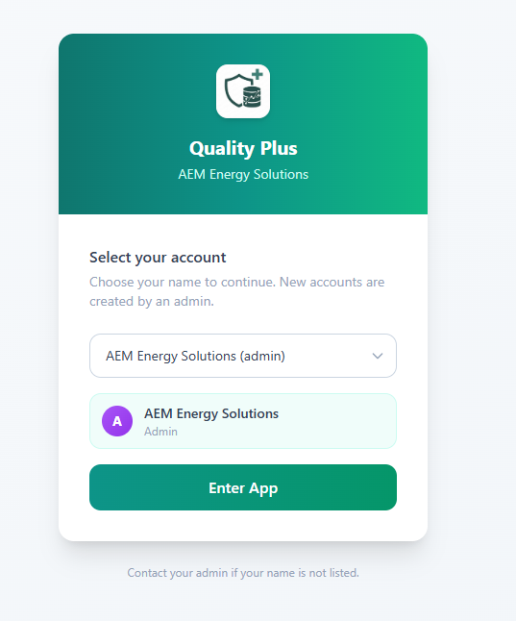
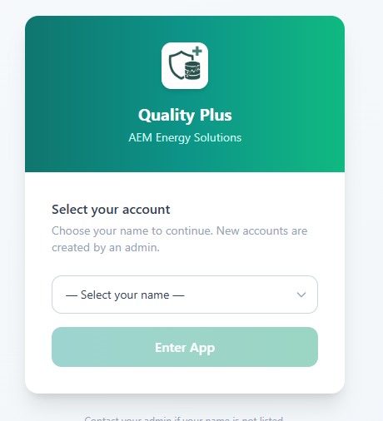
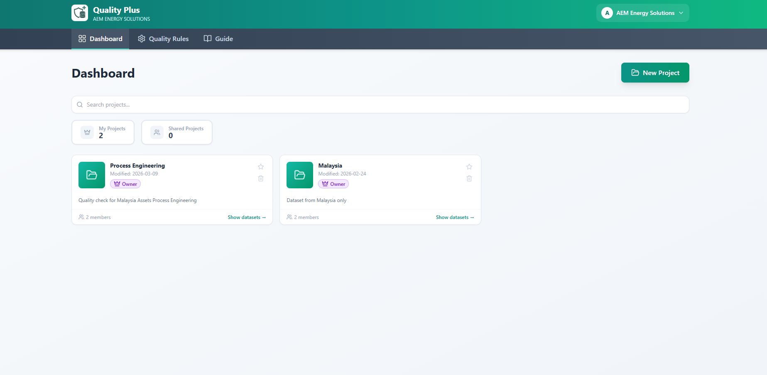

Slide 11
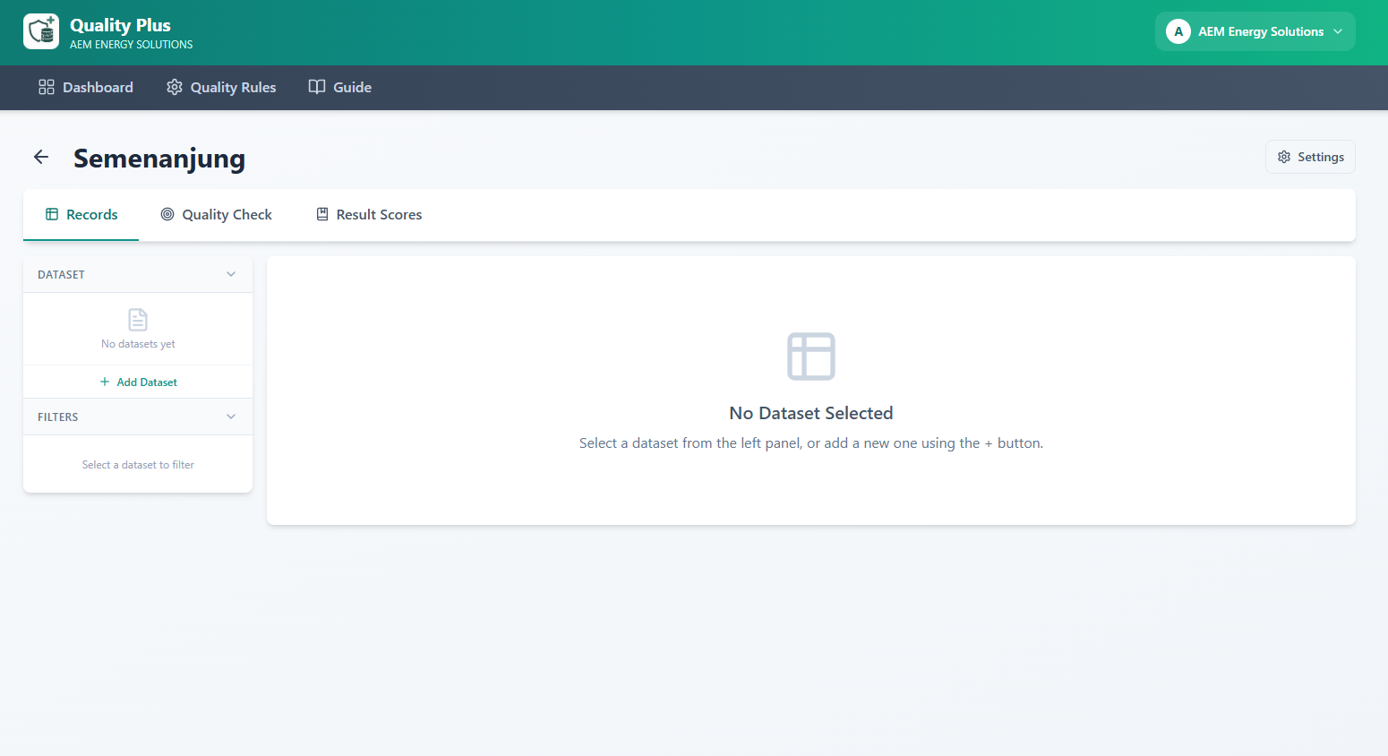
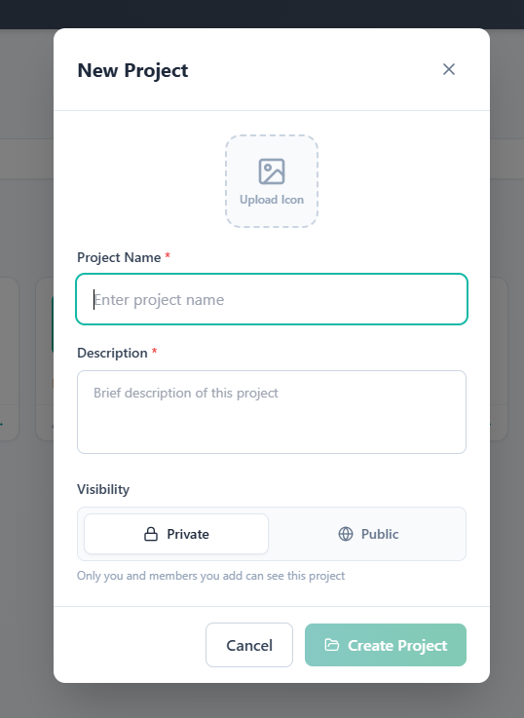
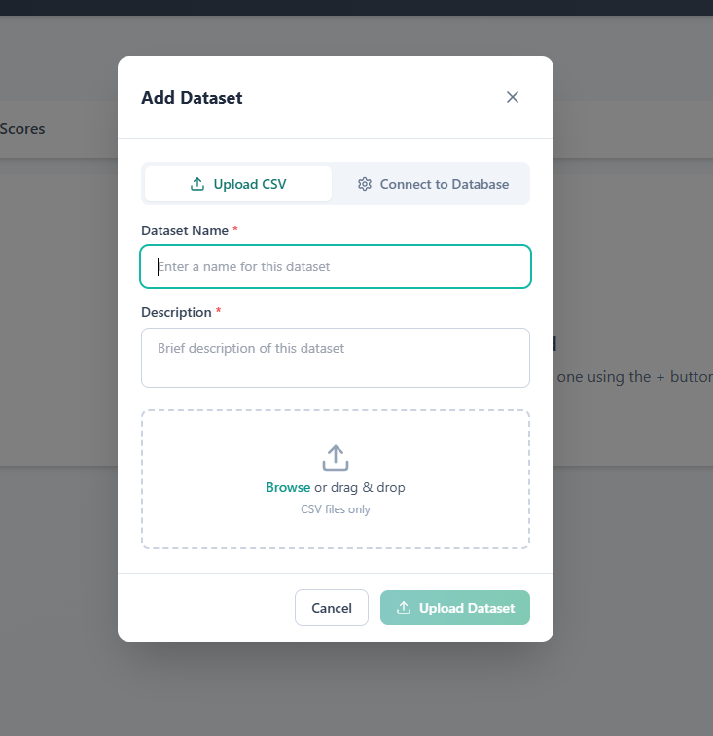
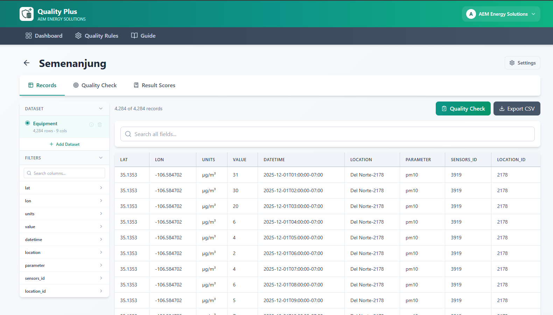

Slide 12
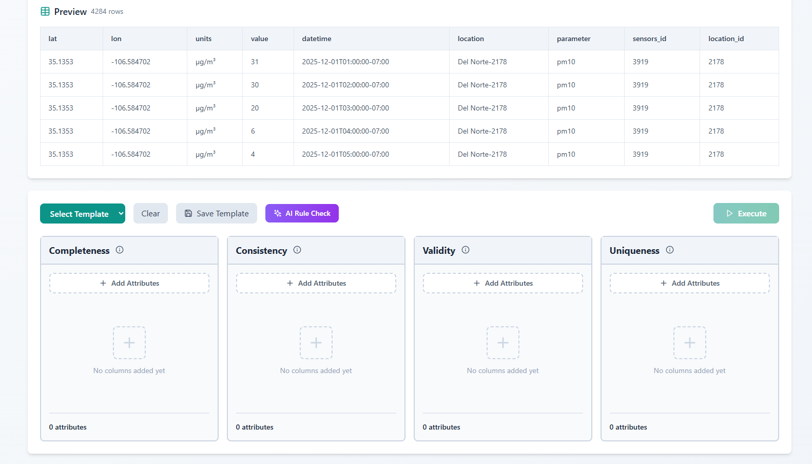

Slide 13
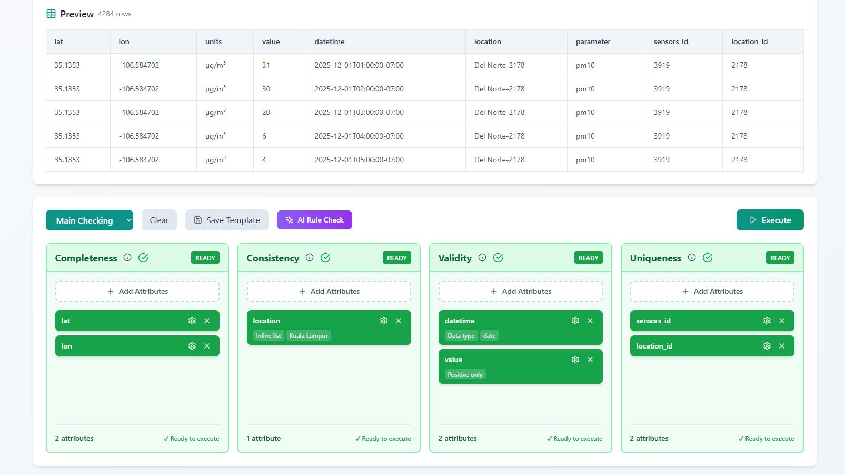

Slide 14
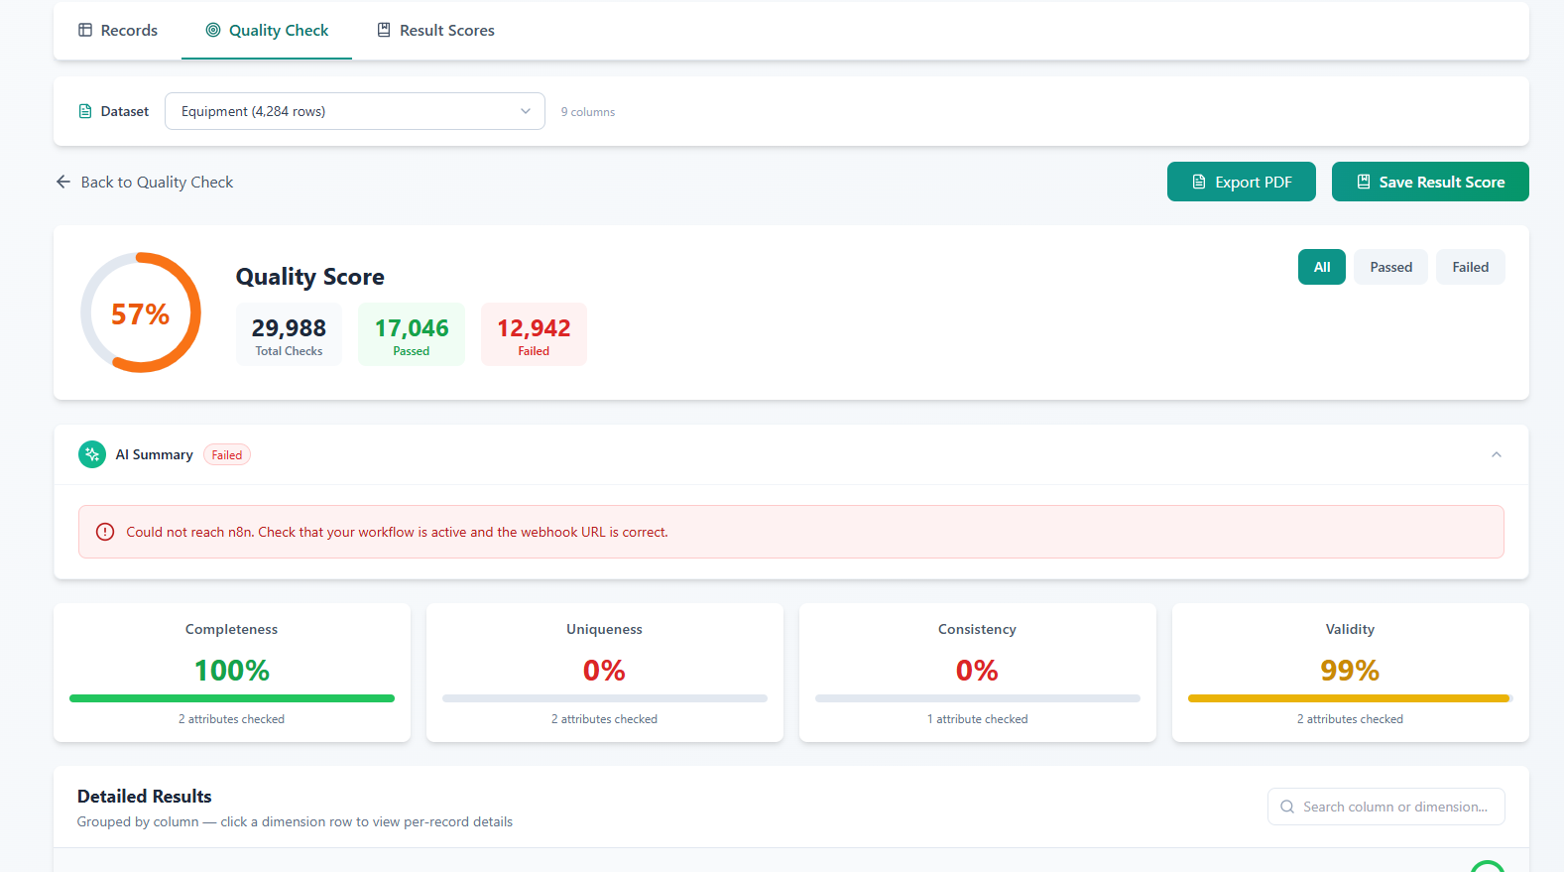

Slide 15
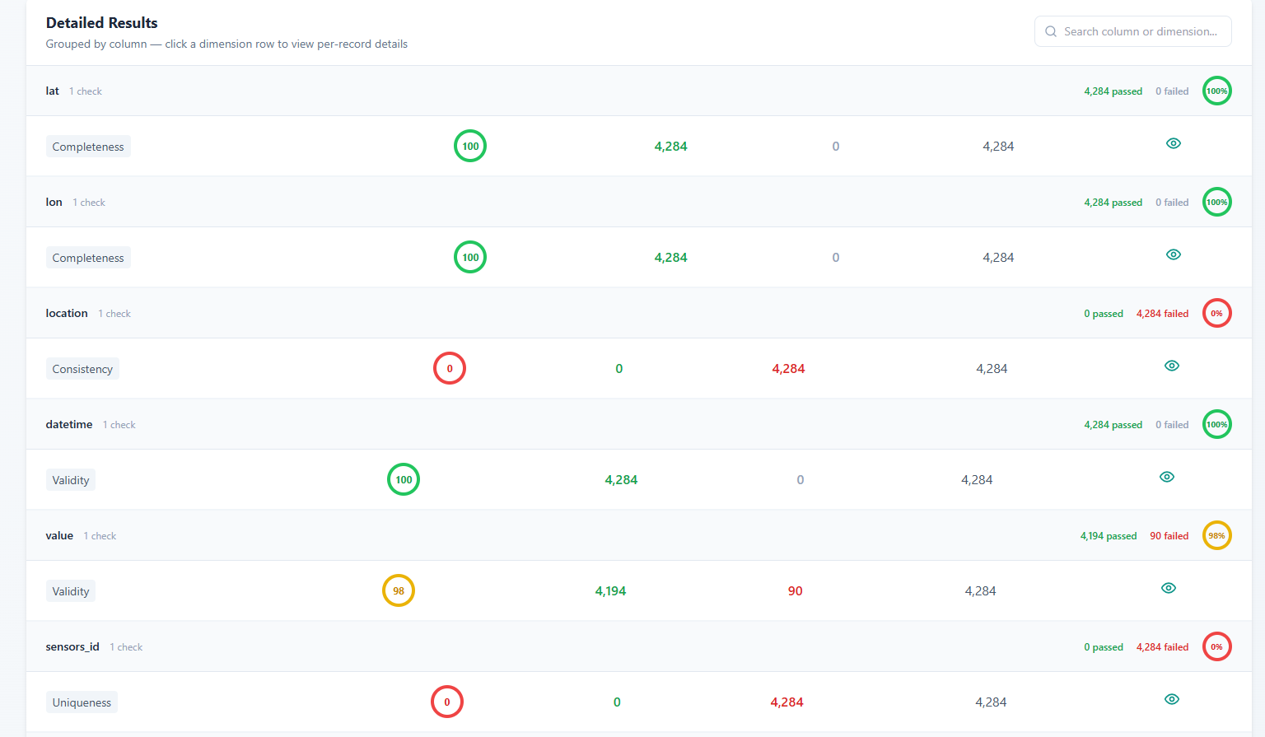

Slide 16
