Slide 1
LockBit 3.0
Ransomware Forensic Analysis
What happened, how it worked, and how we stopped it
📊 Real dataset: Splunk Attack Range — LockBit Sysmon Logs (Jan 16, 2023)
CYB102 Capstone | Kiyali Ross · Tomiwa Olanrewaju · Joseph McLeod · Raabiah Azeez · Zilong Li

Slide 2
Project Overview
What We Did
Our 3 Goals
📁 Analyzed real LockBit 3.0 Windows event logs from a Jan 2023 attack
Reconstruct the Attack Timeline
01
Map every step the attackers took, in order, with exact timestamps.
📖 Followed a modified FRSECURE incident response playbook
Run the Incident Response Playbook
02
🔎 Used Splunk, Catalyst, YARA, and VirusTotal to investigate
Contain, investigate, and clean up following a real security playbook.
Extract Evidence & Give Advice
📝 Documented everything as Case IR-2023-001 in Catalyst
03
Find all malware fingerprints (IOCs) and recommend how to prevent future attacks.

Slide 3
Tools We Used
📊 Splunk
📋 Catalyst
Main Analysis Tool
Case Tracker
We loaded all the Windows event logs into Splunk to search through them and build a timeline of the attack.
We used Catalyst to log every finding, track our tasks, and keep a running timeline. Our case is numbered IR-2023-001.
🔍 YARA
✅ VirusTotal
Malware Detection Rules
Malware Confirmation
We wrote a YARA rule that can automatically spot this ransomware in the future. We tested it against a real live sample.
We uploaded the 4 suspicious files to VirusTotal, which confirmed all of them were 100% malicious.

Slide 4
Our Incident Response Playbook
We started with an existing security playbook and modified it to fit our attack scenario
📖 Original: FRSECURE Playbook
✏️ Our Modified Playbook
› Written for enterprise security teams
✦ We analyze IOCs continuously — not just once
› General-purpose ransomware response
✦ We update and re-deploy YARA rules after each finding
→
› Covers detection, containment, and recovery
✦ We review lessons learned after every cycle
› No assumptions about what data you have
✦ Designed to catch new LockBit versions automatically
› Used as our starting framework
✦ Future plan: automate rule deployment to all computers

Slide 5
The Attack: 6 Steps in 11 Minutes
January 16, 2023 | All times in UTC | Source: Windows Sysmon logs
11:36 · win-host
11:47 · win-dc
1
4
Look Around
Start Encrypting
Attackers scanned the system to learn what they were dealing with.
Ran ConfirmEmail.exe on the main server — encryption started immediately.
11:38 · win-host
11:47 · win-dc
2
5
Hide Themselves
Leave Ransom Notes
Launched malware disguised as a trusted Splunk monitoring tool.
749 ransom note files appeared across the network in under 1 second.
11:45 · win-host
11:47 · win-dc
3
6
Drop the Weapons
Cover Their Tracks
Used 7-Zip to unpack 20+ malicious files into a hidden temp folder.
Deleted 301 Windows recovery keys so the files couldn't be restored.

Slide 6
Step 1–2: Look Around & Hide
win-host · 11:36–11:38 UTC
What happened at 11:36
🎭 The Disguise Trick
The attackers probed the system's memory to figure out what software was running and what they could target.
Real Splunk tool:
✅ SplunkUniversalForwarder\bin\splunk.exe
What happened at 11:38
Fake malware name used:
A fake program called splunk-MonitorNoHandle.exe was launched. Its name looks almost identical to a real, trusted tool — so security software ignored it.
❌ splunk-MonitorNoHandle.exe
The names look almost the same — that's intentional. Security tools saw it as a Splunk process and let it run.
Why this matters
This is called masquerading — naming malware after a real program so it blends in. It's a common first move in ransomware attacks.
Run as: NT AUTHORITY\SYSTEM (full admin access)

Slide 7
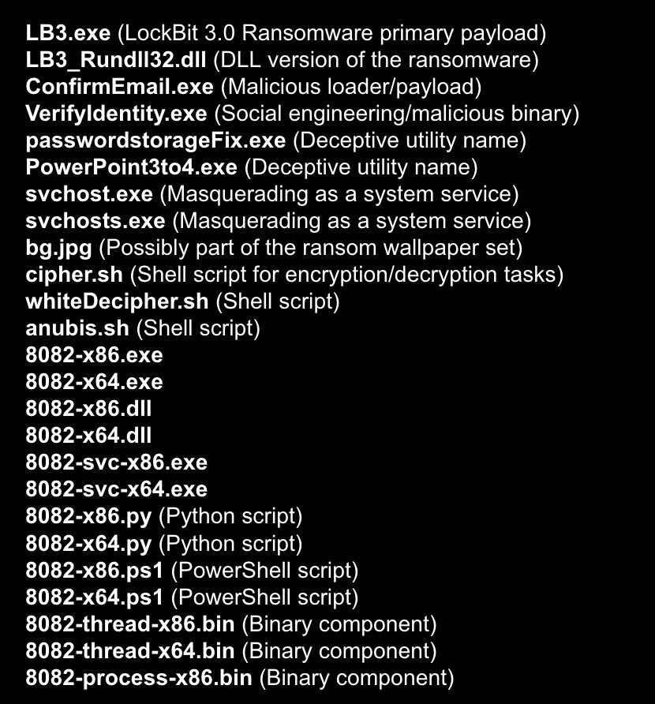
Step 3: Dropping the Weapons
win-host · 11:45 UTC — 7-Zip unpacked a hidden archive into C:\Temp
📦 What the attackers did
Every file the malware dropped onto the system:
1
Opened 7-Zip
Used the normal 7-Zip app — already on the system — to unzip a secret malware package.
2
20+ files dropped
Inside the archive were over 20 malicious files including the main ransomware, decoy programs, and helper scripts.
3
Modified Splunk logs
Some files were written into Splunk's folders to hide the infection and make the logs look normal.
4
Ready to strike
All files were now in place. The attack was just seconds away from launching.

Slide 8
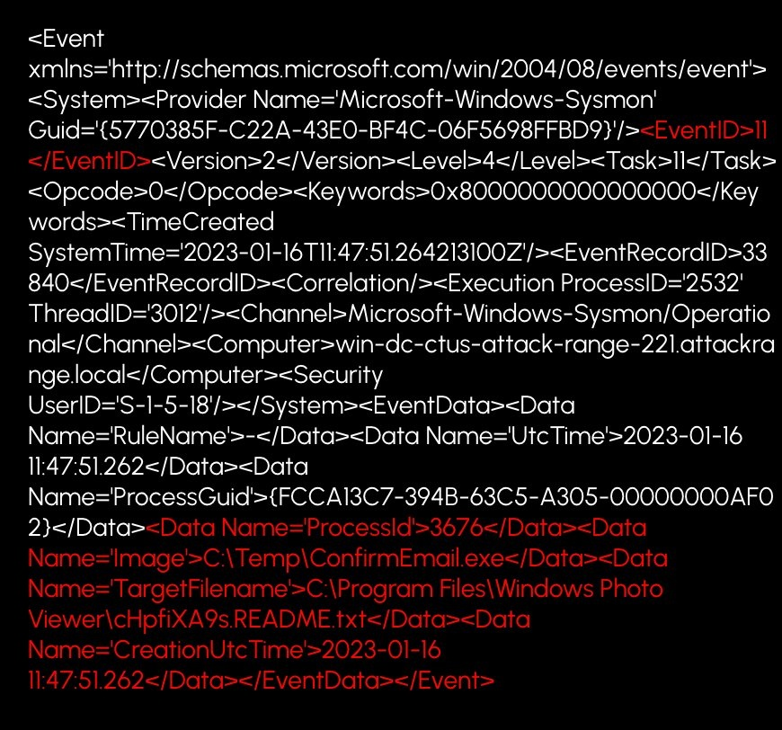
Step 4–5: Encrypt & Demand Ransom
win-dc · 11:47:23 UTC — Encryption launched on the main server in seconds
⚡ ConfirmEmail.exe runs
📄 749 ransom notes appear
🔐 Files get locked
The main ransomware file launches on the domain controller. This is the moment all encryption begins.
Within 1 second, the attacker's README files land in every folder across the network asking for payment.
Documents, databases, and archives are encrypted. Without the key, they're unreadable.
The log below is the actual evidence — it shows ConfirmEmail.exe creating ransom notes in real time:
What to look for in this log:
→ EventID 11
File creation event
→ Image: C:\Temp\ConfirmEmail.exe
The ransomware running
→ TargetFilename: ...README.txt
A ransom note being created
→ Timestamp: 11:47:51
All within 1 second

Slide 9
Step 6: Covering Their Tracks
win-dc · 11:47:32–51 UTC — 301 Windows recovery settings deleted
⏱ Timeline
🗑 301 Things Deleted
🎯 Why they did this
Between 11:47:32 and 11:47:51, the malware quietly deleted hundreds of Windows settings that allow encrypted files to be restored automatically.
These were Windows Restart Manager registry keys — the system's built-in recovery tool. Without them, Windows cannot automatically restore the encrypted files after a reboot.
1. Stop Windows from recovering the files on its own
2. Make it harder for security teams to find out what happened
Evidence from the Windows Registry Logs
The logs show ConfirmEmail.exe rapidly firing 301 delete operations against registry keys at:
HKCU\S-1-5-21-...\SOFTWARE\Microsoft\RestartManager\Session0000
EventID 12 (value deleted) · ProcessID 3676 · Image: C:\Temp\ConfirmEmail.exe · 301 events total

Slide 10
Threat Intelligence & Evidence (IOCs)
IOC = Indicator of Compromise — a unique fingerprint left by the malware, confirmed via VirusTotal
749
301
4
11 min
Ransom notes created
Recovery keys deleted
Malware files confirmed
Total attack time
File | What it is | Confirmed by VirusTotal as | SHA256 (shortened)
ConfirmEmail.exe | Main ransomware file | LockBit 3.0 | 068CA3E9...1D3FFD
cipher.sh | Encryption helper | Cryptodropper | 8B6B5BEB...6D55C
anubis.sh | Trojan script | Trojan shell | FC1BB578...C856E
8082-x86.py | Python malware | Trojan.Python/Rozena | 89E93E9C...D935

Slide 11
Incident Response: What We Did
10 steps across 3 phases, following our modified FRSECURE playbook
Phase 1 — Steps 1–3
Phase 2 — Steps 4–6
Phase 3 — Steps 7–10
Detect & Contain
Investigate & Remove
Recover & Prevent
→ Spotted the attack through unusual activity in the Sysmon logs on Splunk
→ Ran full forensic analysis of all logs and pulled out all malware fingerprints
→ Verified no reinfection — all data was fully recovered
→ Identified the 2 affected computers and the network segments involved
→ Confirmed the malware was LockBit 3.0 using VirusTotal and our YARA rule
→ Completed a lessons-learned document for future incidents
→ Immediately cut both computers off from the network to stop the spread
→ Wiped the malware and rebuilt both infected systems from clean backups
→ Updated firewall and detection rules with the new malware fingerprints
→ Set up continuous monitoring to catch LockBit activity going forward
Severity: Medium-High · 2 hosts affected, no spread to rest of network · Case IR-2023-001 documented in Catalyst

Slide 12
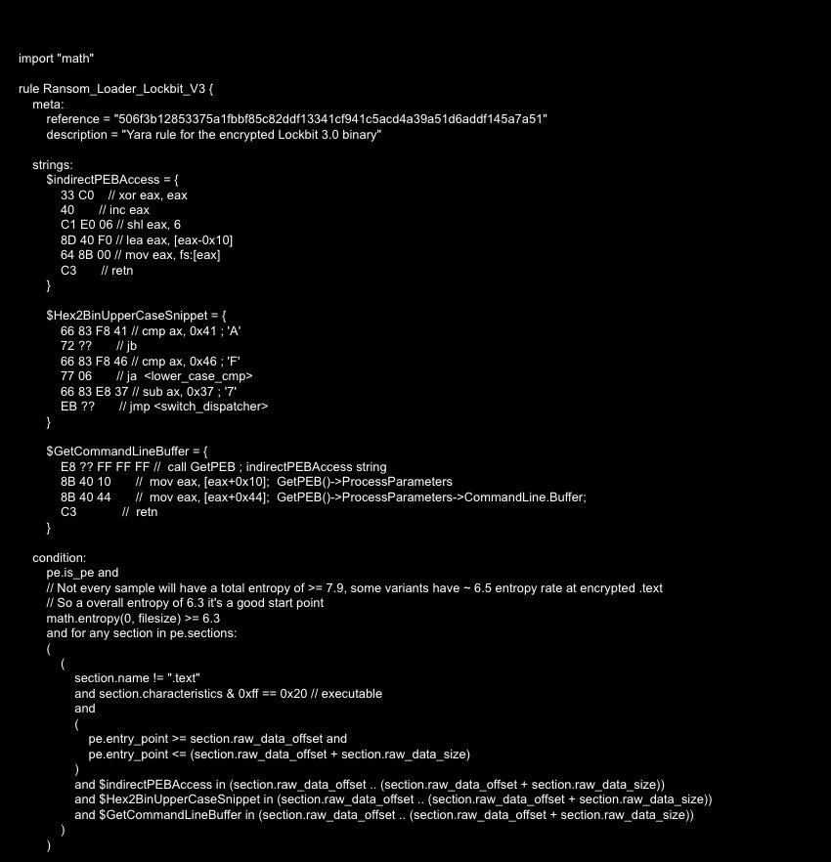
YARA Detection Rule
A YARA rule is like a fingerprint scanner for malware — we built one specifically for LockBit 3.0
What This Rule Does
3 Fingerprints
The rule looks for 3 unique code patterns found only in LockBit 3.0 samples.
Entropy Check
It also checks if the file looks scrambled/packed — a common trick ransomware uses to hide.
Tested Live
We ran this rule against a real LockBit sample — it detected it correctly every time.
Deployable Now
This rule can be loaded into any IDS, EDR, or firewall to automatically block new infections.

Slide 13
How To Stay Safe
5 things any organization can do right now to reduce ransomware risk
💾
3-2-1 Backup Rule
🎣
Phishing Training
🔍
Keep Detection Rules Fresh
Keep 3 copies of your data, on 2 different storage types, with 1 kept completely offline. Ransomware can only encrypt what it can reach.
Most ransomware gets in through fake emails. Train your team to spot suspicious links and attachments — never click without checking.
Regularly update your antivirus, YARA rules, and firewall signatures. Our custom LockBit rule can now catch this ransomware automatically.
🧱
Segment Your Network
🔑
Limit Permissions
Split the network into separate zones. If ransomware hits one area, it can't jump to others — this attack only hit 2 hosts for this reason.
Don't give users or programs more access than they need. If an attacker gets in, they'll have less to work with.

Slide 14
Key Takeaways
01
LockBit went from breaking in to fully encrypting files in under 11 minutes. Speed is the attacker's biggest weapon.
02
Attackers disguise malware as real programs. A process name that looks familiar doesn't mean it's safe.
03
Sysmon logs gave us the full picture — without detailed logging, we would have had no idea what happened.
04
Our updated playbook's continuous loop — find IOCs, update YARA, deploy, repeat — is stronger than a one-time response.
05
With good logging, a clear playbook, and offline backups, ransomware attacks can be fully recovered from.
Ransomware is fast — but so is a prepared team.

