Slide 1
SpaceX Falcon 9
First-Stage Landing Prediction
Data Science Capstone Project Report
Aaron Vargas | IBM Applied Data Science Capstone | 2026-08-19
All completed notebooks and Python files: https://github.com/razerblade09/spacex-falcon9-capstone

Slide 2
CONTENTS
Outline
Executive Summary
Methodology — predictive analysis
Introduction
Results — EDA with visualization
Methodology — data collection
Results — EDA with SQL
Methodology — data wrangling
Results — Folium map
Methodology — EDA with visualization
Results — Plotly Dash dashboard
Methodology — EDA with SQL
Results — predictive analysis
Methodology — interactive maps and dashboard
Conclusion and insights
2

Slide 3
OVERVIEW
Executive Summary
Summary of methodologies Launch data was collected from the SpaceX REST API and by scraping Wikipedia, cross-checked and merged. Records were cleaned, missing payload mass imputed, and a binary landing-success label engineered from the raw outcome text. The data was explored with six charts and with nine SQL queries against SPACEXTABLE, mapped geospatially with Folium, published through a Plotly Dash dashboard, and modelled with four classifiers tuned by 10-fold GridSearchCV.
Summary of results Across 90 Falcon 9 launches from 2010 to November 2020 the overall first-stage landing success rate was 66.7%. Logistic Regression, SVM and KNN each reached 83.3% test accuracy and the Decision Tree 77.8%. Success falls as orbit energy rises, and climbs steadily with booster generation and flight number — landing reliability is a maturing process rather than a fixed property of the hardware.
90
66.7%
83.3%
4
Launches analyzed
Landing success rate
Best model accuracy
Models compared
Conclusion: landing success is highly predictable from public launch parameters, so a competing launch provider can reliably estimate SpaceX's true reusable-launch cost advantage.
3

Slide 4
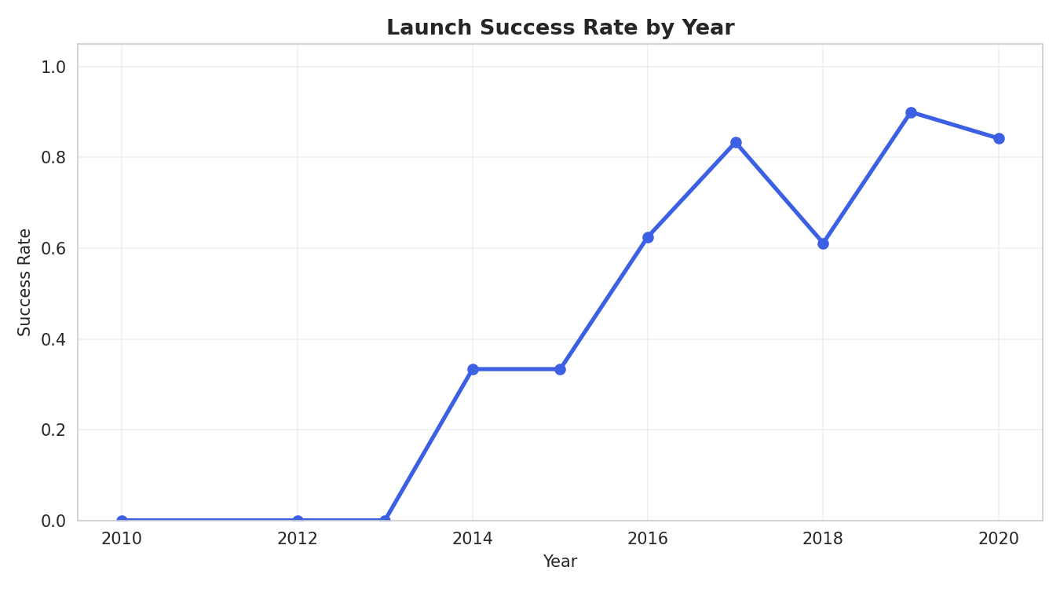
BACKGROUND
Introduction
Project background and context SpaceX advertises a Falcon 9 launch at $62 million against $165 million or more from other providers. The difference exists because SpaceX recovers and reuses the first stage instead of discarding it after every flight, so the cost of any given launch depends on whether that stage comes back. Problems you want to find answers to Acting as a data scientist for a startup competing with SpaceX, this project asks: what launch parameters determine whether the first stage lands successfully? Which orbits, payload masses and launch sites are associated with success? And can the outcome be predicted accurately enough from public data to cost a competing bid?
Landing success climbed from roughly 0% across 2010–2013 to close to 100% by 2019–2020.
4

Slide 5
Section 1
Methodology
How the data was collected, cleaned, explored and modelled
5

Slide 6
METHODOLOGY
Data Collection — SpaceX API
1
GET /v4/launches/past returns every historical launch
api.spacexdata.com/v4/launches/past
Result: 90 clean Falcon 9 launch records spanning 2010 to November 2020, each carrying booster version, payload mass, orbit, launch site with coordinates, flight count, grid fins, reused flag, legs, landing pad, booster block and serial, and landing outcome. Falcon 1 flights were excluded.
2
Filter to single-core, single-payload Falcon 9 flights
3
Resolve IDs through /rockets, /launchpads, /payloads and /cores
4
Assemble one row per launch and export to CSV
6

Slide 7
METHODOLOGY
Data Collection — Web Scraping
1
Request the Wikipedia Falcon 9 launch-history page
BeautifulSoup(response.text, 'html.parser')
This second, independent source validates the API dataset and fills in fields the API does not expose, such as payload customer. It is also the table loaded into SQL for the EDA-with-SQL section. Key techniques: regex and Unicode cleanup of payload-mass strings, and helpers that pull booster version and landing status out of merged cells.
2
Locate the wikitable elements with BeautifulSoup
3
Extract column headers programmatically
4
Parse each row and clean it into a dataframe
7

Slide 8
METHODOLOGY
Data Wrangling
Missing values. PayloadMass was missing for 5.6% of records and was filled with the column mean. LandingPad was missing for 28.9% and was deliberately left as-is, since a null pad legitimately means no ground or drone-ship landing was attempted. Label engineering. The raw Outcome field is free text — "True ASDS", "False Ocean", "None None". Each value was mapped to a binary Class column: 1 where the booster landed successfully by any method (drone ship, ground pad, RTLS return or controlled ocean), 0 where it did not land or no attempt was made. Result. Of 90 launches, 60 ended in a successful first-stage landing and 30 did not. Class is the target variable for the predictive model.
60
landed (66.7%)
30
did not land (33.3%)
8

Slide 9
METHODOLOGY
EDA, Interactive Analytics and Modelling Approach
EDA with data visualization
EDA with SQL
Six charts: flight number against launch site and against orbit, payload mass against launch site and against orbit, success rate by orbit, and success rate by year.
The scraped table loaded into a SQL database as SPACEXTABLE, then nine queries run against it covering sites, payloads, landing dates, boosters and outcome rankings.
Interactive visual analytics
Predictive analysis
A Folium map with launch-site markers, per-launch outcome markers and haversine proximity lines; a Plotly Dash app with a site dropdown, success-rate pie chart and payload range slider.
Features standardized, split 80/20, then Logistic Regression, SVM, Decision Tree and KNN each tuned by 10-fold GridSearchCV and compared on test accuracy and confusion matrix.
9

Slide 10
Section 2
Results — EDA with Data Visualization
Six charts relating flight number, payload, orbit and year to landing outcome
10

Slide 11
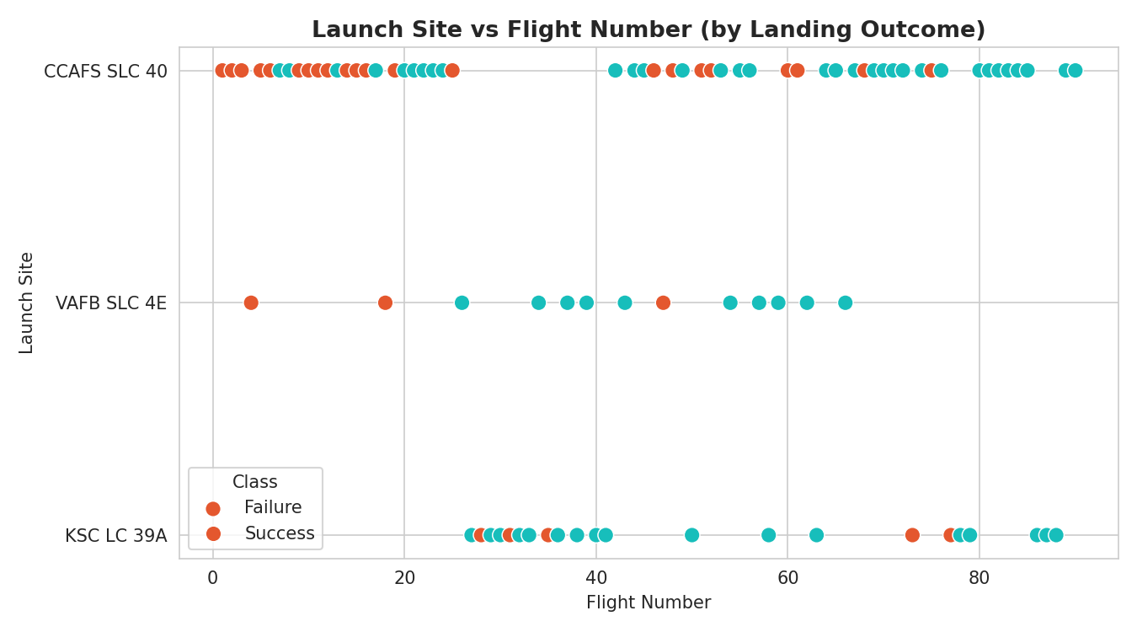
EDA · RESULTS
Flight Number vs. Launch Site
What this shows Each launch plotted by flight number against its site, colored by landing outcome. Early flight numbers at CCAFS LC-40 are almost all failures; as flight number rises, successes dominate at every site. Launch experience, not the site itself, is what changes the outcome.
11

Slide 12
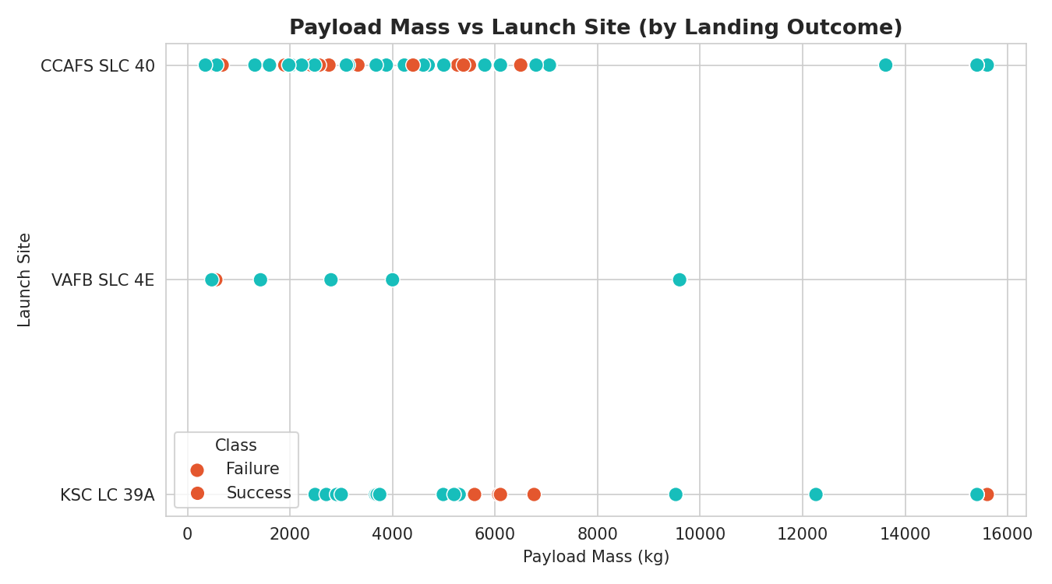
EDA · RESULTS
Payload Mass vs. Launch Site
What this shows Payload mass against launch site, colored by outcome. VAFB SLC-4E carries no payload above roughly 10,000 kg. Heavier payloads cluster at CCAFS and KSC, and above about 7,000 kg the failure rate visibly rises.
12

Slide 13
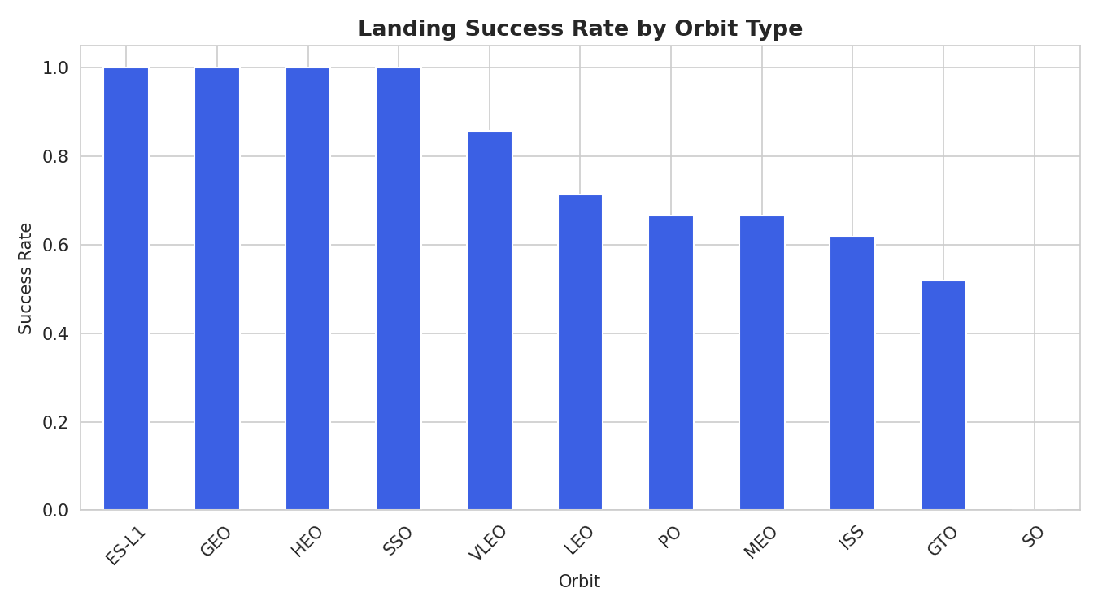
EDA · RESULTS
Success Rate by Orbit Type
What this shows Landing success rate per orbit. ES-L1, GEO, HEO and SSO reach 100%, while GTO sits far lower and SO records no successes. Orbit energy is one of the strongest single predictors in the dataset — high-energy transfers leave less fuel for the recovery burn.
13

Slide 14
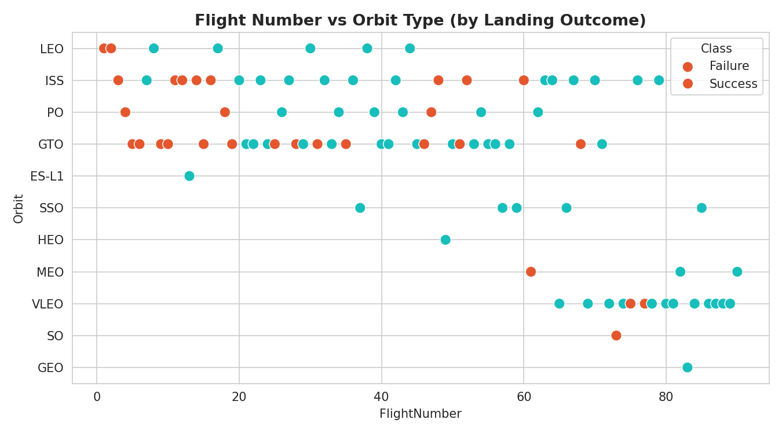
EDA · RESULTS
Flight Number vs. Orbit Type
What this shows Flight number against orbit, colored by outcome. In LEO the relationship between flight number and success is clear, whereas in GTO the outcome looks independent of flight number — the difficulty there is physical rather than procedural.
14

Slide 15
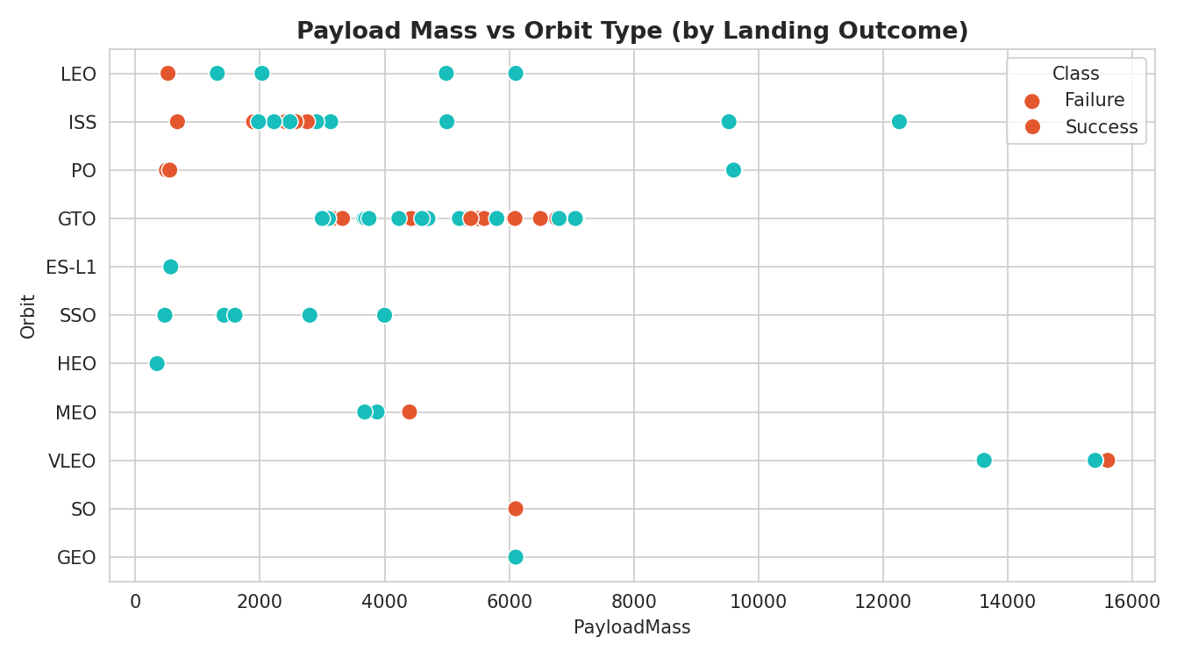
EDA · RESULTS
Payload Mass vs. Orbit Type
What this shows Payload mass against orbit, colored by outcome. Heavy payloads correlate with more successful landings for LEO, ISS and Polar orbits, but for GTO the picture is mixed, which is consistent with GTO's lower overall success rate.
15

Slide 16
EDA · RESULTS
Launch Success Yearly Trend
What this shows Average landing success by year. Success is flat at zero from 2010 to 2013, rises sharply from 2014, dips in 2018, and approaches 100% by 2019 and 2020. This is the single clearest signal in the data: recovery is a capability SpaceX built over time.
16

Slide 17
Section 3
Results — EDA with SQL
Nine queries run against SPACEXTABLE
17

Slide 18
EDA WITH SQL · RESULTS
All Launch Site Names
SELECT DISTINCT Launch_Site FROM SPACEXTABLE;
Result — 4 distinct launch sites
CCAFS LC-40 · CCAFS SLC-40 · KSC LC-39A · VAFB SLC-4E
Three sites sit on the Florida coast at Cape Canaveral and one on the Californian coast at Vandenberg, which is what makes the polar and sun-synchronous launches possible.
18

Slide 19
EDA WITH SQL · RESULTS
Launch Sites Beginning with 'CCA'
SELECT * FROM SPACEXTABLE WHERE Launch_Site LIKE 'CCA%' LIMIT 5;
Result — first 5 records at Cape Canaveral
CCAFS LC-40, from 2010-06-04 onward
The earliest records in the dataset are all CCAFS LC-40, confirming it as the site SpaceX flew from first and therefore the one carrying most of the early failures.
19

Slide 20
EDA WITH SQL · RESULTS
Total Payload Mass Carried for NASA (CRS)
SELECT SUM(PAYLOAD_MASS__KG_) FROM SPACEXTABLE
WHERE Customer = 'NASA (CRS)';
Result — total payload mass
45,596 kg
NASA Commercial Resupply Services is the single largest customer by mass in the dataset, which is why ISS-bound LEO missions dominate the successful-landing records.
20

Slide 21
EDA WITH SQL · RESULTS
Average Payload Mass by Booster Version F9 v1.1
SELECT AVG(PAYLOAD_MASS__KG_) FROM SPACEXTABLE
WHERE Booster_Version = 'F9 v1.1';
Result — average payload mass
2,534.7 kg
The v1.1 generation averages well under half the maximum payload the fleet later carried, showing how much lift capability grew between booster generations.
21

Slide 22
EDA WITH SQL · RESULTS
First Successful Ground-Pad Landing
SELECT MIN(Date) FROM SPACEXTABLE
WHERE Landing_Outcome = 'Success (ground pad)';
Result — first successful ground-pad landing
1 May 2017
Ground-pad recovery came years after the first launches, and marks the point where landing outcomes in the dataset shift decisively from failure to success.
22

Slide 23
EDA WITH SQL · RESULTS
Drone-Ship Successes with Payload 4,000–6,000 kg
SELECT Booster_Version FROM SPACEXTABLE
WHERE Landing_Outcome = 'Success (drone ship)'
AND PAYLOAD_MASS__KG_ BETWEEN 4000 AND 6000;
Result — boosters that landed on a drone ship in this payload band
F9 FT B1021.2 · F9 FT B1022 · F9 FT B1026 · F9 FT B1031.2
Every booster in this band is a Full Thrust variant, and two of them are re-flights, which is direct evidence that reused boosters land successfully.
23

Slide 24
EDA WITH SQL · RESULTS
Total Successful and Failed Mission Outcomes
SELECT Mission_Outcome, COUNT(*) FROM SPACEXTABLE
GROUP BY Mission_Outcome;
Result — mission outcomes across the dataset
98 successful missions · 1 failure · 2 unclear
Mission success and landing success are very different problems: the rocket almost always delivers its payload, while recovering the first stage succeeded only about two thirds of the time.
24

Slide 25
EDA WITH SQL · RESULTS
Boosters That Carried the Maximum Payload
SELECT DISTINCT Booster_Version FROM SPACEXTABLE
WHERE PAYLOAD_MASS__KG_ = (SELECT MAX(PAYLOAD_MASS__KG_) FROM SPACEXTABLE);
Result — maximum payload mass carried
15,600 kg, by the F9 B5 booster series
The Block 5 generation carries roughly six times the average v1.1 payload, and does so while still landing — the clearest single demonstration of how far the design matured.
25

Slide 26
EDA WITH SQL · RESULTS
2015 Drone-Ship Landing Failures
SELECT Booster_Version, Launch_Site FROM SPACEXTABLE
WHERE Landing_Outcome = 'Failure (drone ship)'
AND substr(Date,1,4) = '2015';
Result — failed drone-ship landings during 2015
F9 v1.1 B1012 and F9 v1.1 B1015, both from CCAFS LC-40
Both failures are v1.1 boosters from the same pad, placing them squarely in the pre-Full-Thrust era before drone-ship recovery was reliable.
26

Slide 27
EDA WITH SQL · RESULTS
Ranking of Landing Outcomes, 2010–2017
SELECT Landing_Outcome, COUNT(*) AS cnt FROM SPACEXTABLE
WHERE Date BETWEEN '2010-06-04' AND '2017-03-20' GROUP BY Landing_Outcome ORDER BY cnt DESC;
Landing outcome | Count
No attempt | 10
Success (drone ship) | 5
Failure (drone ship) | 5
Success (ground pad) | 3
Controlled (ocean) | 3
Uncontrolled (ocean) | 2
Failure (parachute) | 2
Precluded (drone ship) | 1
Reading the ranking Across this window no-attempt is still the most common outcome, and drone-ship successes and failures are evenly matched at five each. Recovery in this period was genuinely experimental. It is only after March 2017 — with ground-pad landings established and the Full Thrust boosters flying — that success becomes the expected result rather than a hoped-for one.
27

Slide 28
Section 4
Results — Folium Map
Launch site markers, launch records and proximity analysis
28

Slide 29
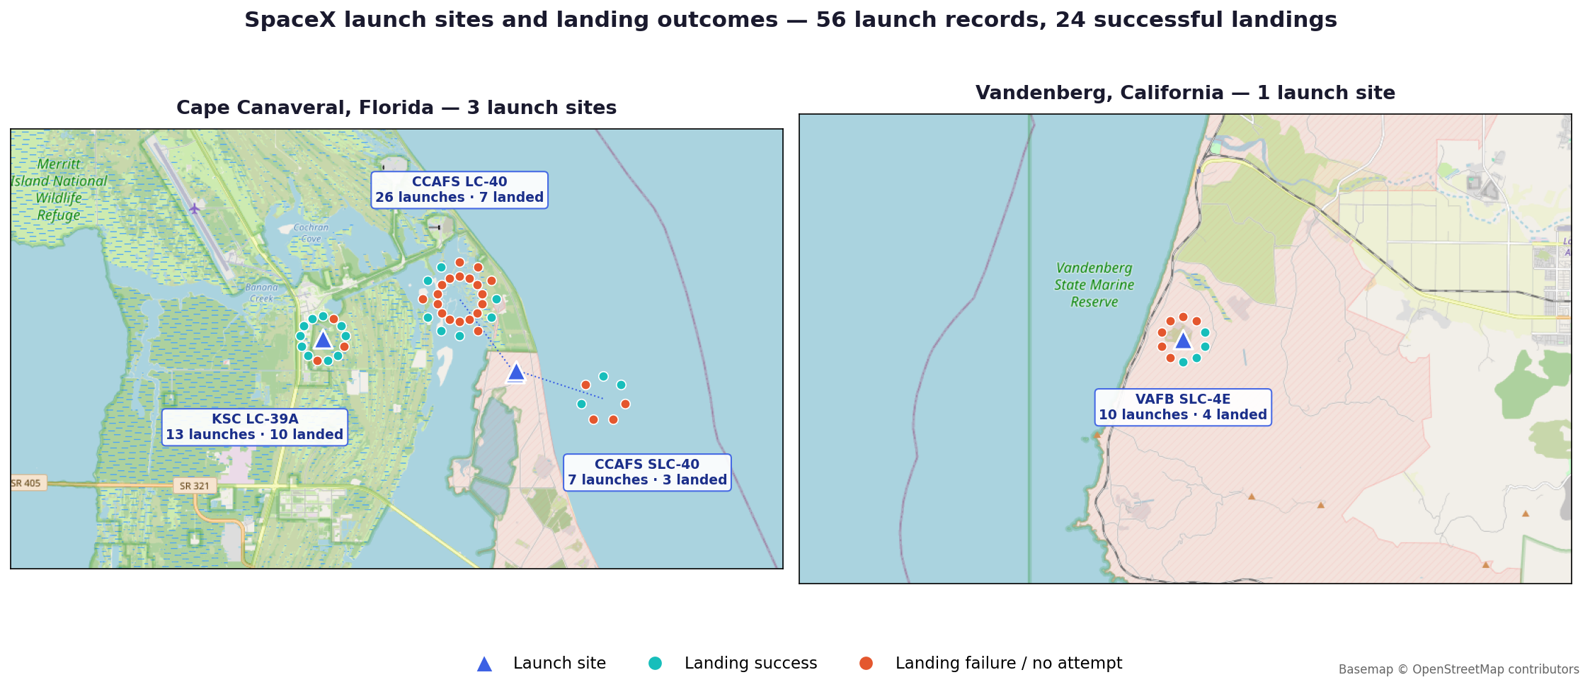
FOLIUM MAP · RESULTS
Launch Site Markers and Launch Records
Markers and outcome clusters All 4 launch sites are marked, and every one of the 56 individual launch records is plotted as a marker colored green for a successful landing and red for a failure or no attempt. Observation KSC LC-39A shows the densest green cluster, landing 10 of 13 launches (77%). CCAFS LC-40, the earliest and highest-volume pad, landed only 7 of 26 (27%) because most of its records predate a working recovery process.
Are all launch sites close to the Equator, and are they all near the coast? Both sites are coastal, and the three Florida pads sit at 28.5° N — closer to the Equator than Vandenberg at 34.6° N, gaining more of Earth's rotational velocity at launch.
29

Slide 30
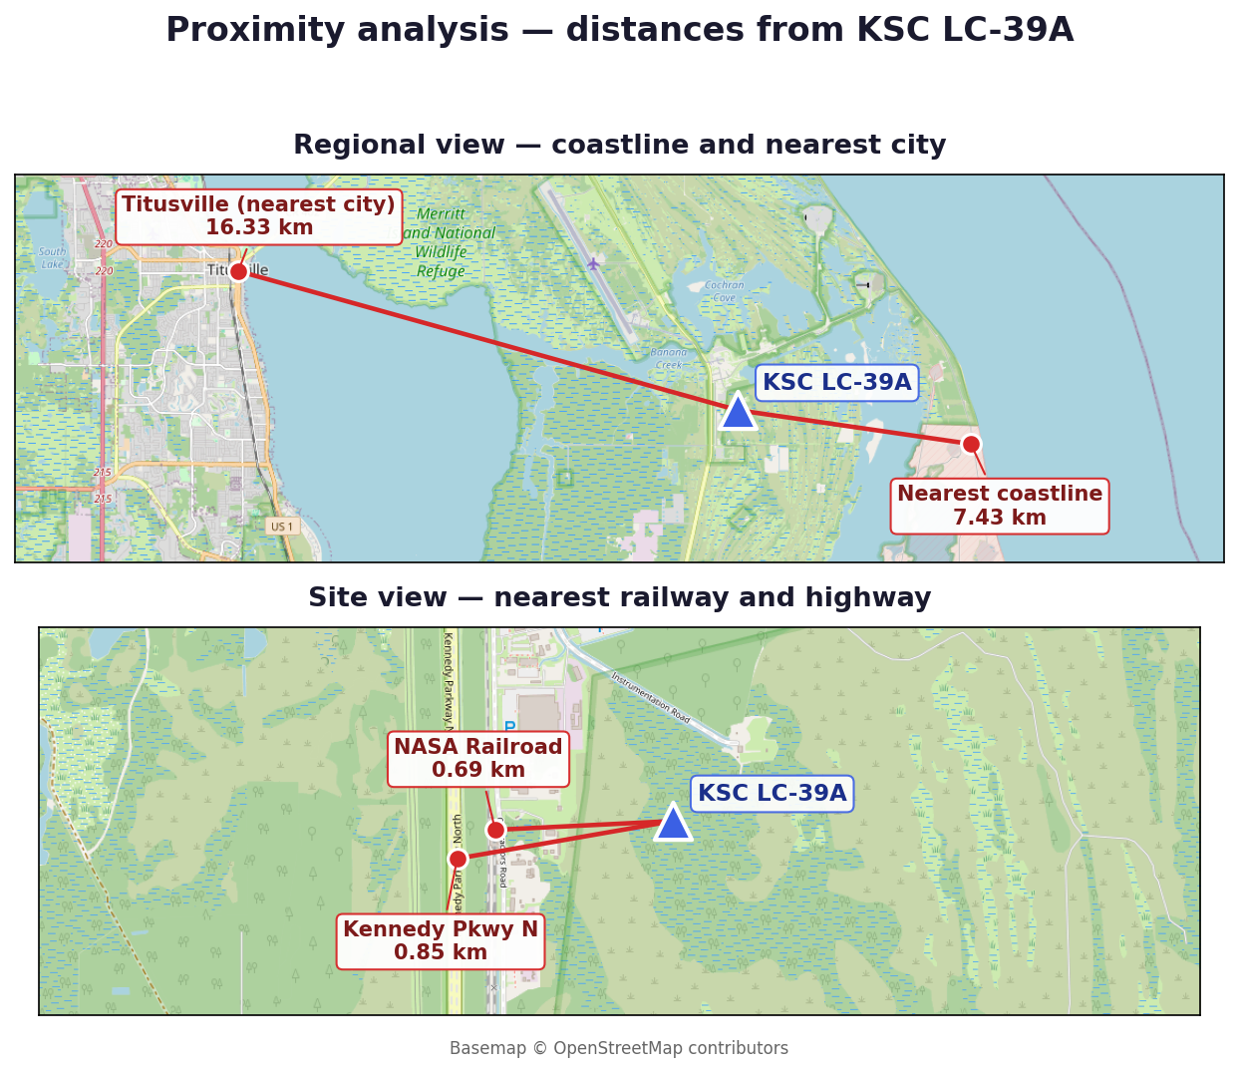
FOLIUM MAP · RESULTS
Proximity Analysis
Feature | Distance from KSC LC-39A
Nearest coastline | 7.43 km
Nearest city (Titusville) | 16.33 km
Nearest railway (NASA Railroad) | 0.69 km
Nearest highway (Kennedy Pkwy N) | 0.85 km
Why the distances matter Distances were computed with the haversine formula; the railway and highway coordinates come from OpenStreetMap. The pattern matches real siting constraints: the pad sits close to open water so that failures fall downrange over the sea, and within a kilometre of both rail and road because boosters and stages arrive overland, yet is kept well clear of the nearest population centre. Any competing launch provider would have to satisfy the same three conditions simultaneously.
30

Slide 31
Section 5
Results — Plotly Dash Dashboard
Success-rate pie charts and payload versus outcome scatter
31

Slide 32
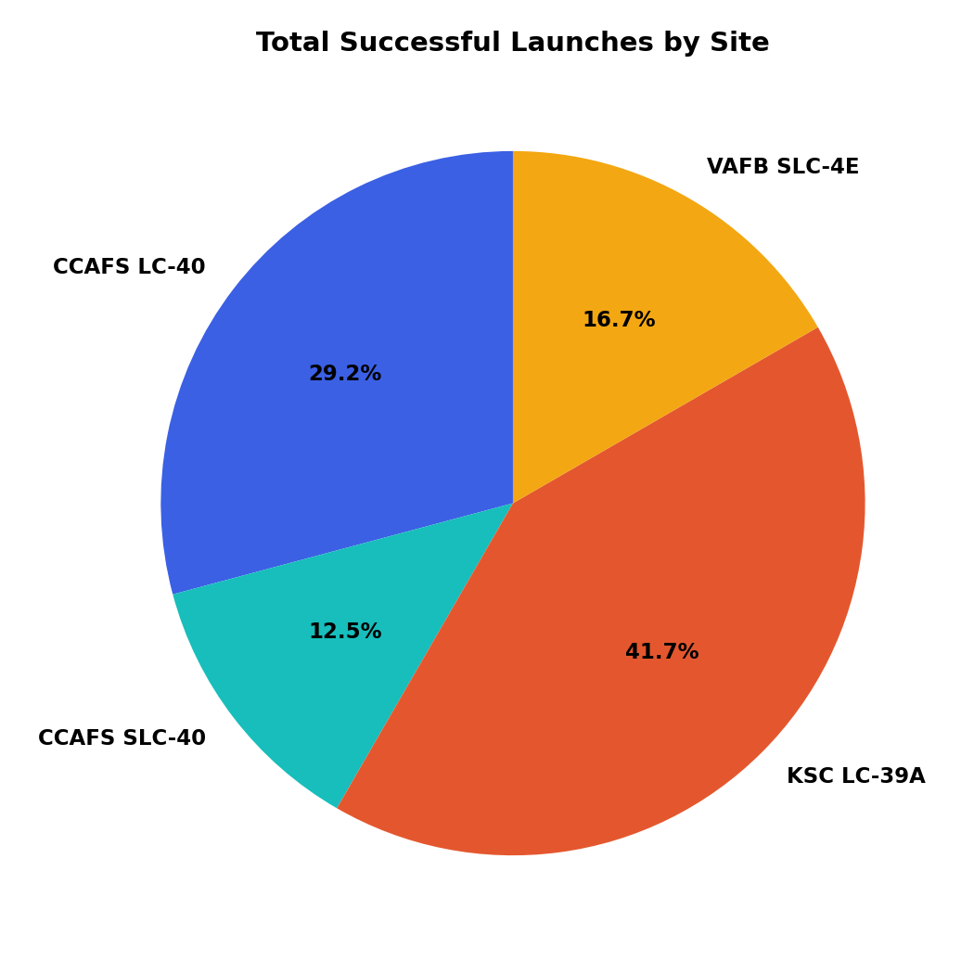
PLOTLY DASH · RESULTS
Total Successful Landings by Site
Reading the pie chart With the dropdown set to All Sites, the pie shows each site's share of all successful landings. KSC LC-39A contributes the largest share despite launching far fewer missions than CCAFS LC-40 — a direct visual of the difference between launch volume and recovery reliability.
32

Slide 33
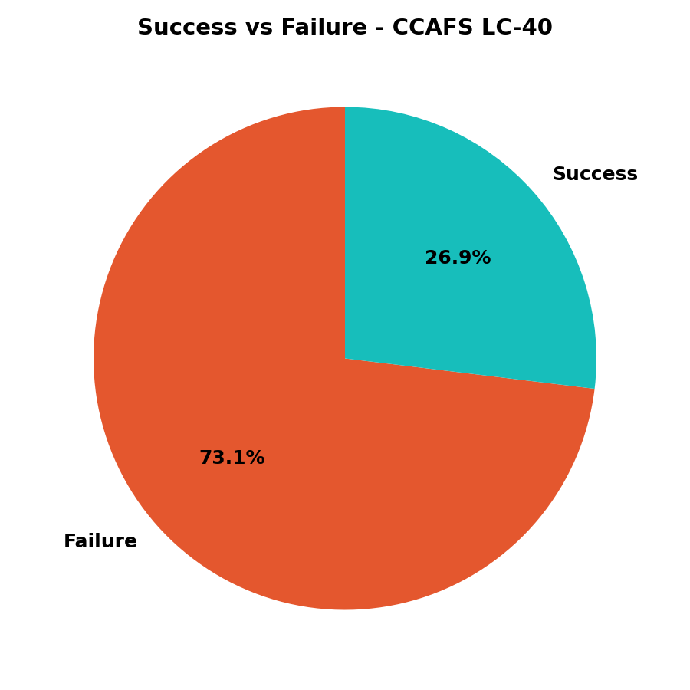
PLOTLY DASH · RESULTS
Success Ratio at the Highest-Volume Site
Reading the pie chart Selecting CCAFS LC-40 in the dropdown redraws the pie as that site's own success-versus-failure split. Its ratio is the weakest of the four, which is expected: it flew the earliest missions, before drone-ship and ground-pad recovery worked.
33

Slide 34
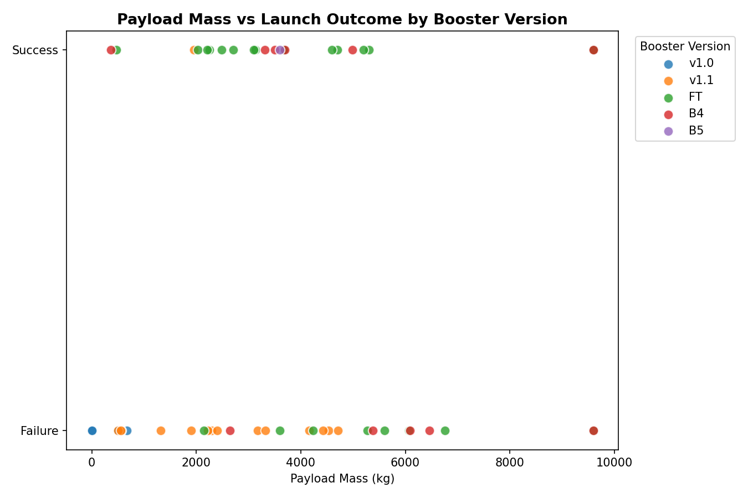
PLOTLY DASH · RESULTS
Payload Mass vs. Launch Outcome
Reading the scatter plot The payload range slider narrows the mass window from 0 to 10,000 kg while the scatter recolors by booster version category. Newer generations (FT, B4, B5) succeed across a much wider payload range than v1.0 and v1.1 — booster maturity, not payload mass alone, drives the outcome.
34

Slide 35
Section 6
Results — Predictive Analysis
Classification models, evaluation and the best performer
35

Slide 36
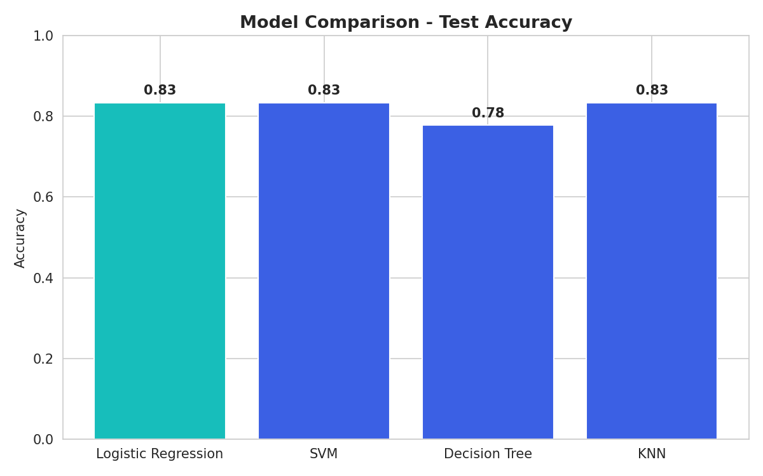
PREDICTIVE ANALYSIS
Classification Methodology
Features. 80 one-hot-encoded columns covering orbit, launch site, landing pad and booster serial, plus flight number, payload mass, flights, grid fins, reused, legs and block. All standardized with StandardScaler. Split. 80/20 train-test, giving 72 training launches and 18 test launches. Tuning. Each model tuned by 10-fold GridSearchCV over its own hyperparameter grid: Logistic Regression across C, penalty and solver; SVM across kernel, C and gamma; Decision Tree across criterion, max depth and minimum samples per split; KNN across n_neighbors and distance metric.
36

Slide 37
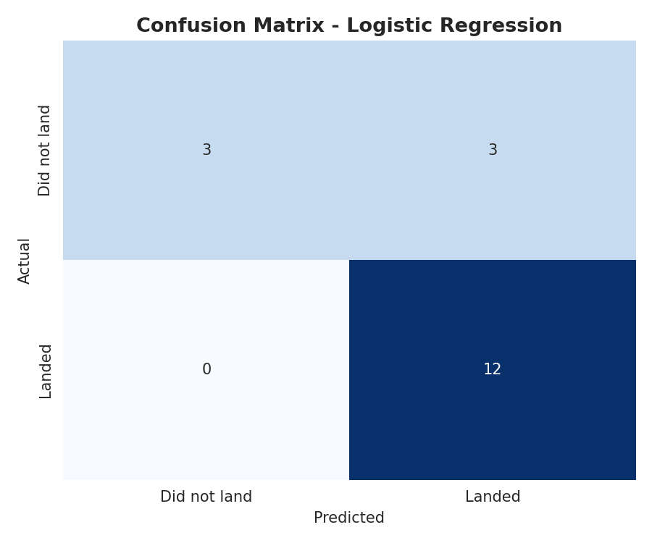
PREDICTIVE ANALYSIS · RESULTS
Model Evaluation Results
Model | CV score | Test accuracy
Logistic Regression | 0.821 | 0.833
Support Vector Machine | 0.834 | 0.833
K-Nearest Neighbors | 0.834 | 0.833
Decision Tree | 0.804 | 0.778
What the comparison shows Logistic Regression, SVM and KNN converge on exactly the same 83.3% test accuracy, and only the Decision Tree falls behind at 77.8%. When three very different algorithms agree to the decimal on a held-out set, the signal is coming from the engineered features rather than from any model's inductive bias — feature quality mattered far more here than model choice.
37

Slide 38
PREDICTIVE ANALYSIS · RESULTS
Confusion Matrix and Best Model
Reading the confusion matrix (18 test launches) 12 successful landings correctly predicted, 3 unsuccessful correctly predicted, 3 unsuccessful misclassified as successful, and 0 successful landings missed. Every error is a false positive, so the model never fails to spot a booster that actually lands — the conservative direction for cost bidding. Best model: Logistic Regression Tuned to C=1 with an L2 penalty and the lbfgs solver. It ties SVM and KNN at 83.3% test accuracy, but it is the only one of the three whose coefficients directly express each feature's effect on landing-success odds — which is what lets a cost bid be explained to a non-technical stakeholder. It is also the cheapest of the four to retrain as new launches accumulate.
38

Slide 39
WRAP-UP
Conclusion
1
Landing success is highly learnable from public launch parameters — 83.3% test accuracy from a simple, interpretable Logistic Regression model.
2
Orbit type is the strongest single predictor: high-energy GTO transfers land far less reliably than LEO, ISS and SSO missions.
3
Success improved dramatically from 2013 to 2020, so recovery reliability is a capability SpaceX built rather than a fixed property of the hardware.
4
Booster generation matters more than payload mass alone: FT, B4 and B5 succeed across a much wider payload range than v1.0 and v1.1.
5
Launch sites are measurably constrained — 7.43 km from the coast, within 0.85 km of rail and road, and 16.33 km from the nearest city.
6
A competing bidder can use this model as a first-pass cost-risk estimator, retraining continuously rather than assuming a fixed success rate.
39

Slide 40
APPENDIX
Project Repository
All completed notebooks and Python files for every stage of this project are published in the GitHub repository below, together with the datasets, the generated figures and the Plotly Dash application.
https://github.com/razerblade09/spacex-falcon9-capstone
Data collection — SpaceX API
notebooks/01_data_collection_api.py
Data collection — web scraping
notebooks/02_web_scraping.py
Data wrangling
notebooks/03_data_wrangling.py
EDA, SQL and machine learning
notebooks/04_07_eda_sql_ml.py
Folium map and proximity analysis
notebooks/06_folium_map.py
Plotly Dash application
dashboard/app.py
40

