Slide 1
SpaceX Falcon 9
First-Stage Landing Prediction
Data Science Capstone Project Report
Completed 12-slide presentation PDF — Executive Summary, Introduction, Data Collection, Data Wrangling, EDA with Visualization, EDA with SQL, Folium Map, Plotly Dash, Predictive Analysis, Conclusion — GitHub repository: https://github.com/razerblade09/spacex-falcon9-capstone
Contains all completed notebooks, Python scripts (data collection, web scraping, wrangling, EDA, SQL, Folium, ML modeling) and the Plotly Dash dashboard app referenced in this presentation: https://github.com/razerblade09/spacex-falcon9-capstone
Presented by: Aaron Vargas | 2026-08-19

Slide 2
OVERVIEW
Executive Summary
Project links — GitHub repository: https://github.com/razerblade09/spacex-falcon9-capstone (all notebooks, scripts, and dashboard code) — completed presentation, 90 launches, 66.7% landing success, 83.3% best-model accuracy
Methods used: Data was collected via the SpaceX REST API and Wikipedia web scraping, cleaned and labeled, explored with visualization and SQL, mapped geospatially with Folium, presented interactively through a Plotly Dash dashboard, and modeled with four classifiers (Logistic Regression, SVM, Decision Tree, KNN) tuned via 10-fold GridSearchCV.
Key results: Across 90 Falcon 9 launches (2010–Nov 2020) the overall first-stage landing success rate was 66.7%. Logistic Regression, SVM and KNN each reached 83.3% test accuracy; the Decision Tree reached 77.8%. Landing success rises with booster maturity and falls with orbit energy.
90
66.7%
83.3%
4
Launches analyzed
Overall landing success
Best model test accuracy
ML models compared
Executive summary of every completed section: Introduction — SpaceX bids $62M against $165M because it reuses the first stage. Data Collection — 90 launch records from the SpaceX API, cross-checked by scraping Wikipedia. Data Wrangling Methodology — PayloadMass mean-imputed at 5.6% missing and the free-text Outcome engineered into a binary Class, giving 60 landings and 30 failures. EDA with Data Visualization — six charts showing GTO lands least reliably and success rising from 0% in 2013 to near 100% by 2020. EDA with SQL — nine queries returning 4 launch sites, 45,596 kg for NASA CRS and the first ground-pad landing on 1 May 2017. Folium Map — 56 launch records mapped, 7.43 km to coastline and 0.69 km to rail. Plotly Dash — site dropdown, success-rate pie chart and payload scatter. Predictive Analysis — four classifiers at up to 83.3% test accuracy with a 12/3/3/0 confusion matrix. Conclusion — Logistic Regression selected for interpretability.
2

Slide 3
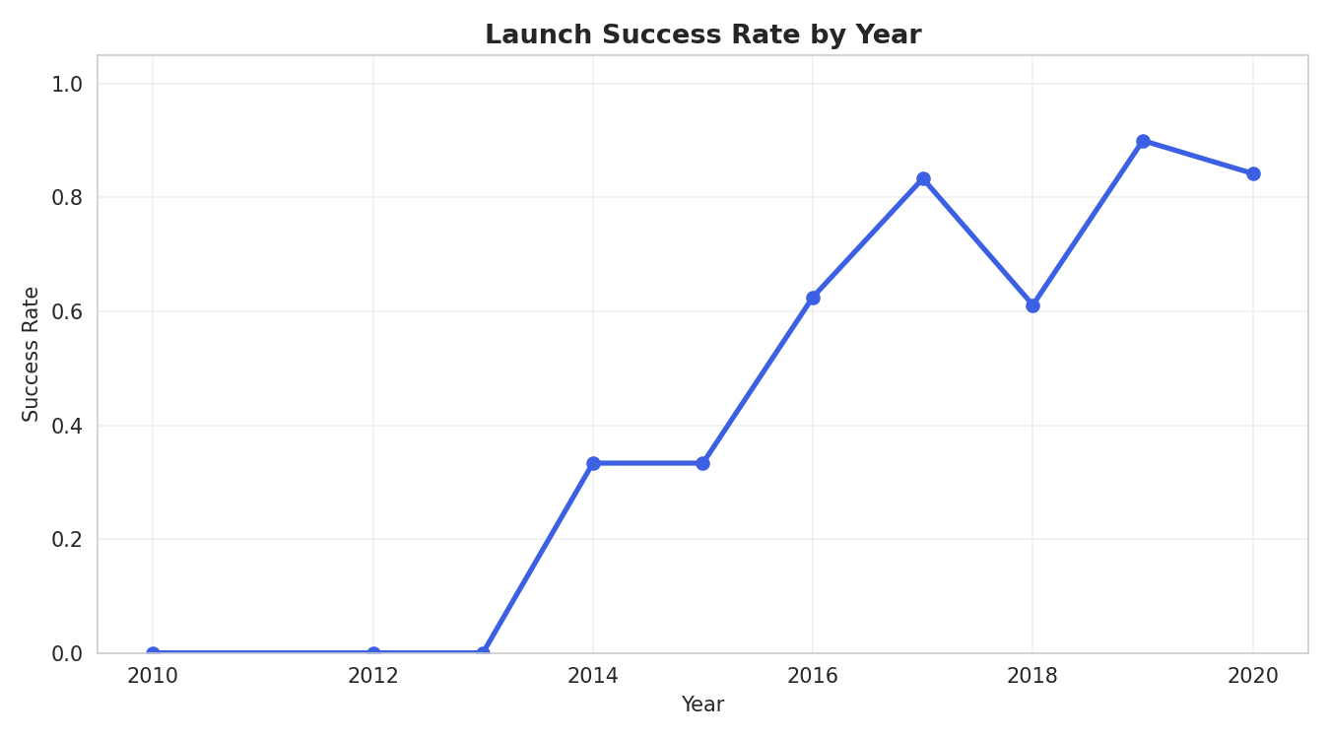
BACKGROUND
Introduction
Introduction — background: SpaceX advertises Falcon 9 launches at $62 million, versus $165 million or more from other providers — largely because SpaceX recovers and reuses the rocket's first stage instead of discarding it after every flight. Problem statement: If the first stage does not land successfully, that launch's true cost changes substantially. Acting as a data scientist for a startup competing with SpaceX, this project predicts from public launch parameters whether the first stage will land, so a competing bid can be costed accurately. Objectives:
Collect and clean historical Falcon 9 launch data from the SpaceX API and Wikipedia
Falcon 9 landing success climbed from roughly 0% across 2010–2013 to close to 100% by 2019–2020 as SpaceX matured its recovery process, which is what makes the outcome predictable at all.
Identify which launch parameters correlate with landing success
Visualize patterns across launch sites, orbits, payload mass and time
Build, tune and evaluate a landing-outcome classifier
3

Slide 4
DATA COLLECTION · PART 1
Data Collection – SpaceX API
Pipeline:
api.spacexdata.com/v4/launches/past
1
GET /v4/launches/past → all historical launches
Result: 90 clean Falcon 9 launch records spanning 2010 to November 2020, one row per launch, each carrying booster version, payload mass, orbit, launch site with coordinates, flight count, grid fins, reused flag, legs, landing pad, booster block and serial, and landing outcome.
2
Filter to single-core, single-payload Falcon 9 flights
3
Call /rockets, /launchpads, /payloads and /cores per launch
4
Assemble one row per launch: booster, orbit, site, outcome, mass
Falcon 1 launches were excluded — this project addresses only the Falcon 9 landing-prediction problem.
Completed Data Collection (SpaceX API) slide: 90 Falcon 9 records from /v4/launches/past — GitHub repository: https://github.com/razerblade09/spacex-falcon9-capstone/blob/main/notebooks/01_data_collection_api.py
4

Slide 5
DATA COLLECTION · PART 2
Data Collection – Web Scraping
Pipeline:
BeautifulSoup(response.text, 'html.parser')
1
Request the Wikipedia "List of Falcon 9 and Falcon Heavy launches" page
This gives an independent, cross-checked source for the launch records: it validates the API dataset, fills in fields the API does not expose such as payload customer, and supplies the table that is loaded into SQL for the EDA-with-SQL section.
2
Parse HTML tables with BeautifulSoup, locating the wikitable elements
3
Extract column headers, then walk each row of launch data
4
Clean dates, booster serials and payload mass into a dataframe
Key techniques: regex and Unicode cleanup of payload-mass strings, plus helper functions that pull booster version and landing status out of merged table cells.
Completed Data Collection (web scraping) slide: Wikipedia launch tables parsed with BeautifulSoup — GitHub repository: https://github.com/razerblade09/spacex-falcon9-capstone/blob/main/notebooks/02_web_scraping.py
5

Slide 6
PREPARATION
Data Wrangling Methodology
Data wrangling methodology — missing values: PayloadMass was missing for 5.6% of records and was filled with the column mean. LandingPad was missing for 28.9% and was deliberately kept as-is, because a null pad legitimately means no ground or drone-ship landing was attempted. Label engineering: The raw Outcome field — free text such as "True ASDS", "False Ocean" or "None None" — was converted into a binary Class label: 1 if the booster landed successfully by any method (drone ship, ground pad, RTLS return or controlled ocean), 0 if it did not land or no attempt was made. Result: of 90 launches, 60 (66.7%) ended in a successful first-stage landing and 30 (33.3%) did not. This Class column is the target variable for the predictive model.
60
successful landings
30
unsuccessful
Completed Data Wrangling slide: Outcome text to binary Class, 60 landings and 30 failures of 90 — GitHub repository: https://github.com/razerblade09/spacex-falcon9-capstone/blob/main/notebooks/03_data_wrangling.py
6

Slide 7
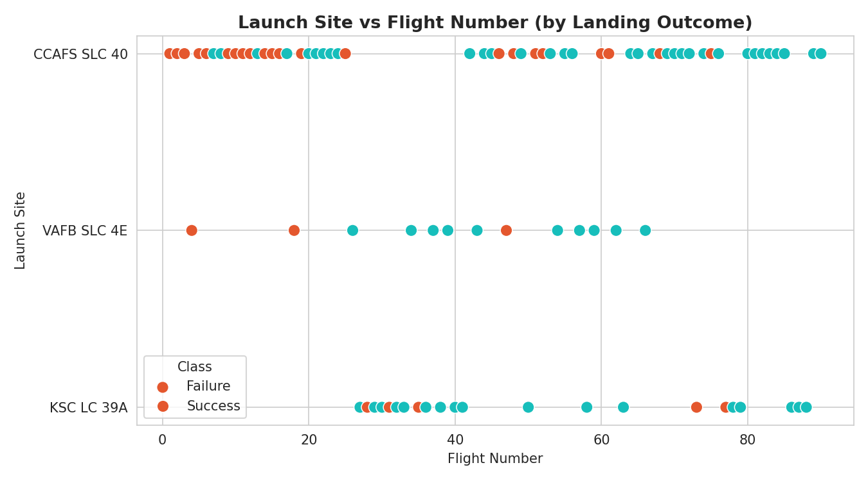
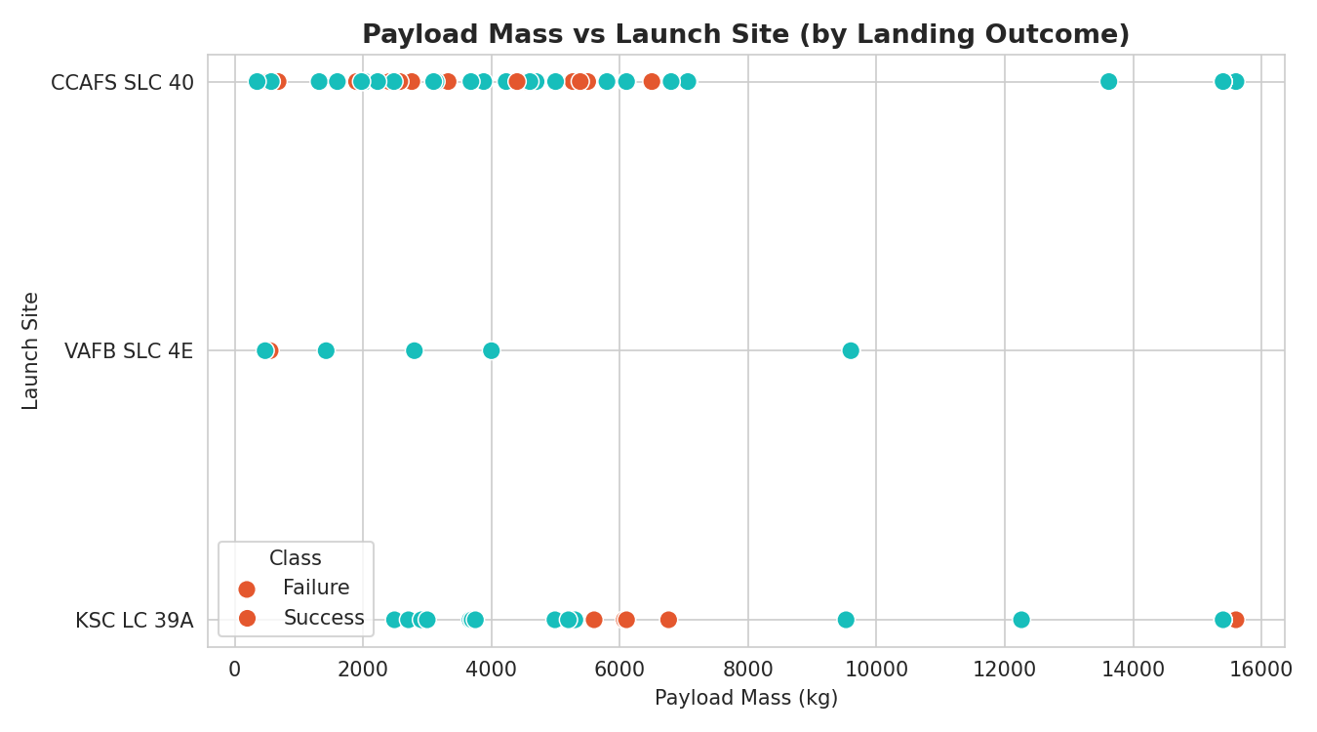
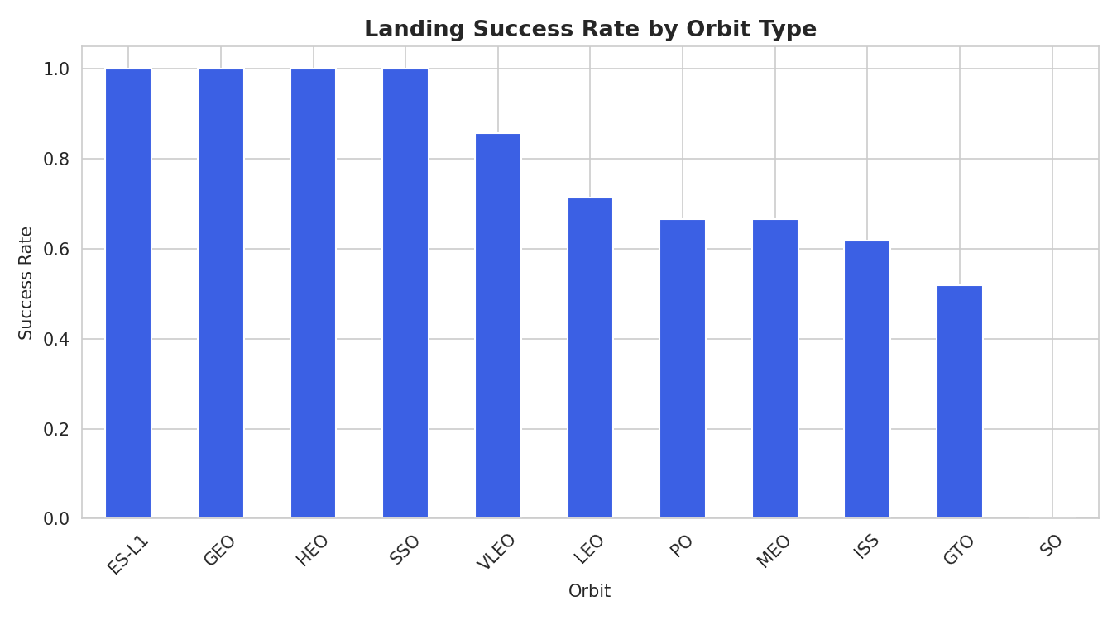
EXPLORATORY ANALYSIS
EDA with Data Visualization
EDA with data visualization methodology: flight number, payload mass, orbit type and launch year were plotted against landing outcome to surface which factors correlate with success. Six charts were produced: scatter plots of flight number against launch site and against orbit, scatter plots of payload mass against launch site and against orbit, a bar chart of success rate by orbit, and a line chart of success rate by year.
Flight # vs Launch Site
Payload vs Launch Site
Success Rate by Orbit
EDA with data visualization results: heavier, higher-energy GTO and ISS missions land least reliably, while light LEO, SSO and GEO missions land most reliably. Success rate climbs steadily with flight number at every site, and rises from roughly 0% across 2010–2013 to close to 100% by 2019–2020 — landing success is a maturing process, not a fixed property of the hardware.
Completed EDA with Data Visualization slide: 6 charts, GTO lands least reliably, success near 100% by 2020 — GitHub repository: https://github.com/razerblade09/spacex-falcon9-capstone/blob/main/notebooks/04_07_eda_sql_ml.py
7

Slide 8
EXPLORATORY ANALYSIS
EDA with SQL
The scraped launch table was loaded into a SQL database (SQLite / IBM Db2) as SPACEXTABLE and queried to answer specific business questions:
Distinct launch sites used
Query | Result
Distinct launch sites | CCAFS LC-40, CCAFS SLC-40, KSC LC-39A, VAFB SLC-4E
Total payload, NASA (CRS) | 45,596 kg
Avg. payload, F9 v1.1 | 2,534.7 kg
First ground-pad landing | 1 May 2017
Max payload carried | 15,600 kg (F9 B5)
Failed drone-ship, 2015 | 2 (B1012, B1015)
Top outcome, 2010–2017 | Success (20), No attempt (10)
Total payload mass carried for NASA (CRS)
Average payload mass for F9 v1.1 boosters
Date of the first successful ground-pad landing
Drone-ship successes carrying 4,000–6,000 kg
Count of each mission outcome
Booster(s) carrying the maximum payload mass
Failed drone-ship landings during 2015
Ranking of landing outcomes, 2010–2017
EDA with SQL results: the nine queries returned four distinct launch sites (CCAFS LC-40, CCAFS SLC-40, KSC LC-39A and VAFB SLC-4E); 45,596 kg of total payload flown for NASA CRS; an average payload of 2,534.7 kg for F9 v1.1 boosters; 1 May 2017 as the date of the first successful ground-pad landing; a maximum payload of 15,600 kg carried by the F9 B5 series; two failed drone-ship landings during 2015, both v1.1 boosters from CCAFS LC-40; and a 2010–2017 landing-outcome ranking led by 20 outright successes against 10 no-attempts.
Completed EDA with SQL slide: 9 queries, 4 launch sites, 45,596 kg for NASA CRS, first pad landing 1 May 2017 — GitHub repository: https://github.com/razerblade09/spacex-falcon9-capstone/blob/main/notebooks/04_07_eda_sql_ml.py
8

Slide 9
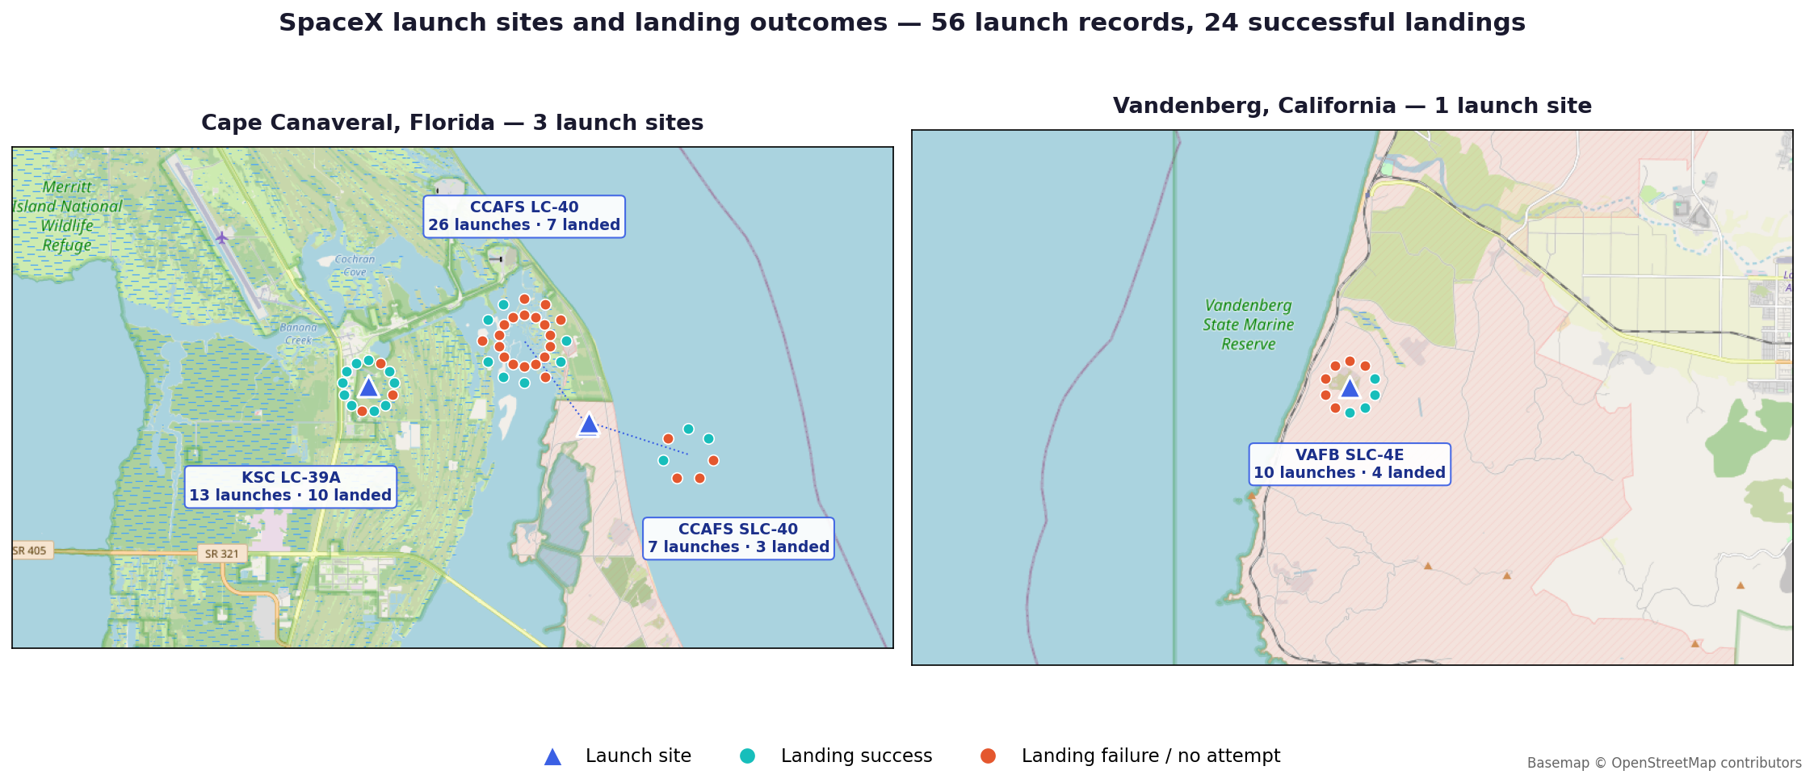
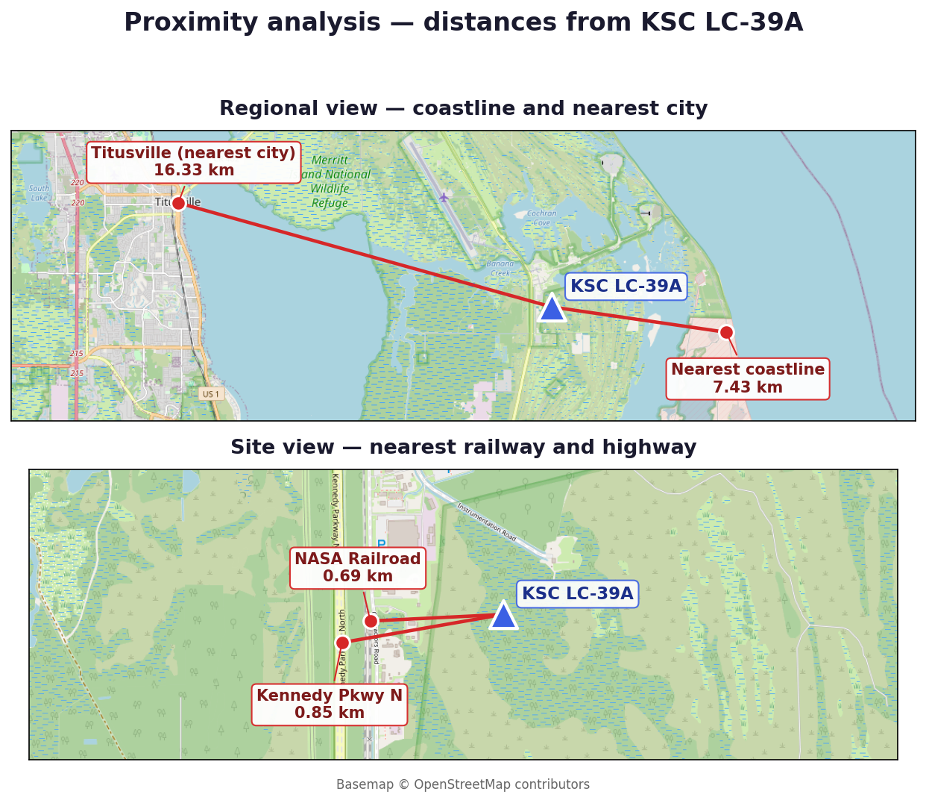
INTERACTIVE VISUAL ANALYTICS
Folium Map
All 4 launch sites are plotted with markers, and every individual launch (56 records) is plotted as a marker colored green for a successful landing and red for a failed or no-attempt landing, so denser green clusters are visible per site. Observation: KSC LC-39A shows the densest green cluster, landing 10 of 13 launches (77%), while CCAFS LC-40 — the earliest and highest-volume pad — landed only 7 of 26 (27%), because most of its records predate a working recovery process. Proximity analysis (haversine distance from KSC LC-39A): nearest coastline 7.43 km, nearest city Titusville 16.33 km, nearest railway the NASA Railroad 0.69 km, nearest highway Kennedy Parkway North 0.85 km. Launch sites sit close to open water for downrange safety and within a kilometre of rail and road links, since boosters arrive overland, yet well clear of population centres — a siting constraint any competing provider must replicate.
Completed Folium Map slide: 4 sites, 56 launch records, 7.43 km coast and 0.69 km rail — GitHub repository: https://github.com/razerblade09/spacex-falcon9-capstone/blob/main/notebooks/06_folium_map.py
9

Slide 10
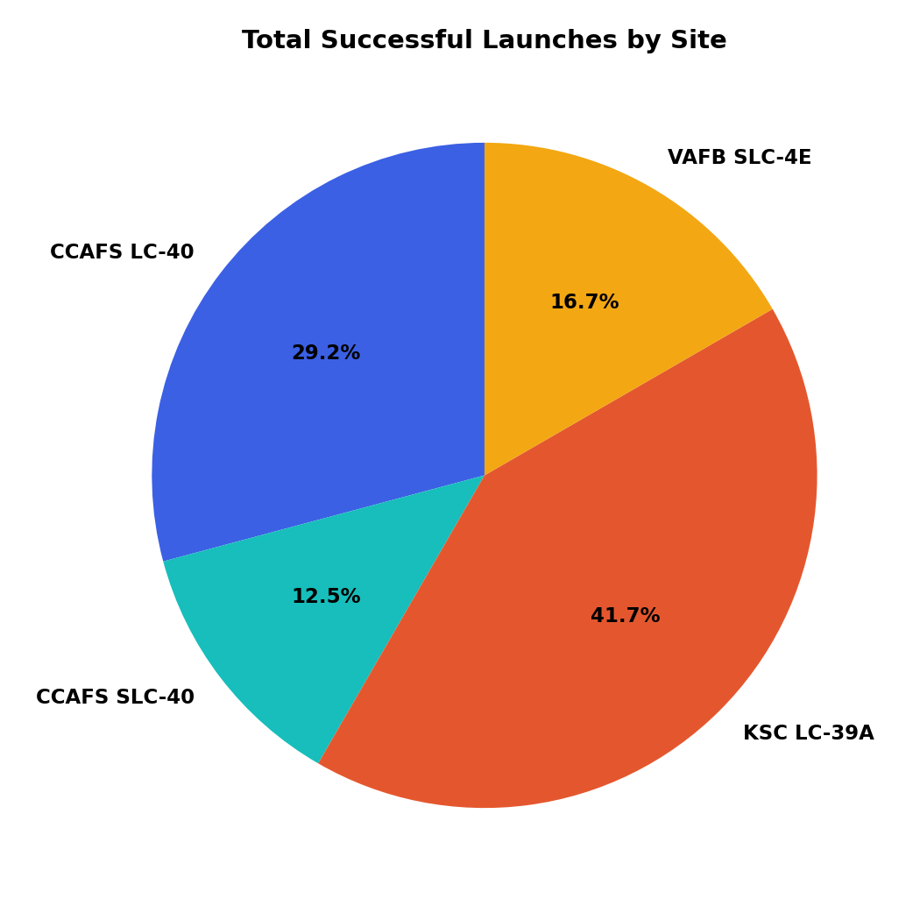
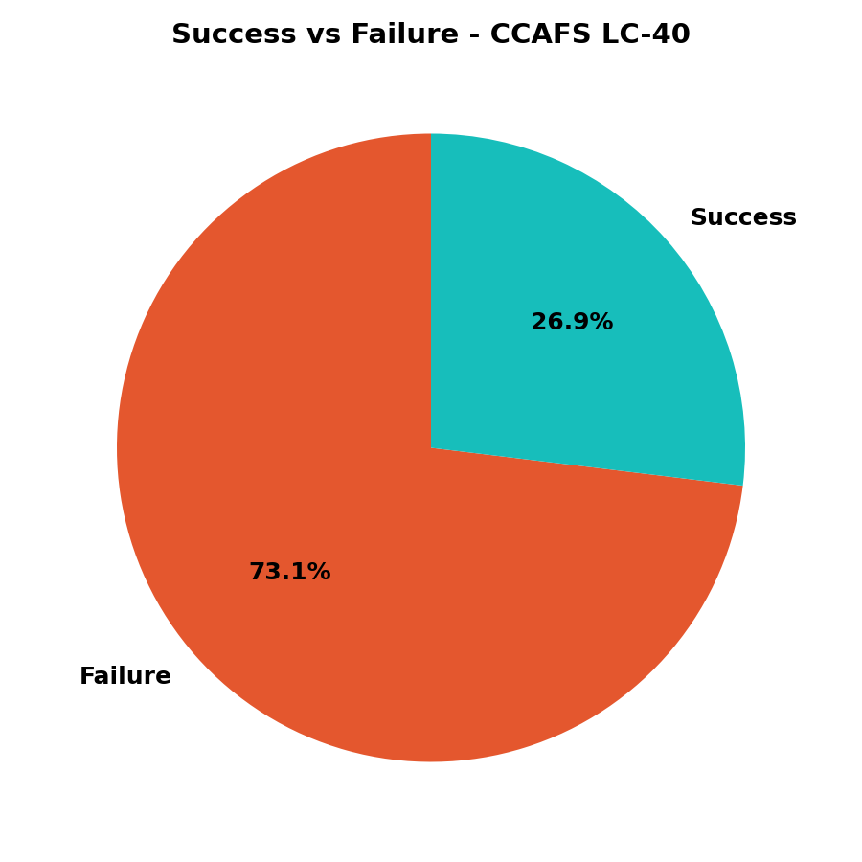
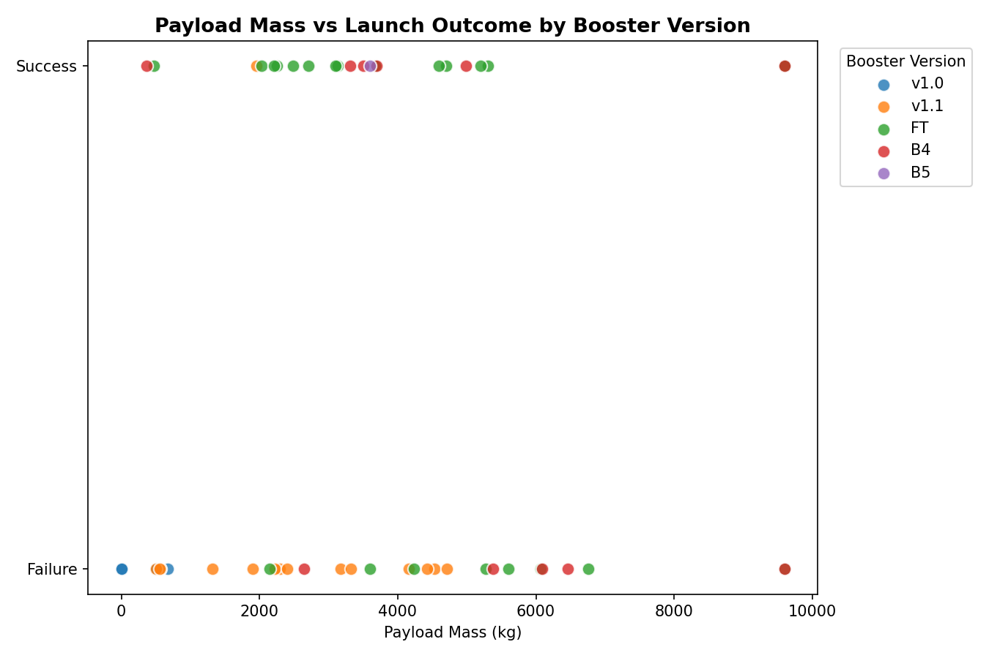
INTERACTIVE VISUAL ANALYTICS
Plotly Dash App
Dropdown to filter by launch site drives a live-updating success-rate pie chart (left: share of successful landings per site; center: success/failure split at the top-volume site, CCAFS LC-40) and a RangeSlider (0–10,000 kg) narrows the payload window on the scatter plot (right), which recolors by booster version (v1.0 / v1.1 / FT / B4 / B5).
Insight: newer booster generations (FT, B4, B5) succeed reliably across a much wider payload range than the early v1.0 and v1.1 boosters — reusability maturity, not payload size alone, drives landing success. KSC LC-39A contributes the largest share of all successful landings despite launching far fewer missions than CCAFS LC-40.
Completed Plotly Dash slide: site dropdown, success-rate pie chart, payload-outcome scatter — GitHub repository: https://github.com/razerblade09/spacex-falcon9-capstone/blob/main/dashboard/app.py
10

Slide 11
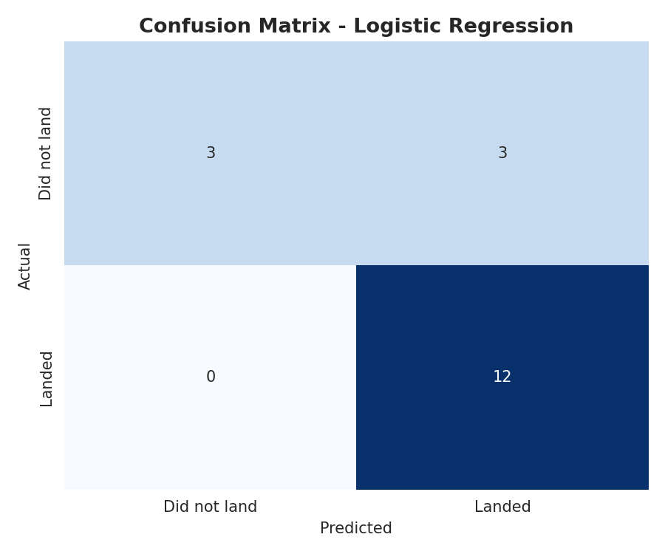
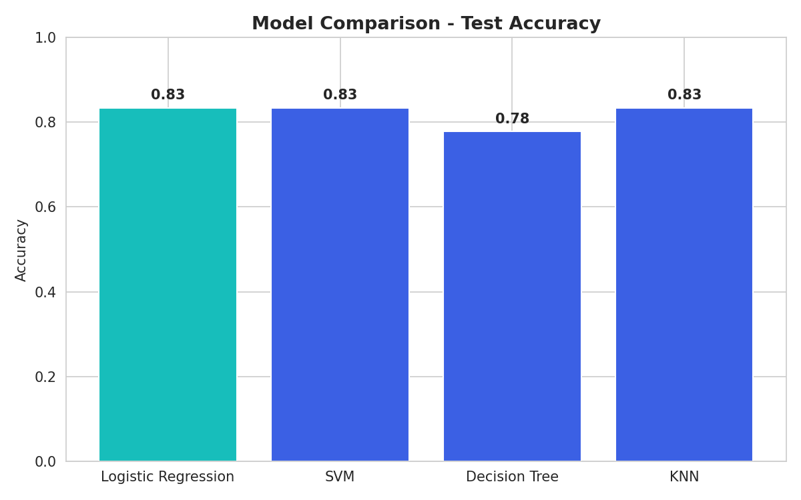
PREDICTIVE ANALYSIS
Methodology, Results & Best Model
Features: 80 one-hot-encoded columns (orbit, launch site, landing pad, booster serial) plus flight number, payload mass, flights, grid fins, reused, legs and block, standardized with StandardScaler. Split: 80/20 train-test (72 / 18 launches). Models, each tuned with 10-fold GridSearchCV: Logistic Regression (C, penalty, solver), Support Vector Machine (kernel, C, gamma), Decision Tree (criterion, max depth, min samples split) and K-Nearest Neighbors (n_neighbors, distance metric).
Model | CV | Test Acc.
Logistic Regression | 0.821 | 0.833
SVM | 0.834 | 0.833
KNN | 0.834 | 0.833
Decision Tree | 0.804 | 0.778
Confusion matrix (18 test launches): 12 successful landings correctly predicted, 3 unsuccessful correctly predicted, 3 unsuccessful misclassified as successful, and 0 successful landings missed — the model errs conservatively, in the safer direction for cost bidding. Best model: Logistic Regression (C=1, L2 penalty, lbfgs solver). It ties SVM and KNN on accuracy at 83.3% but is far more interpretable — each coefficient shows a feature's effect on landing-success odds, which matters when explaining a cost bid — and it is the cheapest of the four to retrain as new launches arrive.
Completed Predictive Analysis slide: 4 classifiers, 83.3% test accuracy, confusion matrix 12/3/3/0 — GitHub repository: https://github.com/razerblade09/spacex-falcon9-capstone/blob/main/notebooks/04_07_eda_sql_ml.py
11

Slide 12
WRAP-UP
Conclusion & Insights
1
Landing success is highly learnable from public launch parameters — 83.3% test accuracy from a simple, interpretable Logistic Regression model.
2
Orbit type and payload mass are the strongest predictors; heavier GTO missions land far less reliably than light LEO and ISS missions.
3
Success rate improved dramatically over time (2013 → 2020), reflecting SpaceX's iterative process improvements rather than a static property of the hardware.
4
Site geography matters and is measurable: pads sit 7.43 km from the coast and within 0.85 km of rail and road, but 16.33 km from the nearest city.
5
Interactive tools — the Folium map and the Plotly Dash dashboard — let stakeholders verify these patterns themselves rather than trusting static charts.
6
Recommendation: a competing bidder can use this model as a first-pass cost-risk estimator, refining it with more recent launches and continuous retraining.
Completed Conclusion slide: Logistic Regression at 83.3% test accuracy, orbit type and payload mass strongest predictors — full code, notebooks, and dashboard app: https://github.com/razerblade09/spacex-falcon9-capstone
12

