Slide 1
SpaceX Falcon 9
First-Stage Landing Prediction
Data Science Capstone Project Report
GitHub Repository: https://github.com/razerblade09/spacex-falcon9-capstone
Contains all completed notebooks, Python scripts (data collection, web scraping, wrangling, EDA, SQL, Folium, ML modeling) and the Plotly Dash dashboard app referenced in this presentation.
Presented by: razerblade09 | 2026-08-03
1

Slide 2
OVERVIEW
Executive Summary
Project links — GitHub repository: https://github.com/razerblade09/spacex-falcon9-capstone (all notebooks, scripts, and dashboard code)
Methods used: Data was collected via the SpaceX REST API and Wikipedia web scraping, cleaned and labeled, explored with visualization and SQL, mapped geospatially with Folium, and modeled with four classifiers (Logistic Regression, SVM, Decision Tree, KNN) tuned via GridSearchCV.
Key results: Across 90 Falcon 9 launches, the overall first-stage landing success rate was 67%. The best-performing model, Logistic Regression, reached 83% test accuracy in predicting landing outcome.
90
67%
83.3%
4
Launches analyzed
Overall landing success rate
Best model test accuracy
ML models compared
Conclusion: Landing success is highly predictable from launch parameters, meaning a competing launch provider could reliably estimate SpaceX's true reusable-launch cost advantage — see full Conclusion & Insights on the final slide.
GitHub repository: https://github.com/razerblade09/spacex-falcon9-capstone
2

Slide 3
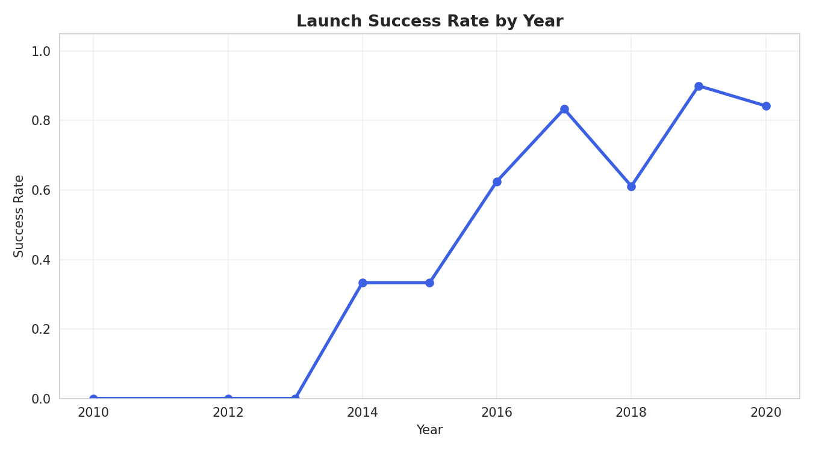
BACKGROUND
Introduction
SpaceX advertises Falcon 9 launches at $62 million, versus $165M+ from other providers — largely because SpaceX reuses the rocket's first stage instead of discarding it. Problem statement: If the first stage does not land successfully, that launch's cost estimate changes substantially. This project builds a model to predict whether the first stage will land, using historical launch data — enabling accurate cost estimation for a competing bid. Objectives:
Collect and clean historical Falcon 9 launch data
Falcon 9 landing success climbed steadily as SpaceX matured its recovery process.
Identify factors correlated with landing success
Visualize patterns across sites, orbits, and time
Build and evaluate a landing-outcome classifier
GitHub repository: https://github.com/razerblade09/spacex-falcon9-capstone
3

Slide 4
DATA COLLECTION · PART 1
Data Collection – SpaceX API
Pipeline:
api.spacexdata.com/v4/launches/past
1
GET /v4/launches/past → all historical launches
Result: 90 clean Falcon 9 launch records (2010–Nov 2020), each with booster version, payload mass, orbit, launch site, flight count, grid fins, reused flag, legs, landing pad, and outcome.
2
Filter to single-core, single-payload Falcon 9 flights
3
For each launch, call /rockets, /launchpads, /payloads, /cores endpoints
4
Assemble into one row per launch: booster, orbit, site, outcome, mass
Falcon 1 launches were excluded — this project focuses only on the Falcon 9 landing-prediction problem.
GitHub repository: https://github.com/razerblade09/spacex-falcon9-capstone/blob/main/notebooks/01_data_collection_api.py
4

Slide 5
DATA COLLECTION · PART 2
Data Collection – Web Scraping
Pipeline:
BeautifulSoup(response.text, 'html.parser')
1
Request the Wikipedia "List of Falcon 9 and Falcon Heavy launches" page
Purpose: an independent, cross-checked source for launch records — used to validate the API dataset and fill in fields (like precise payload customer) the API doesn't expose.
2
Parse HTML tables with BeautifulSoup, locate the wikitable elements
3
Extract column headers, then walk each row of launch data
4
Clean text (dates, booster serials, payload mass) into a dataframe
Key techniques: regex/Unicode cleanup for payload-mass strings, and helper functions to pull booster version and landing status out of merged table cells.
GitHub repository: https://github.com/razerblade09/spacex-falcon9-capstone/blob/main/notebooks/02_web_scraping.py
5

Slide 6
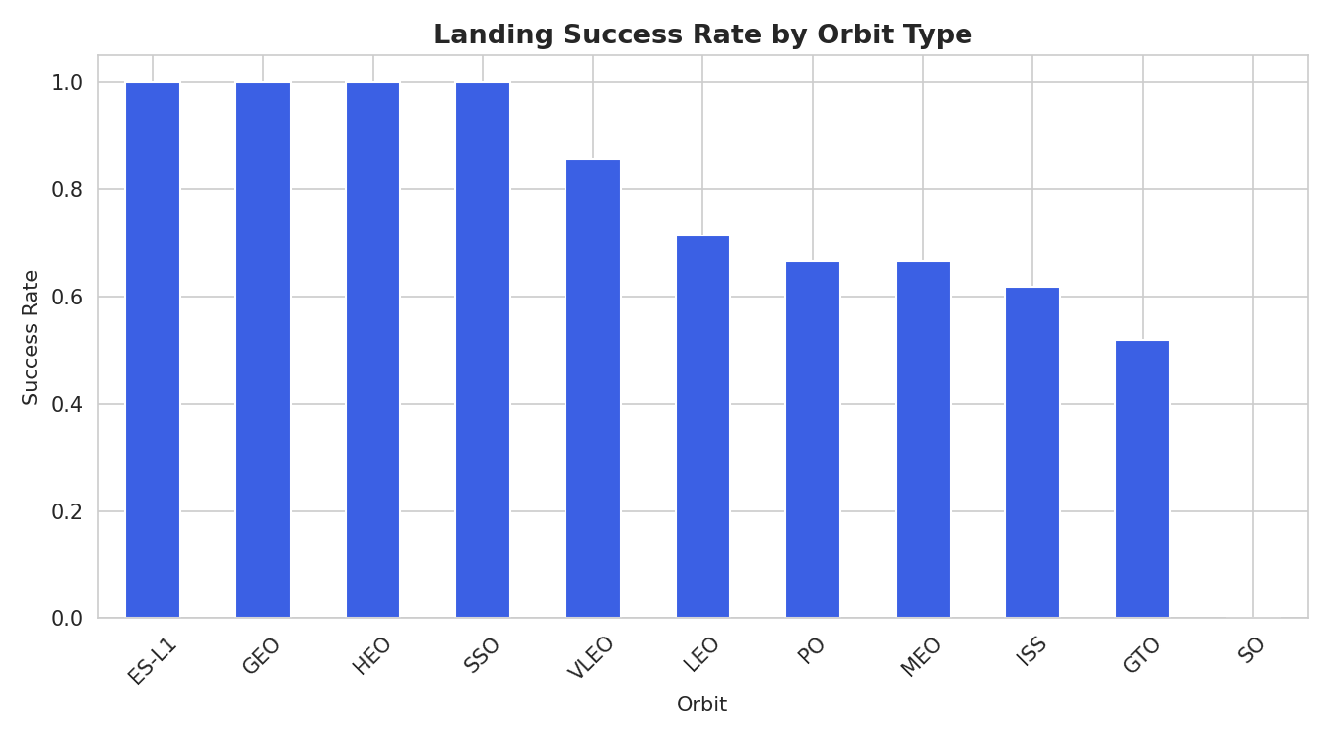
PREPARATION
Data Wrangling Methodology
Missing values: PayloadMass (5.6% missing) filled with column mean; LandingPad (28.9% missing) kept as-is since a null pad legitimately means "no ground/drone-ship landing occurred." Label engineering: The raw Outcome field (e.g. "True ASDS", "False Ocean", "None None") was converted into a binary Class label — 1 if the booster landed successfully by any method, 0 otherwise.
Result: 90 launches → 60 successful landings (66.7%), 30 unsuccessful (33.3%)
GitHub repository: https://github.com/razerblade09/spacex-falcon9-capstone/blob/main/notebooks/03_data_wrangling.py
6

Slide 7
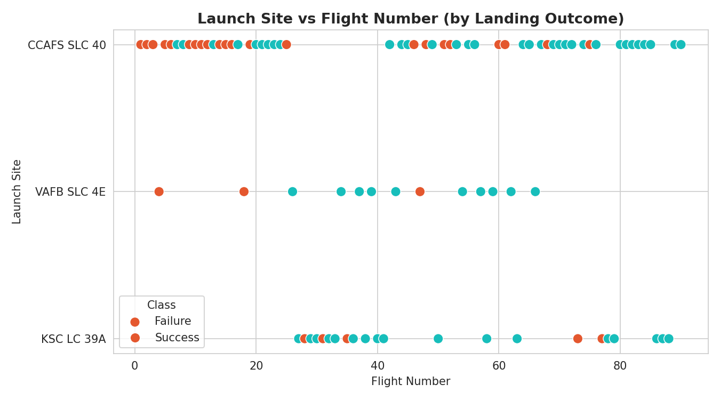
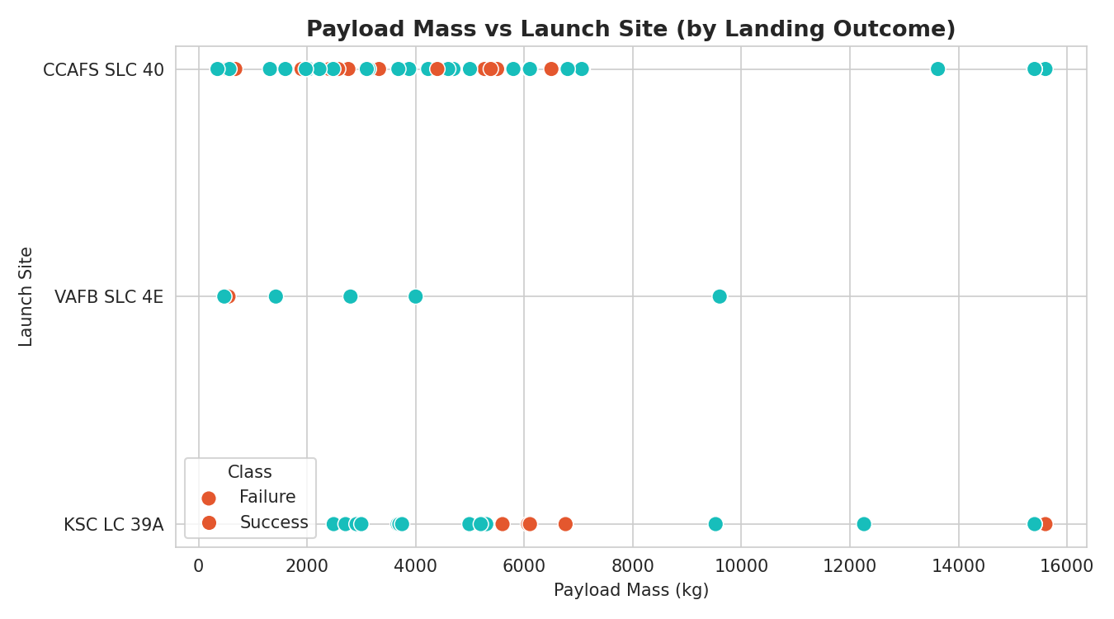
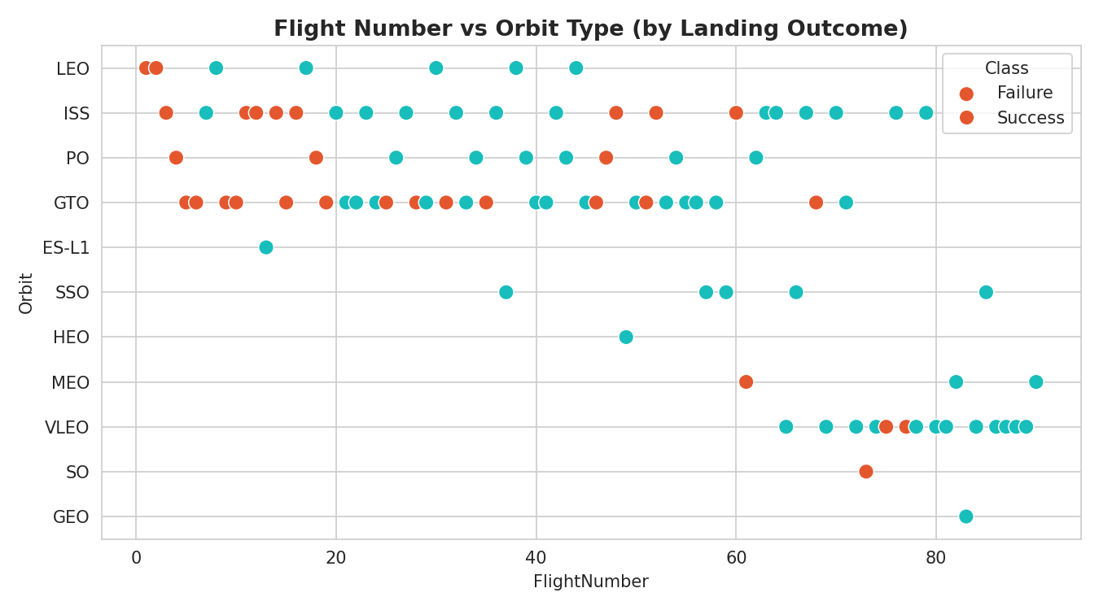
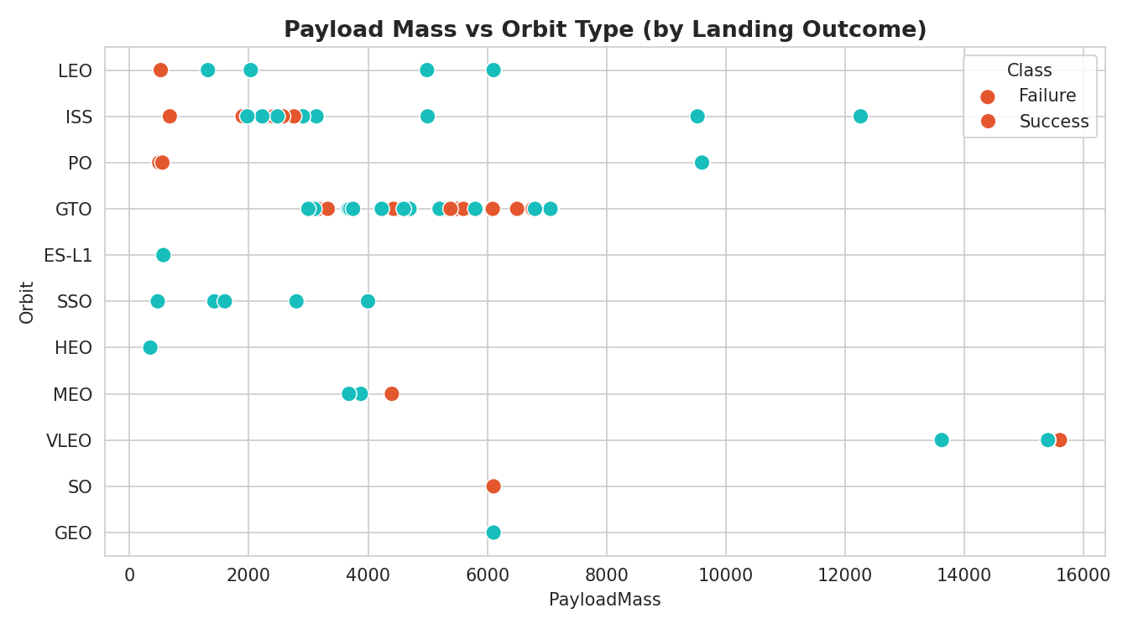
EXPLORATORY ANALYSIS
EDA with Data Visualization
We plotted flight number, payload mass, orbit type, and launch year against landing outcome to surface which factors correlate with success.
Flight # vs Site
Payload vs Site
Success Rate by Orbit
Flight # vs Orbit
Payload vs Orbit
Success Rate by Year
Takeaway: GTO/ISS-orbit missions (heavier, higher-energy) show lower success rates; success climbed year-over-year, from ~0% in 2010–2013 to near 100% by 2019–2020. Chart types used: scatter plots and bar/line charts.
GitHub repository: https://github.com/razerblade09/spacex-falcon9-capstone/blob/main/notebooks/04_07_eda_sql_ml.py
7

Slide 8
EXPLORATORY ANALYSIS
EDA with SQL
The scraped launch table was loaded into a SQL database (SQLite / IBM Db2) as SPACEXTABLE and queried to answer specific business questions:
Distinct launch sites used
Count of each mission outcome
Total payload mass for NASA (CRS)
Booster(s) carrying max payload mass
Avg. payload mass, F9 v1.1 boosters
Failed drone-ship landings in 2015
Date of first successful ground-pad landing
Ranking of landing outcomes 2010–2017
Boosters landing on drone ship, 4–6t payload
Query Results
Landing Outcome Ranking (2010–2017, top 5)
4 launch sites: CCAFS LC-40, CCAFS SLC-40, KSC LC-39A, VAFB SLC-4E NASA (CRS) total payload: 45,596 kg Max single payload: 15,600 kg (F9 B5) First successful ground-pad landing: 1 May 2017 Mission outcomes 2010–2020: 98 of 101 successful (booster-recovery success is the separate, harder metric this model targets)
Outcome | Count
Success | 20
No attempt | 10
Success (drone ship) | 8
Success (ground pad) | 6
Failure (drone ship) | 4
GitHub repository: https://github.com/razerblade09/spacex-falcon9-capstone/blob/main/notebooks/04_07_eda_sql_ml.py
8

Slide 9
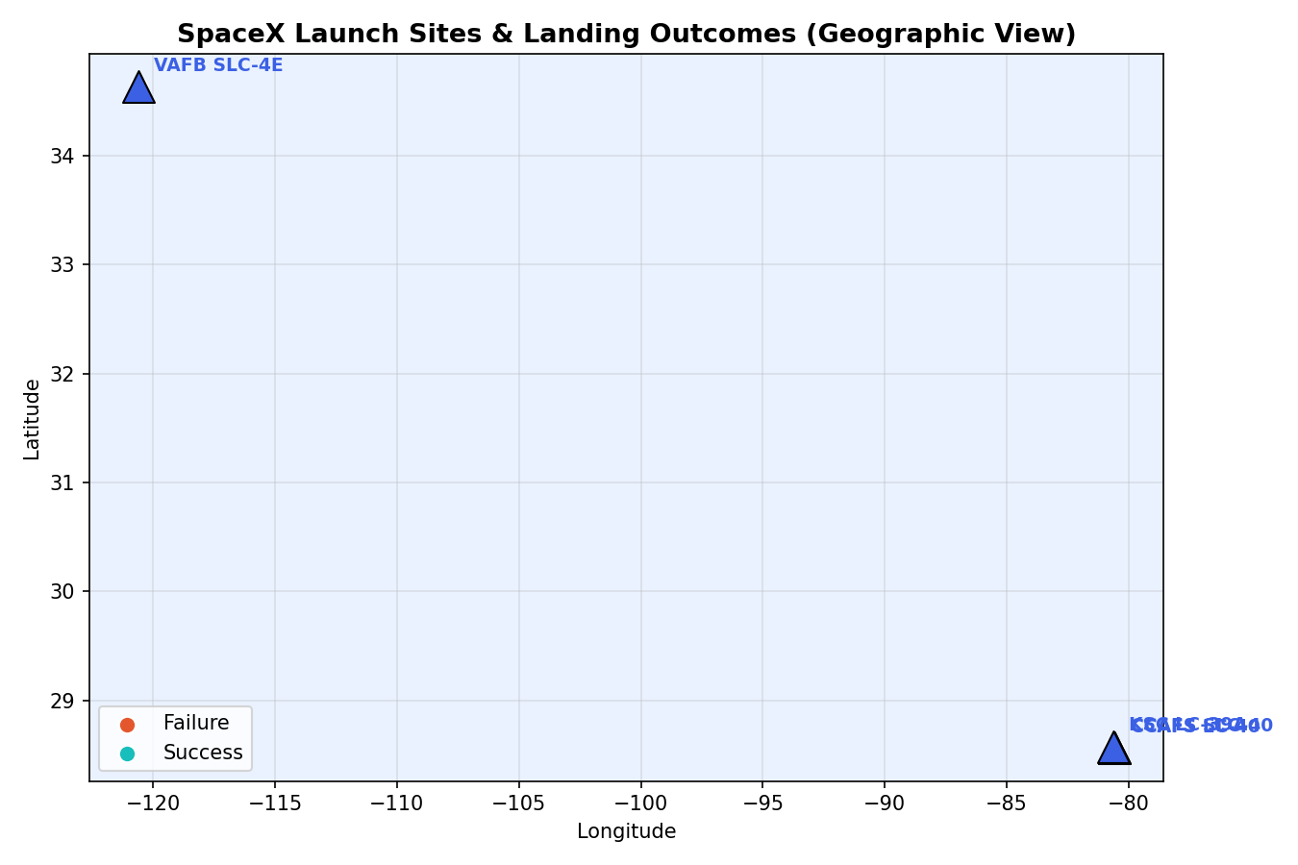
INTERACTIVE VISUAL ANALYTICS
Folium Map
All 4 launch sites plotted with markers. Every individual launch (55 records) is a marker, colored green for a successful landing and red for a failed/no-attempt landing — showing which sites cluster more successes. Observation: KSC LC-39A and CCAFS SLC-40 show visibly denser green clusters than VAFB SLC-4E, consistent with higher launch cadence and a more refined recovery process. Proximity analysis (haversine distance from KSC LC-39A): nearest coastline point 7.43 km; nearest city (Titusville area) 20.50 km. Sites are deliberately close to coastlines for downrange safety but a safe distance from population centers — a siting constraint any competing provider must replicate.
GitHub repository: https://github.com/razerblade09/spacex-falcon9-capstone/blob/main/notebooks/06_folium_map.py
9

Slide 10
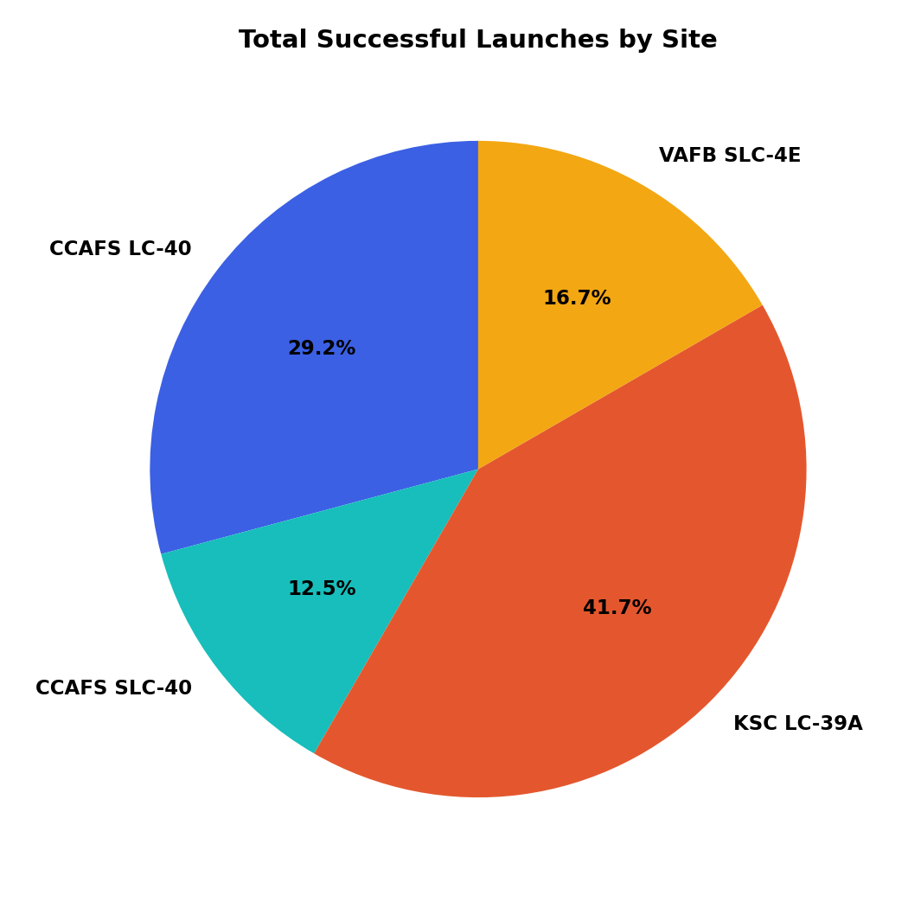
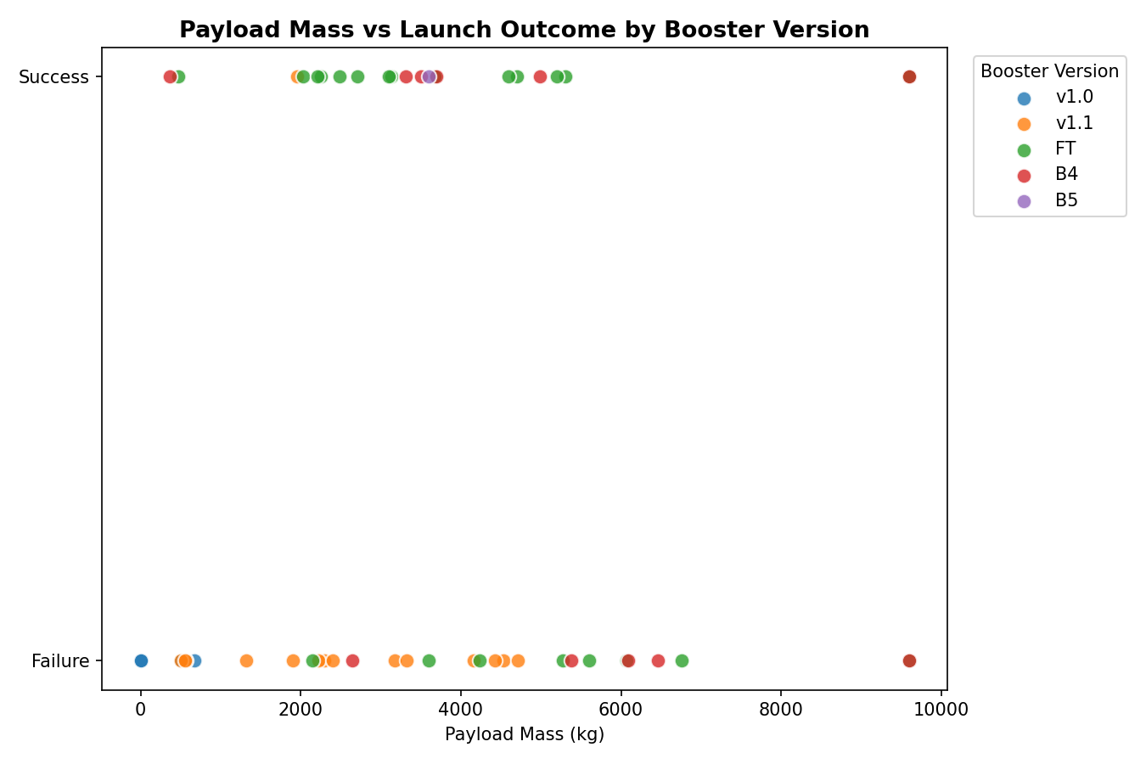
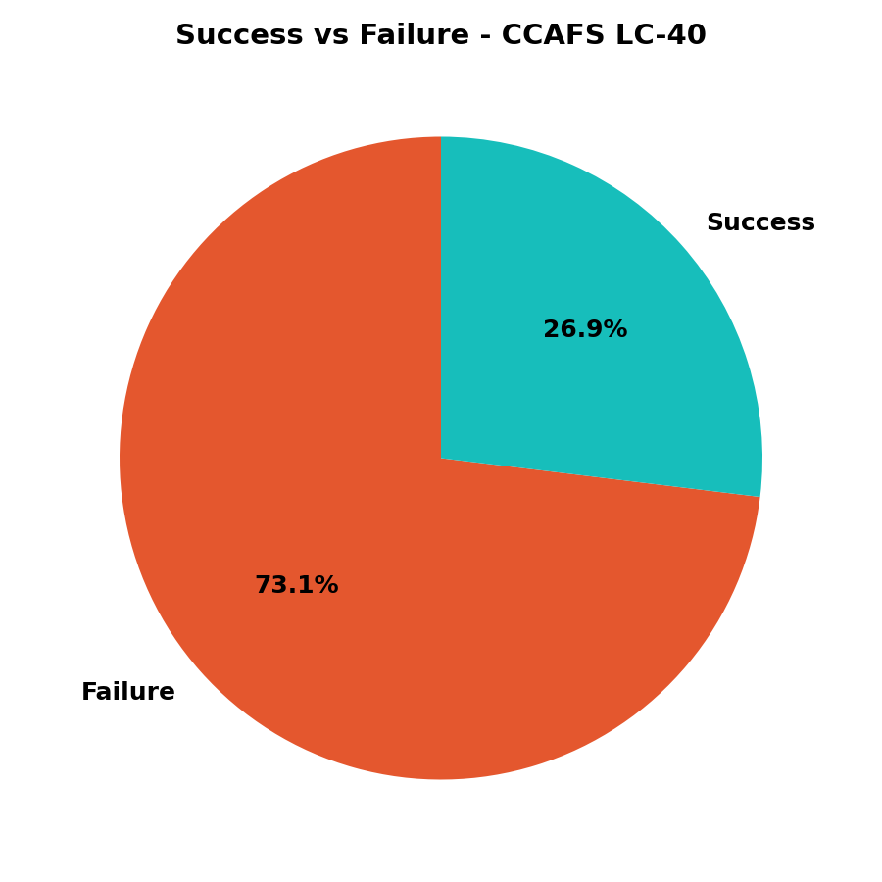
INTERACTIVE VISUAL ANALYTICS
Plotly Dash App
Dropdown to filter by launch site drives a live-updating success-rate pie chart (left: share of successful landings per site; center: success/failure split at the top-volume site, CCAFS LC-40) and a RangeSlider (0–10,000 kg) narrows the payload window on the scatter plot (right), which recolors by booster version (v1.0/v1.1/FT/B4/B5). Insight: newer booster generations succeed reliably across a much wider payload range than early versions — reusability maturity, not just payload size, drives success.
GitHub repository: https://github.com/razerblade09/spacex-falcon9-capstone/blob/main/dashboard/app.py
10

Slide 11
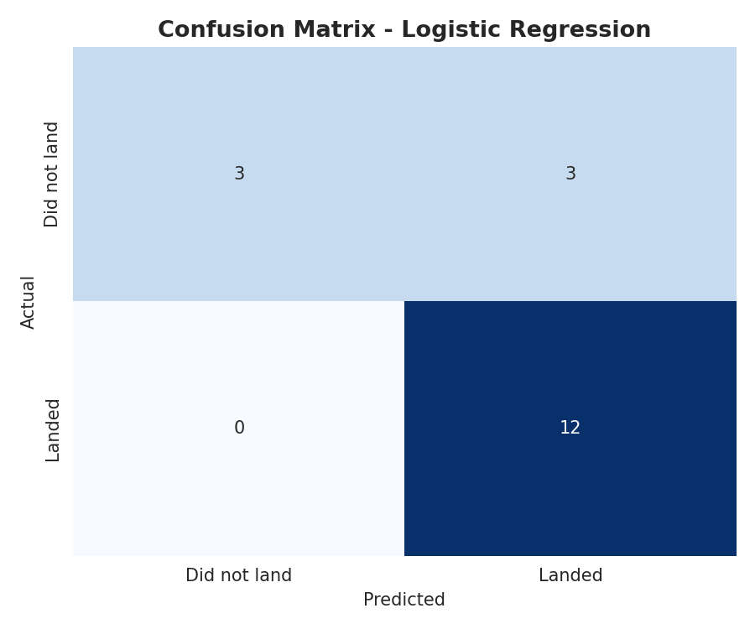
PREDICTIVE ANALYSIS
Methodology, Results & Best Model
Features: 80 one-hot-encoded columns (orbit, site, landing pad, booster serial) + flight #, payload mass, flights, grid fins, reused, legs, block — standardized. Split: 80/20 train-test (72/18), stratified. Models (10-fold GridSearchCV each):
Model | CV | Test Acc.
Log. Regression | 0.821 | 0.833
SVM | 0.834 | 0.833
KNN | 0.834 | 0.833
Decision Tree | 0.804 | 0.778
Confusion matrix (18 test launches): 12 successful landings correctly predicted, 3 unsuccessful correctly predicted, 3 misclassified as successful, 0 successful landings missed — conservative in the safer direction for cost bidding. Best Model: Logistic Regression (C=1, L2, lbfgs). Ties SVM/KNN on accuracy (83.3%) but is far more interpretable — coefficients directly show each feature's effect on landing-success odds, useful for explaining a cost bid to stakeholders, and it's cheapest to retrain as new launches arrive.
Logistic Regression
Support Vector Machine
Decision Tree
K-Nearest Neighbors
All four converged near 83% test accuracy — feature quality matters more than model choice.
GitHub repository: https://github.com/razerblade09/spacex-falcon9-capstone/blob/main/notebooks/04_07_eda_sql_ml.py
11

Slide 12
WRAP-UP
Conclusion & Insights
1
Landing success is highly learnable from launch parameters — 83% test accuracy from a simple, interpretable model (Logistic Regression).
2
Orbit type and payload mass are the strongest predictors; heavier GTO missions land less reliably than light LEO/ISS missions.
3
Success rate improved dramatically over time (2013 → 2020), reflecting SpaceX's iterative process improvements — not a static property of the hardware.
4
Interactive tools (Folium map, Plotly Dash) let stakeholders verify these patterns themselves rather than trusting static charts alone.
5
Recommendation: a competing bidder can use this model as a first-pass cost-risk estimator, refining it further with more recent launches and continuous re-training.
Full code, notebooks, and dashboard app: https://github.com/razerblade09/spacex-falcon9-capstone
12

