Slide 1
SpaceX Falcon 9
First-Stage Landing Prediction
Data Science Capstone Project Report
Presented by: Aaron Vargas | 2026-08-19

Slide 2
OVERVIEW
Executive Summary
Methods used: Data was collected via the SpaceX REST API and Wikipedia web scraping, cleaned and labeled, explored with visualization and SQL, mapped geospatially with Folium, and modeled with four classifiers (Logistic Regression, SVM, Decision Tree, KNN) tuned via GridSearchCV.
Key results: Across 90 Falcon 9 launches, the overall first-stage landing success rate was 67%. The best-performing model, Logistic Regression, reached 83% test accuracy in predicting landing outcome.
90
67%
83.3%
4
Launches analyzed
Overall landing success rate
Best model test accuracy
ML models compared
Conclusion: Landing success is highly predictable from launch parameters, meaning a competing launch provider could reliably estimate SpaceX's true reusable-launch cost advantage.
2

Slide 3
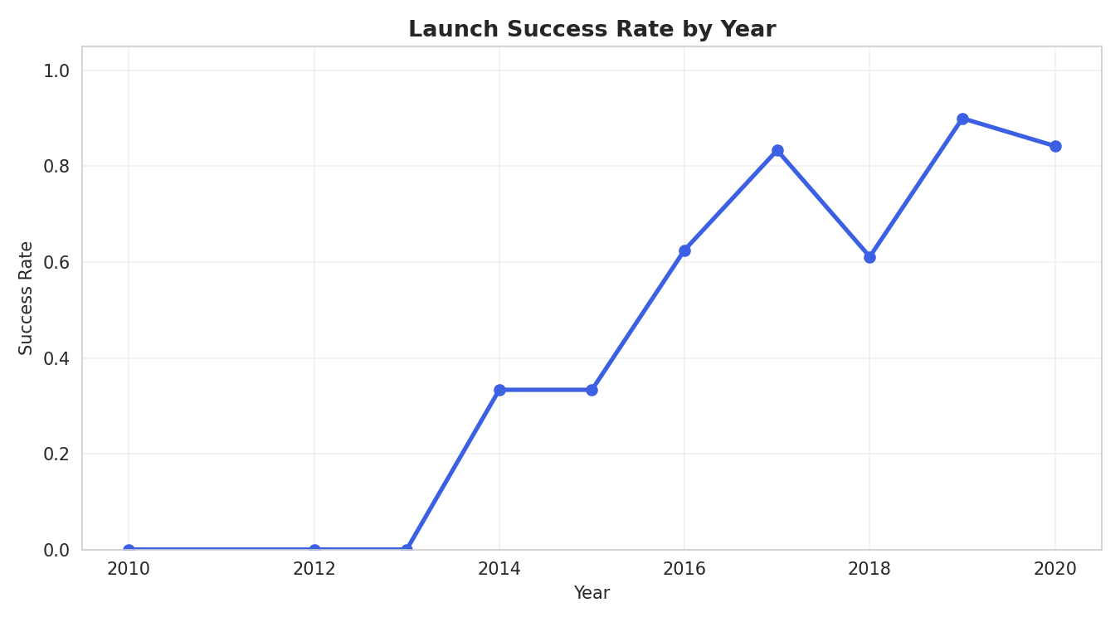
BACKGROUND
Introduction
SpaceX advertises Falcon 9 launches at $62 million, versus $165M+ from other providers — largely because SpaceX reuses the rocket's first stage instead of discarding it. Problem statement: If the first stage does not land successfully, that launch's cost estimate changes substantially. This project builds a model to predict whether the first stage will land, using historical launch data — enabling accurate cost estimation for a competing bid. Objectives:
Collect and clean historical Falcon 9 launch data
Falcon 9 landing success climbed steadily as SpaceX matured its recovery process.
Identify factors correlated with landing success
Visualize patterns across sites, orbits, and time
Build and evaluate a landing-outcome classifier
3

Slide 4
DATA COLLECTION · PART 1
Data Collection – SpaceX API
Pipeline:
api.spacexdata.com/v4/launches/past
1
GET /v4/launches/past → all historical launches
Result: 90 clean Falcon 9 launch records (2010–Nov 2020), each with booster version, payload mass, orbit, launch site, flight count, grid fins, reused flag, legs, landing pad, and outcome.
2
Filter to single-core, single-payload Falcon 9 flights
3
For each launch, call /rockets, /launchpads, /payloads, /cores endpoints
4
Assemble into one row per launch: booster, orbit, site, outcome, mass
Falcon 1 launches were excluded — this project focuses only on the Falcon 9 landing-prediction problem.
GitHub: https://github.com/razerblade09/spacex-falcon9-capstone/blob/main/notebooks/01_data_collection_api.py
4

Slide 5
DATA COLLECTION · PART 2
Data Collection – Web Scraping
Pipeline:
BeautifulSoup(response.text, 'html.parser')
1
Request the Wikipedia "List of Falcon 9 and Falcon Heavy launches" page
This gives an independent, cross-checked source for launch records — used to validate the API dataset and fill in fields (like precise payload customer) the API doesn't expose.
2
Parse HTML tables with BeautifulSoup, locate the wikitable elements
3
Extract column headers, then walk each row of launch data
4
Clean text (dates, booster serials, payload mass) into a dataframe
Key techniques: regex/Unicode cleanup for payload mass strings, and helper functions to pull booster version and landing status out of merged table cells.
GitHub: https://github.com/razerblade09/spacex-falcon9-capstone/blob/main/notebooks/02_web_scraping.py
5

Slide 6
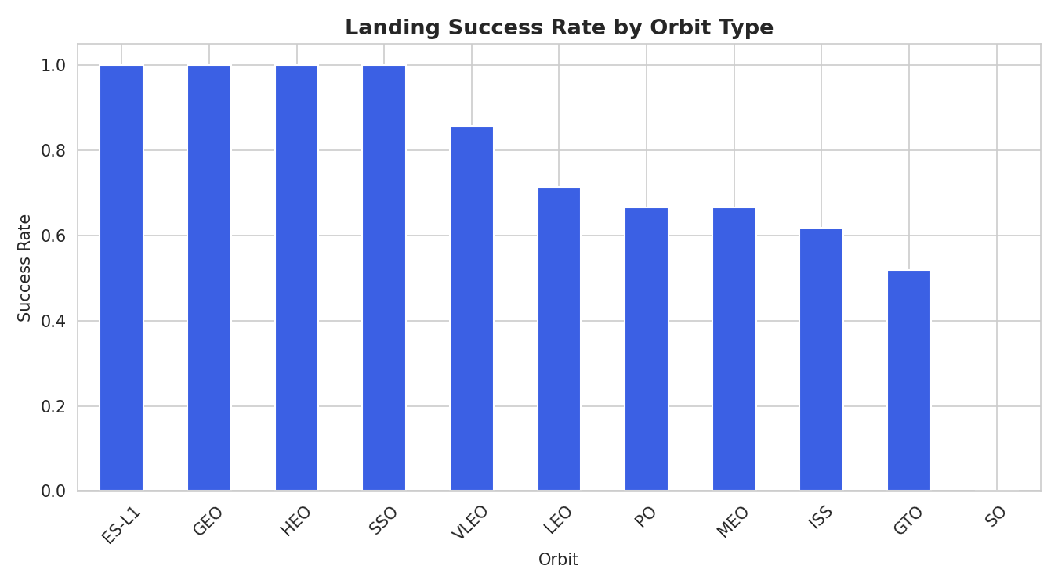
PREPARATION
Data Wrangling Methodology
Missing values: PayloadMass (5.6% missing) filled with column mean; LandingPad (28.9% missing) kept as-is since a null pad legitimately means "no ground/drone-ship landing occurred." Label engineering: The raw Outcome field (e.g. "True ASDS", "False Ocean", "None None") was converted into a binary Class label — 1 if the booster landed successfully by any method, 0 otherwise.
Result: 90 launches → 60 successful landings (66.7%), 30 unsuccessful (33.3%)
GitHub: https://github.com/razerblade09/spacex-falcon9-capstone/blob/main/notebooks/03_data_wrangling.py
6

Slide 7
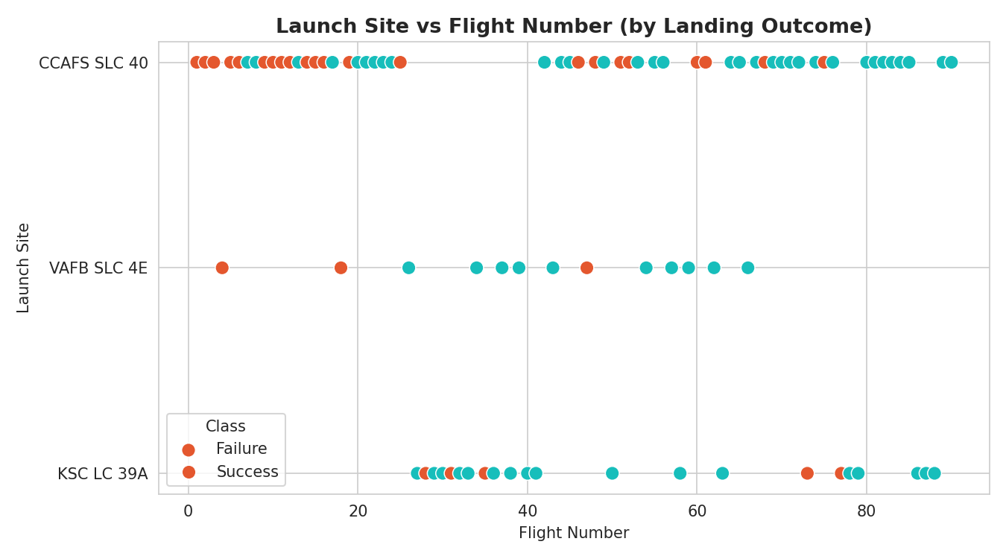
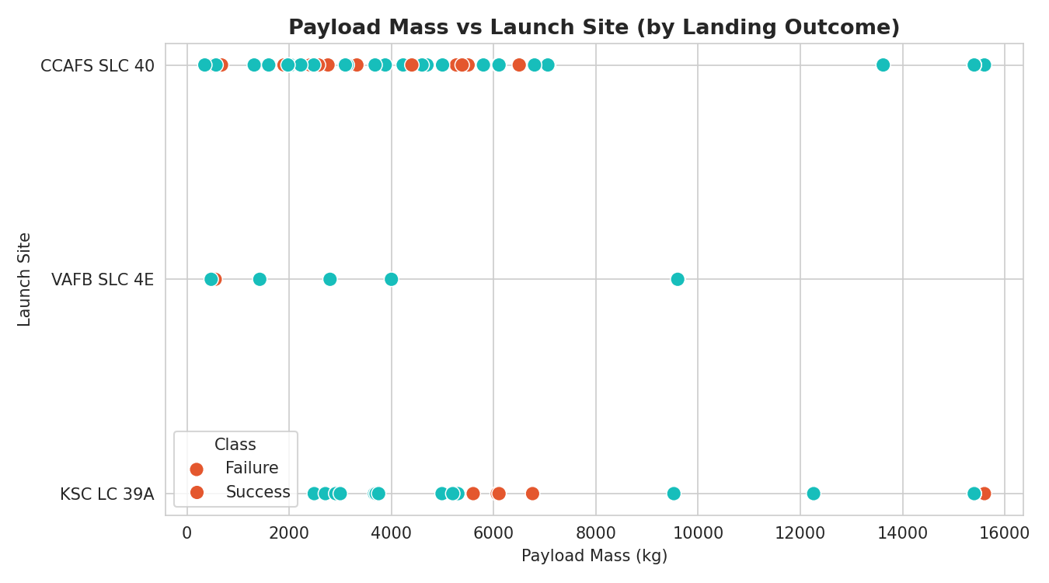
EXPLORATORY ANALYSIS · PART 1
EDA with Data Visualization
We plotted flight number, payload mass, orbit type, and launch year against landing outcome to surface which factors correlate with success.
Flight # vs Launch Site
Payload vs Launch Site
Success Rate by Orbit
Chart types used: scatter plots (flight #/payload vs site or orbit), bar charts (success rate by orbit), and a line chart (yearly trend, see Introduction slide).
GitHub: https://github.com/razerblade09/spacex-falcon9-capstone/blob/main/notebooks/04_07_eda_sql_ml.py
7

Slide 8
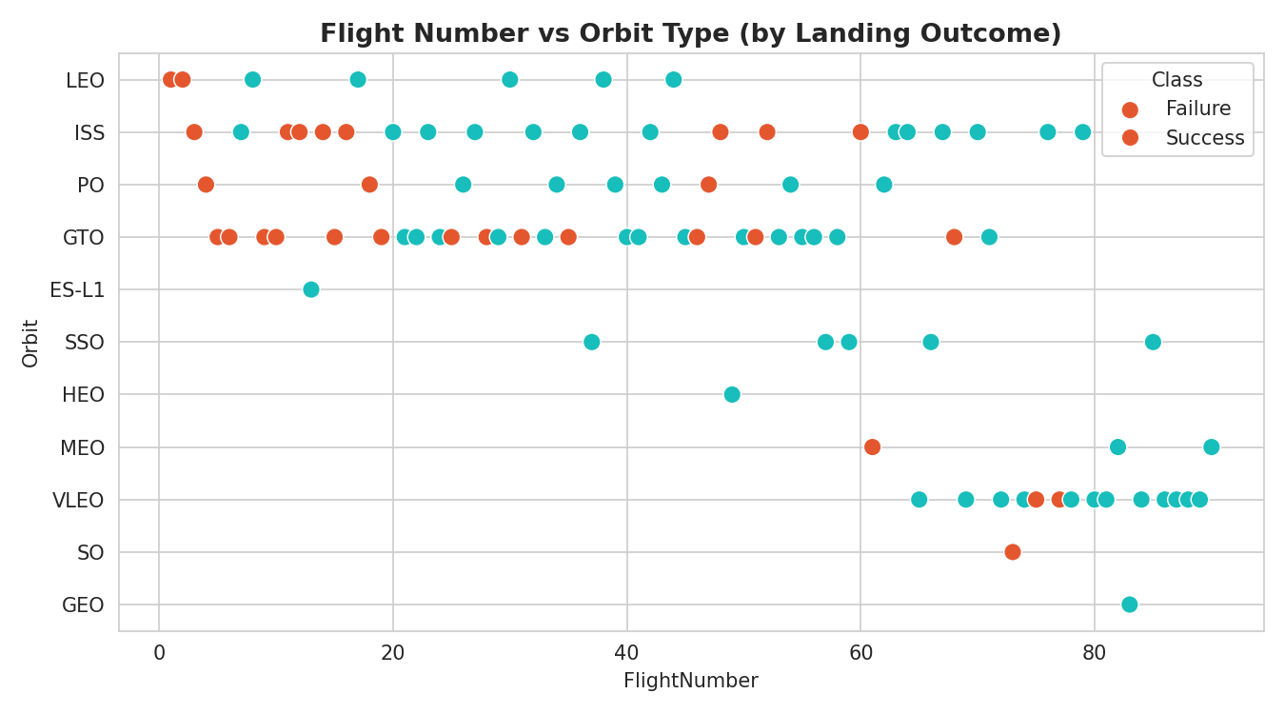
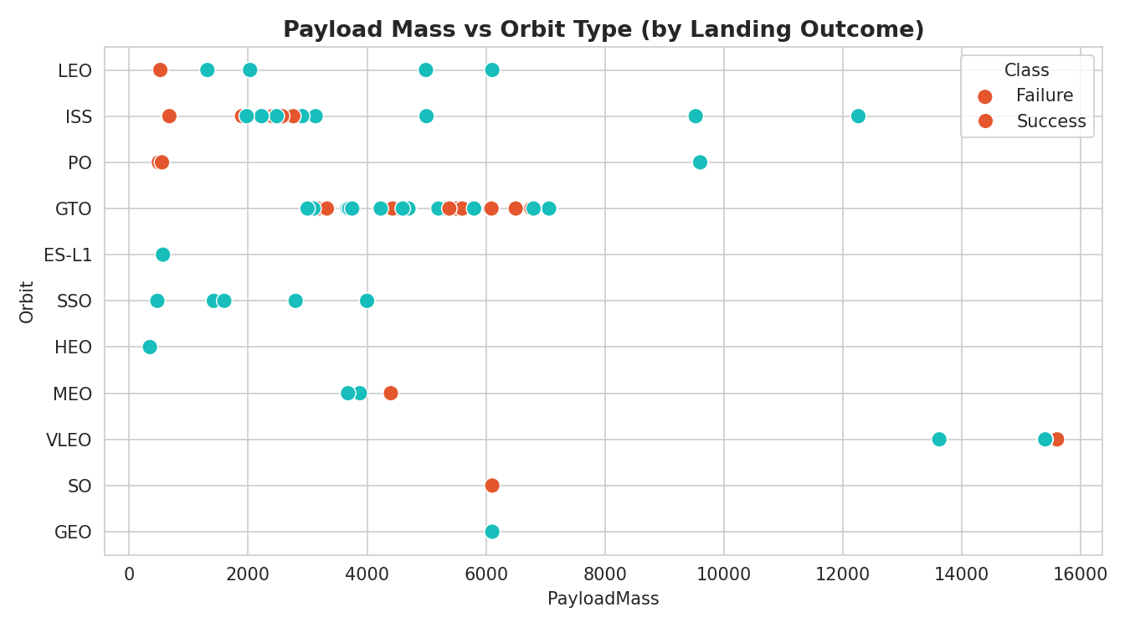
EXPLORATORY ANALYSIS · PART 1 (CONT.)
EDA Visualization — Orbit & Trend Detail
Flight # vs Orbit Type
Payload vs Orbit Type
Success Rate by Year
Takeaway: GTO and ISS-orbit missions (heavier, higher-energy) show lower success rates; success climbed year-over-year as SpaceX refined the recovery process, from ~0% in 2010–2013 to consistently near 100% by 2019–2020.
8

Slide 9
EXPLORATORY ANALYSIS · PART 2
EDA with SQL
The scraped launch table was loaded into a SQL database (SQLite / IBM Db2) as SPACEXTABLE, then queried directly to answer specific business questions.
Distinct launch sites used
Count of each mission outcome (success/failure)
Total payload mass carried for NASA (CRS)
Booster(s) carrying the maximum payload mass
Average payload mass for F9 v1.1 boosters
Failed drone-ship landings in 2015
Date of the first successful ground-pad landing
Ranking of landing outcomes between 2010–2017
Boosters that succeeded on a drone ship with 4,000–6,000 kg payload
GitHub: https://github.com/razerblade09/spacex-falcon9-capstone/blob/main/notebooks/04_07_eda_sql_ml.py
9

Slide 10
EXPLORATORY ANALYSIS · PART 2 (CONT.)
EDA SQL Results — Sites & Payload
Launch Sites (4 distinct)
Milestones
CCAFS LC-40 · CCAFS SLC-40 · KSC LC-39A · VAFB SLC-4E
First successful ground-pad landing: 1 May 2017
Total payload for NASA (CRS): 45,596 kg
2015 drone-ship landing failures: 2 (F9 v1.1 B1012, B1015 — CCAFS LC-40)
Avg. payload, F9 v1.1 boosters: 2,534.7 kg
Max payload carried: 15,600 kg (F9 B5)
4,000–6,000 kg drone-ship successes: F9 FT B1021.2, B1022, B1026, B1031.2
These figures ground the EDA charts in exact, query-verified numbers rather than visual estimates.
GitHub: https://github.com/razerblade09/spacex-falcon9-capstone/blob/main/notebooks/04_07_eda_sql_ml.py
10

Slide 11
EXPLORATORY ANALYSIS · PART 2 (CONT.)
EDA SQL Results — Success Rates & Rankings
Landing outcome ranking, 2010–2017 (by count):
Landing Outcome | Count
Success | 20
No attempt | 10
Success (drone ship) | 8
Success (ground pad) | 6
Failure (drone ship) | 4
Failure | 3
Controlled (ocean) | 3
Failure (parachute) | 2
Mission outcome (2010–2020): 98 of 101 recorded outcomes were successful missions — first-stage recovery success is the harder, separate problem this model targets.
GitHub: https://github.com/razerblade09/spacex-falcon9-capstone/blob/main/notebooks/04_07_eda_sql_ml.py
11

Slide 12
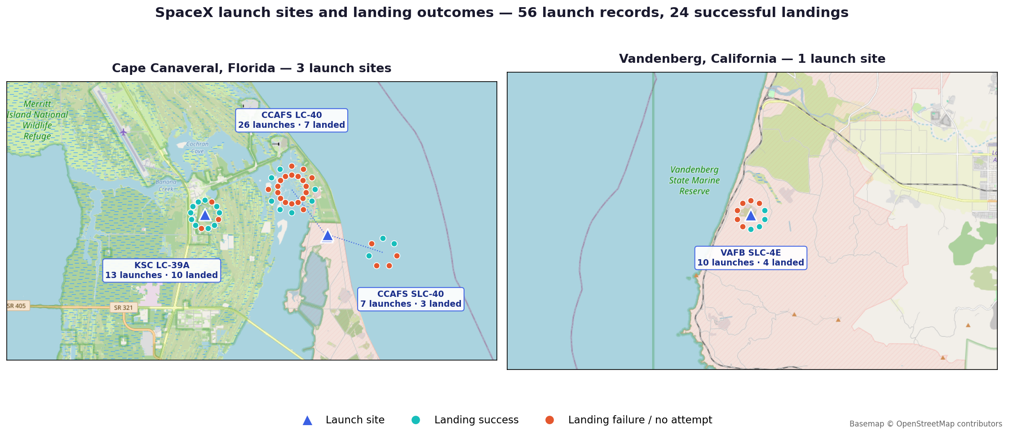
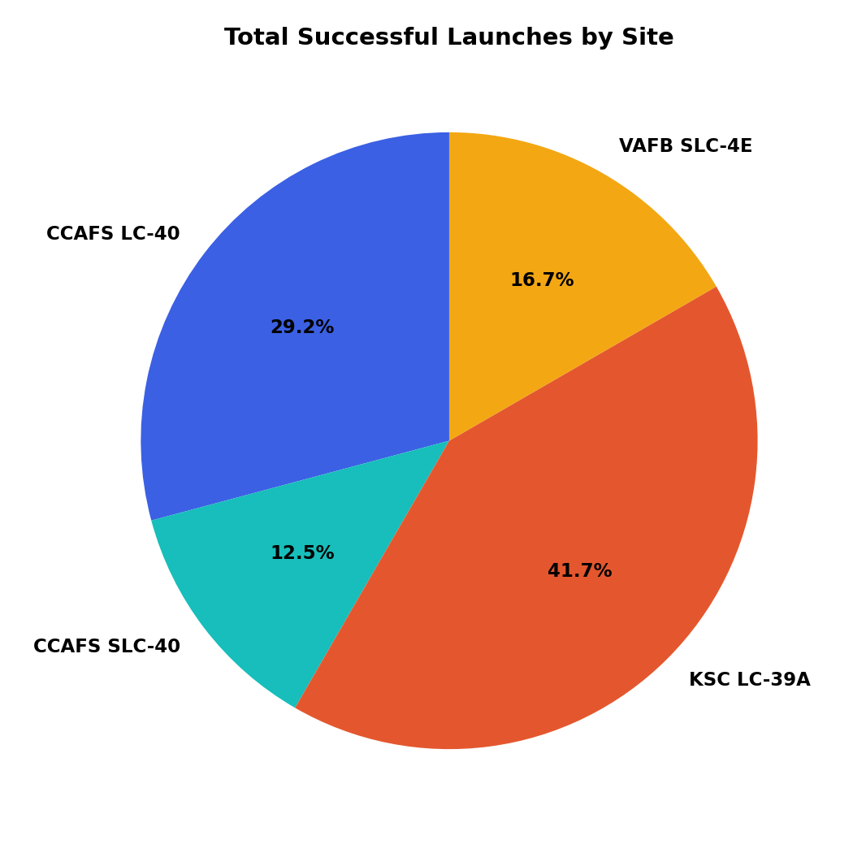
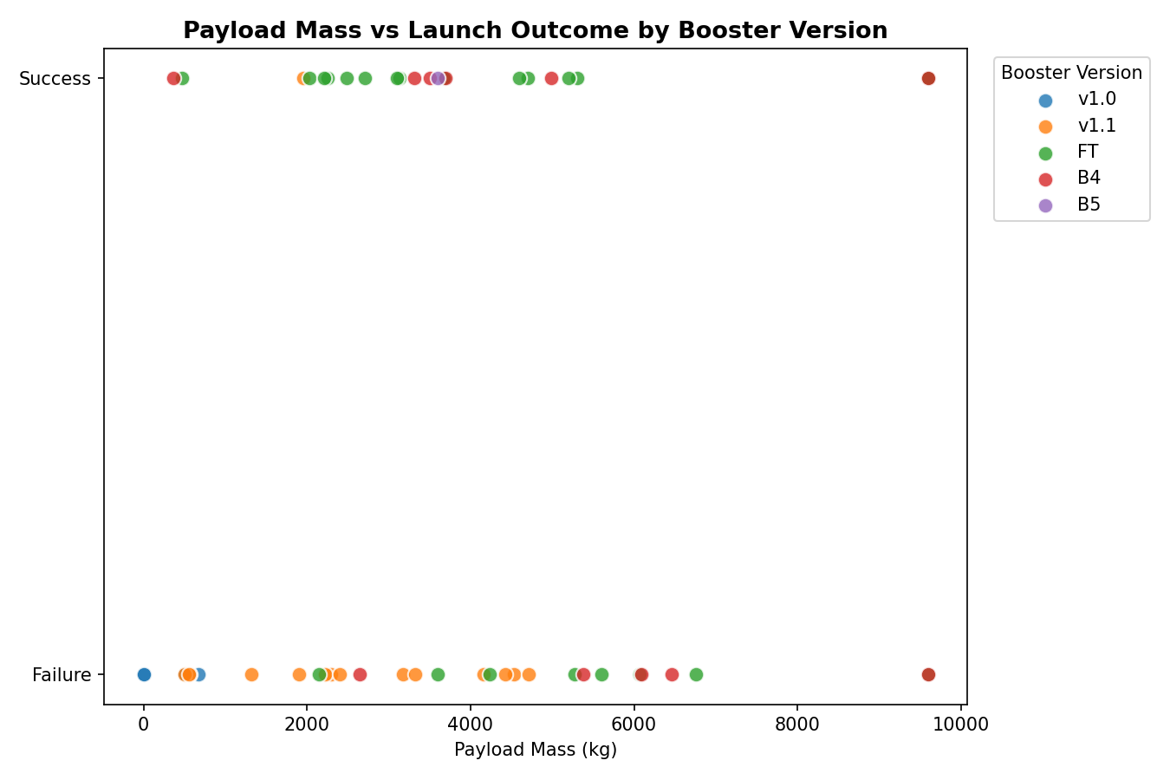
EXPLORATORY ANALYSIS · PART 3
Interactive Visual Analytics
Two interactive tools let stakeholders explore the data themselves rather than reading static charts:
Folium Map
Plotly Dash App
Launch-site markers, per-launch outcome markers (color-coded), and proximity distance lines (coastline, city, railway, highway).
Dropdown to filter by launch site; live-updating success-rate pie chart and payload-vs-outcome scatter plot.
GitHub: https://github.com/razerblade09/spacex-falcon9-capstone/blob/main/dashboard/app.py
12

Slide 13
INTERACTIVE VISUAL ANALYTICS · FOLIUM
Launch Site Markers & Launch Records
All 4 launch sites plotted with markers. Every individual launch (56 records) plotted as a marker cluster, colored green for a successful landing and red for a failed/no-attempt landing — letting you see which sites cluster more successes. Observation: KSC LC-39A shows the densest green cluster — 10 landings from 13 launches (77%). CCAFS LC-40, the earliest and highest-volume pad, landed only 7 of 26 (27%): most of its records predate a working recovery process.
GitHub: https://github.com/razerblade09/spacex-falcon9-capstone/blob/main/notebooks/06_folium_map.py
13

Slide 14
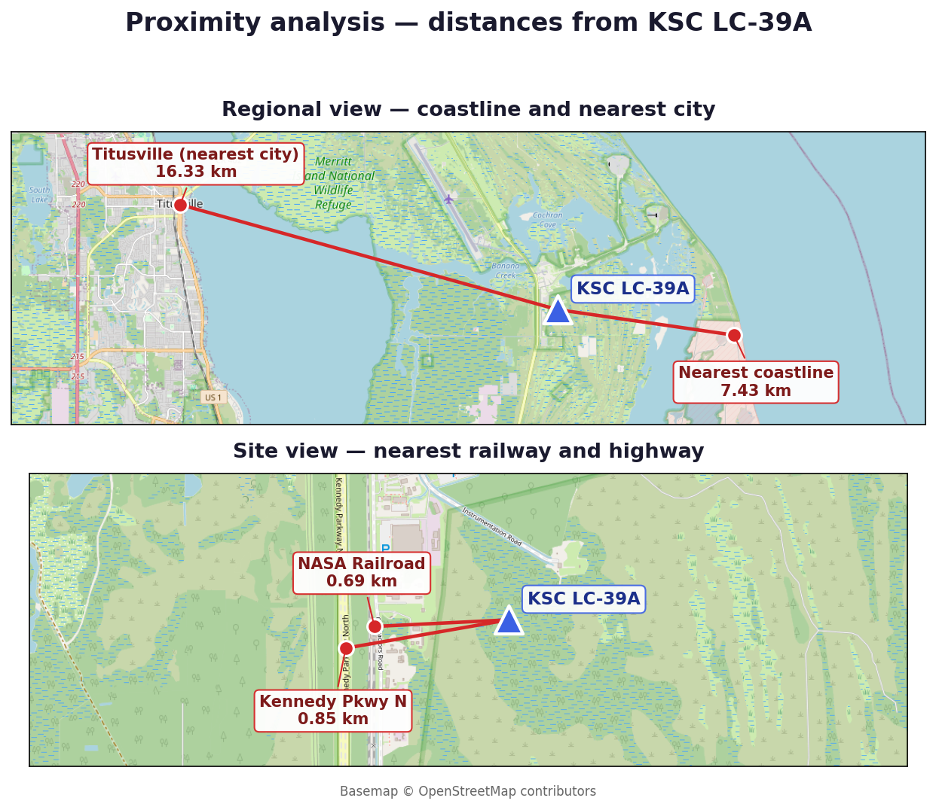
INTERACTIVE VISUAL ANALYTICS · FOLIUM
Proximity Analysis
Using the haversine formula, we measured distance from KSC LC-39A to nearby geographic features:
Feature | Distance from Launch Site
Nearest coastline point | 7.43 km
Nearest city (Titusville) | 16.33 km
Nearest railway (NASA Railroad) | 0.69 km
Nearest highway (Kennedy Pkwy N) | 0.85 km
Why this matters: Launch sites are deliberately sited close to coastlines (for downrange safety over open water) and to rail and road links (boosters and stages arrive overland), but a safe distance from population centers — real siting constraints any competing launch provider would need to replicate.
City, railway and highway coordinates sourced from OpenStreetMap.
GitHub: https://github.com/razerblade09/spacex-falcon9-capstone/blob/main/notebooks/06_folium_map.py
14

Slide 15
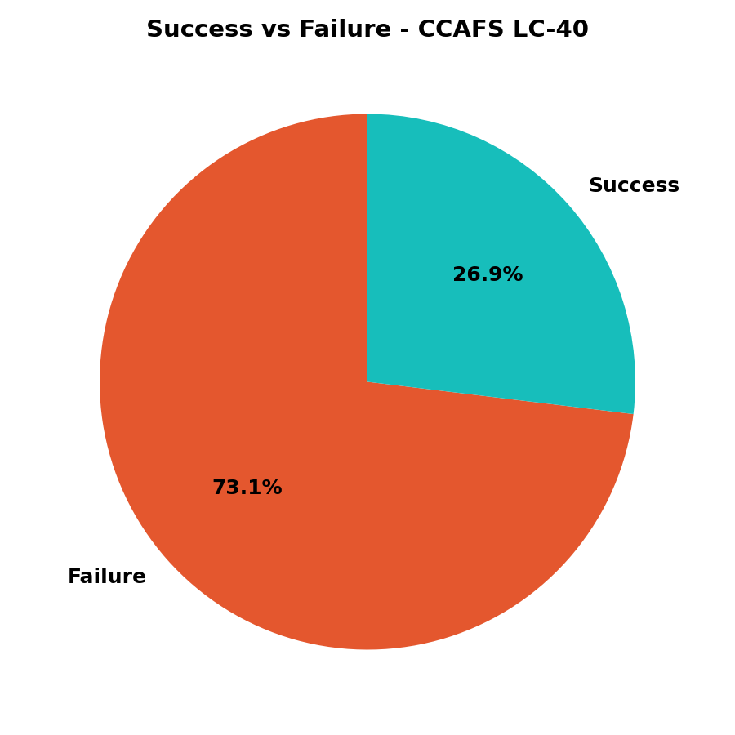
INTERACTIVE VISUAL ANALYTICS · DASH
Success Rate — Pie Charts
Left: share of total successful landings contributed by each site. Right: success-vs-failure split at the top-volume site (CCAFS LC-40) — filterable live via the dashboard dropdown.
GitHub: https://github.com/razerblade09/spacex-falcon9-capstone/blob/main/dashboard/app.py
15

Slide 16
INTERACTIVE VISUAL ANALYTICS · DASH
Payload Mass vs. Launch Outcome
A RangeSlider (0–10,000 kg) lets users narrow the payload window; the scatter plot recolors by booster version category (v1.0 / v1.1 / FT / B4 / B5), revealing that newer booster generations succeed reliably across a much wider payload range than early versions.
GitHub: https://github.com/razerblade09/spacex-falcon9-capstone/blob/main/dashboard/app.py
16

Slide 17
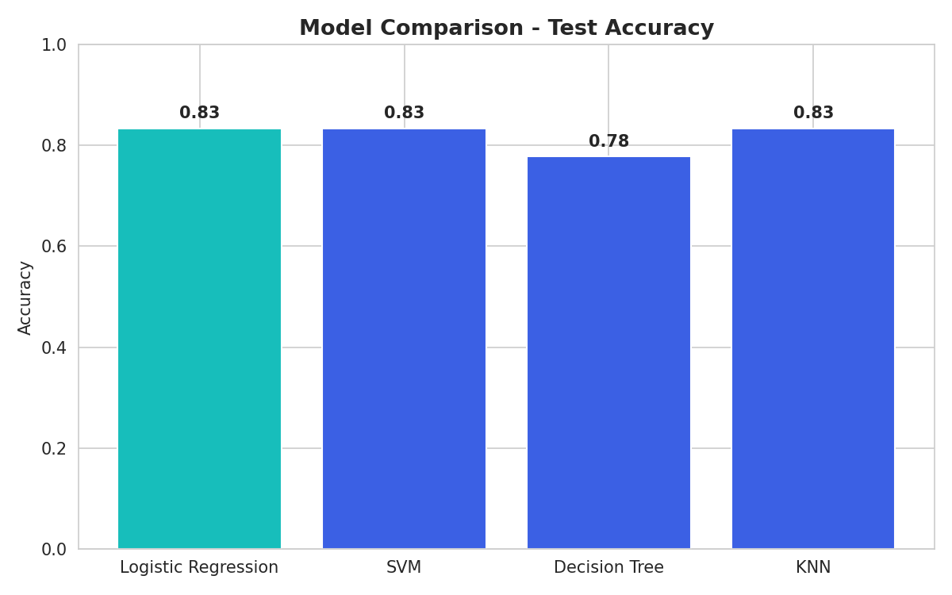
PREDICTIVE ANALYSIS · PART 1
Model Development
Features: 80 one-hot-encoded columns (orbit, launch site, landing pad, booster serial) plus flight number, payload mass, flights, grid fins, reused, legs, and block — standardized with StandardScaler. Split: 80% train / 20% test (72 / 18 launches), stratified via random_state=2. Models compared (each tuned via 10-fold GridSearchCV):
Logistic Regression — C, penalty, solver
Support Vector Machine — kernel, C, gamma
Decision Tree — criterion, max_depth, min_samples_split
K-Nearest Neighbors — n_neighbors, distance metric (p)
All four models converged near 83% test accuracy, with Decision Tree slightly behind — signal that the engineered features are strong and model choice matters less than feature quality here.
GitHub: https://github.com/razerblade09/spacex-falcon9-capstone/blob/main/notebooks/04_07_eda_sql_ml.py
17

Slide 18
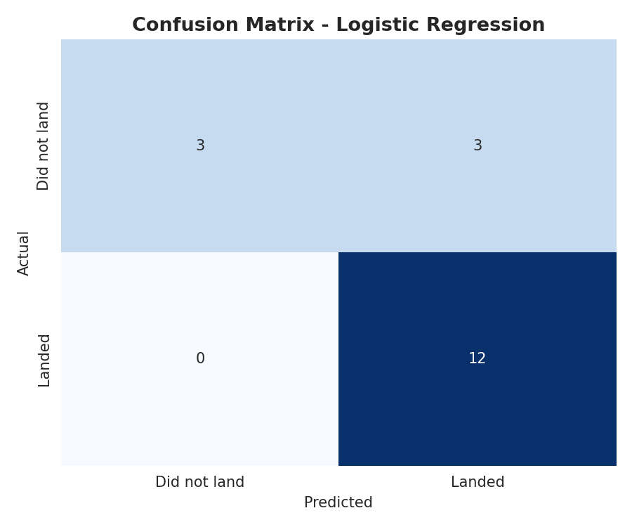
PREDICTIVE ANALYSIS · PART 2
Evaluation Results & Confusion Matrix
Model | CV Score | Test Accuracy
Logistic Regression | 0.821 | 0.833
SVM | 0.834 | 0.833
KNN | 0.834 | 0.833
Decision Tree | 0.804 | 0.778
Reading the confusion matrix (18 test launches): 12 successful landings correctly predicted, 3 unsuccessful landings correctly predicted, 3 unsuccessful landings misclassified as successful, 0 successful landings missed. The model never misses a true landing — it's conservative in the safer direction for cost bidding.
GitHub: https://github.com/razerblade09/spacex-falcon9-capstone/blob/main/notebooks/04_07_eda_sql_ml.py
18

Slide 19
PREDICTIVE ANALYSIS · PART 3
Best Model & Conclusion
Conclusion & Insights
Best Model: Logistic Regression
Landing success is highly learnable from launch parameters — 83% test accuracy from a simple, interpretable model.
Best params: C=1, L2 penalty, lbfgs solver Why it wins: Ties SVM and KNN on raw accuracy (83.3%) but is far more interpretable — each feature's coefficient directly shows its effect on landing-success odds, which matters for explaining a cost bid to stakeholders. It's also the cheapest to retrain as new launches arrive.
Orbit type and payload mass are the strongest visual predictors; heavier GTO missions land less reliably than light LEO/ISS missions.
Success rate improved dramatically over time (2013 → 2020), reflecting SpaceX's iterative process improvements — not a static property of the hardware.
Recommendation: a competing bidder can use this model as a first-pass cost-risk estimator, refining it further with more recent launches and continuous re-training.
GitHub: https://github.com/razerblade09/spacex-falcon9-capstone
19

