Slide 1
Snap-2-Ask
Snap. Ask. Done.

Slide 2
Who We Are
SNAP-2-ASK
Elena Villamil Rodriguez Database
Raymond Martin Database/GUI
Raz Friman Database/GUI
Roman Stolyarov Database/GUI
Vipul Kohli GUI
Notes:
Raz: android app
Raymond: gui for web page

Slide 3
Product Idea
What?
An image-based, academic Q&A software application.
Why?
To aid in a student’s ability to post on a Q&A forum through the use of photos.
How?
Photo-based Q&A will aid the user by eliminating typing of symbols or graphs that may accompany an academic question.
Snap-2-Ask makes outsourcing a question faster and easier than ever.

Slide 4
Product idea
Android Application – For Students
Student opens app and sees camera view.
Student quickly “snaps” and sends a question.
Student notified when question is answered.
Student views and rates answer(s).
Website – For Answerers
Answerer opens site and sees array of questions.
Answerer chooses question by category, at random, or unanswered.
Answerer answers, gets rated.

Slide 5
Product idea
Database Concepts
We will draw upon skills acquired through Database Concepts by creating and managing a database, including tables for students accounts, tutor accounts, questions asked, and answers.
GUI
We will use our abilities gained from GUI by implementing a simple and fast mobile app for students and a clear web interface for tutors.

Slide 6
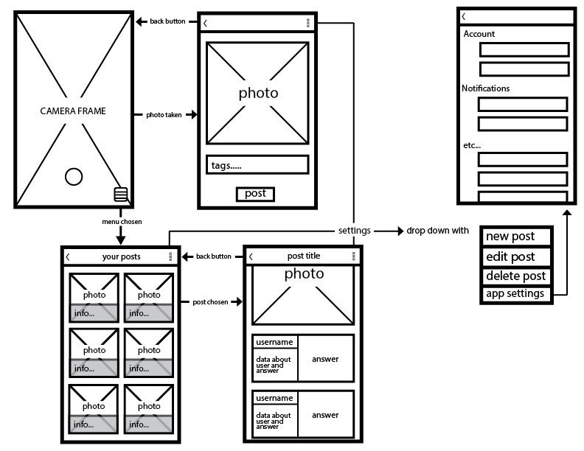

Slide 7
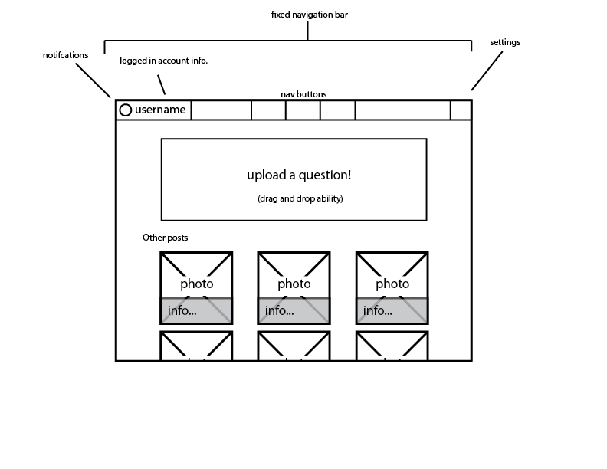

Slide 8
Market Analysis
Online tutoring is a rapidly growing industry.
$102.8 billion by 2018 (Forbes)
Why?
Budget cuts in U.S. public schools.
Increasing cost of higher education
Top five online tutoring companies
Tutor.com, Growing stars, TutorVista, eTutorWorld, Steps
Typical pay $8-12 per tutoring hour.
Typical cost $20-40 per tutoring hour.

Slide 9
Market Analysis
Snap-2-Ask is comparable to online tutoring industry-wise.
However, our approach is appealing in several ways:
Customers can ask questions without paying hefty per-hour fees.
Customers can get answers to particular questions.
Asking is easy; answers come fast.
Snap-2-Ask charges students and compensates tutors on a per-question basis. As an example:
Students pay $1.10 for an answer from a high-rated user
User is paid $1 for his answer
Tutor can make at least $12/hour assuming 5 minutes per question

Slide 10
Product Features version 1.0
Students will have accounts and be able to ask questions by uploading:
A picture
A category to which the question belongs
An optional description of the question
Answerers will have accounts and be able to answer questions through text.
Answerer will have a publicly viewable rating.

Slide 11
PRODUCT FEATURES version 1.0
Students will be able to rate the answers.
Answerer rating will be calculated from average of their answer rankings and total number of questions answered.
Students will be able to search for answerers who live nearby.
Students will have access to their own Q&A history.
Notes:
The idea of giving a rating to tutors is to provide the students with an idea of how reliable an answer is.
Tutor will provide location information, so if a students keep getting good answers from the same tutor, and thinks it will be a good idea to get a tutor appointment, the student can go look if the tutor lives close and sent him and email.
The same way a student can look for tutors close to their location and get some a list of tutors possibilities and their contacts information.

Slide 12
Product features version 2.0
If a student forget their password they will receive a new password to their email address.
Students will have to pay for each answer.
Credit/debit card payment method
Student can make deposit so as not to pay every time
Answerers will have to get validated.
Answerers will get paid for their answers based on their rating.
Can link their Snap-2-Ask account to their bank account
Withdraw money at any time

Slide 13
Intended User Groups
Askers
Middle school students
High school students
College students
Answerers
College students
Teachers
Anyone who passes subject-based tests

Slide 14
Thank you!
QUESTIONS/
COMMENTS

