Slide 2
Background
Why I chose to do this project
Gilbert Sebenste from Northern Illinois University needed a website rather instead of using an excel sheet
Is the Meteorologist on campus who aids in the decision making process if the school should be closed
Purpose of site was to evaluate potential severe weather conditions to assist in the closure decision making process for the area of concern
Project was an interest of mine. Graduated from Northern Illinois University in 2012 with a BS in Meteorology

Slide 3
Problems I Faced
Knowledge of PHP, HTML, and CSS was limited
Learning how to use XAMPP
Getting the Current Weather to output the right data
Making sure the website was easy to use, easy to maintain, and aesthetically appealing
Limited amount of time

Slide 4
This isn't the first version though!
Professor Rachel Adler gave a very good analysis on the issues my project presented
After creating the 2nd version, I saw how poorly made my 1st version was

Slide 5
Version 1 of the Project

Slide 6
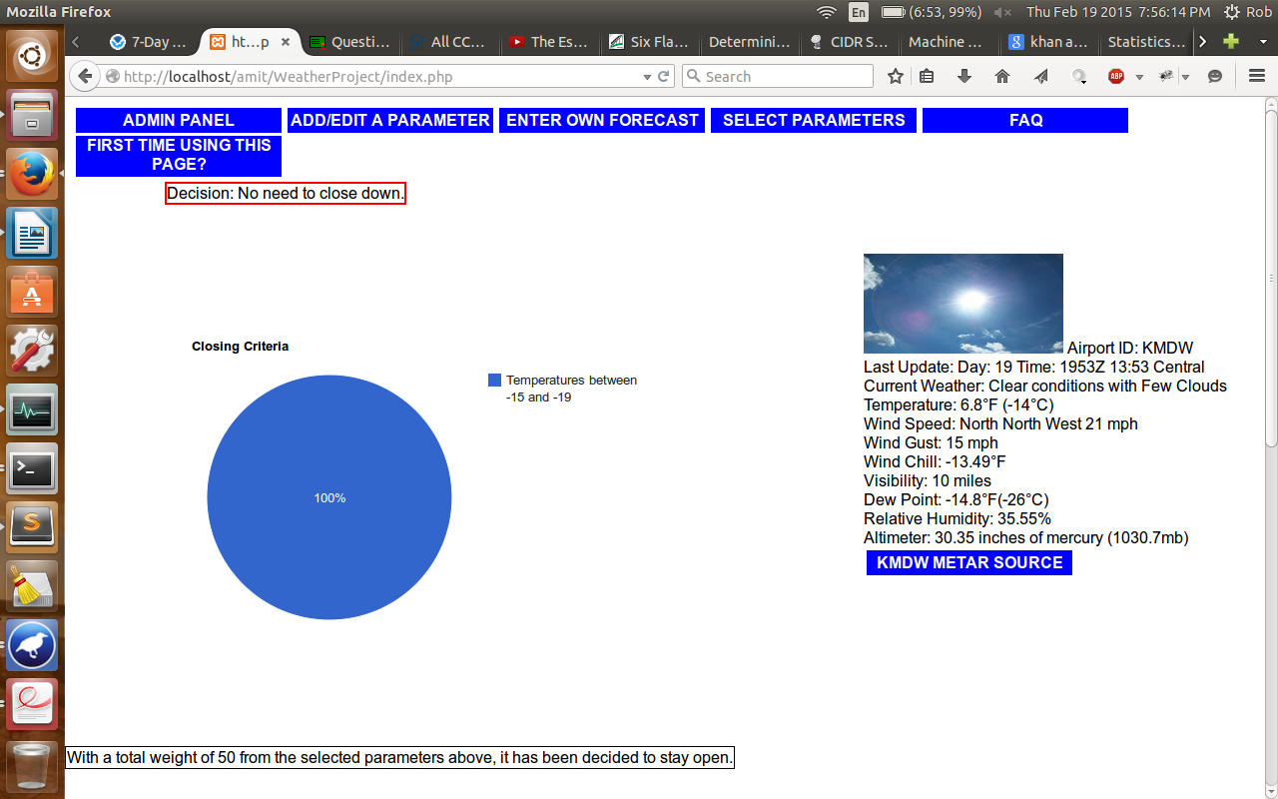
Main Page

Slide 7
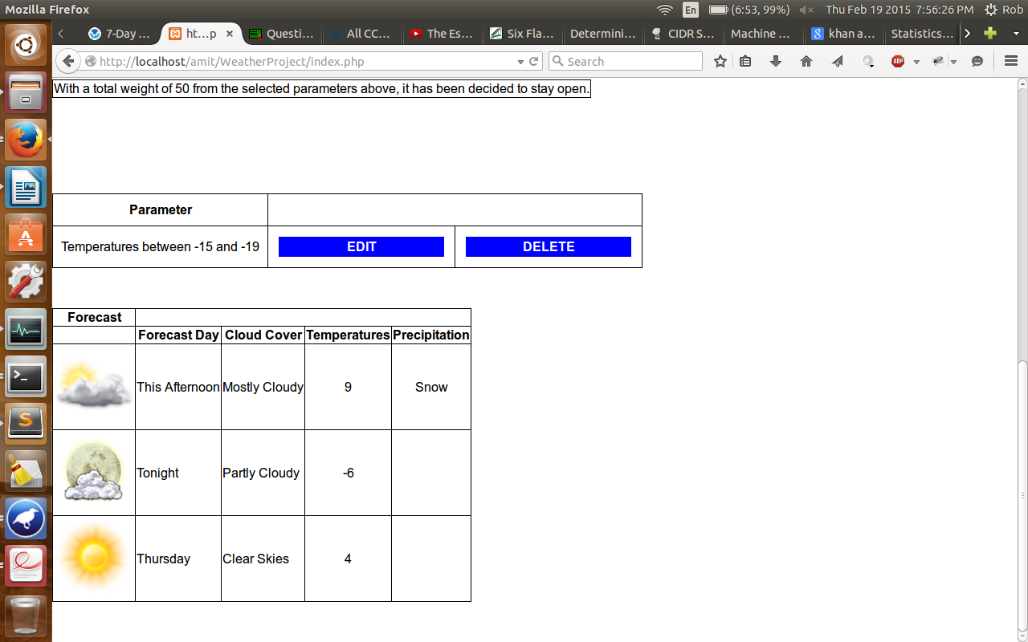
More of the main page

Slide 8
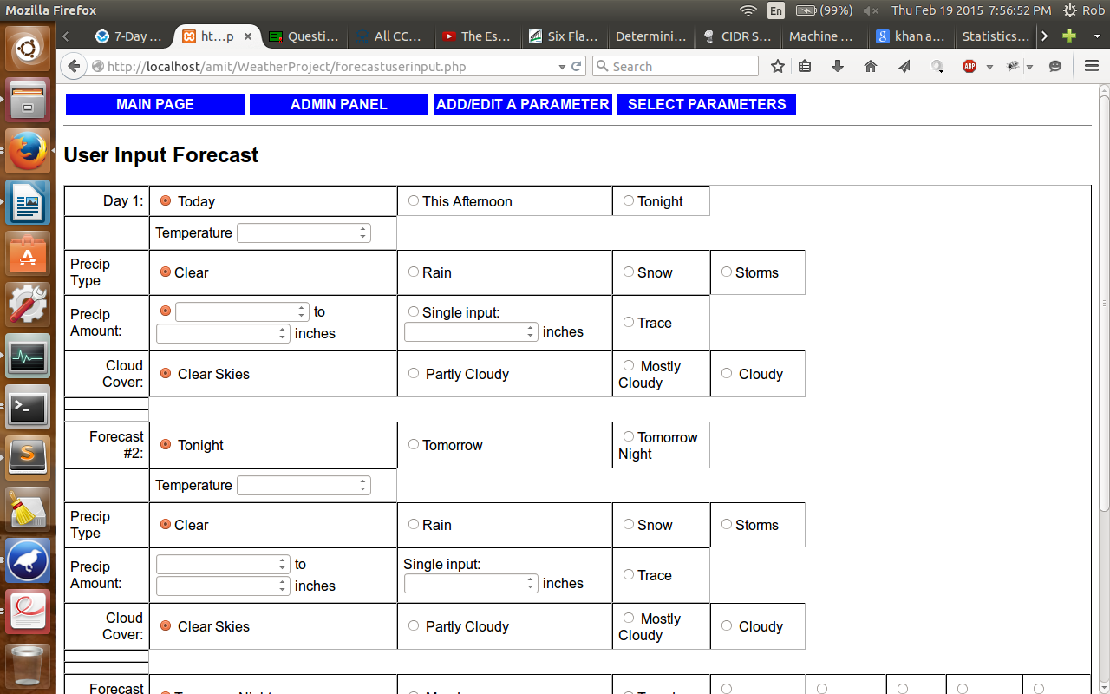
Enter Forecast

Slide 9
Version 2

Slide 10
Downsides to this version that could be addressed
Parameter outputs were obtained from the parameters Gilber gave me
Entering in a number for a lower amount reults in a higher amount to be outputted in the closing criteria for certain parameters such as Wind Gust

Slide 11
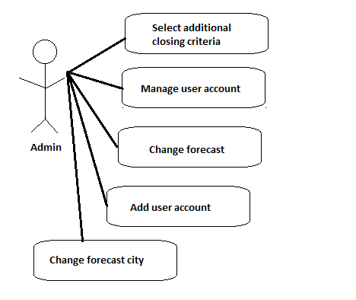
What the Admin is able to do

Slide 12
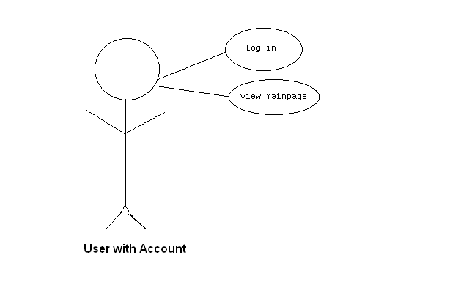
What the user is able to do

Slide 13
Calculations in Current Weather
Wind speed to miles per hour = (Wind speed in knots * 1.15077945)
Relative Humidity = (Vapor Pressure / Saturation Vapor Pressure) * 100
Vapor Pressure = 6.112 * exp ((17.67 * Dew Point in Celsius) / (243.50 + Dew Point in Celsius))
Saturation Vapor Pressure = 6.112 * exp ((17.67 * Temp in Celsius) / (243.50 + Temp in Celsius))
Wind Chill = 35.74 + 0.6215*(Air Temp in Fahrenheit) – 35.75*(WindSpeed in MPH)^{0.16} + 0.4275 *(Air Temp in Fahrenheit) *(WindSpeed in MPH)^{0.16}

Slide 14
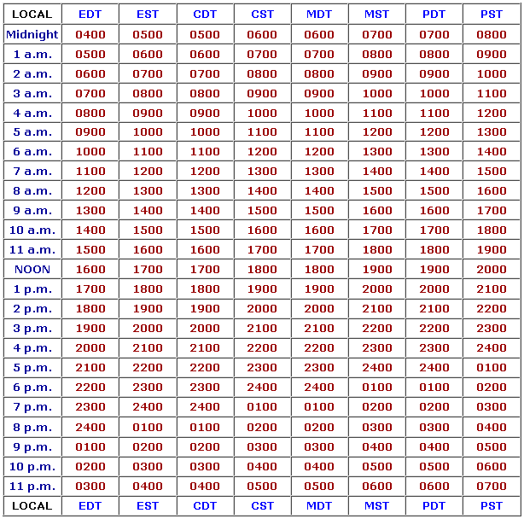
Calculations cont.
Zulu Time (Greenwich Mean Time): used in aviation and in the military.
5 to 6 hour difference.

Slide 15
Features
Current weather taken from local airport observation sites courtesy of National Weather Service
w1.weather.gov/data/METAR/KORD.1.txt
Admin page and Guest page
Ability to change current weather city
Admin entered forecast for day of concern
Ability to select parameters that didn’t fall in the user entered forecast

Slide 16
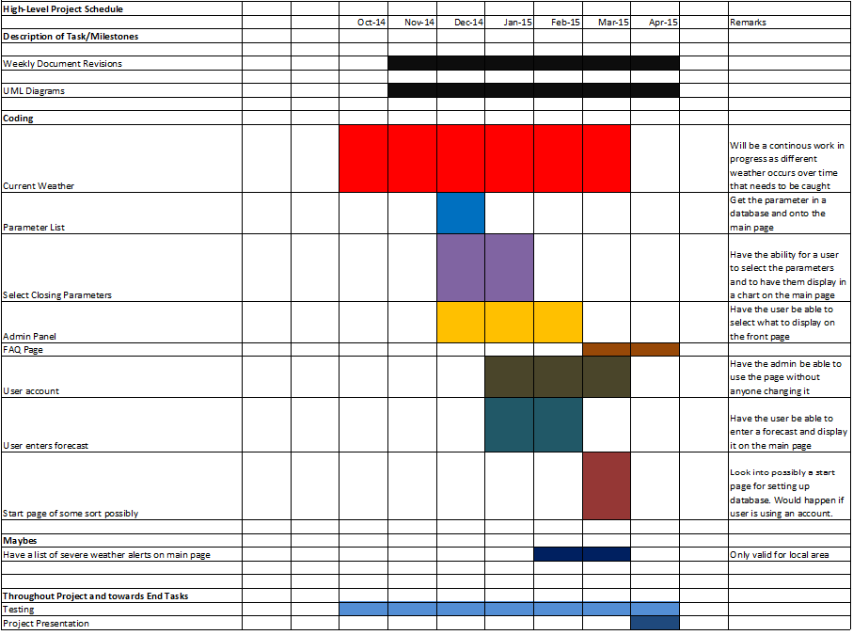

Slide 17
What I learned from this project
How to build a website
How to use PHP
How to create a login/logout feature and user account

Slide 18
Future work to be done
Add in a feature to allow weather alerts to be listed on the main page
Creation of non-admin accounts to be able to access the website to make certain change
Add in heat index calculation
Continue to add in current weather cities to support all 50 states and to remove any dead links

