Slide 1
Analytics and ML on car price predection
By Raziuddin Khazi

Slide 2
Tasks
Find Interesting insights and Statistical in the dataset
Machine Learning Model to predict the price of the vehicle

Slide 3
Dataset Quality Analysis
Year: non integer type and nan values, text information
Price : missing values and non numeric values
Cylinder : non integer type, some text information
Manufacturer : categorical data
Many Unnamed columns

Slide 4
Explorative Data Analysis
Drop the Unnamed Columns, Columns with text data, urls etc
Extract selected columns (Price, Year, Manufacturer, Cylinder., etc)
Drop nan values, string information, outliers Eg: price value 0, negative value, extreamly large values., etc and reset their data types accordingly.
Replace the string with equivalent numbers notations

Slide 5
Insights from the dataset

Slide 6
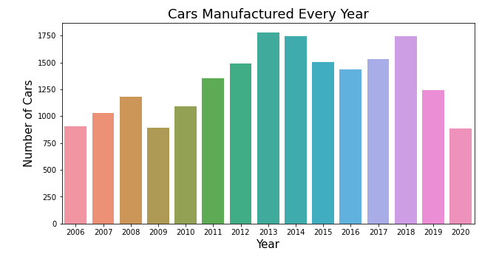
Number of cars significantly increased in the last decade, however, this has reduced 2019 and 2020. This could be because of the pandemic or companies switching towards electric cars.

Slide 7
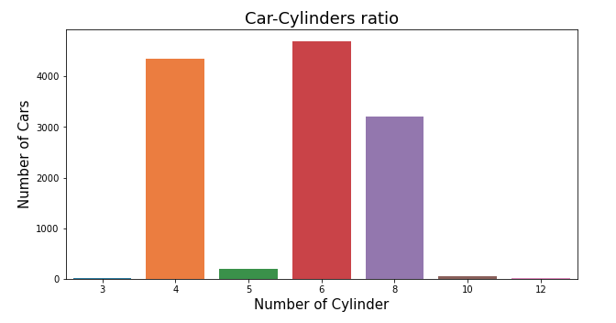
Most of the cars have 6,4,and 8 Cylinders

Slide 8
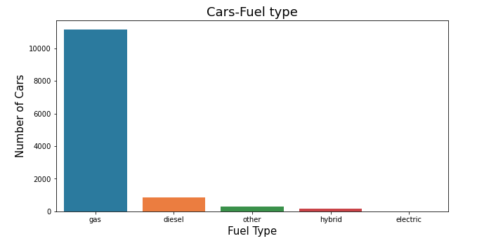
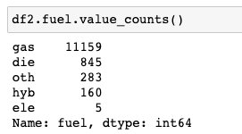
Most of the cars consume gas, then comes diesel, and least is the electric vehicles.

Slide 9
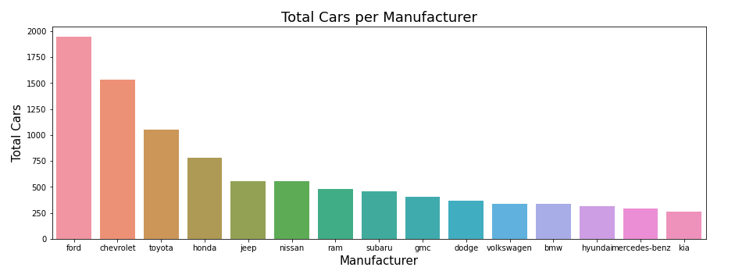
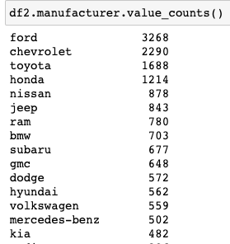
Ford, Chevrolet, Toyota, and Honda are the market players

Slide 10
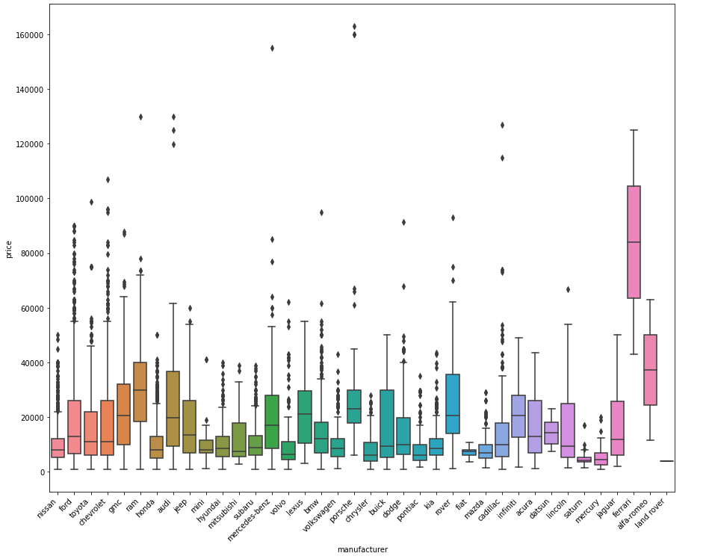
Box Plot : Comparing all the manufacturers price range

Slide 11
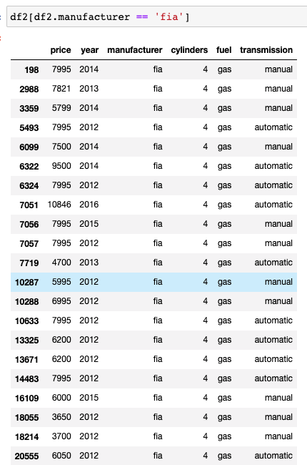
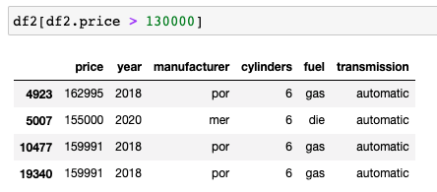
According to the boxplot in the previous slide:
Ferrari has the highest Median Price.
Porsche and Mercedes sell the most expensive cars.
Most market players target 7000-20000 range
Price range for Fiat is between 6000 – 10000
No Electric Vehicals in 2020

Slide 12
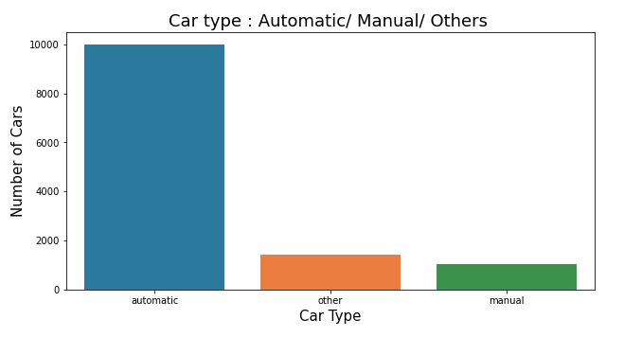
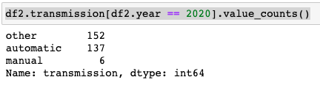

Slide 13
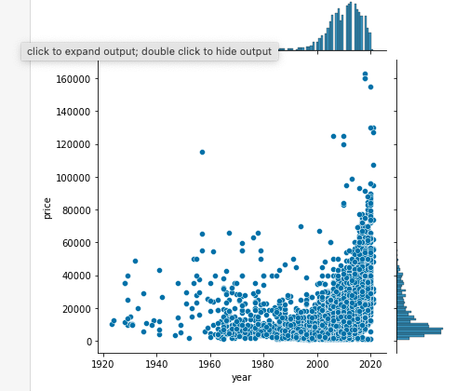
Car consumers increased in the last decade.
High end cars production increased over the last decade.

Slide 14
Linear Regression

Slide 15
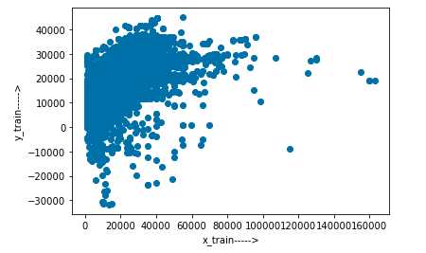
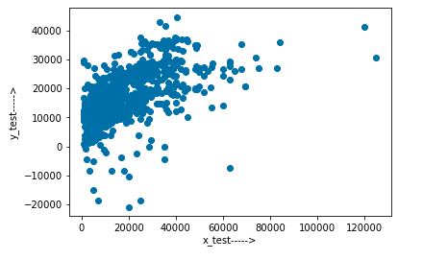
Linear Regression Results

Slide 16
Thank You

Slide 17
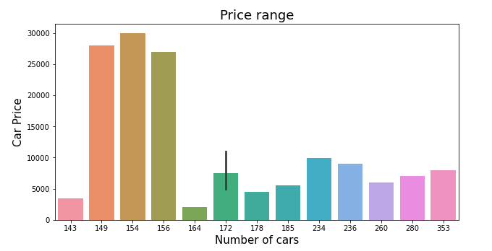
Below 12,000 is the good market for the manufacturers

