Slide 1

Crime_Rate_per_100k Analysis Dashboard
- Created By Razia Awais
Powered By

Slide 2
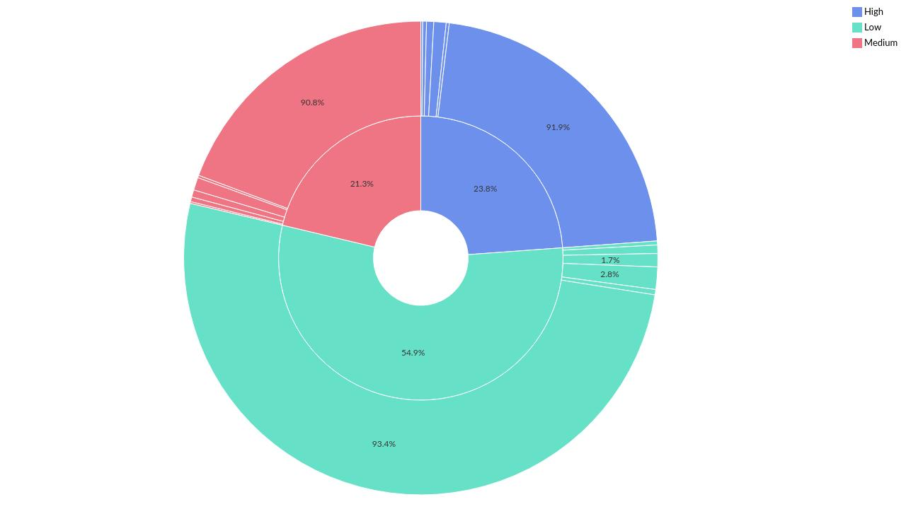
Severity-wise Crime_Rate_per_100k by Region
Powered By

Slide 3
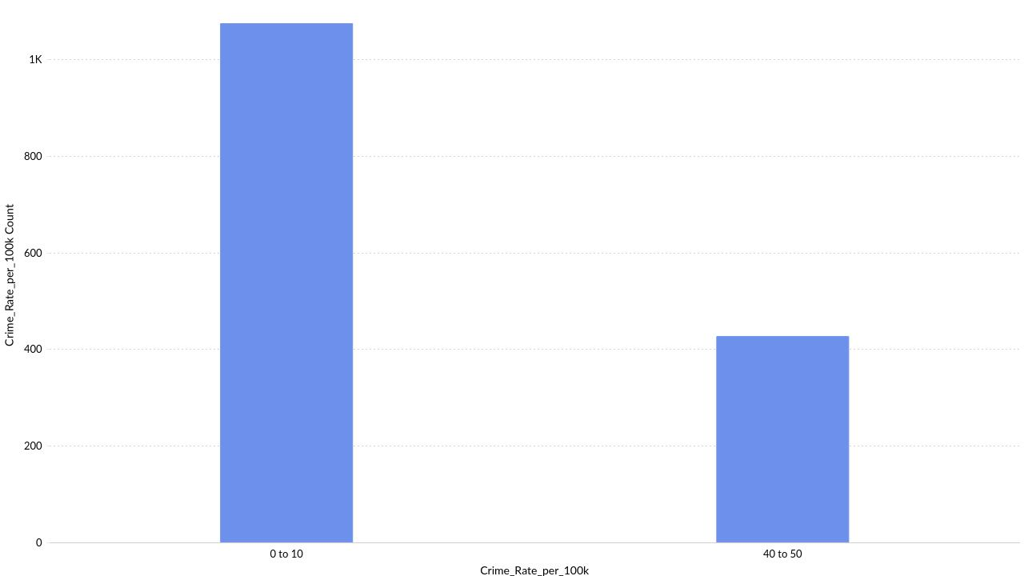
Distribution of Crime_Rate_per_100k over different ranges
Powered By

Slide 4
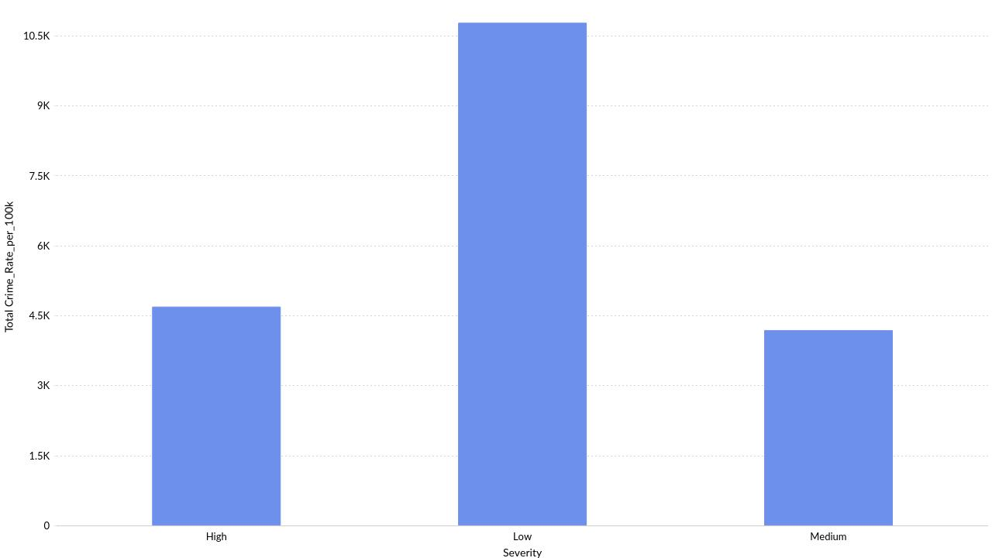
Severity-wise Crime_Rate_per_100k
Powered By

Slide 5
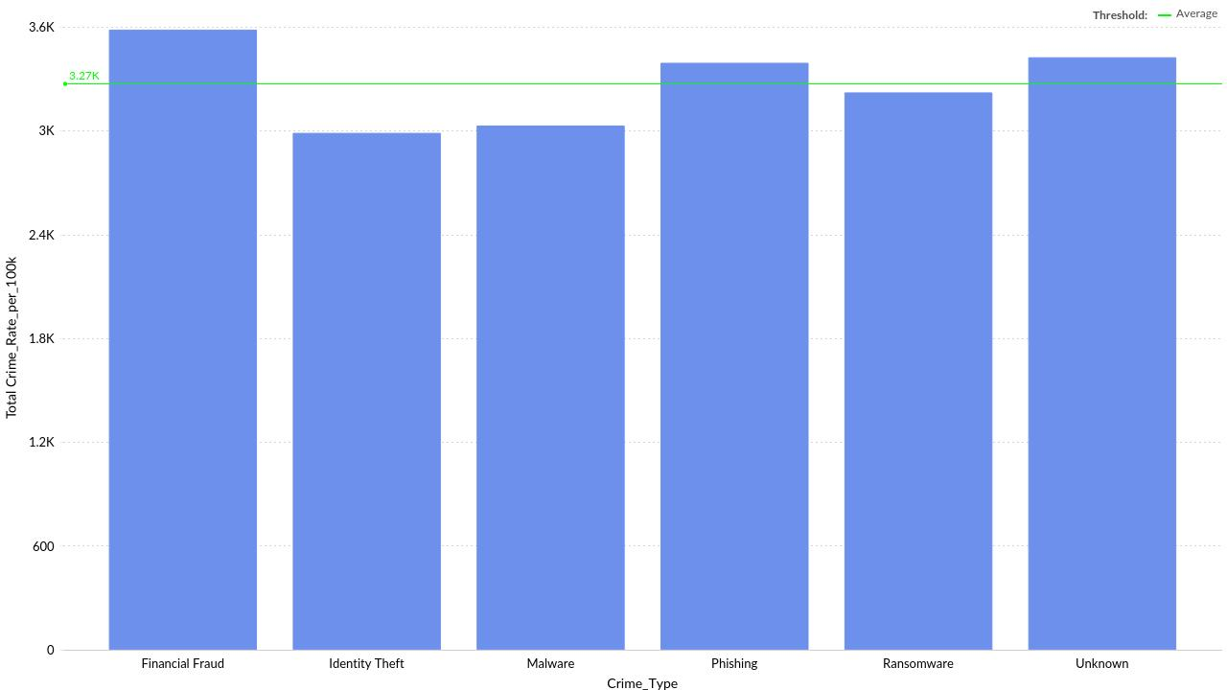
Crime_Type-wise Crime_Rate_per_100k
Powered By

Slide 6
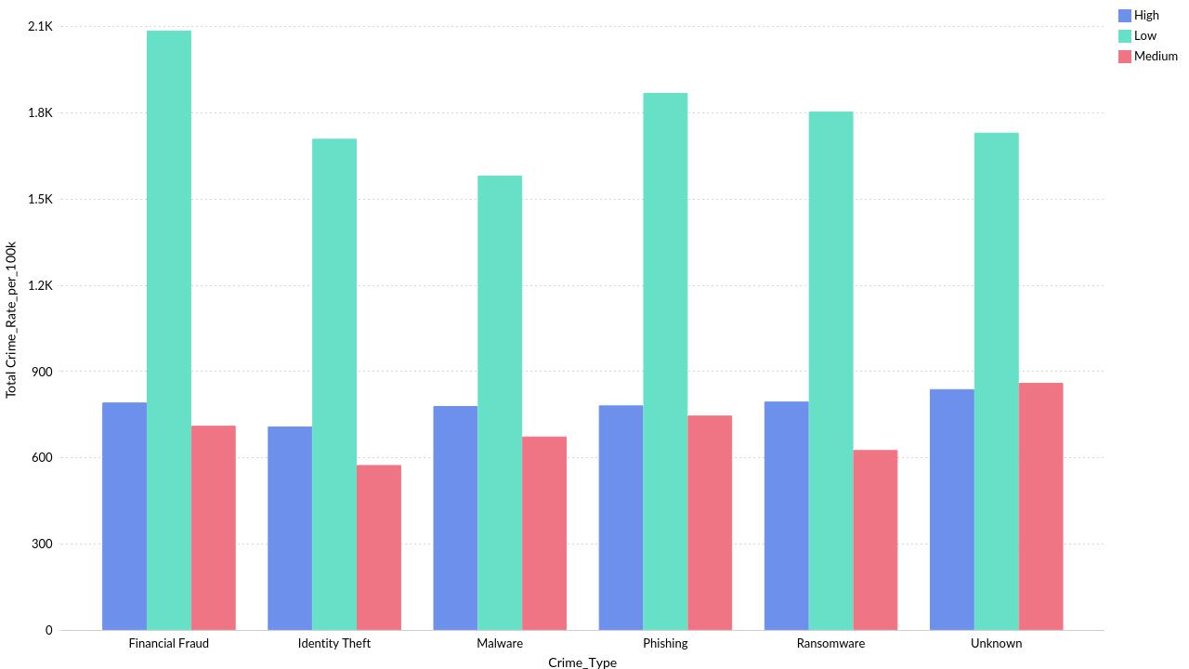
Crime_Type-wise Crime_Rate_per_100k by Severity
Powered By

Slide 7
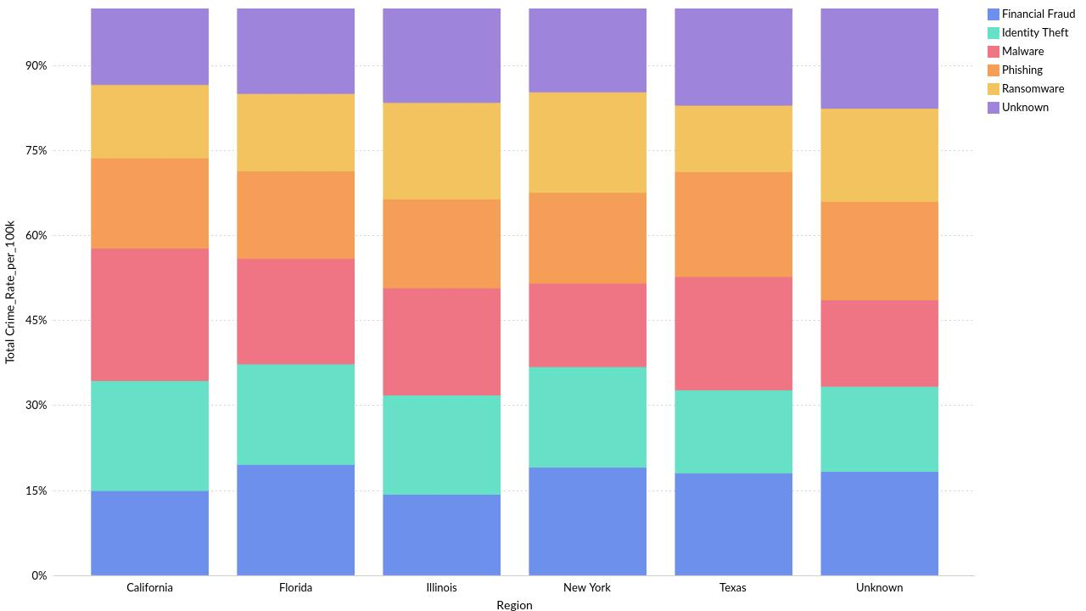
Ratio of Region-wise Crime_Rate_per_100k by Crime_Type
Powered By

Slide 8

Region-wise Crime_Rate_per_100k
Powered By

Slide 9
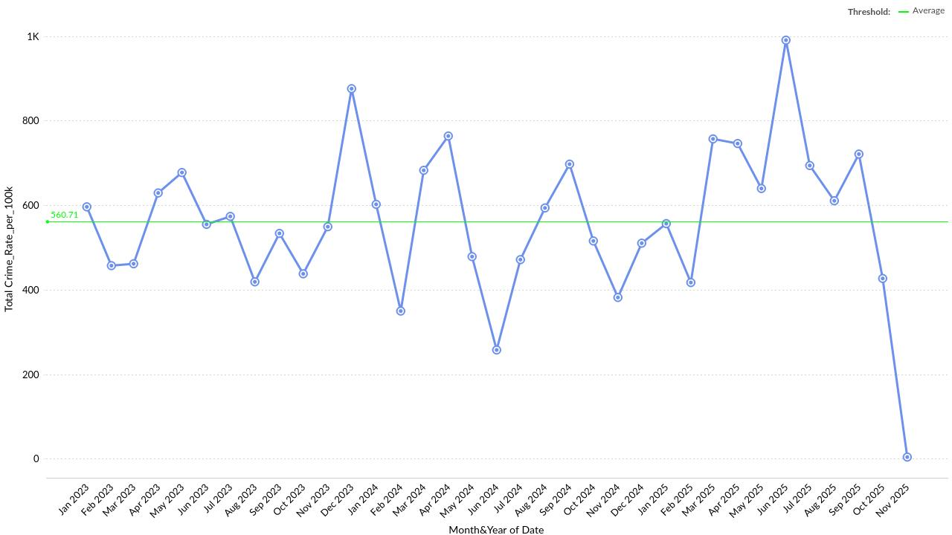
Crime_Rate_per_100k Across Months(Date)
Powered By

Slide 10
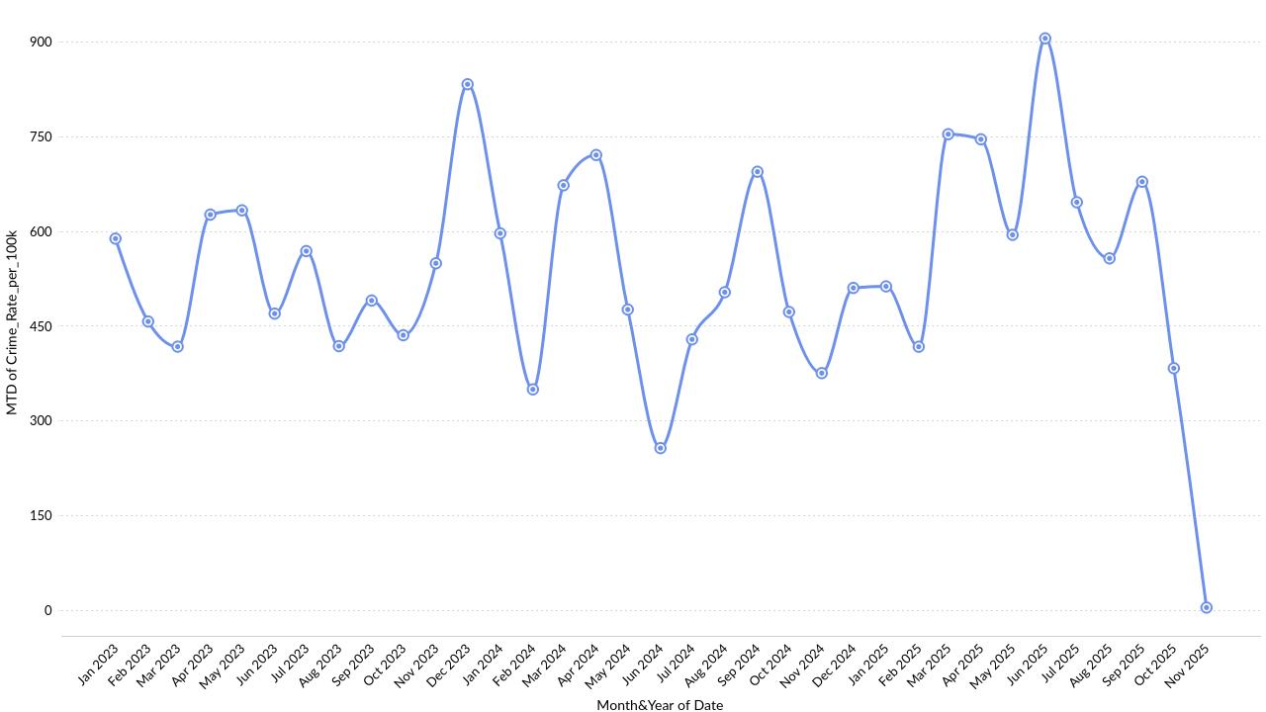
Month to Date(MTD) Crime_Rate_per_100k by each Month(Date)
Powered By

Slide 11
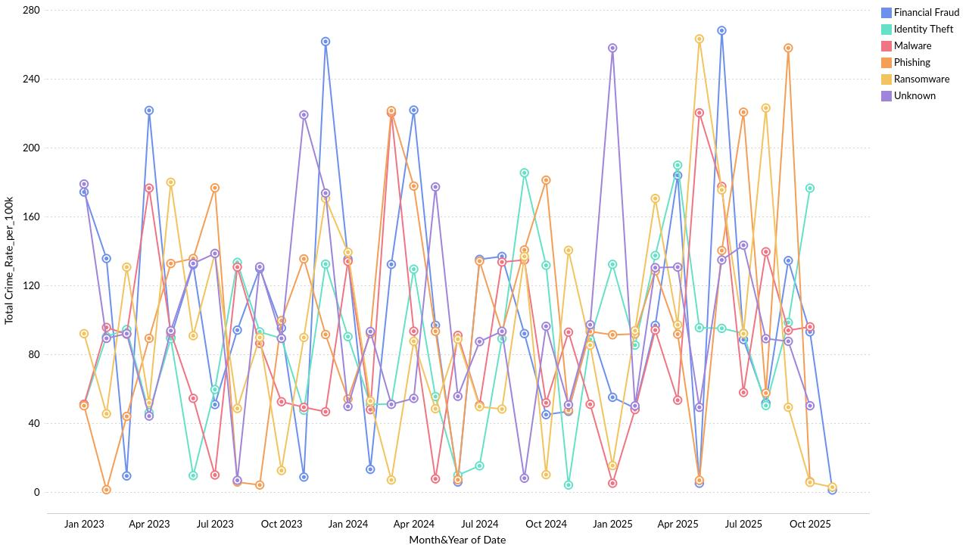
Crime_Rate_per_100k Across Months(Date) by Crime_Type
Powered By

Slide 12
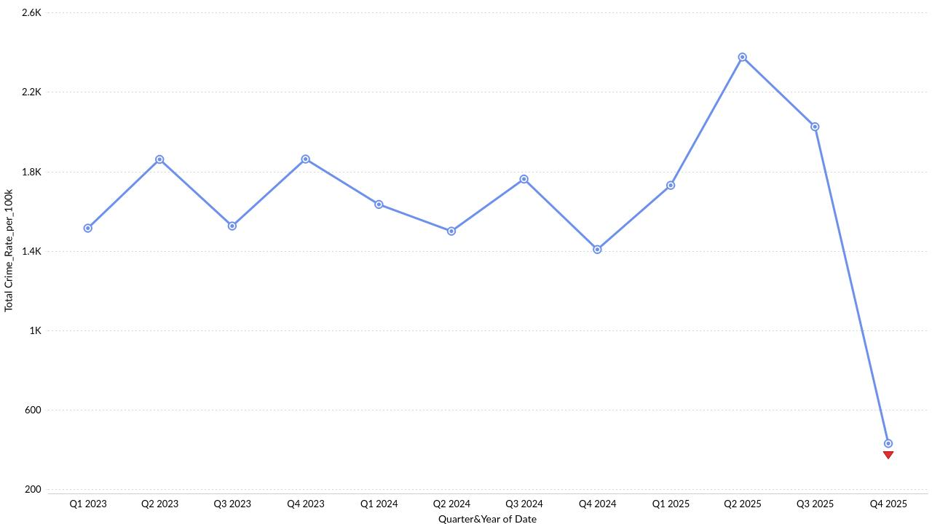
Crime_Rate_per_100k showing Anomaly across Quarters
Powered By

Slide 13
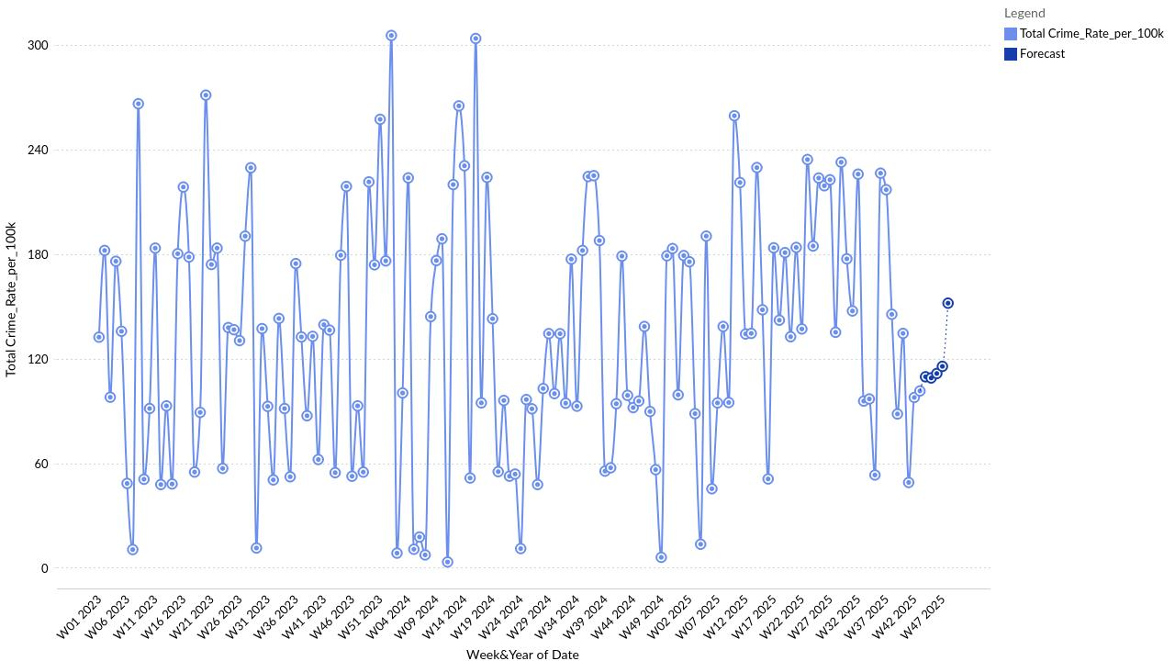
Crime_Rate_per_100k across Weeks with Forecast
Powered By

Slide 14
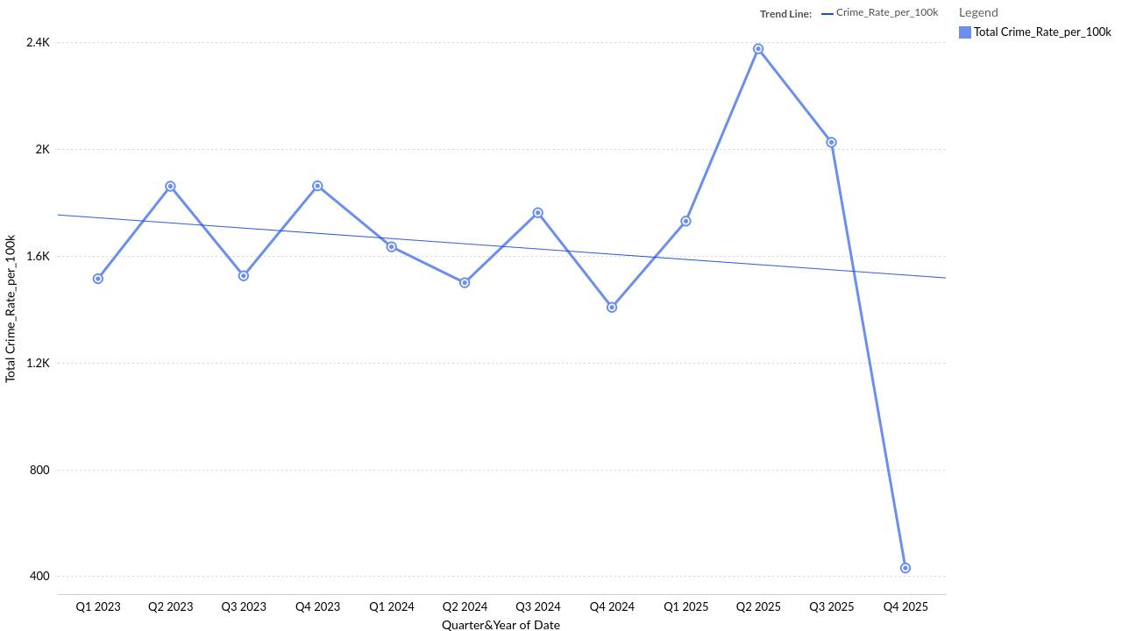
Crime_Rate_per_100k Trend (based on Date)
Powered By

Slide 15
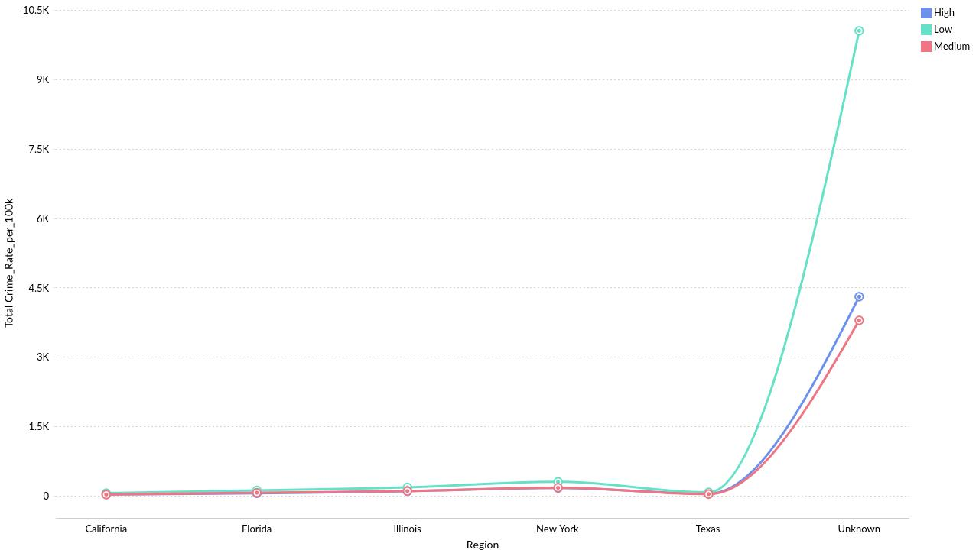
Region-wise Crime_Rate_per_100k by Severity
Powered By

Slide 16
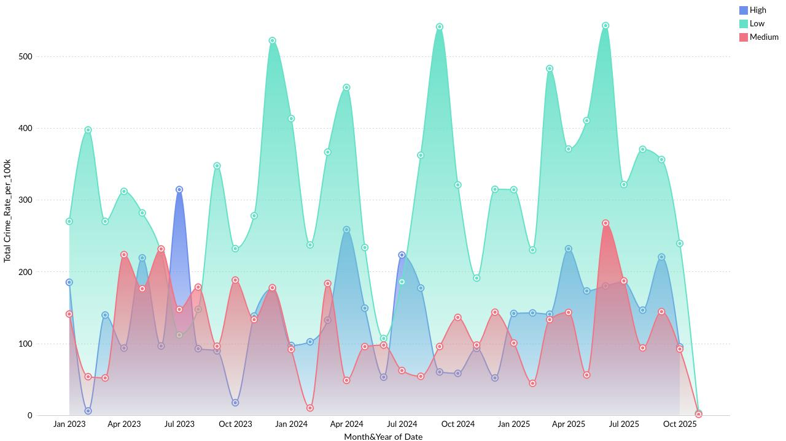
Crime_Rate_per_100k Across Months(Date) by Severity
Powered By

Slide 17
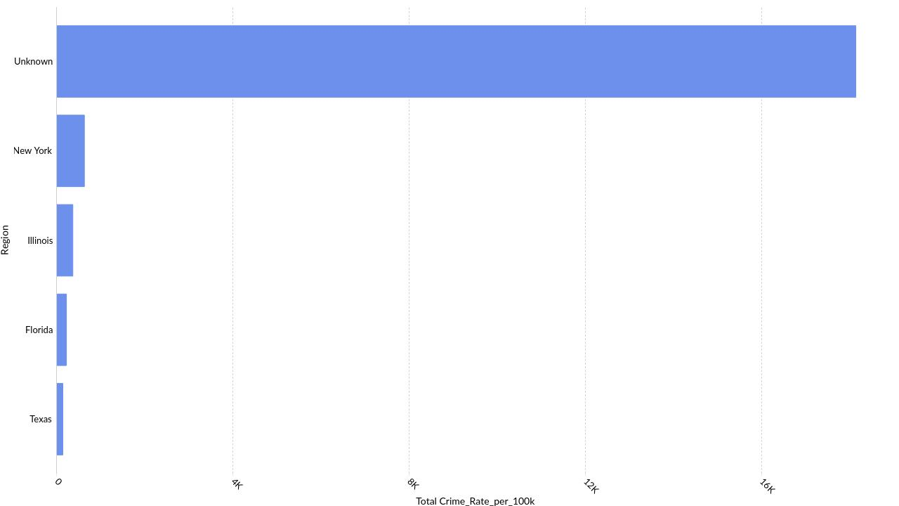
Top 5 Region by Crime_Rate_per_100k
Powered By

Slide 18
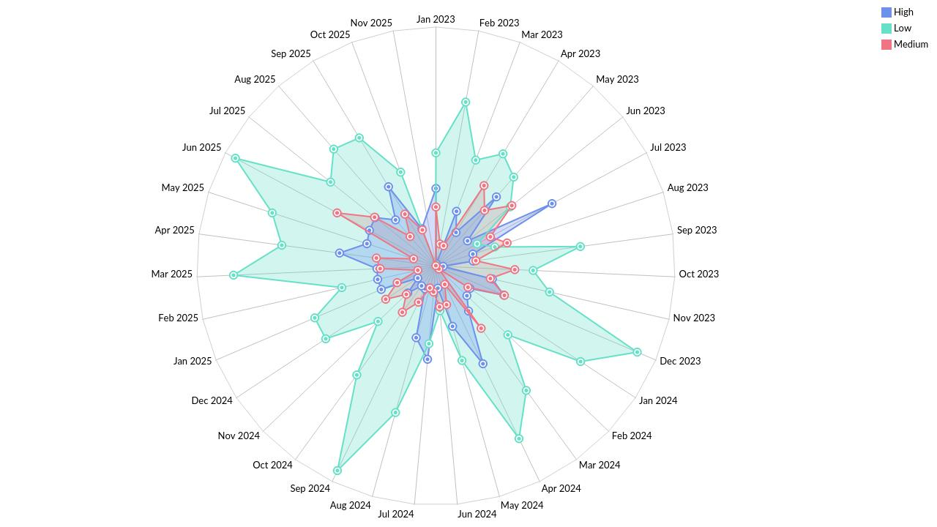
Date-wise Crime_Rate_per_100k by Severity
Powered By

Slide 19
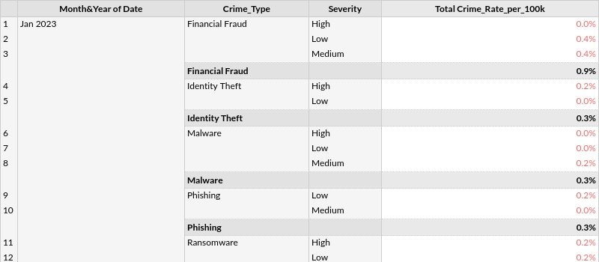
Crime_Rate_per_100k distribution across Months and Crime_Type by Severity
Powered By

Slide 20
Thank you
Powered By

