Slide 1
effectiveskiing.com
effectiveskiing.com
☑✔
☒✖

Slide 2
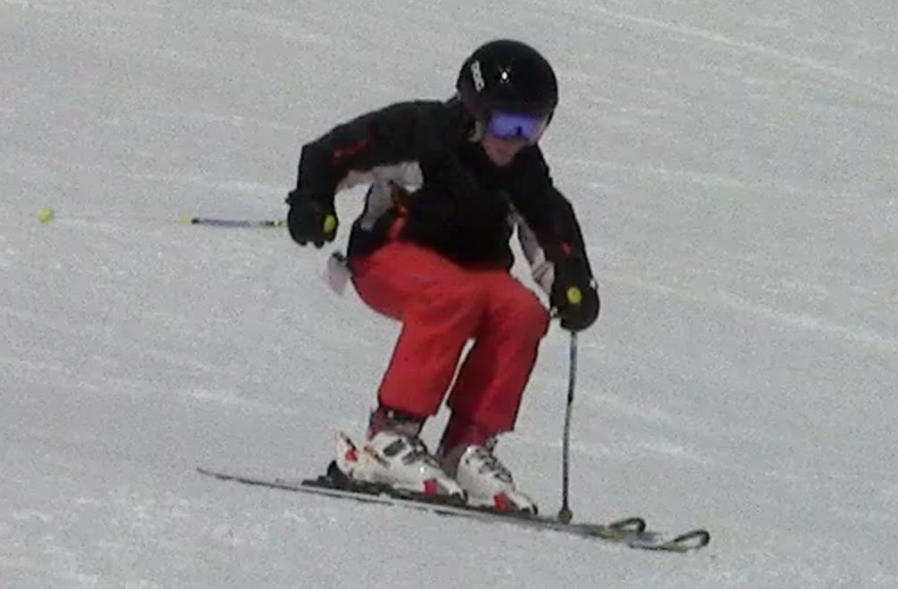
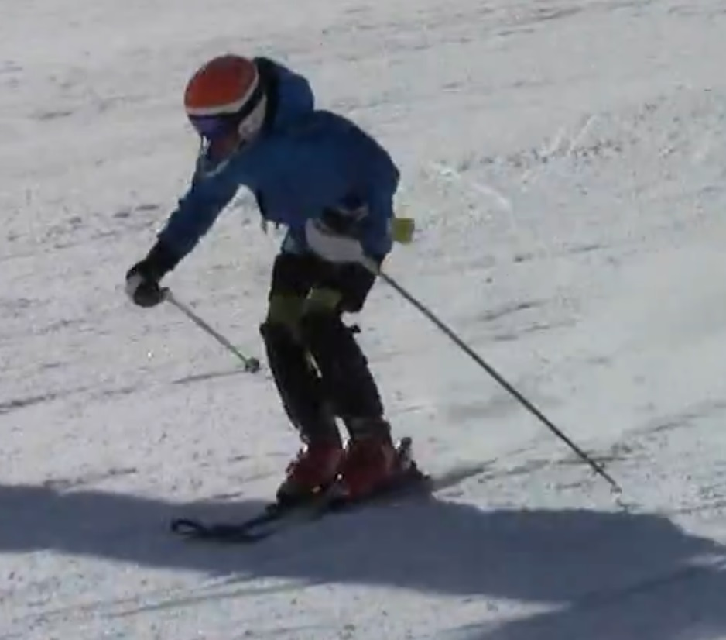
✔
✖
effectiveskiing.com

Slide 3
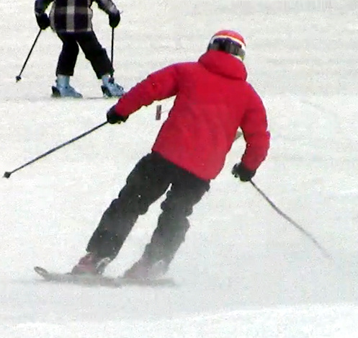
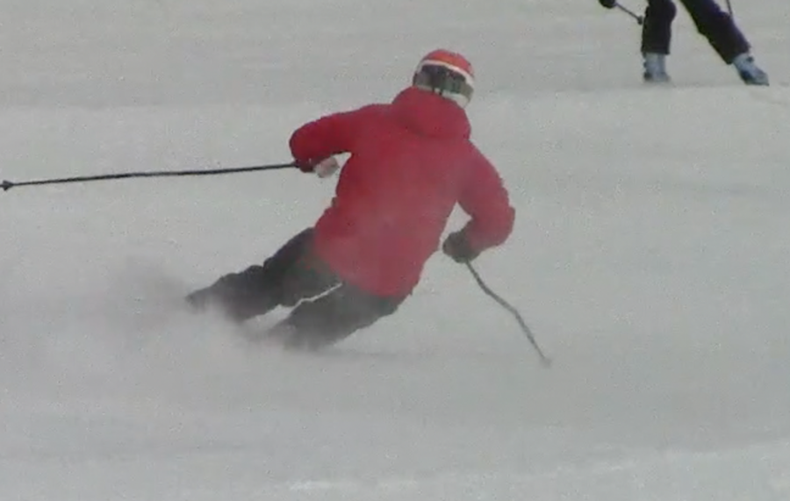

Slide 4
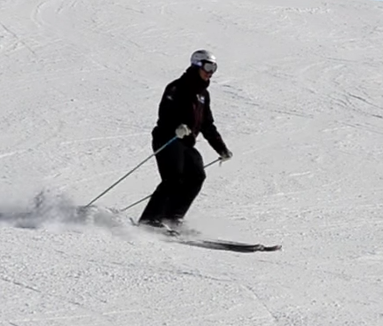
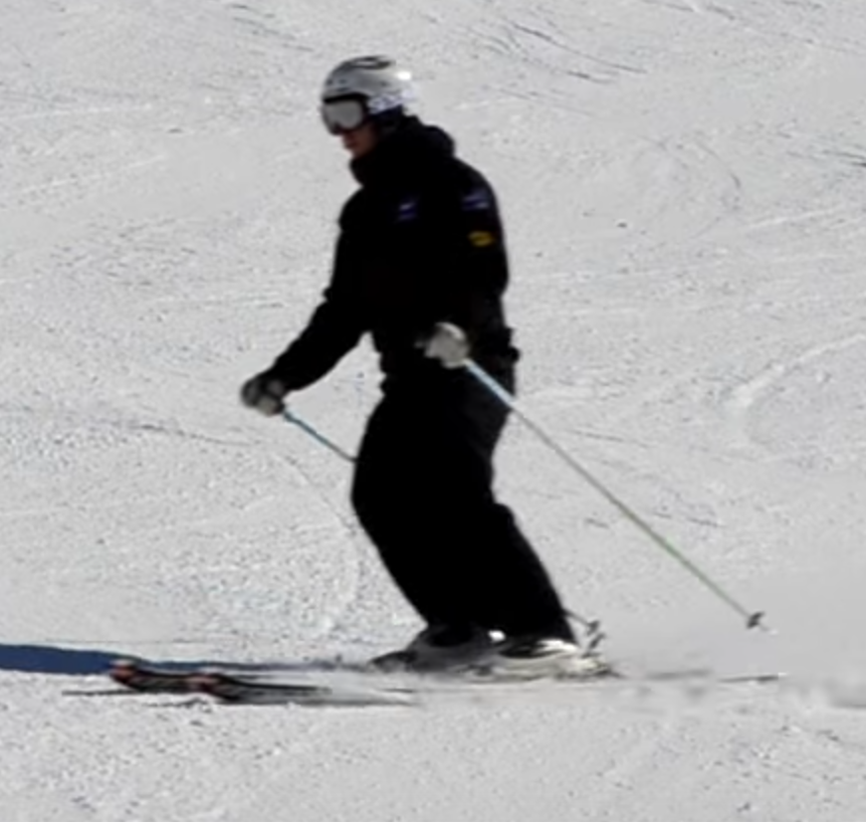

Slide 5
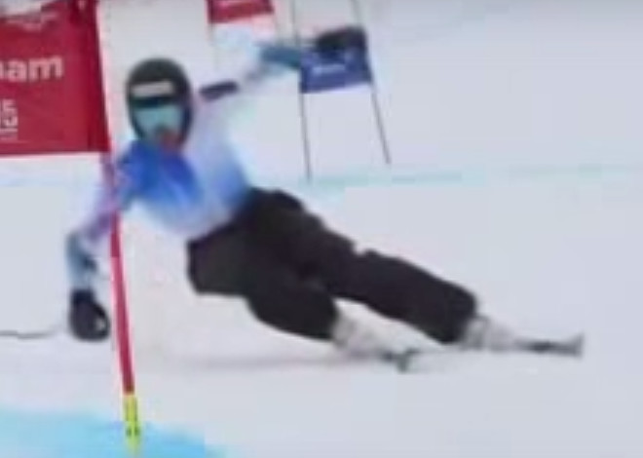
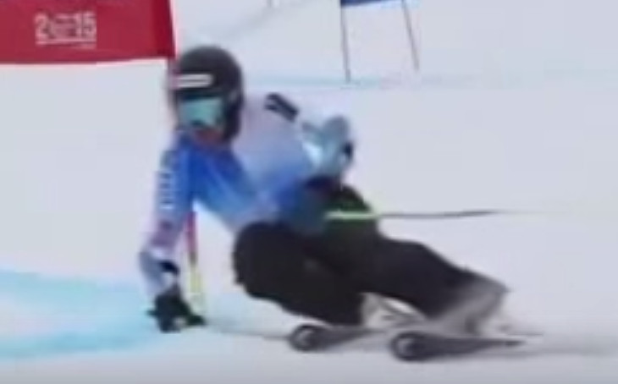

Slide 6
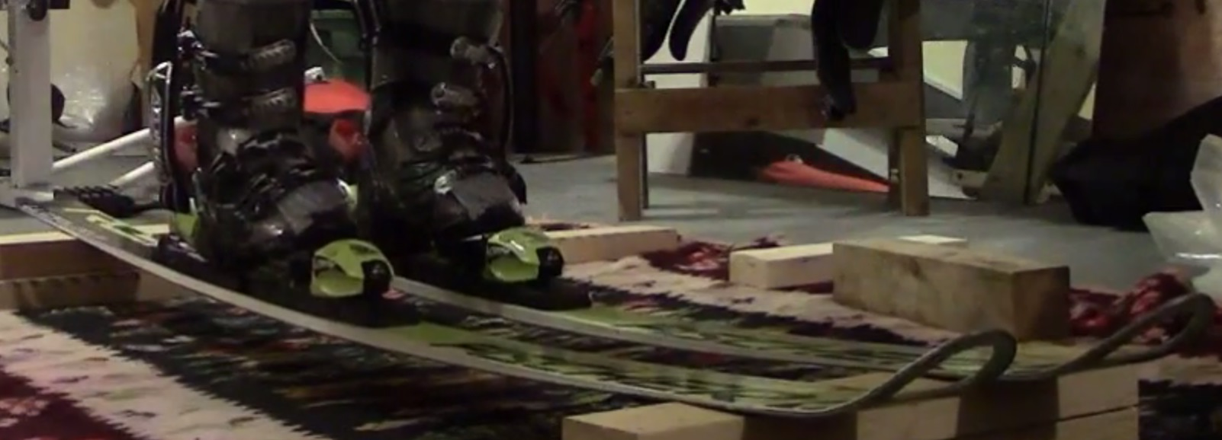
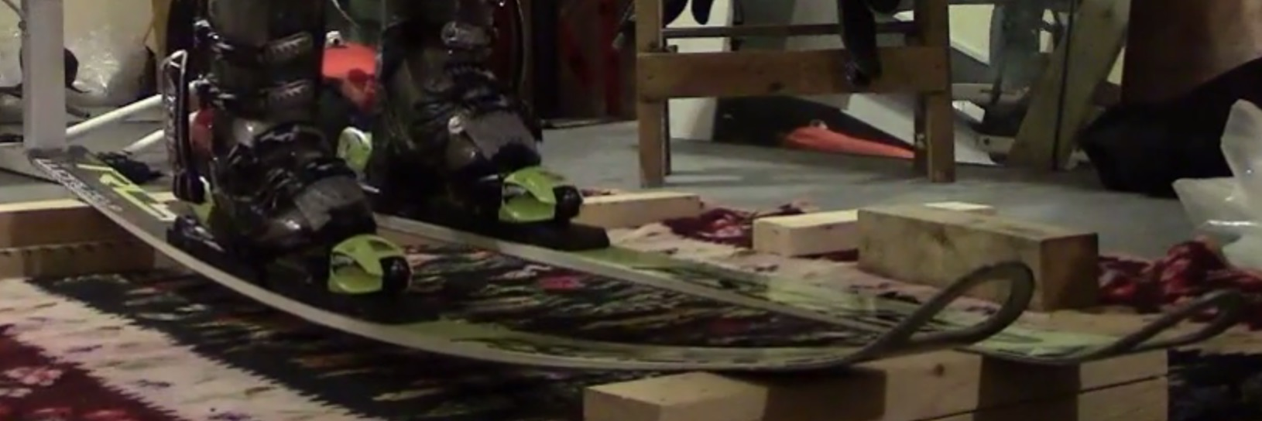
effectiveskiing.com

Slide 7
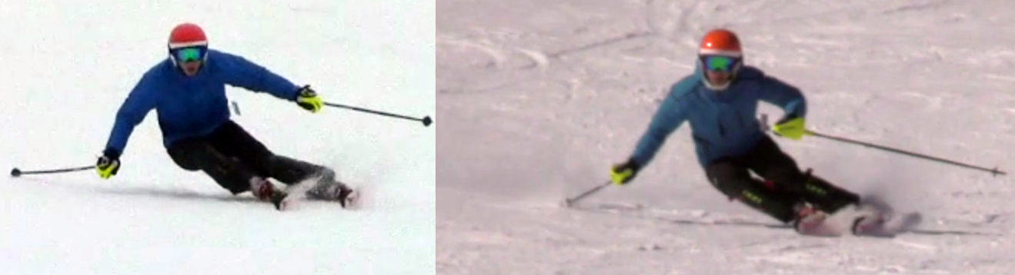
effectiveskiing.com

Slide 8
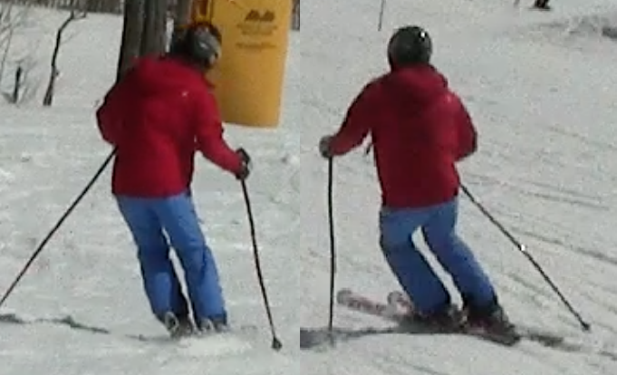
effectiveskiing.com
4
2
1
3

Slide 9
effectiveskiing.com
CA
CB
TIP
TURN

Slide 10
effectiveskiing.com

Slide 11
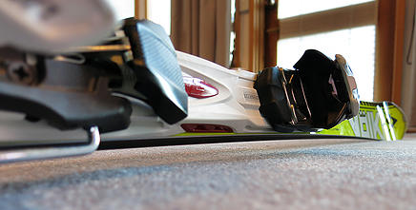
TIPPING
EXTENDING
effectiveskiing.com

Slide 12
TIPPING
effectiveskiing.com

Slide 13
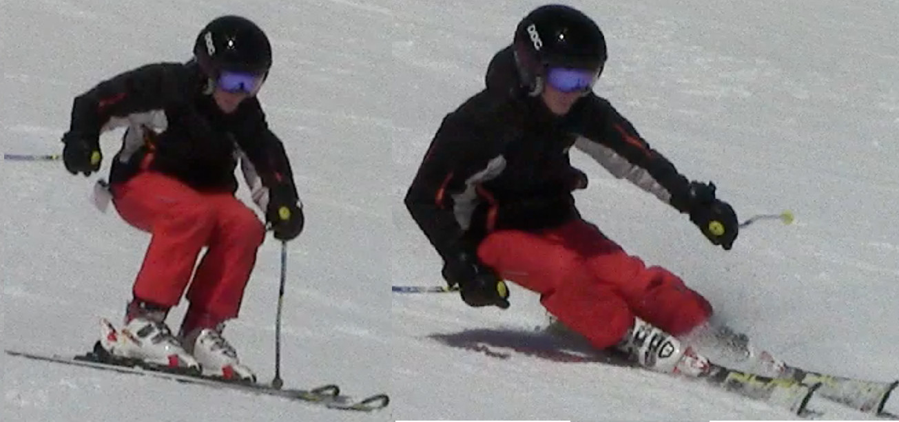
effectiveskiing.com

Slide 14
effectiveskiing.com

Slide 15
effectiveskiing.com

Slide 16
effectiveskiing.com

Slide 17
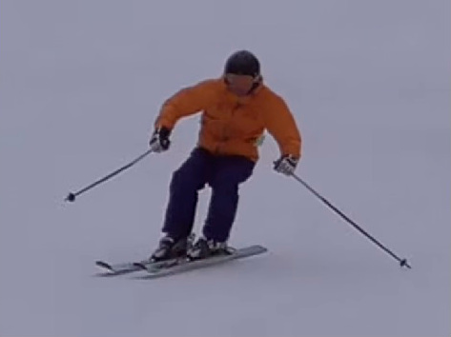
effectiveskiing.com

Slide 18
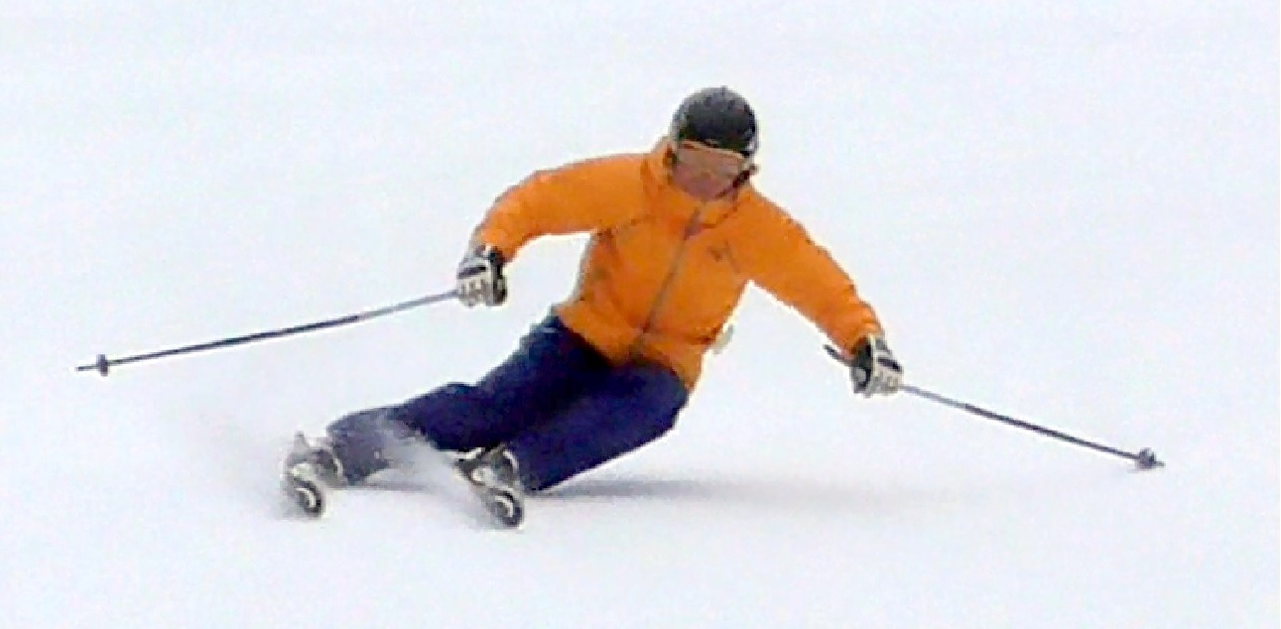
effectiveskiing.com

Slide 19
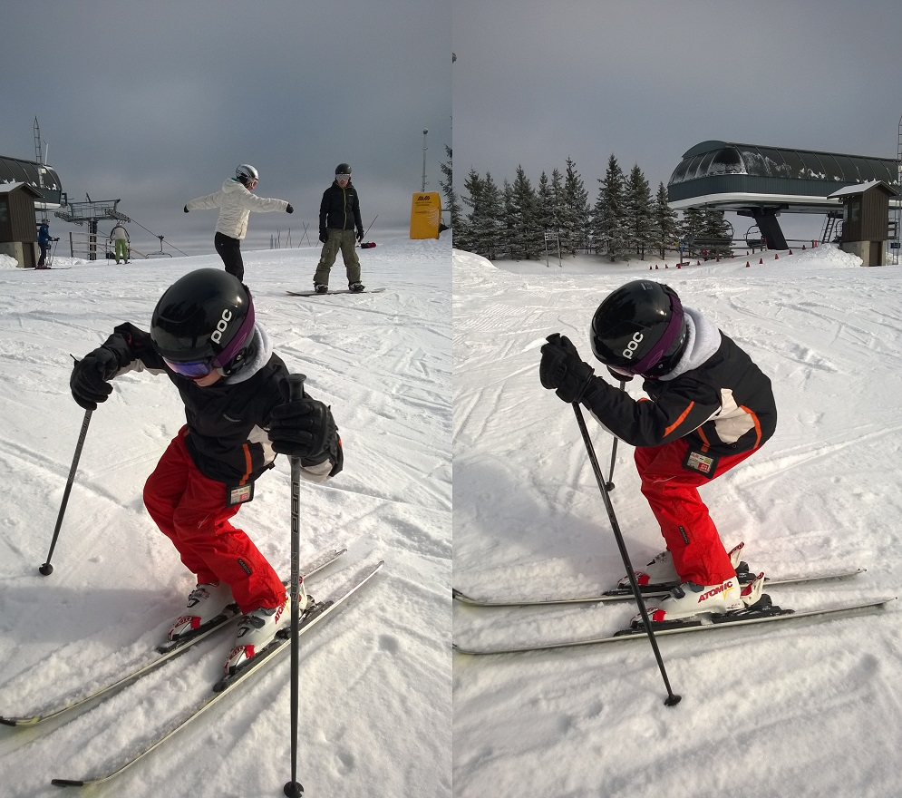
effectiveskiing.com

Slide 20
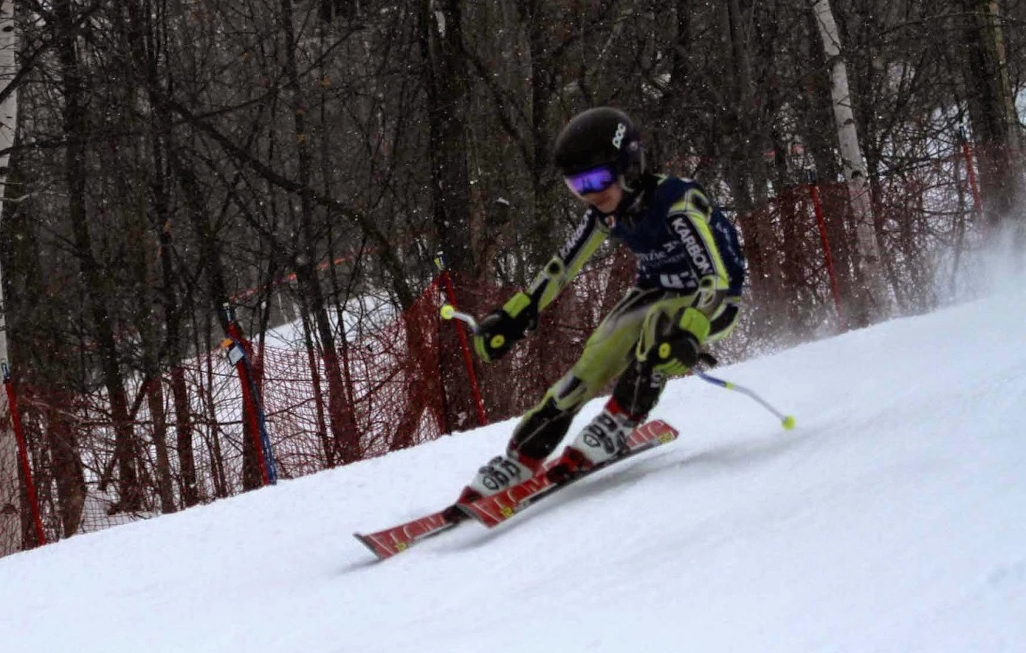
effectiveskiing.com

