Slide 1
RacerKidz.com - coaching
Structured racer-coach interaction
and ski club management

Slide 2
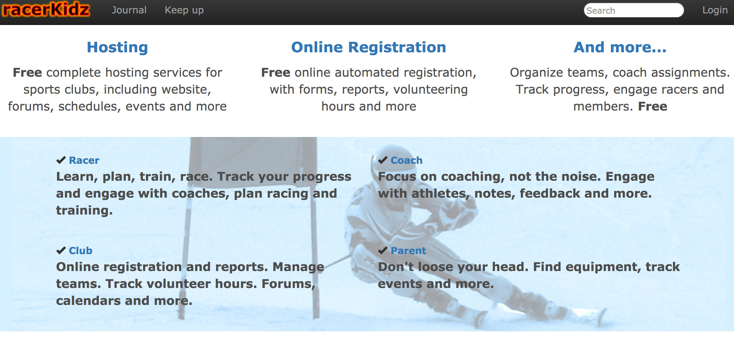
Dedicated for ski racing !
Not players… racers !
Free !

Slide 3
Overview
Structure athlete-coach interaction
Manage teams, notes, evaluations
Maintain athlete history
Event registration (camps, extra training…)
Club management
Assign racers to teams
Assign coaches to teams
Manage registration forms and waivers
Track volunteers (work, hours)
Calendars and event registration
Forums (announcements, buy and sell etc)

Slide 4
Racers, teams and events
Manage teams and events

Slide 5
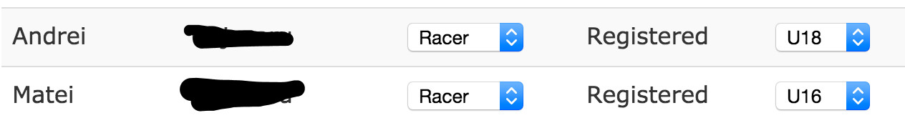
Racers and teams
Assign racers and coaches to teams

Slide 6

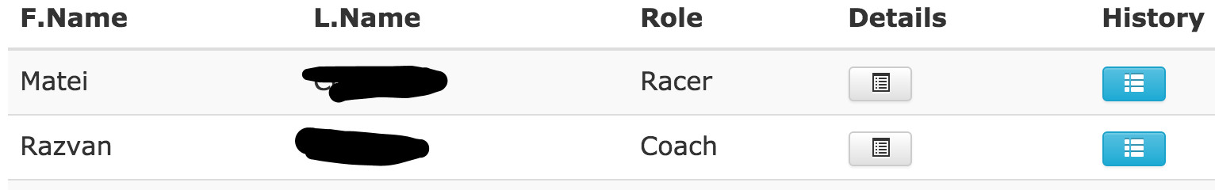
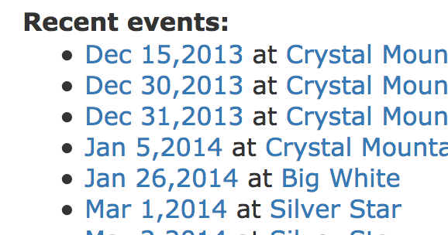
Coaches
See assignments, racers, events

Slide 7
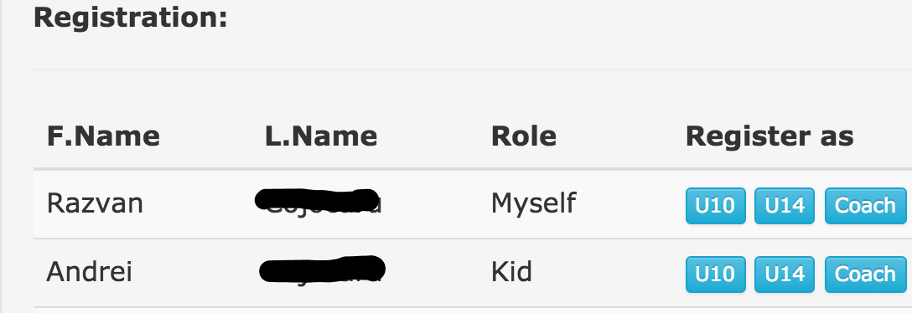
Racers and events
Racers / parents register for events

Slide 8
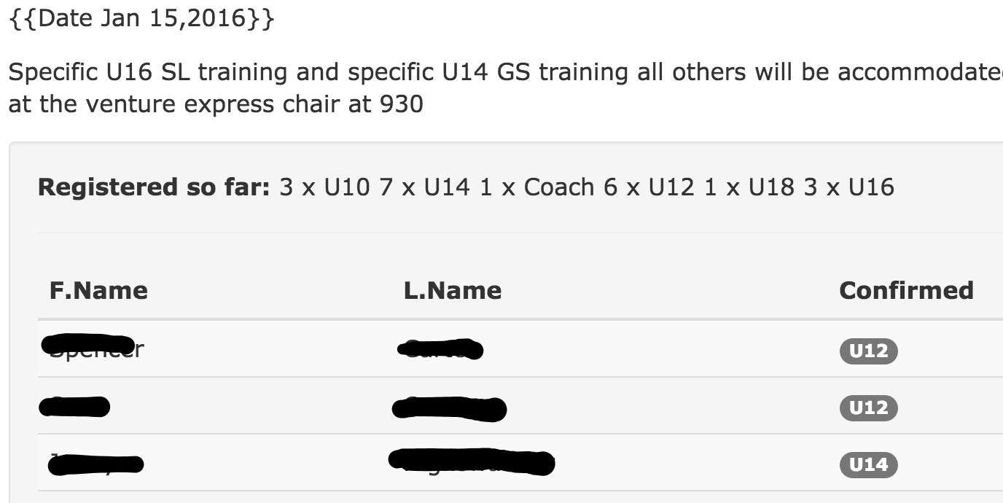
Coaches and events
Coaches see attendance, notify all of changes

Slide 9
Coaches, teams and racers
Manage teams and racers

Slide 10
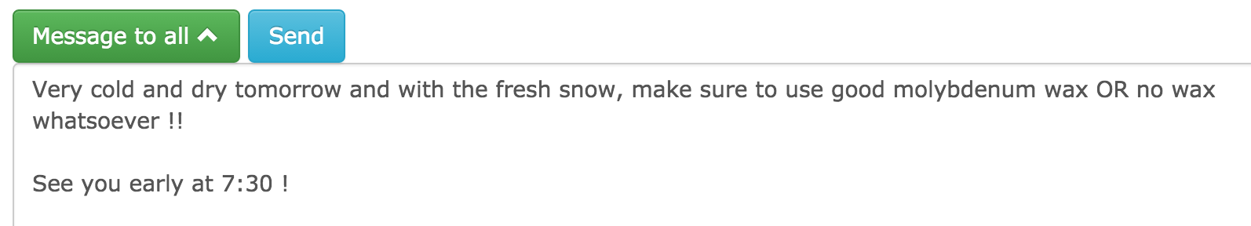
Coaches
Send message to team

Slide 11
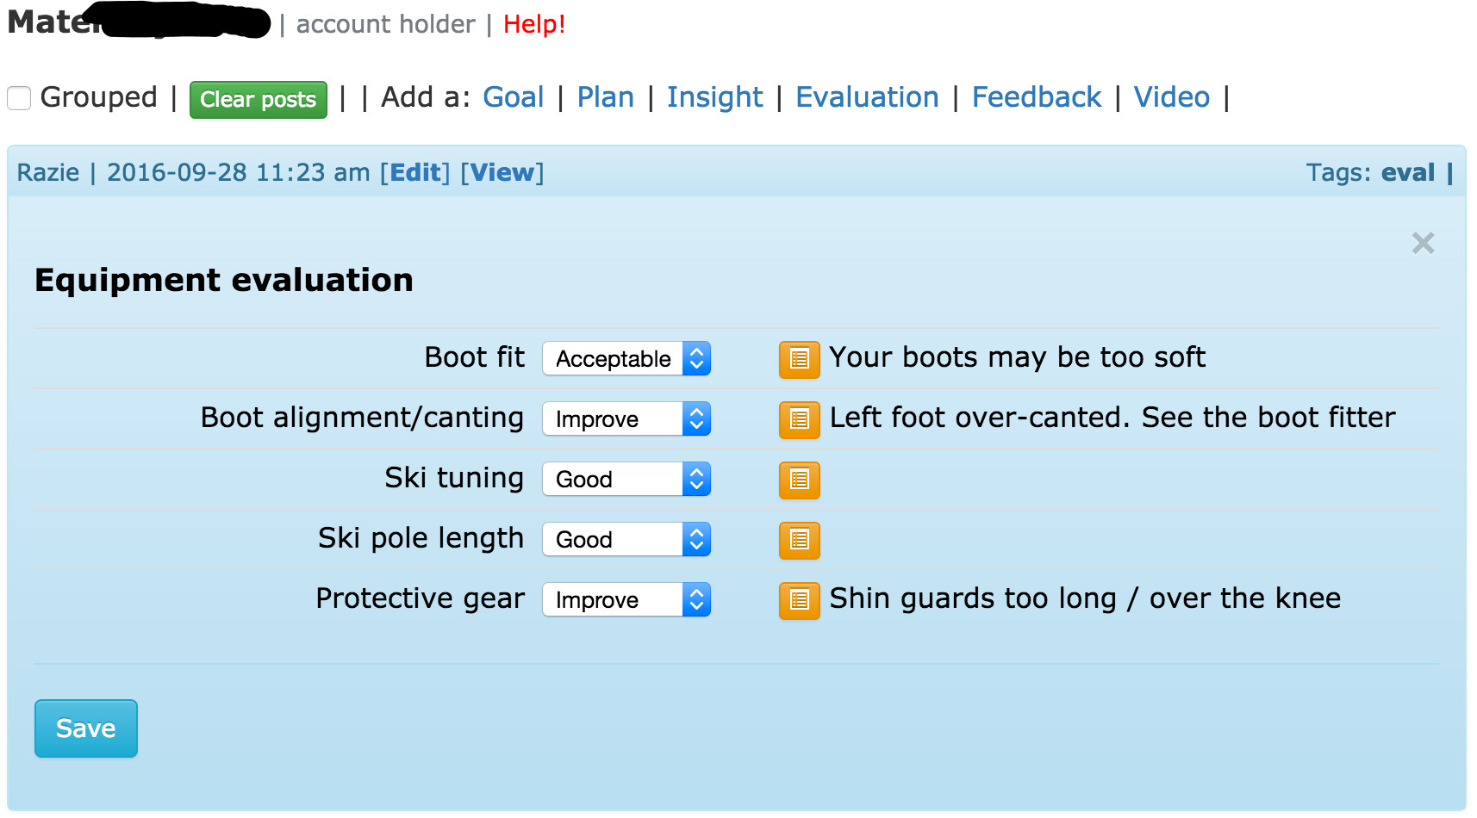
Coaches
Individual evaluations for athletes (equipment, technical etc)

Slide 12
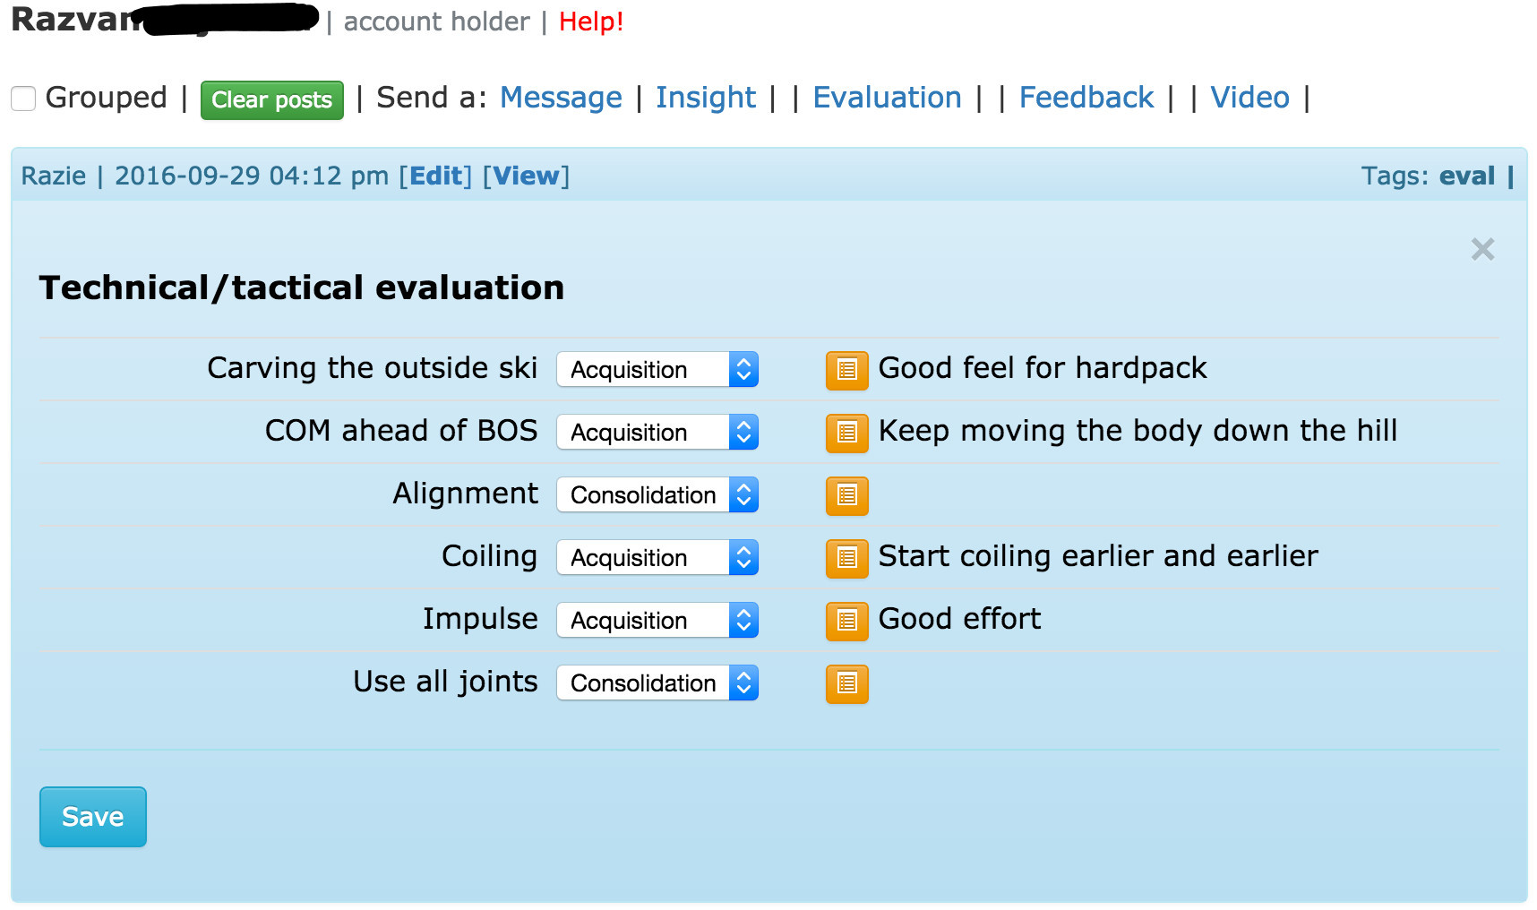
Coaches
Technical evaluations, recording testing results etc

Slide 13
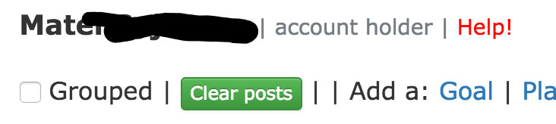
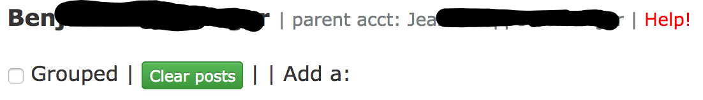
Racers / parents
See evaluations, notes, feedback, videos
If racer does not have account, parent will see the notes

Slide 14
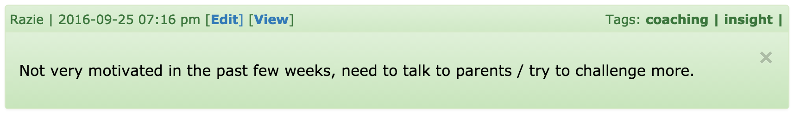
Coaches
Private notes (hidden from athletes)
Shared with co-coaches
Color-coded: green means private

Slide 15
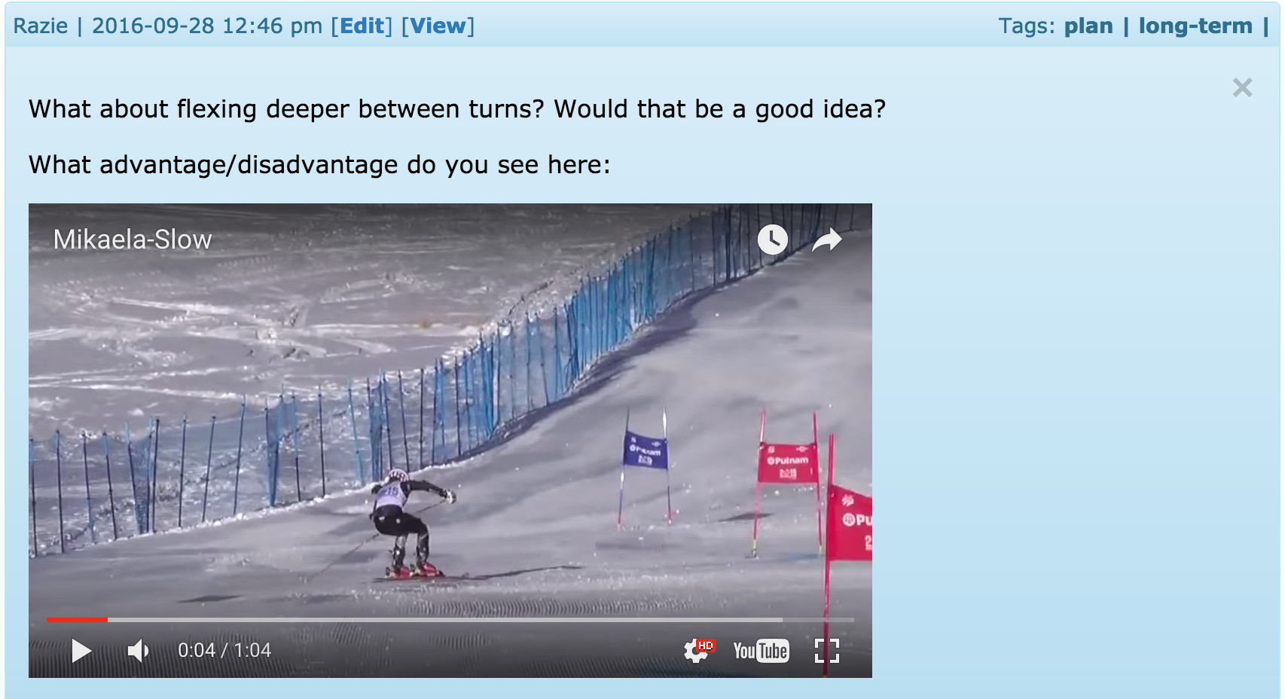
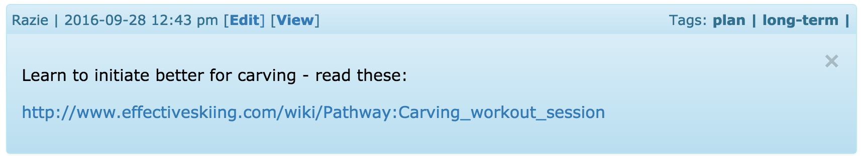
Coaches
Assign work / videos / reading

Slide 16
Coaches
Track progress
Plans and goals
Progress cards
Customizable evaluation forms
More features being tested, soon to be available

Slide 17
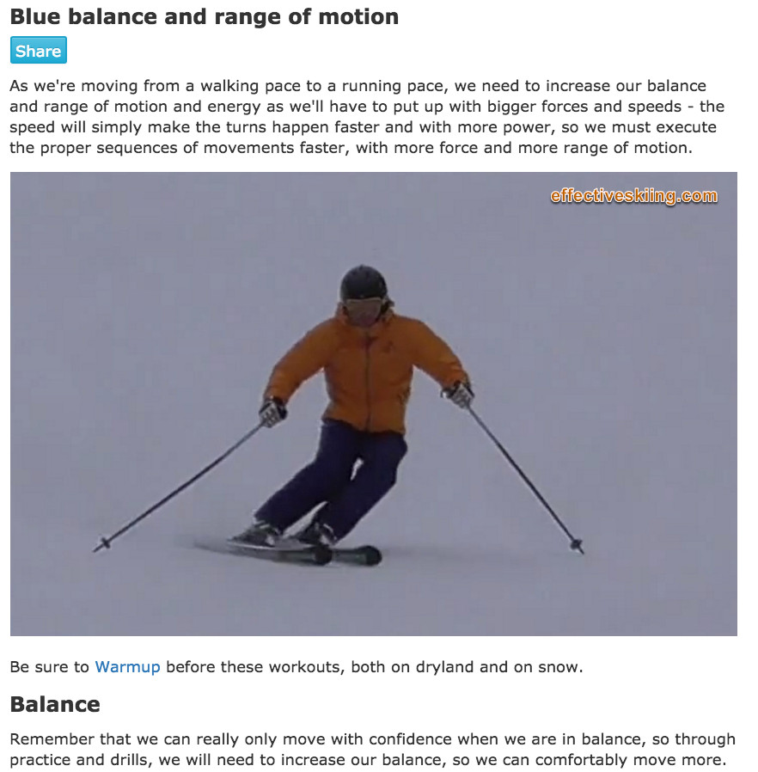
Technical content
Coaches can select from over 200 existing topics
Or easily create specific topics

Slide 18
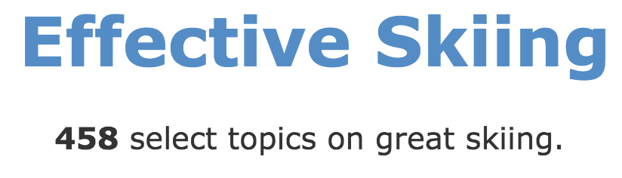
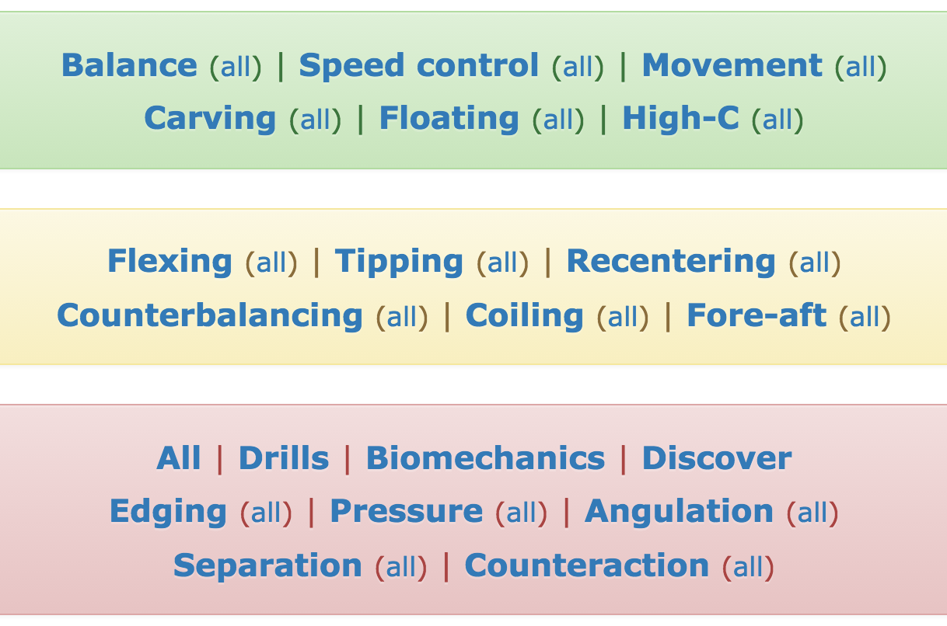
Lots of topics
Partner website – www.EffectiveSkiing.com
Over 200 technical topics are available
Racers can refer to / watch / think / learn

Slide 19
Athlete journal
Effective self-coaching

Slide 20
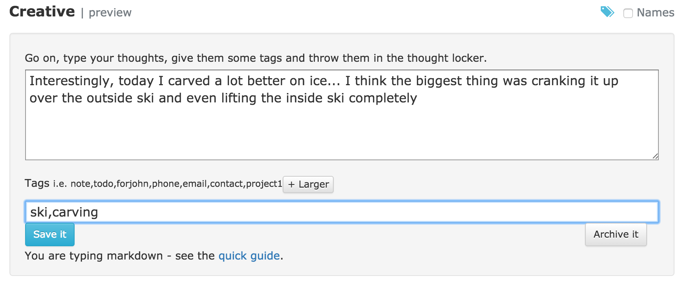
Personal journal
Maintaining a journal is proven to help athletes improve
Racers can keep a journal, record their evolution, notes etc

Slide 21
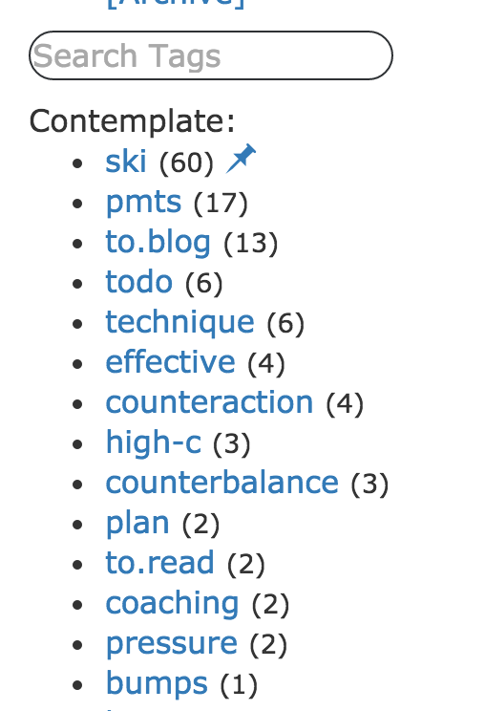
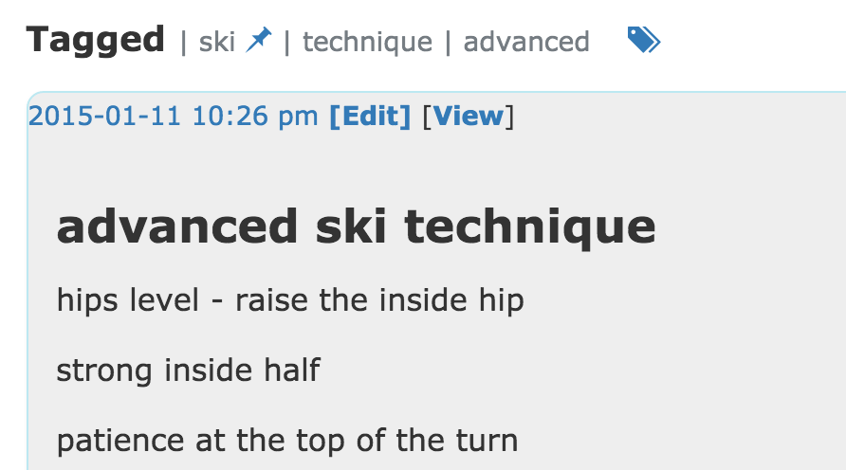
Organized
Organize notes with tags
Search all notes etc

Slide 22
Parents and racers
Club management

Slide 23
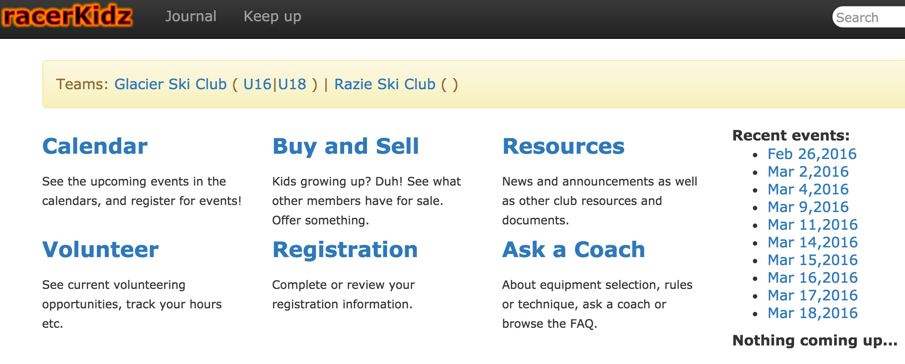

Slide 24
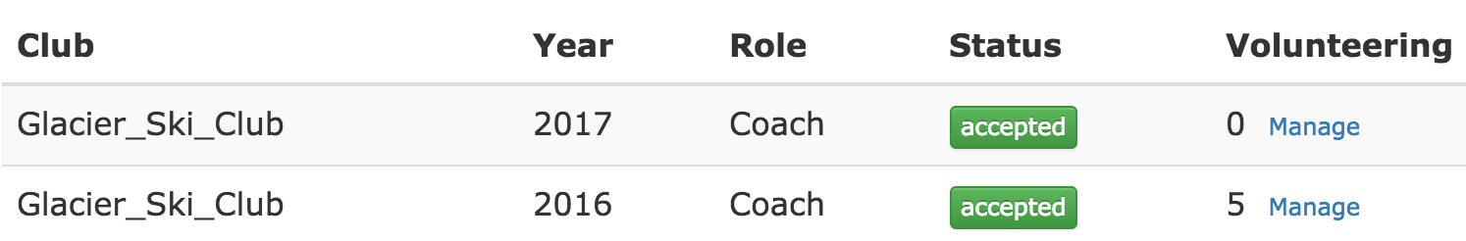
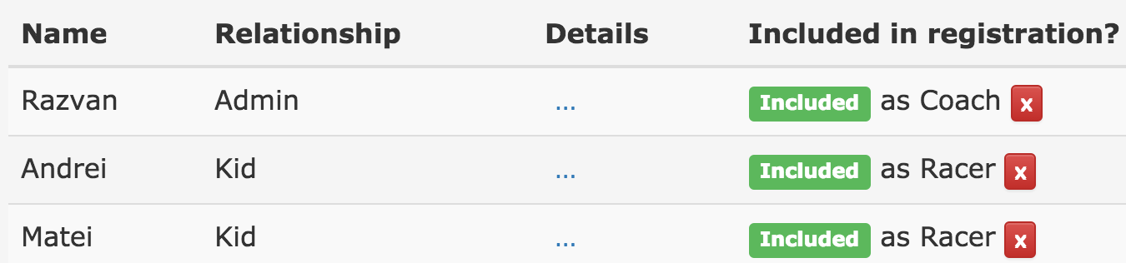
Parents
Register racers for programs

Slide 25
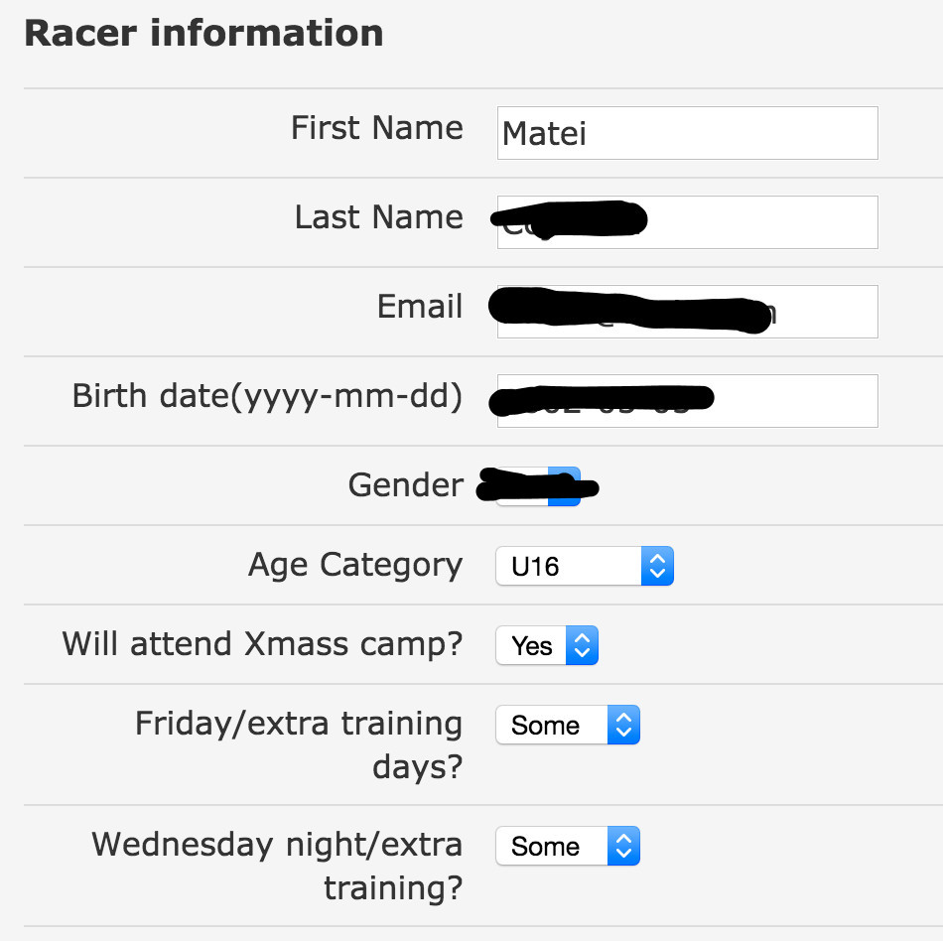
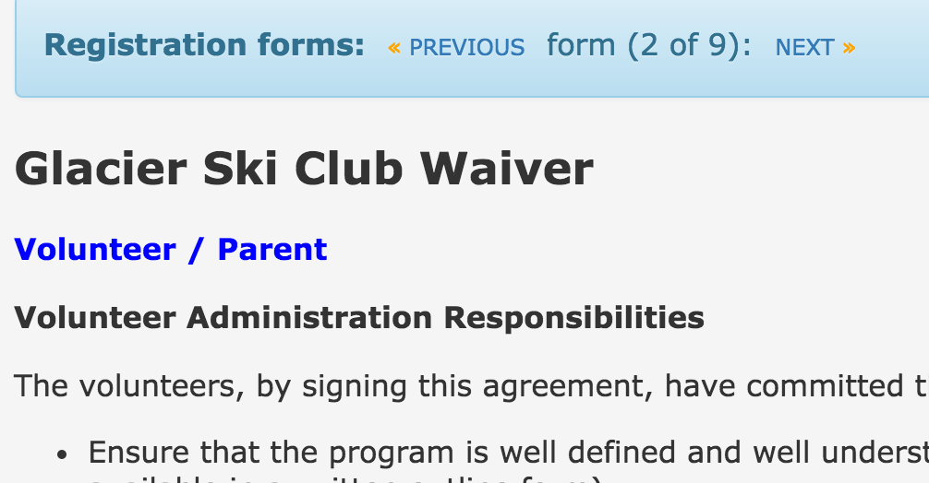
Parents
Waivers and forms

Slide 26
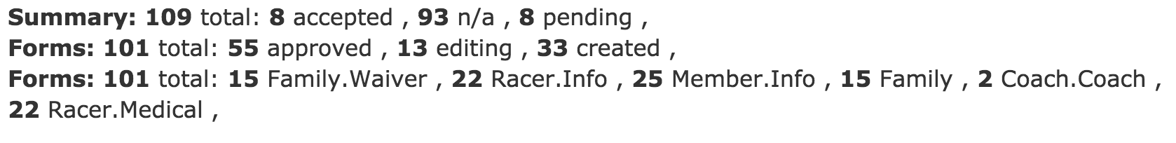
Club administrators
Useful reports with registration data
Save to Excel tables with age groups, phone numbers and emails etc

Slide 27
Try it now!
It’s free…

Slide 28
Try it now !
Go to www.racerkidz.com and create an account
Verify your email
Join the “Demo Ski Club”
You are prompted to complete the registration
Register yourself as “Racer”
You will be assigned to team U16
See “history” and create evaluations for yourself etc

