Slide 1
SnowProApp.com
Structured instructor-guest interaction
and snow school management

Slide 2
Why
Keep in touch with guests, after the initial “one hour” on snow
Maintain a guest’s history
Keep detailed notes about each person
Complement on-snow instruction with on-line guidance
Increase the value your guests receive
Consistency for guests across instructors and resorts
Evaluations, notes, articles to read, video etc
Increase customer satisfaction
and
Generate return business !!

Slide 3
Overview
Structure instructor-guest interaction
Manage programs, notes, evaluations
Custom evaluations and questionnaires
Maintain guest history
Event registration (camps, extra training…)
School management
Assign guests to programs
Assign instructors to programs
Manage registration forms and waivers
Calendars and event registration
Forums (announcements, buy and sell etc)

Slide 4
Guests, programs and events
Manage programs and events

Slide 5

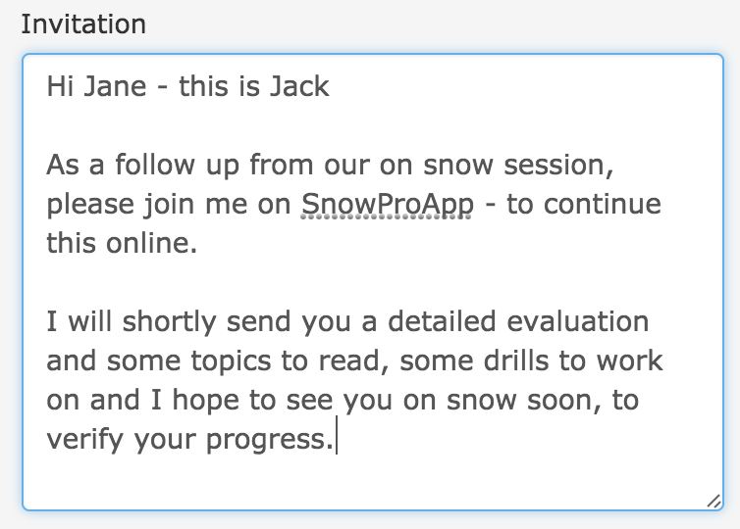
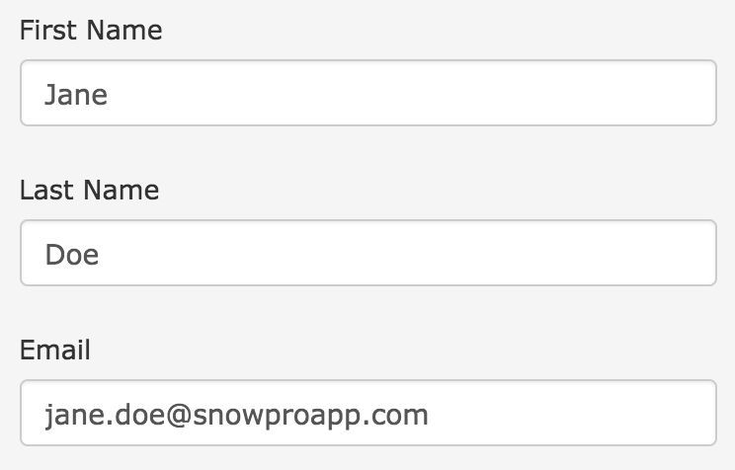
Invite guests
After on snow session
Instructor can invite guest and fill out an evaluation

Slide 6
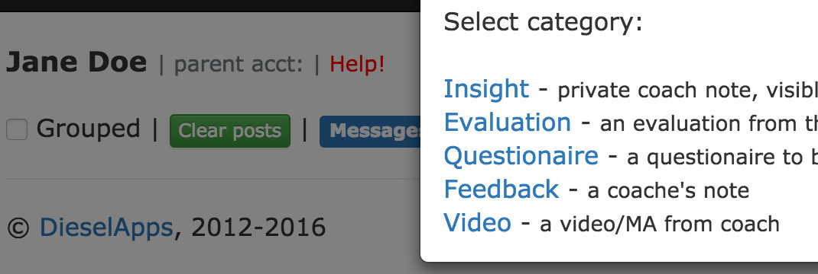
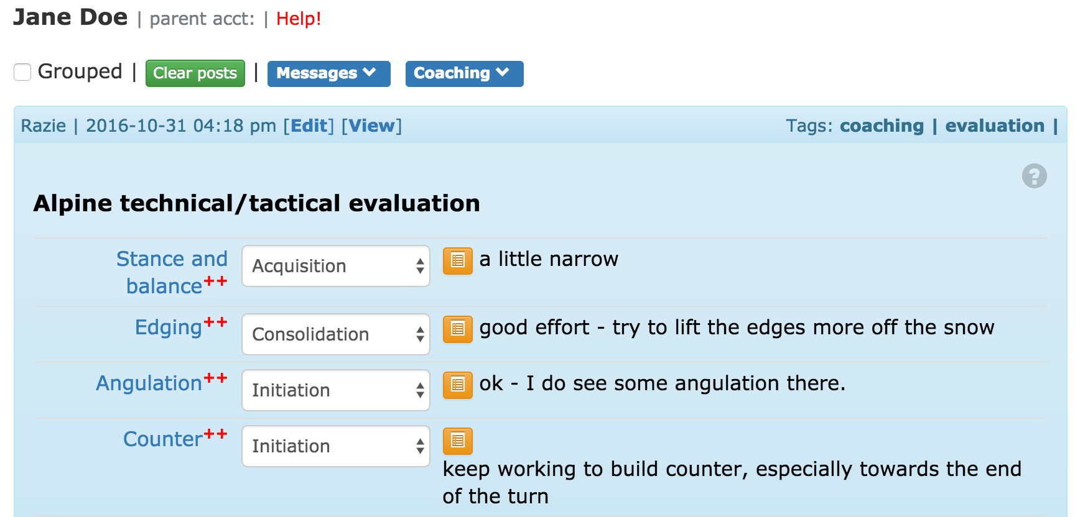
Create an evaluation / notes
After on snow session and invitation

Slide 7
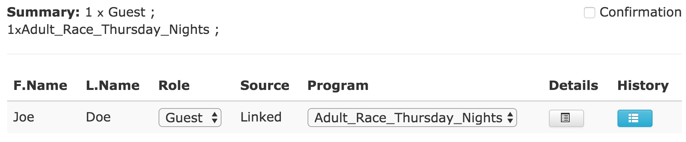
Guests and programs
Assign guests and instructors to programs

Slide 8

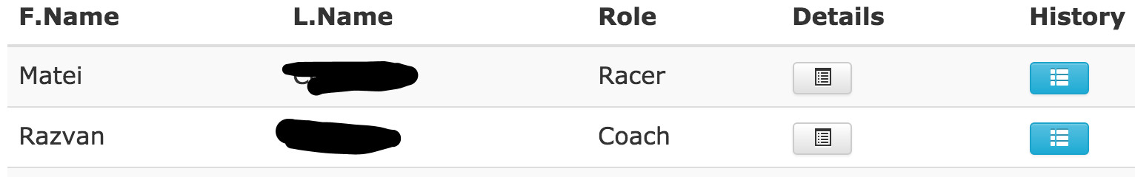
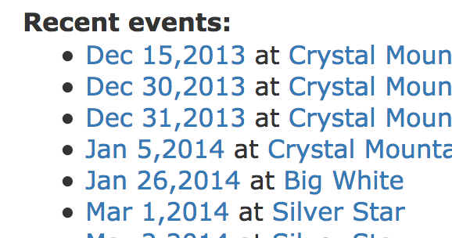
Instructors
See assignments, guests, events

Slide 9
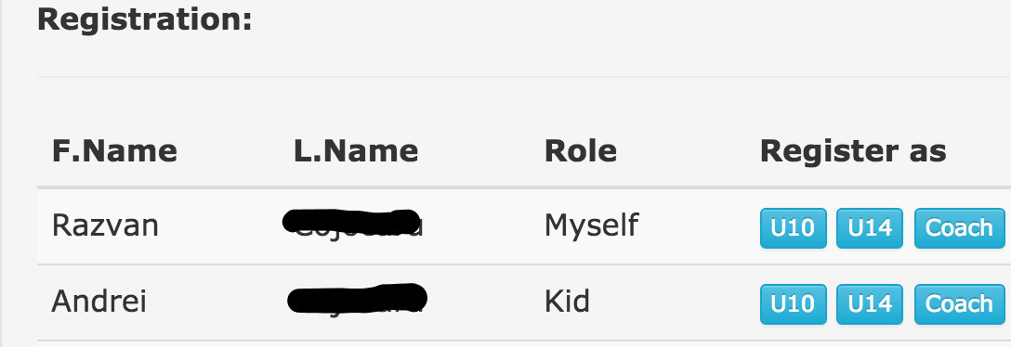
Guests and events
Guests / parents register for events

Slide 10
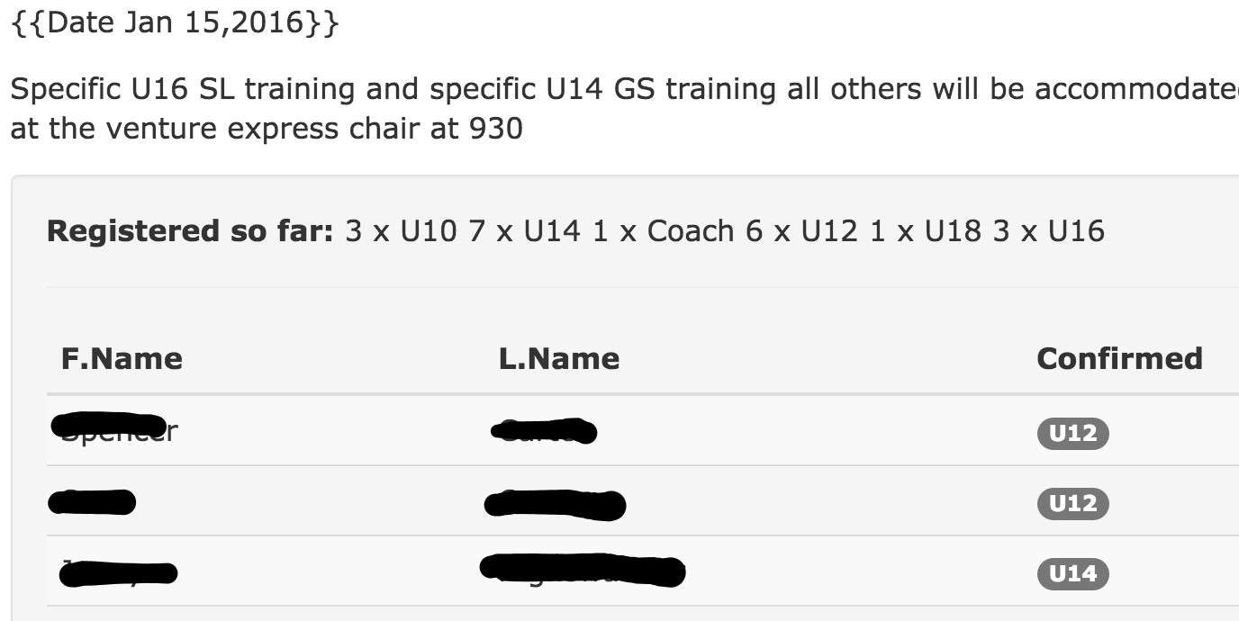
Instructors and events
Instructors see attendance, notify all of changes

Slide 11
Instructors, programs and guests
Manage programs and guests

Slide 12
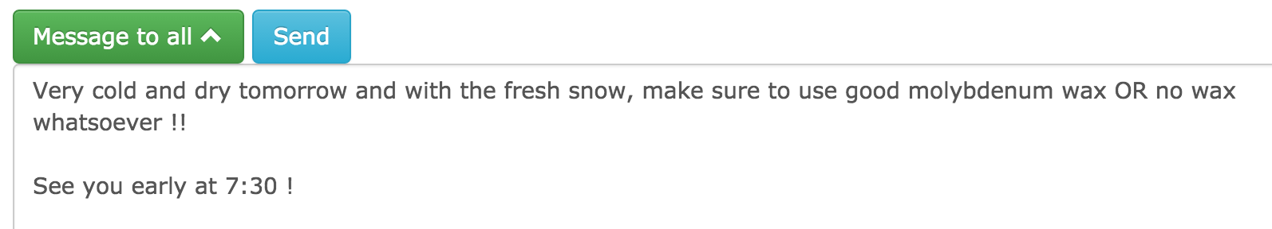
Instructors
Send message to members of a program

Slide 13
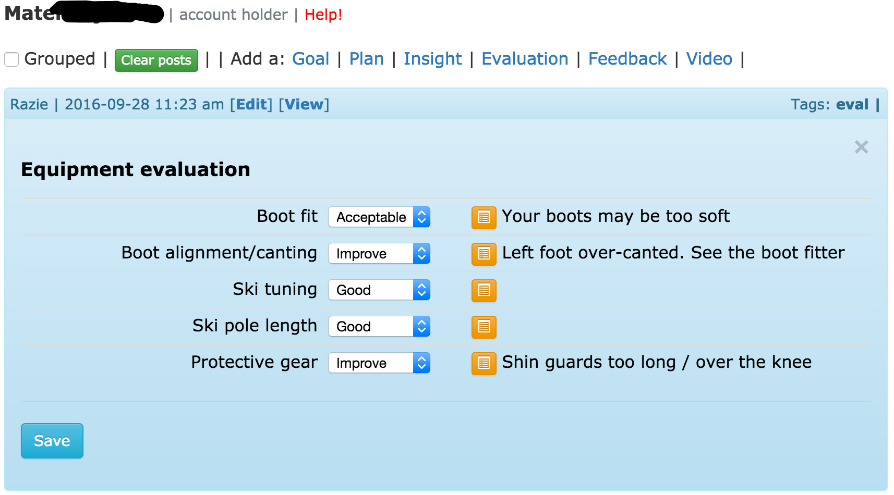
Instructors
Individual evaluations for guests (equipment, technical etc)

Slide 14
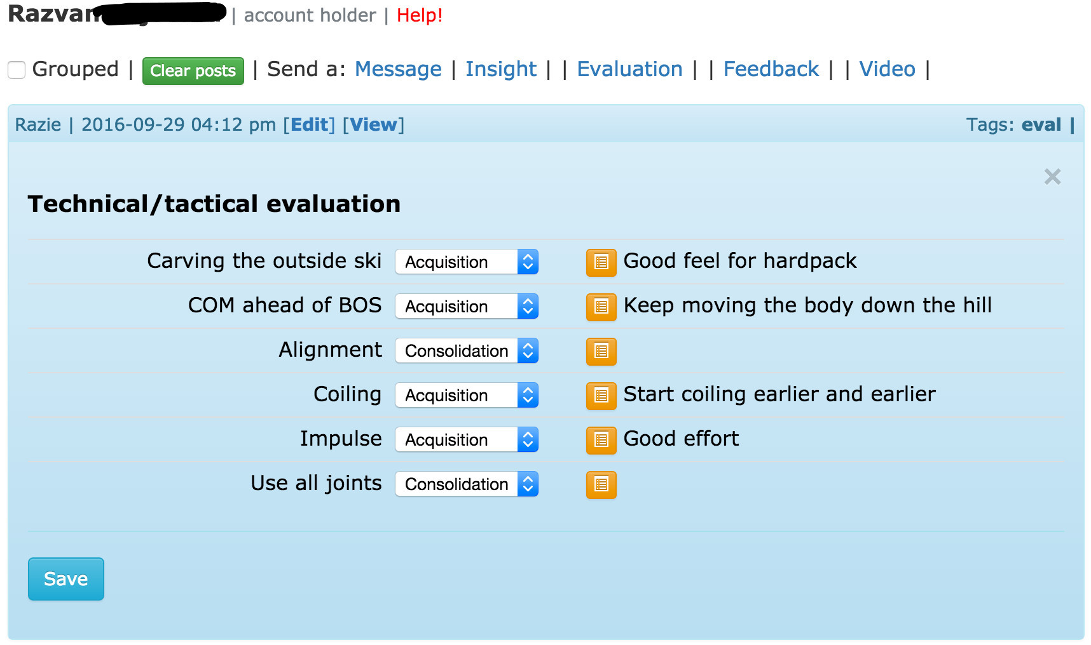
Coaches
Technical evaluations, recording testing results etc

Slide 15
Coaches
Questionnaires
Forms that a coach/instructor asks the racer/guest to complete
Coach is notified when the form is completed
Custom forms
All feedback/evaluation and questionnaires can be customized
Per organization, per school or per instructor

Slide 16
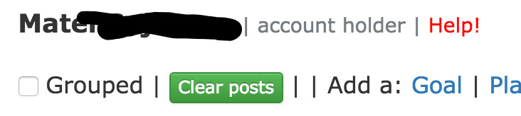
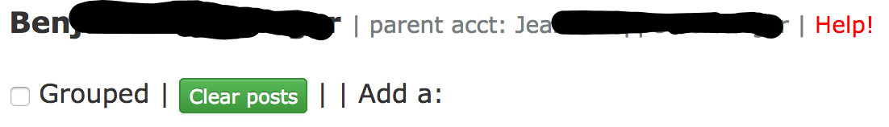
Kids & parents
See evaluations, notes, feedback, videos
If child does not have account, the parent will see the notes

Slide 17
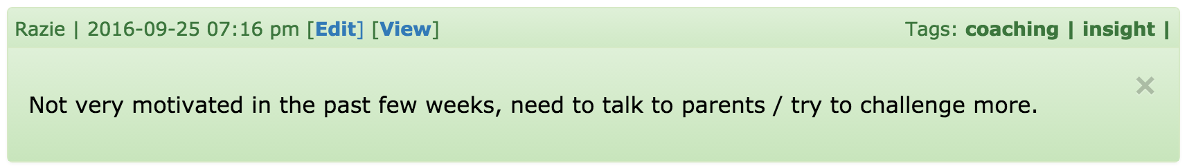
Coaches and Instructors
Private notes (hidden from guests)
Shared with co-coaches
Color-coded: green means private

Slide 18
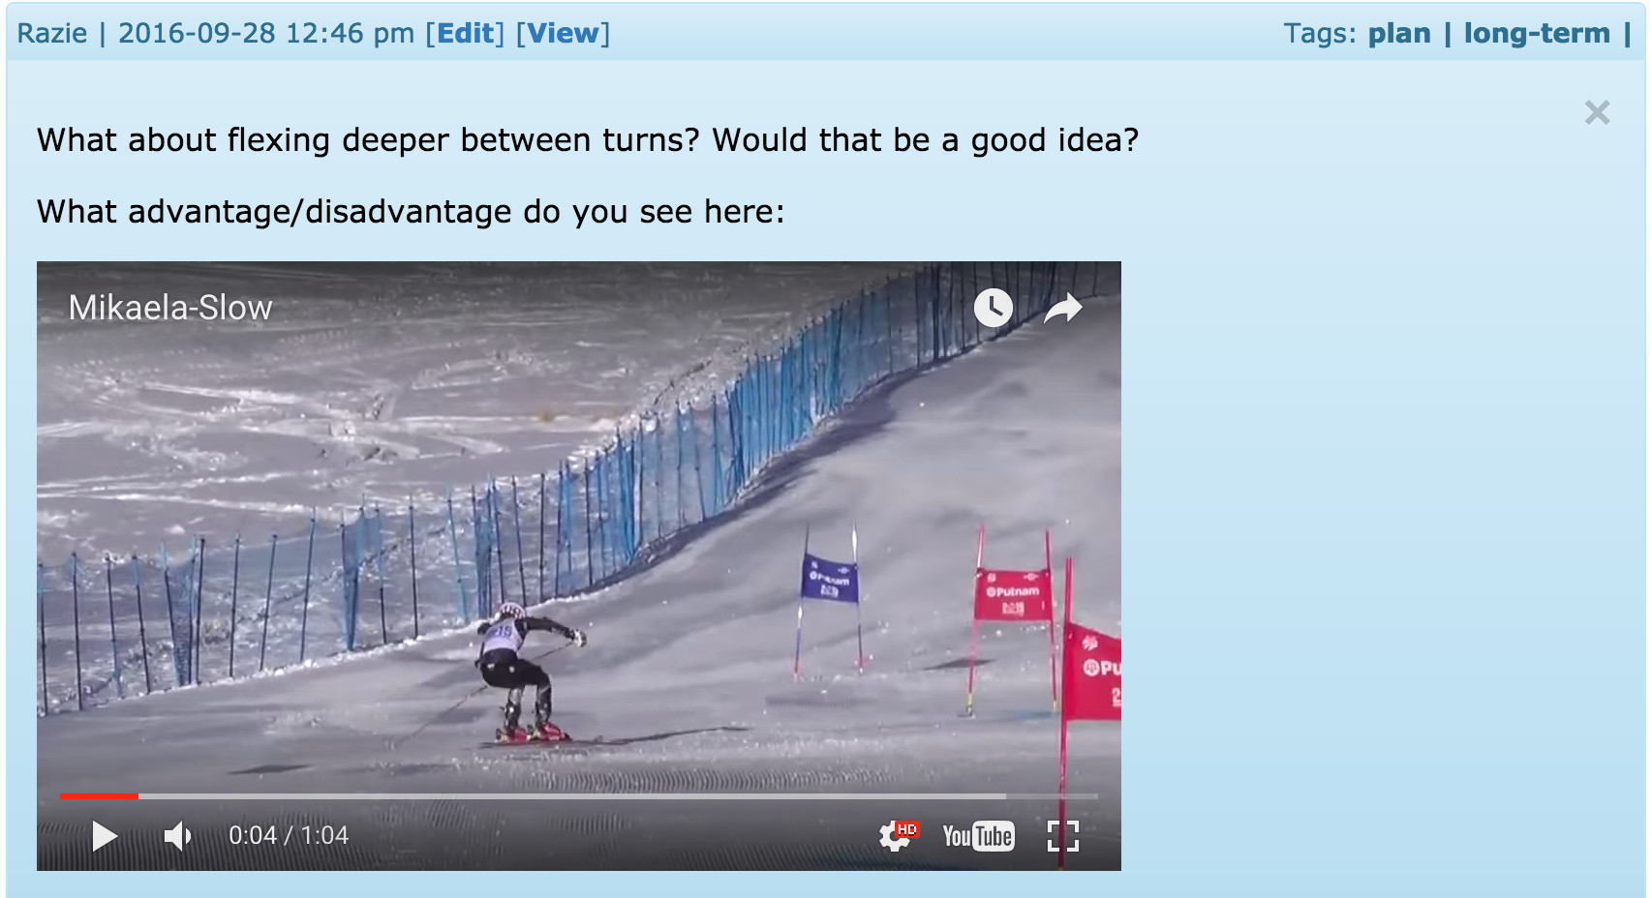
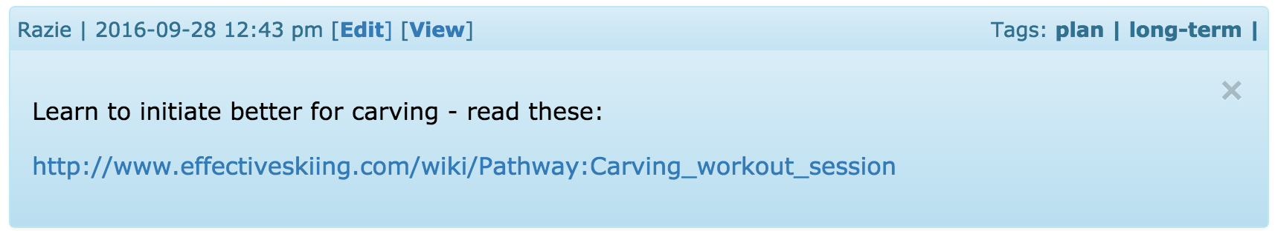
Instructors
Give guests ideas / videos / reading

Slide 19
Coaches
Track progress
Plans and goals
Progress cards
Customizable evaluation forms
More features being tested, soon to be available

Slide 20
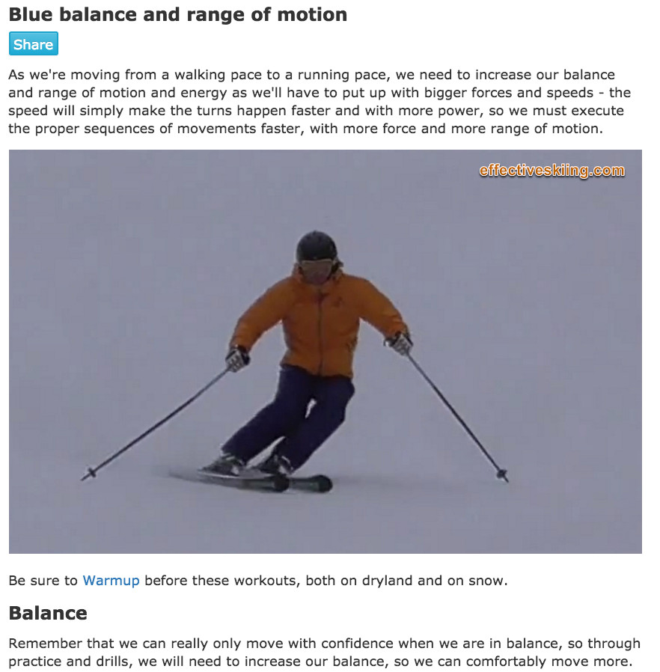
Technical content
Coaches can select from over 200 existing topics
Or easily create specific topics

Slide 21
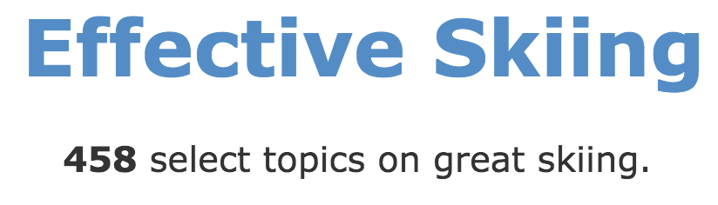
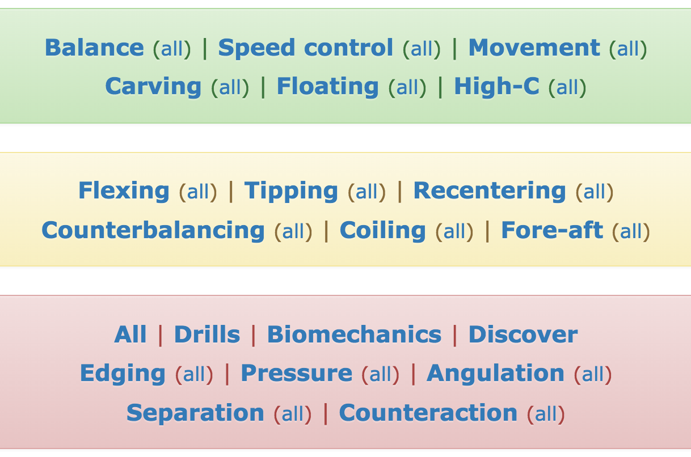
Lots of topics
Partner website – www.EffectiveSkiing.com
Over 200 technical topics are available
Racers can refer to / watch / think / learn

Slide 22
Guest journal
Effective self-coaching

Slide 23
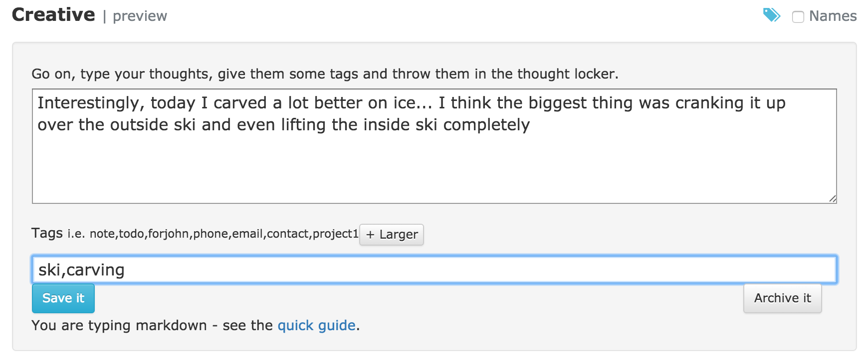
Personal journal
Maintaining a journal is proven to help us improve
Guests can keep a journal, record their evolution, notes etc

Slide 24
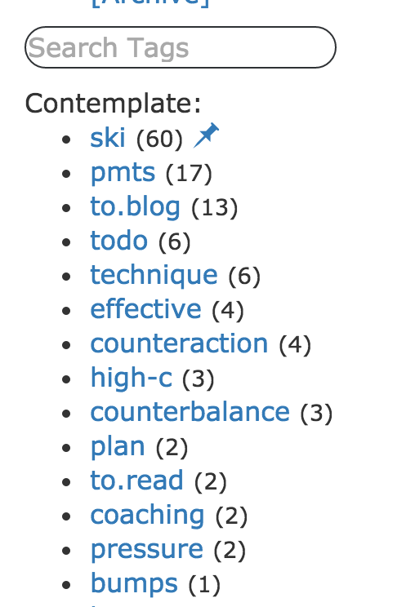
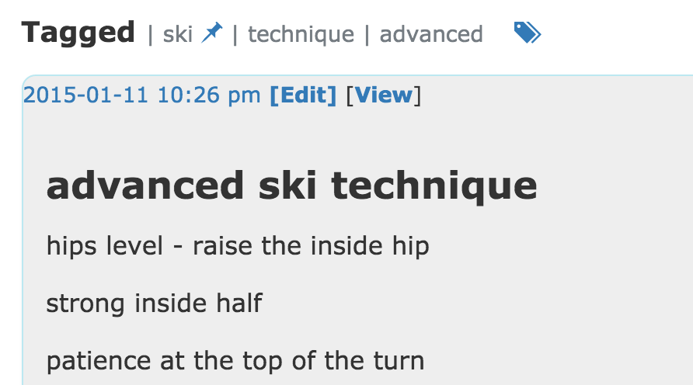
Organized
Organize notes with tags
Search all notes etc

Slide 25
Parents and kids
School management

Slide 26
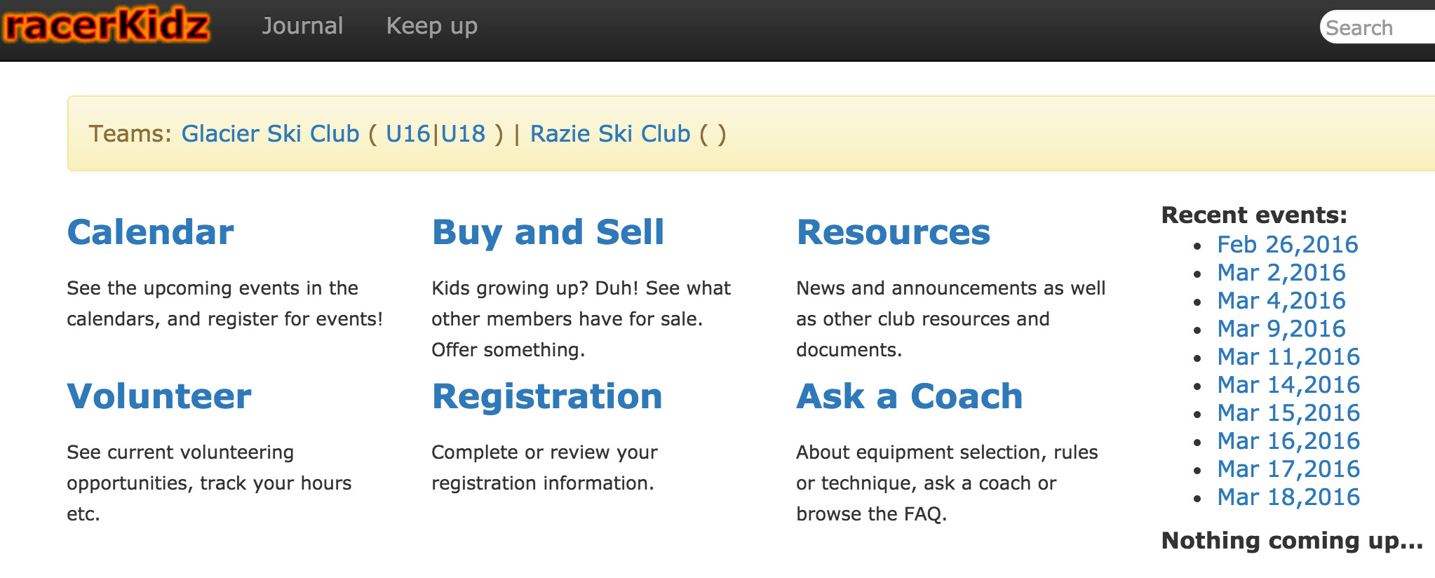

Slide 27
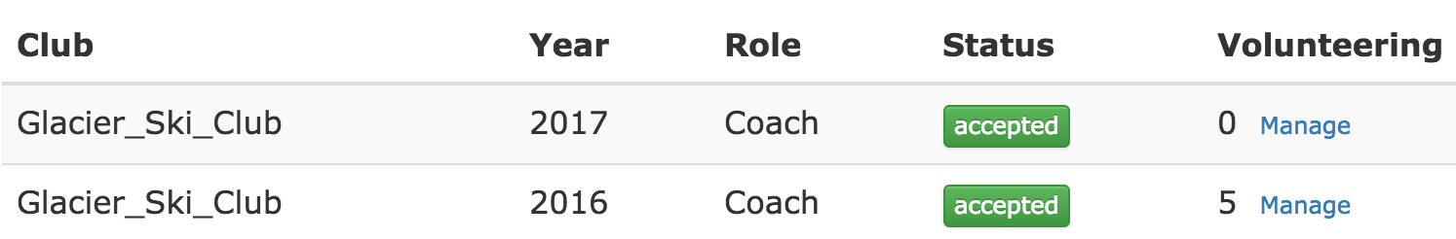
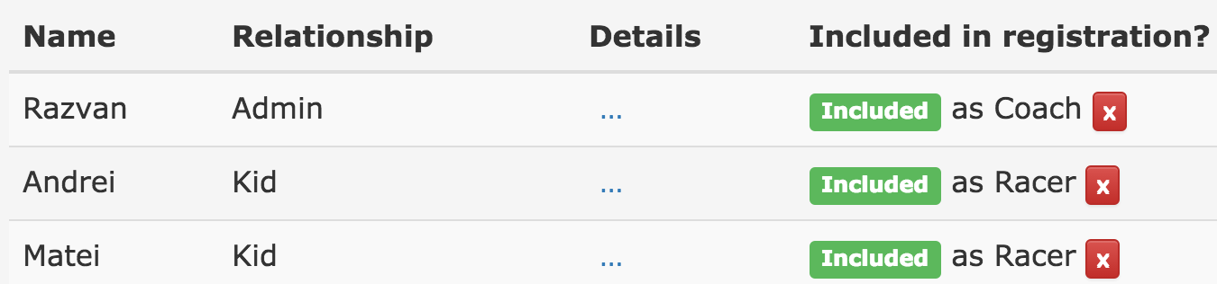
Parents
Register kids for programs

Slide 28
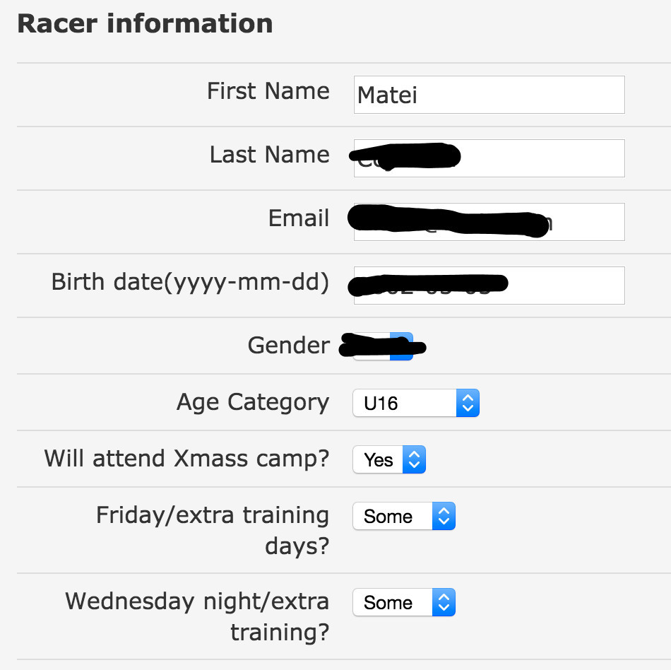
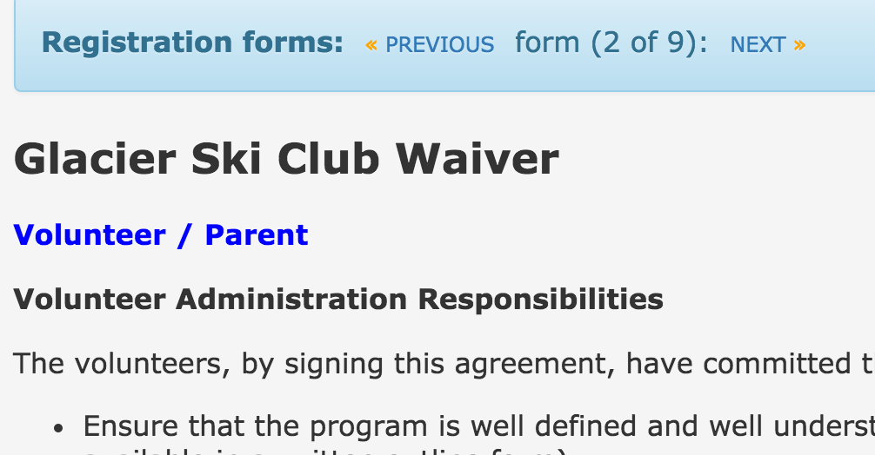
Parents
Waivers and forms

Slide 29
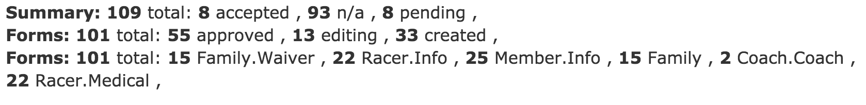
School administrators
Useful reports with registration data
Save to Excel tables with age groups, phone numbers and emails etc

Slide 30
Try it now!
It’s free…

Slide 31
Try it now !
Go to www.snowproapp.com and create an account
Verify your email
Join the “Demo Ski School”
You are prompted to complete the registration
Register yourself as “Guest”
See “history” and create evaluations for yourself etc
If you want to see how your school would look on SnowProApp – we’ll create it for you: just send us an email (support@racerkidz.com)

