Slide 1

1
GLOBAL Communication
Razi Mograbi
Dolev Seri
Advisors:
Mrs. Elena Kramer
Dr. Dan Lemberg
Capstone Project Phase A-24-2-R-21

Slide 2
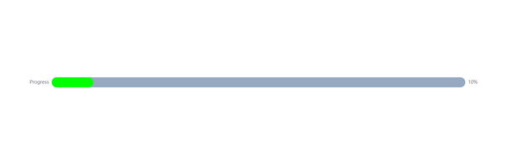

2
INTRODUCTION
Efficient solutions to language barriers are more crucial than ever.
There is a need for translation tools that better resemble natural conversation.
Current tools lack personalized, human-like output.
Many current methods offer low-leve translations.

Slide 3
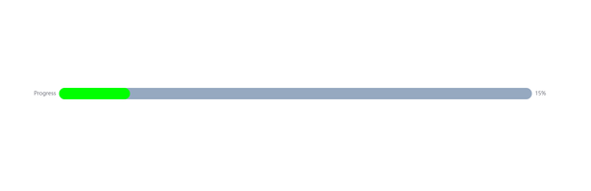
3
EXISTING SOLUTIONS
Real-time translation: Offers live spoken translations.
Message-based translation: Translates recorded speech.
Transcrption-based translation: Provides translated text from speech.

Slide 4

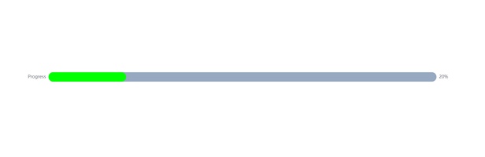
4
PROPOSED SOLUTION
GLOBALCommunication:
GlobalCommunication is an app made for both Android and iOS that
provides high-quality speech-to-speech translation in near real-time,
retaining the original speaker's voice with low latency for natural conversations.

Slide 5


5
PROJECT GOALS
Enable real-time, natural communication between people speaking different languages.
Provide personalized translations that retain the speaker's original voice.
Support multiple languages to make the app accessible to a wide range of users.
Develop an intuitive app that works seamlessly on both Android and iOS.

Slide 6

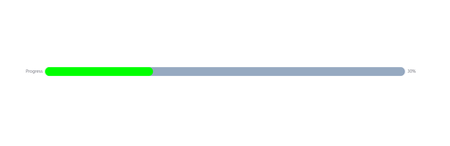
6
GlobalCommunication FEATURES
Speech-to-speech translation using OpenAI APIs for real-time communication.
Voice cloning and conversion through advanced AI models for personalized speech output.
Stream-Based Communication System for continuous and fluid conversations.
Noise suppression and voice separation to enhance clarity in various environments.

Slide 7
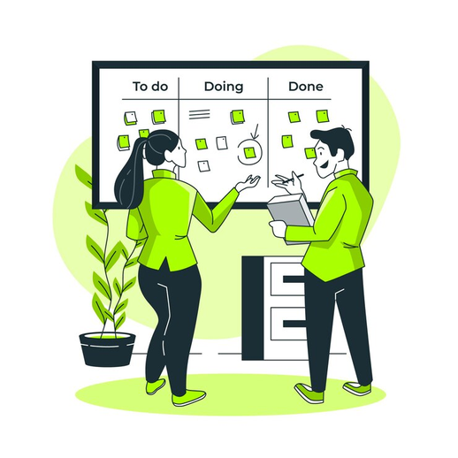
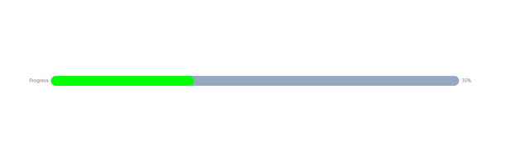
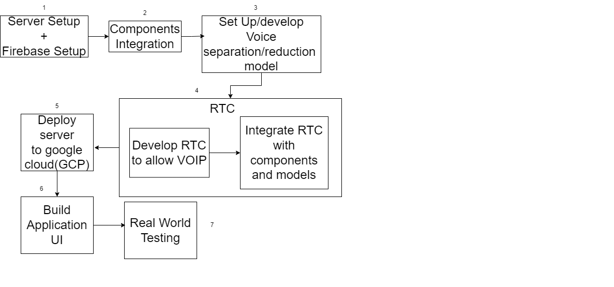
7
Execution plan
Using the agile methodology for each box

Slide 8
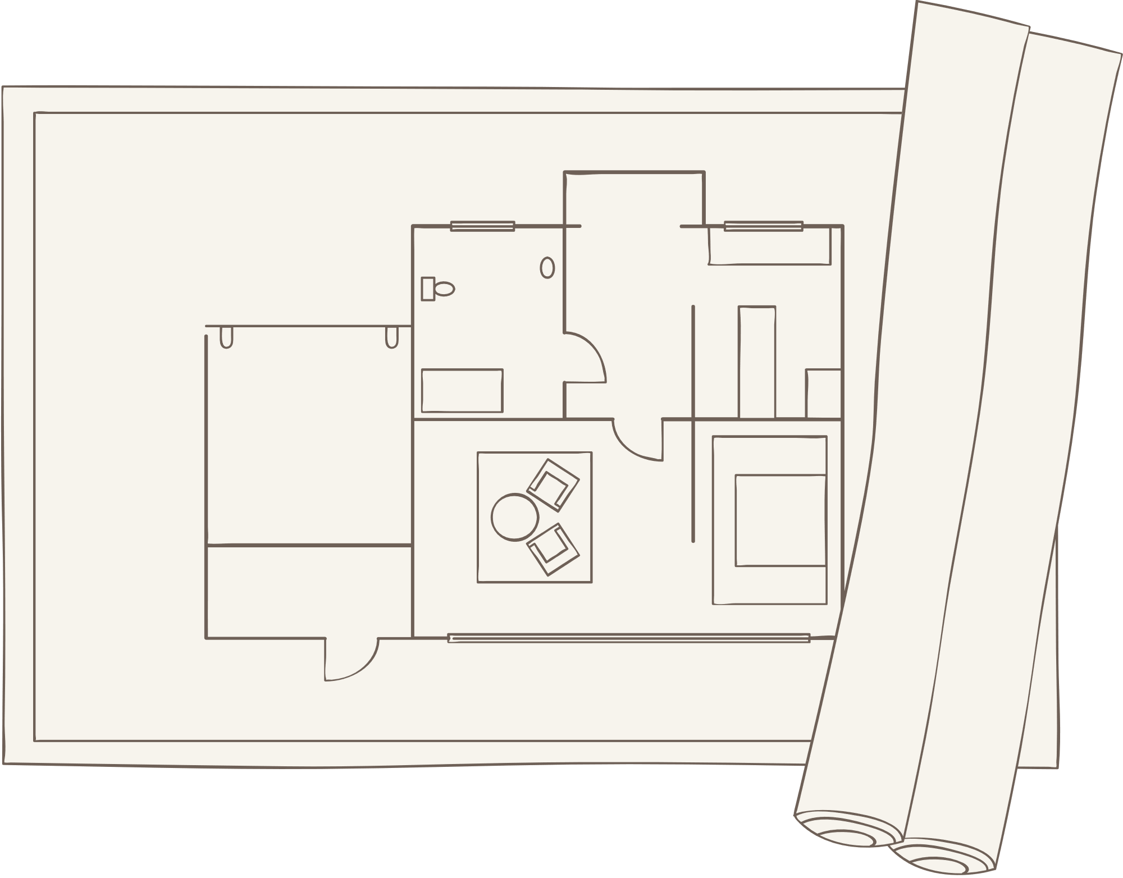
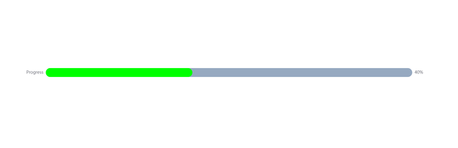
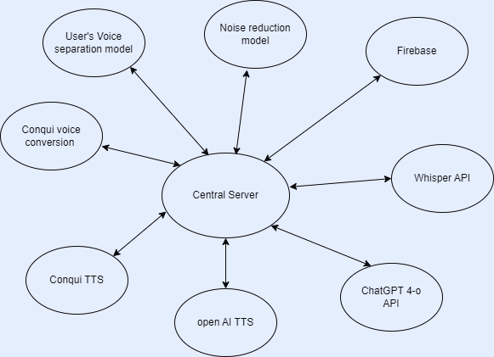
8
ARCHITECTURE OVERVIEW
Service-Oriented Architecture (SOA) In the Backend

Slide 9
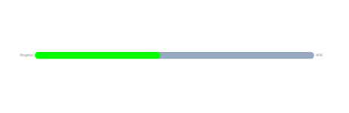
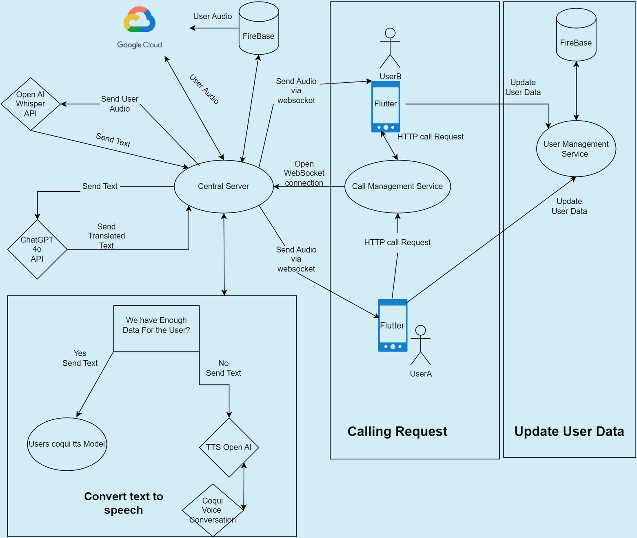
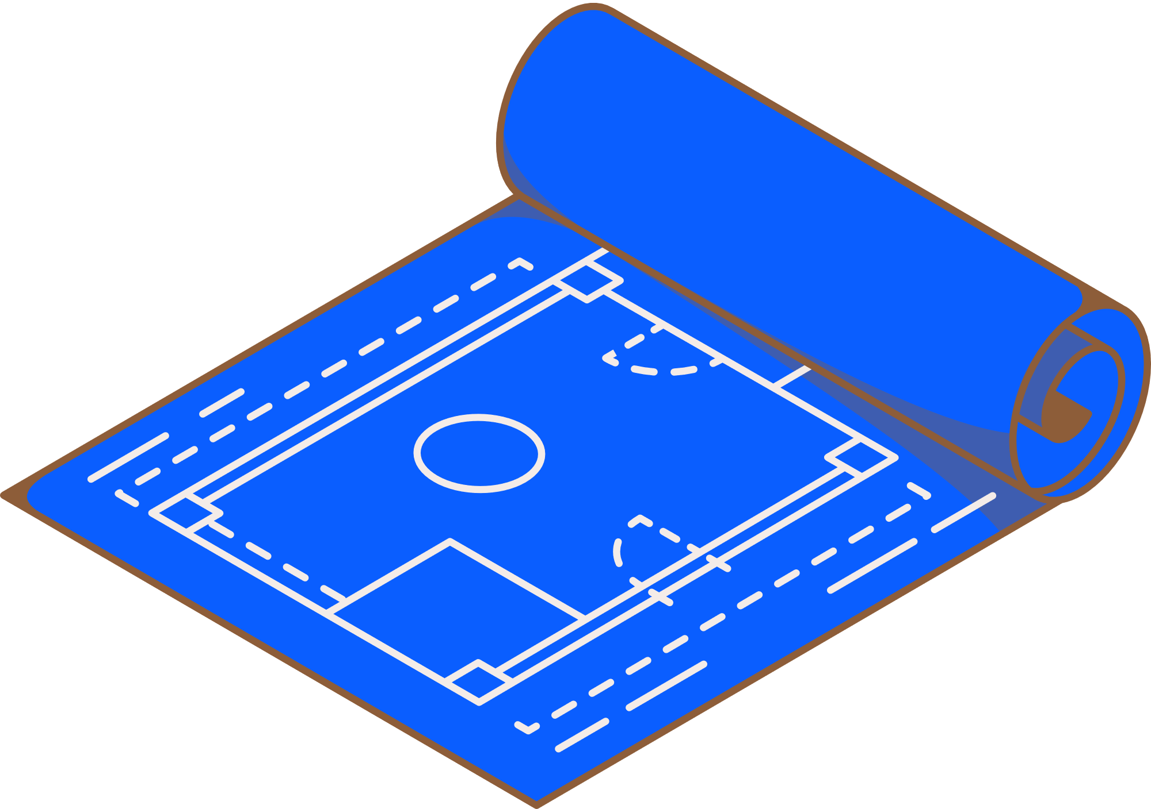
9
ARCHITECTURE OVERVIEW
Call Management Service
User Management Service
Central Server
Firebase
Conqui TTS
Google Cloud(GCP)
Flutter

Slide 10
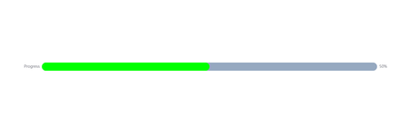
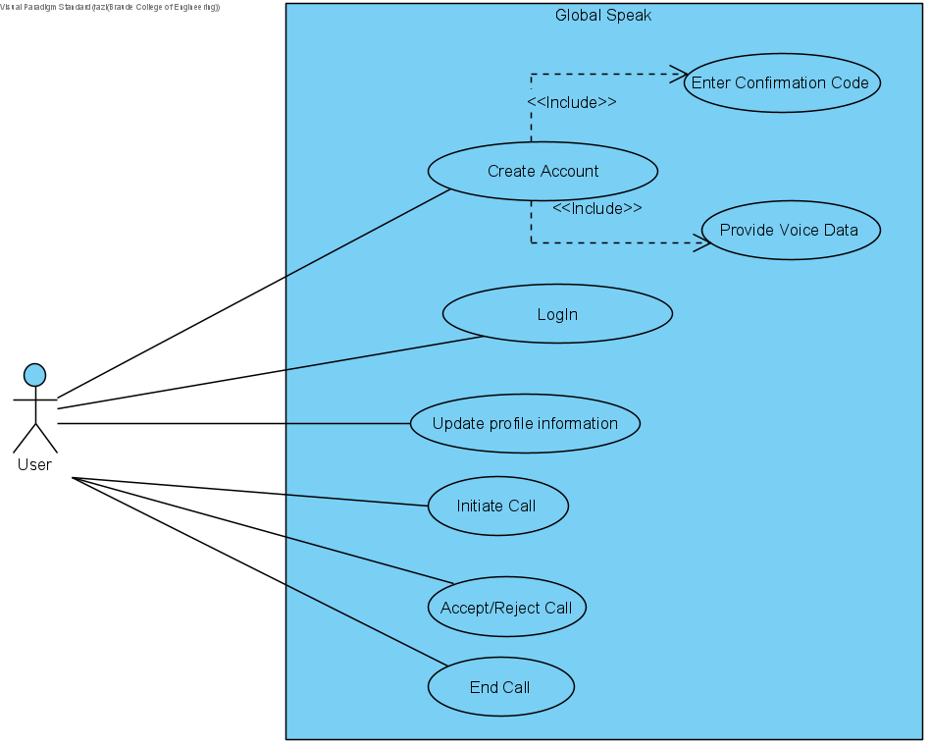
10
Diagrams
UseCase

Slide 11
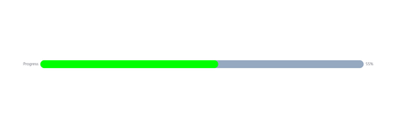
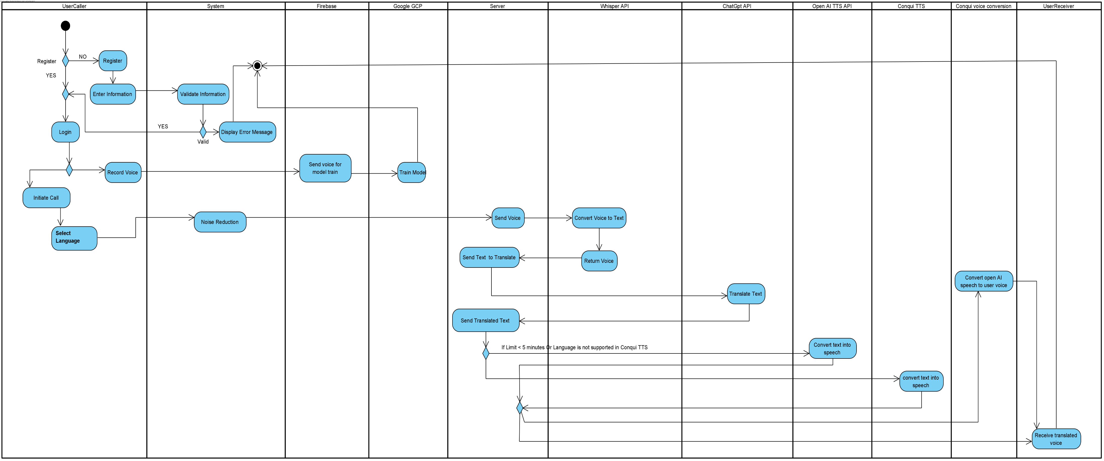
Diagrams
11
Activity

Slide 12
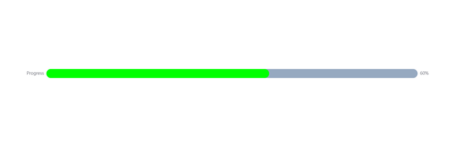
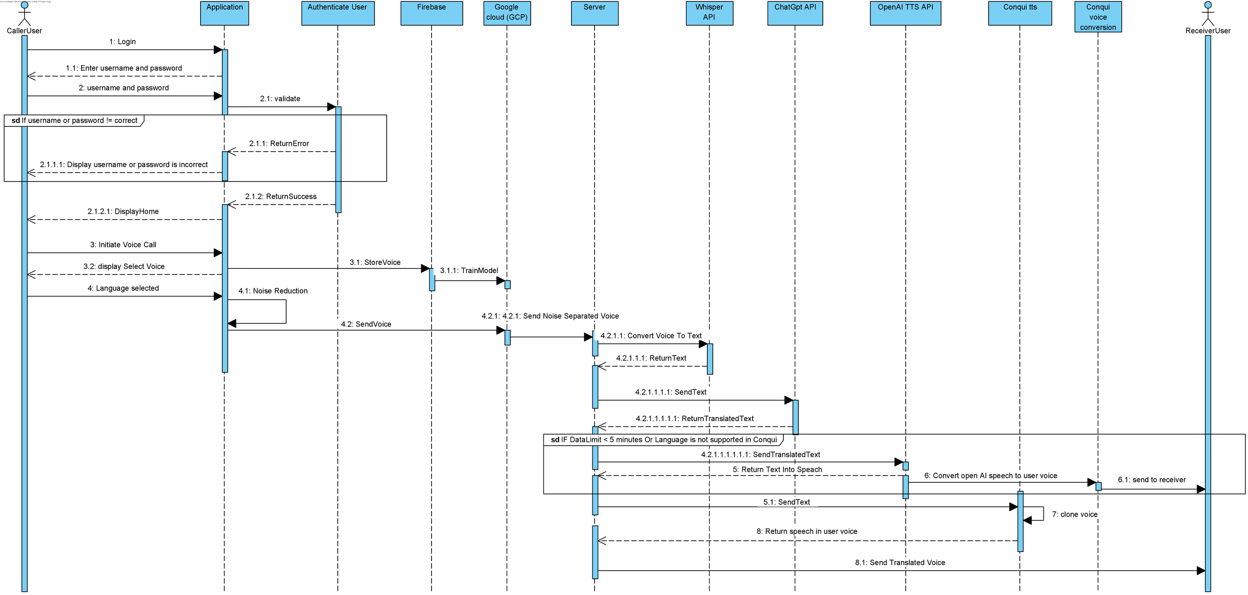
12
Diagrams
Sequence

Slide 13
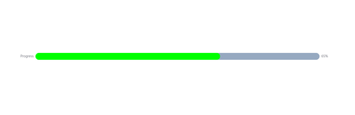
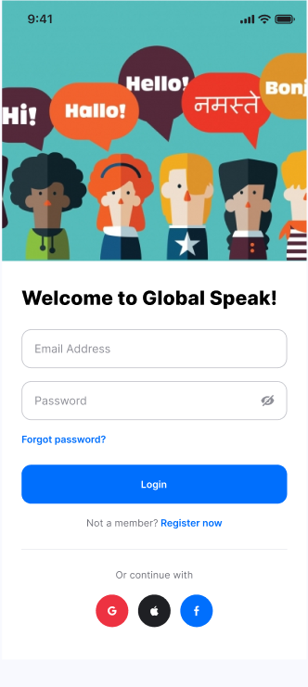
13
Screens
Login

Slide 14

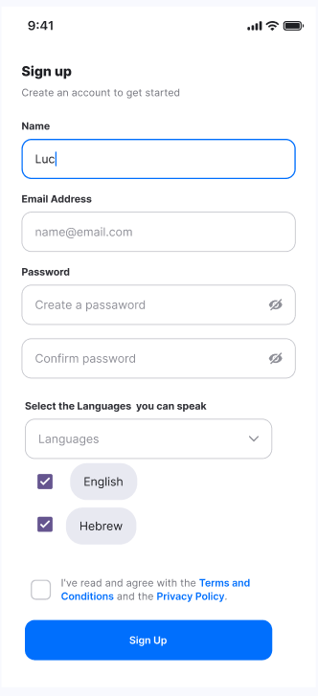
14
Screens
Sign Up

Slide 15
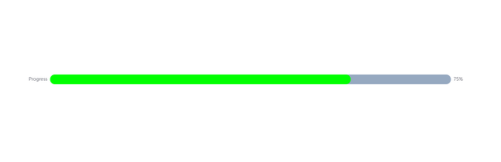
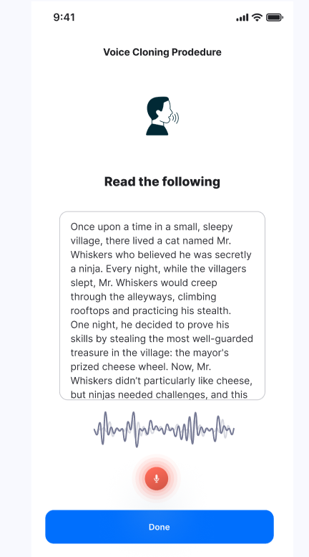

15
Screens
Voice Cloning

Slide 16
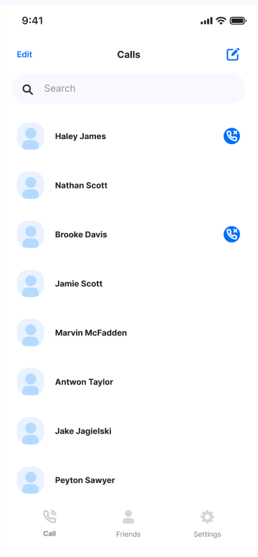


16
Screens
Home Screen

Slide 17
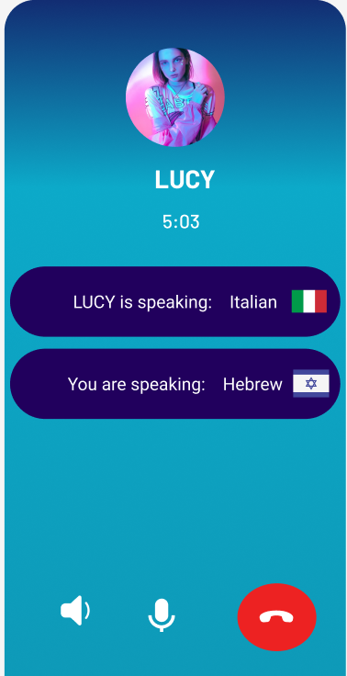
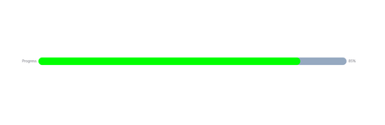
17
Screens
Calling

Slide 18
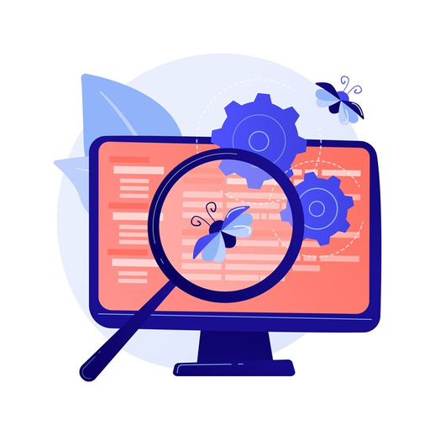

18
VERIFICATION AND EVALUATION
Test UI responsiveness and navigation
Test all components in different Environments*.
Test all components latency.
Test overall application latency and quality.

Slide 19


19
Challenges
Voice cloning/conversion training may yield inconsistent results.
Noise suppression and voice separation may distort audio quality.
Managing low latency is challenging due to the need to process multiple components.
Our project relies on external components that may experience downtime.

Slide 20
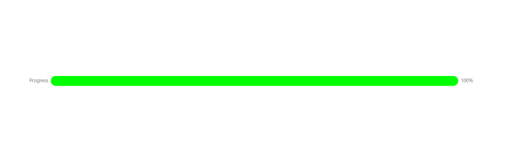

20
thank
you
ANY QUESTIONS ?

