Slide 1

Continual Learning in Source Camera Identification
Master’s Thesis Project-1
Mid Semester 2024
Presented By:
Abdul Razique (2023CSM1001)
M.Tech. in Computer Science and Engineering
Team Members:-
Rejoy Chakraborty
Dr. Puneet Goyal(Supervisor)
Protyay Dey
Abhilasha Jadhav

Slide 2
Content:-
Introduction
Motivation
Literature Review
Dataset Creation
Problem Statement
Methodology
Dataset Creation for Document Forensics
Results
Future Work
Challenges

Slide 3
Introduction
Source camera model identification is a task in digital forensics where the goal is to identify the device or model of the camera used to capture a given image.
This is useful in investigating image authenticity, tracing the origin of a photo, or detecting image manipulation.
Availability of advanced and affordable devices has made the acquisition and manipulation of digital media images very easy.
This accessibility is one of the reason for increased cyber crimes like paper leak and untrusted media images circulation.
Traditional method of source camera identification includes noise patterns, PRNU (Photo-Response Non-Uniformity) fingerprinting, metadata tracking.

Slide 4
Introduction
PRNU involves extracting a camera’s unique noise pattern caused by imperfections in the sensor's manufacturing process.
Companies are competing to capture market and hence producing high quality camera and phones.
Post processing to enhance image or to efficiently store it erases these patterns so these techniques are not promising.
These methods have limitations like pattern can be inconsistent for post processing.
Changes in camera setting affects the these methods.
These patterns and metadata can be edited/altered with post processing and counter forensic techniques.
Manual Feature Extraction can be time consuming.
Limitations of these techniques led us towards modern deep learning techniques.

Slide 5
Introduction: Continual Learning
Learning approach where models incrementally learn new data without forgetting prior knowledge.
Adapts to new tasks or data without retraining from scratch.
Essential in dynamic environments where new data constantly arrives and new devices are continuously developing.

Slide 6
Introduction: Catastrophic Forgetting
The tendency to forget previously learned information when updated with new data.
It is a phenomenon in neural network, where when model is trained on multiple tasks in sequence, It tend to forget the information learned in previous tasks.
It is happened because the model’s parameters are updated to optimize performance on the new data.
It leads to the significance drop of accuracy.

Slide 7
Motivation: Why Source Camera Model Identification?
Helpful to Law Enforcement Agencies(for both solving and to prove).
Confidentiality Breaches and Leaks.
Increased Question paper leak.
Confidential or sensitive document leak can be threat to nation.
Strengthens the credibility of digital evidence by showing a clear link between the image and the capturing device.
Counteracting Fake News and Misinformation.

Slide 8
Motivation: Why Continual Learning?
Continuous development and manufacturing of new smartphones and camera devices.
Demand for phones are increasing.
Every month many new phones come in market.
Traditional approaches to include new device typically require building new model and train it from scratch for each along with old phones.
Slow and Inefficient - This is inefficient and impractical in a fast-evolving market, where retraining models for each update incurs significant time and computational costs.
Only training new samples on pretrained model will cause catastrophic forgetting.

Slide 9
Literature Review
Camera model identification with Residual Neural Network[3]
Authors: Chen et al.
Used ResNet deep on Dresden and a customized data set which contain 1444 images from 6 cell phones. 99.12% accuracy in discriminating brands, 94.73% accuracy in model-level camera identification, 45.81% accuracy in discriminating based on devices and 97.73% accuracy when 13 classes added to 1st task.
Efficient Source Camera Identification with Diversity-Enhanced Patch Selection and Deep Residual Prediction[4]
Authors: Liu et al.
Proposed Residual Prediction Module for patch extraction. A modified VGG model is used for classification, achieving 98.14% brand-level, 92.62% model-level, and 41.54% instance-level accuracy on the Dresden dataset, using 64 patches of size 64x64 as an optimal parameter.

Slide 10
Literature Review
Overcoming catastrophic forgetting in neural networks[1]
Authors: James Kirkpatrick et al.
Paper proposed the Elastic Weight Consolidation (EWC) method, a regularization-based approach that leverages the Fisher Information Matrix to quantify the importance of each parameter for previously learned tasks by penalizing changes to important parameters during the training of new tasks. EWC effectively mitigates catastrophic forgetting without requiring explicit storage of past data.
Online Continual Learning in Image Classification[2]
Authors: Zheda Mai et al.
The paper categorizes continual learning into three main scenarios: task incremental, class incremental, and domain incremental learning. The survey evaluates various state-of-the-art methods like iCaRL, MIR, and GDumb across these scenarios to determine which methods perform best under different experimental conditions.

Slide 11
Problem Statement
Creating Document Forensic dataset and corresponding Benchmark results.
Exploring the Continual Learning in the field of Source Camera Model Identification(SCMI).

Slide 12
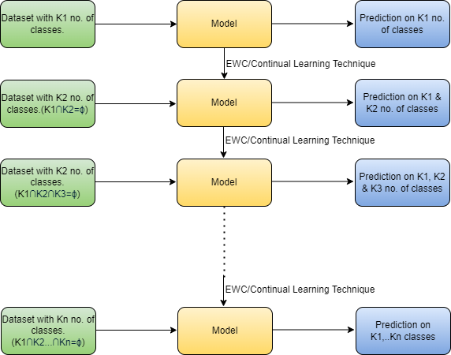
Methodology: Continual Learning

Slide 13
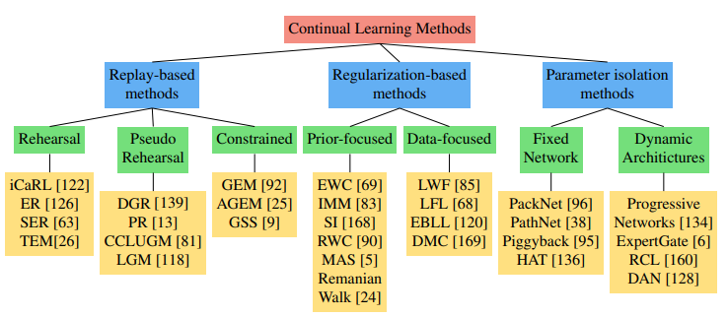
Methodology: Methods of Continual Learning
Img Src: Parisi, German I., et al. "Continual lifelong learning with neural networks: A review." Neural networks 113 (2019): 54-714
Url: https://arxiv.org/pdf/1910.02718.

Slide 14
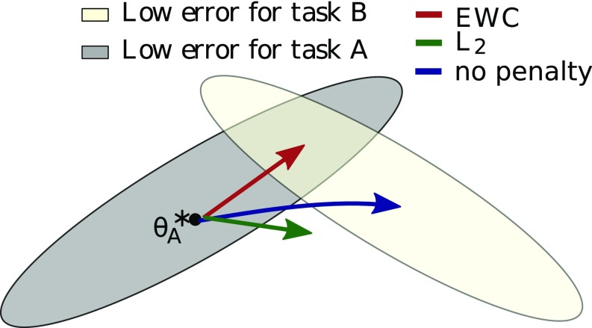
Methodology: Elastic Weight Consolidation(EWC)
During the training of later tasks, changes to important parameters(associated with previous tasks) are penalized.
Fig: EWC ensures task A is remembered while training on task B.[1]

Slide 15

Methodology: Elastic Weight Consolidation(EWC)
L is minimize in EWC[1]:
L_{B}(𝜽): loss for task B only.
λ : importance factor.
i : importance factor.
𝜽*_{A,i}: i^{th} parameter for model trained on task A.
F_{i}: Fisher Matrix diagonal.

Slide 16


Methodology: Evaluation Matrices
Evaluation Matrices for Continual Learning:
Average Accuracy: measures the overall performance of the model across all tasks after the final task has been learned.
Forgetting Measure: Forgetting quantifies how much performance on previous tasks deteriorates as the model learns new tasks.
T: Total number of tasks
a_{T,i} : Accuracy of i^{th} Task after completing all T Tasks.
T: Total number of tasks
a_{t,i :} Accuracy of i^{th} Task after completing t^{th} Tasks.
a_{T,i} : Accuracy of i^{th} Task after completing all T Tasks.

Slide 17
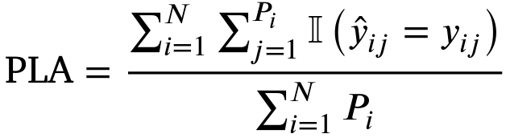
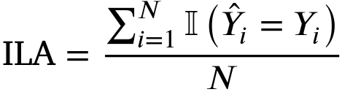
Methodology: Evaluation Matrices
Evaluation Metrics for Source Camera Identification:
Patch Level Accuracy (PLA)
Image Level Accuracy (ILA)
N: Total number of captured images
Ⅰ : Indicator Function
P: Number of patches in image i
ŷ_{ij}: Prediction camera model of j^{th} patch of i^{th} image
у_{ij}: Actual camera model of j^{th} patch of i^{th} image
Ŷ_{i}: Prediction of camera model for i^{th} image
Υ_{i}: Actual camera model of i^{th} image

Slide 18
Dataset Creation for Document Forensics
Dataset contains images of School/Board/University/College question Papers.
Documents are collected from various states and are available in multiple languages, including English, Hindi, Bangla.
All the images captured under Natural Lighting Condition.
Contains images of each document in both Sitting and Standing positions.
Camera setting used: default camera settings with jpeg format.
Same Camera setting maintained across all devices.

Slide 19
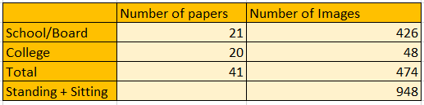
Dataset Creation: Document Details
Document Details:
Language Covered: English, Hindi, Bangla.
States Covered: Punjab, Kolkata, Hyderabad.

Slide 20
Dataset Creation
Dataset curated till now:
Note: All 24,648 Images captured by Abdul Razique and Rejoy only.
Brands Captured till now: Poco, Xiaomi, Apple, Samsung, OnePlus, IQOO, Realme, Lava, Infinix
Total images in Sitting Position | 474 pages x 26 devices = 12,324 images
Total images in Standing Position | 474 pages x 26 devices = 12,324 images
Total Images | 24,648 Images
Number of Device Completed | 26 devices

Slide 21
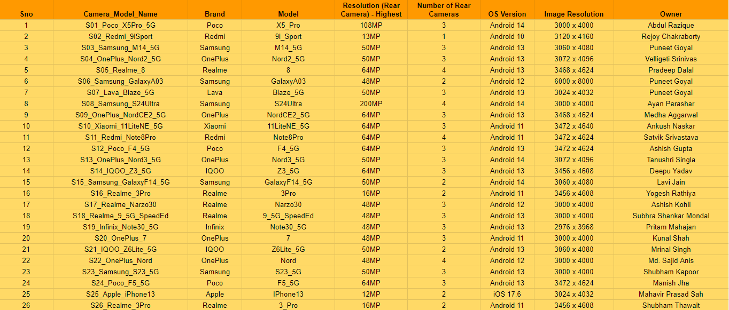
Dataset Creation: Device Details
Table: Document Forensic Dataset details

Slide 22


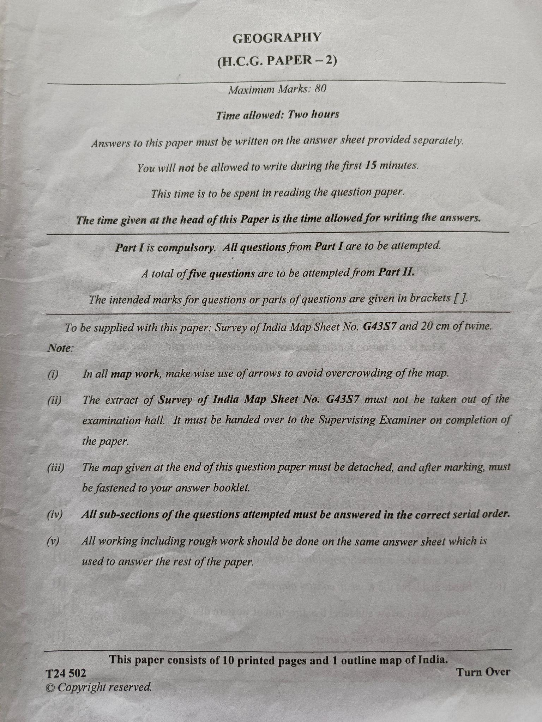
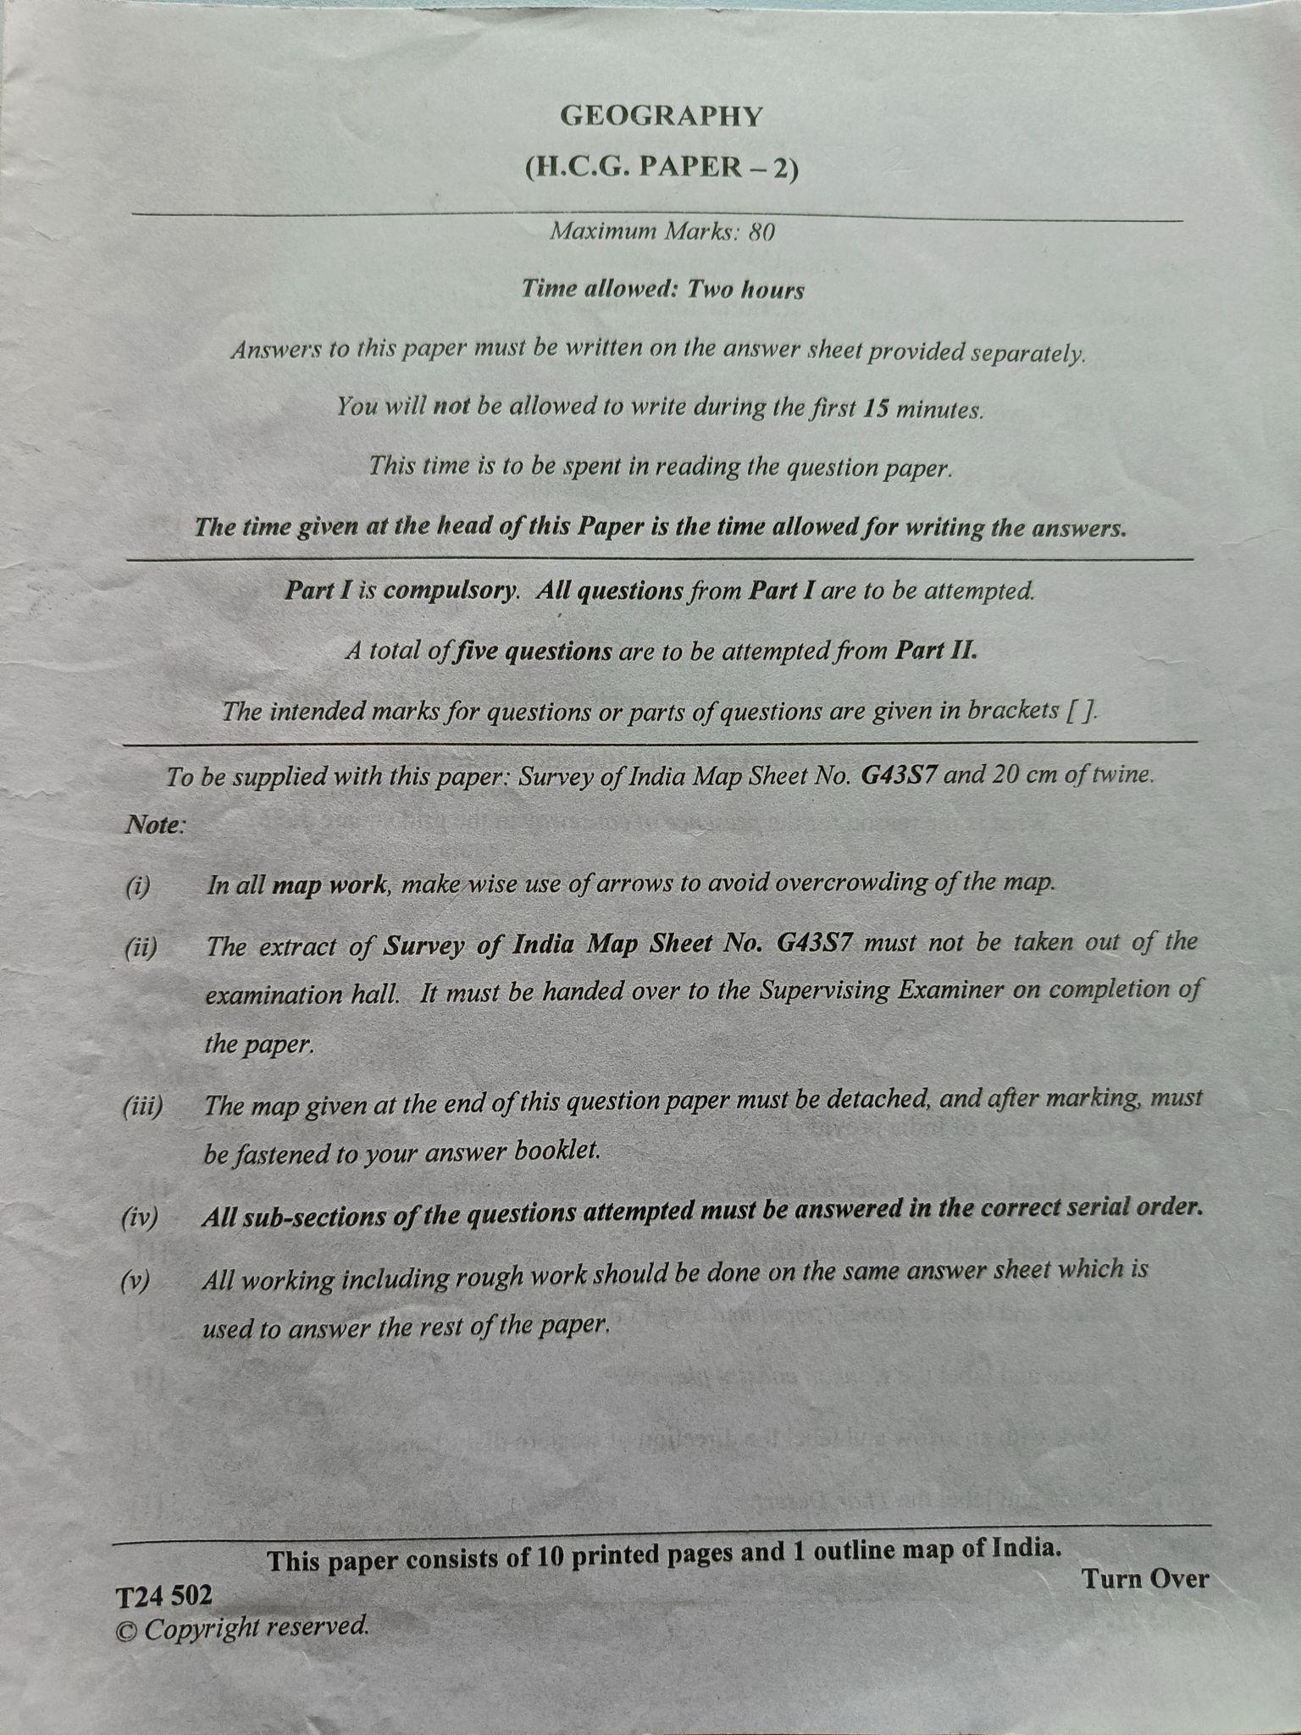
Dataset Creation: some images of dataset
Realme 3 Pro Standing
Realme 3 Pro Sitting
Infinix note 3 5g Standing
Infinix note 3 5g Sitting
Fig: Page 01 of Doc 20 from different Phones in both Position

Slide 23
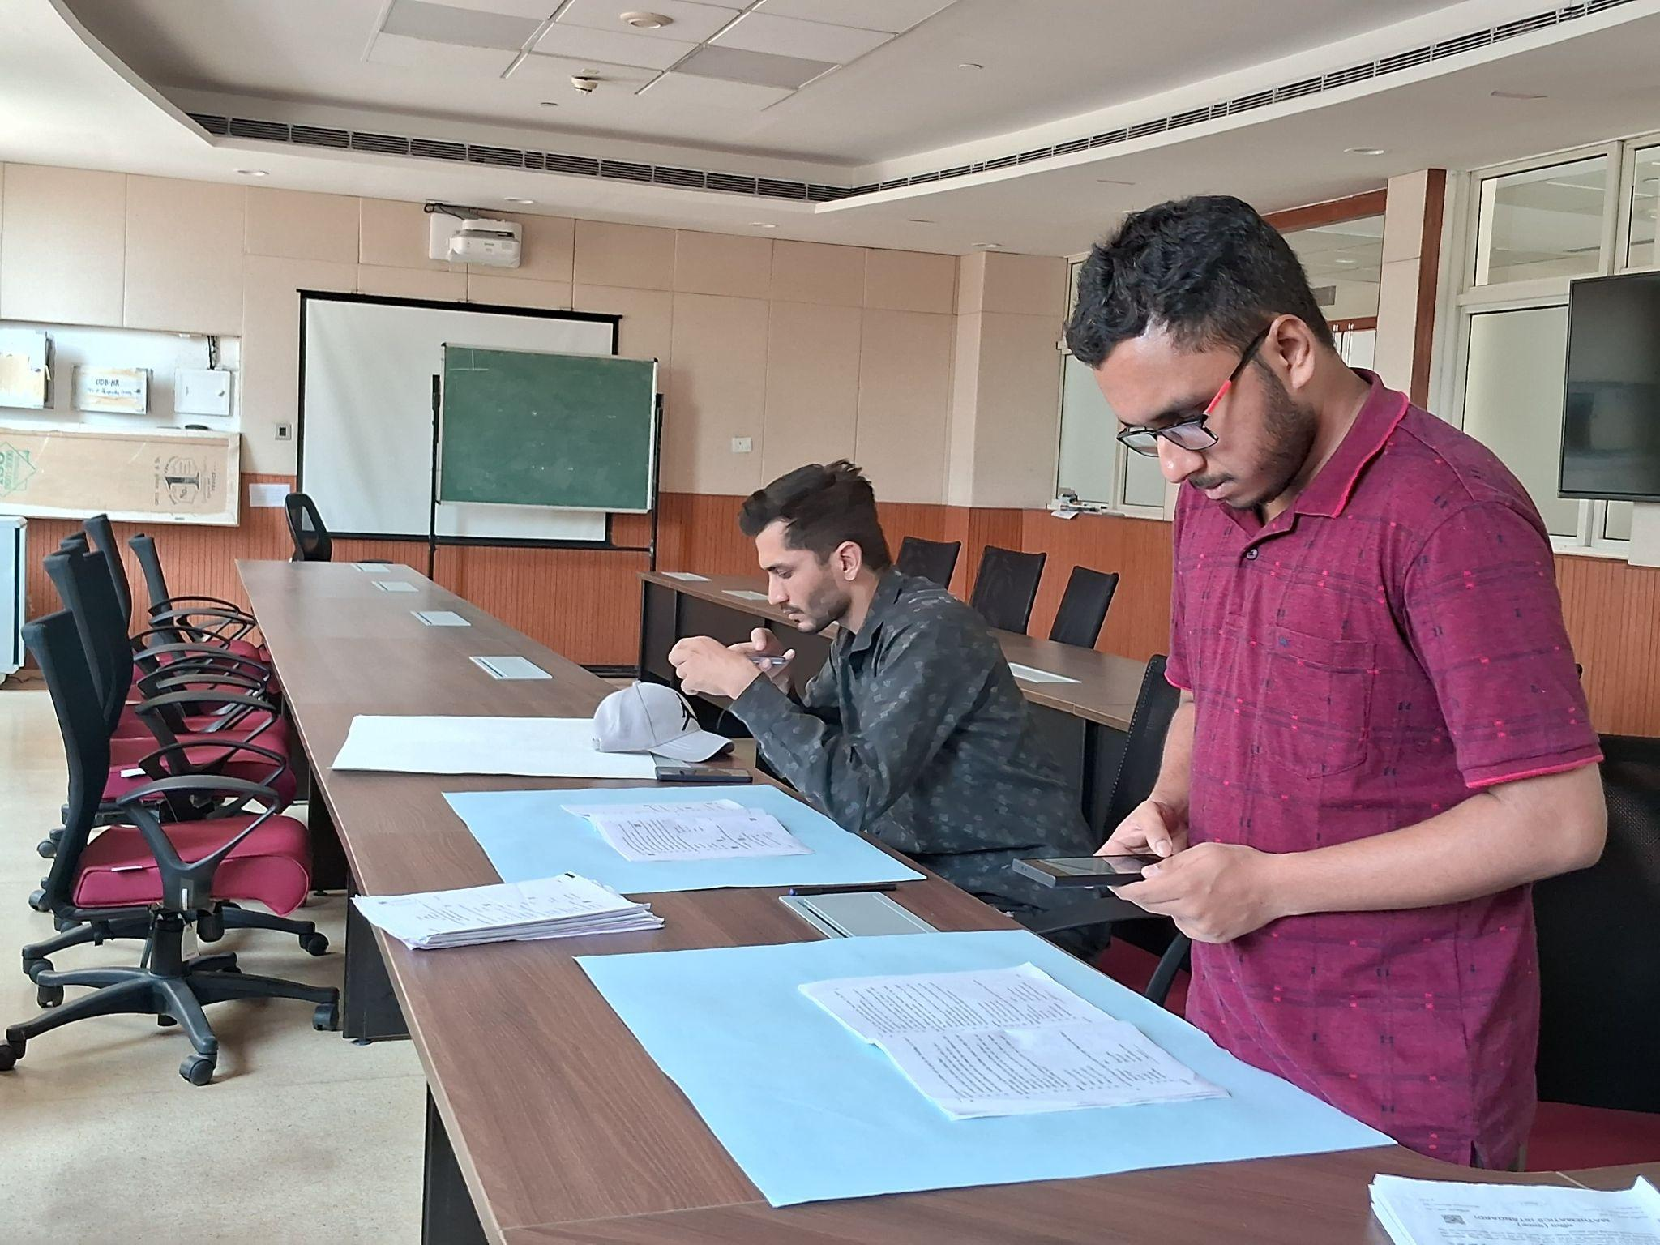
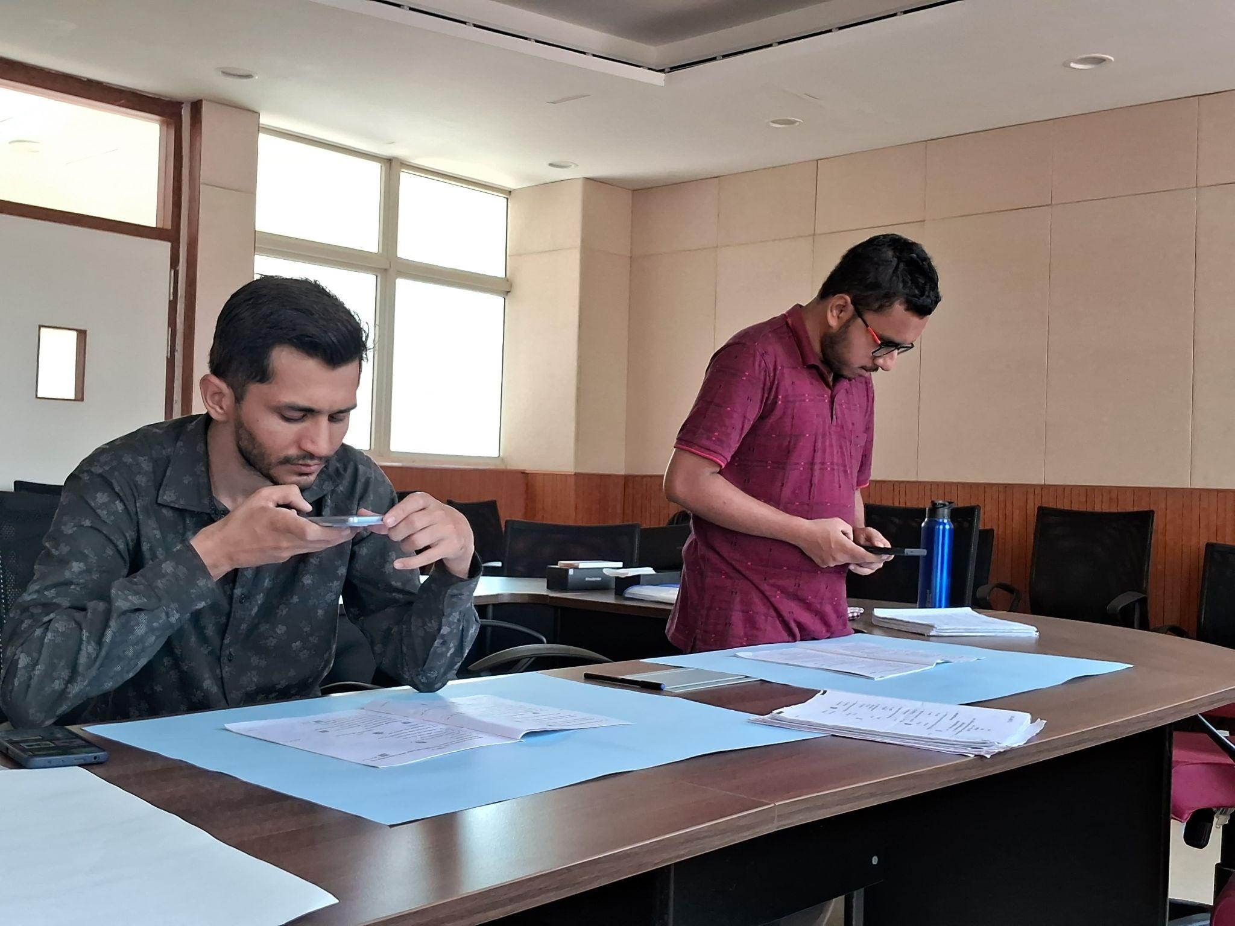
Dataset Creation
Figs: Photos while creating dataset

Slide 24
[WIP]Results of Document Forensics Dataset
Method | Patches per Image | Patch Dimension | Patching Strategy | Total training images/patches | Total testing images/patches | PLA | ILA
Chen[3] | - | - | - | 814*10 | 134*10 | - | 100%
Liu[4] | 128 | 64x64 | Quality Score + K Means Clustering | 814*10*128 | 134*10*128 | 100% | 100%
Bennabhaktula[6] | 400 | 128x128 | Homogeneous overlapping patches | 814*10*400 | 134*10*400 | 99.99% | 100%

Slide 25
[WIP]Results of Continual Learning
Train on Task 1: MNIST Dataset
Train Samples : 60,000
Test Samples : 10,000
Number of Classes : 10
Train on Task 2: Fashion MNIST Dataset
Train Samples : 60,000
Test Samples : 10,000
Number of Classes : 10
Batch Size: 32
Epochs: 25
Learning rate: 0.001
Importance factor, λ = 100
Note: Fisher Matrix is Updated based on 2880 images only

Slide 26
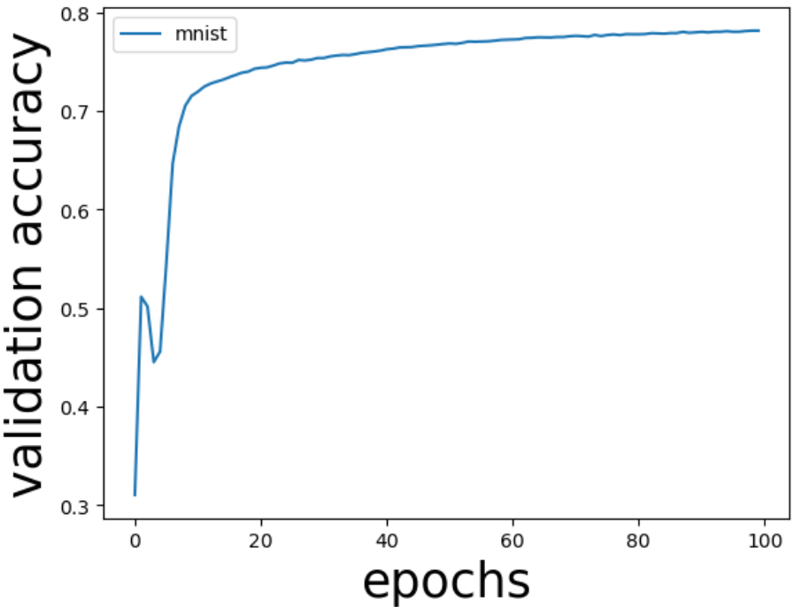
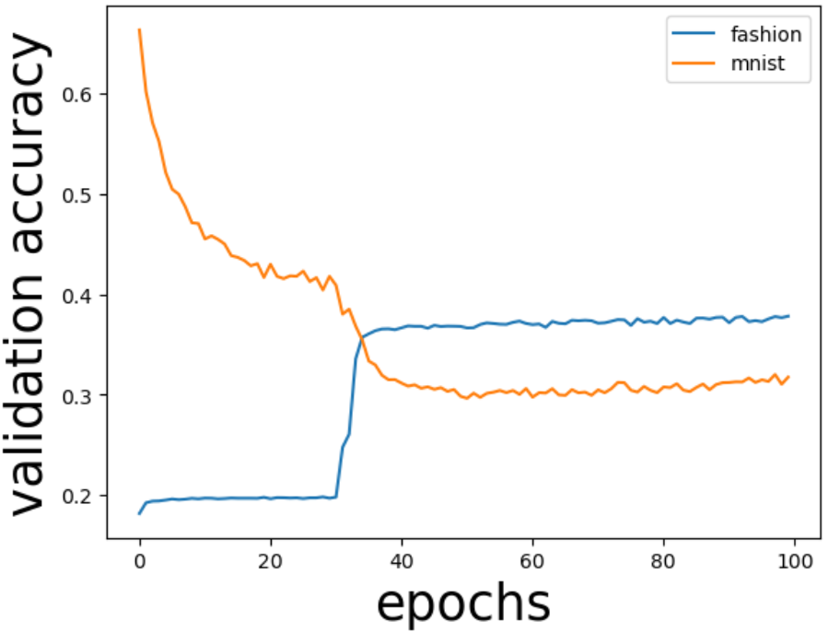
[WIP]Results of Continual Learning: Without EWC
Accuracy for Task 1
Accuracy for Task 1 and Task 2 after Retraining
MNIST: 78.15%
MNIST: 32.50% Fashion MNIST: 38.70%

Slide 27
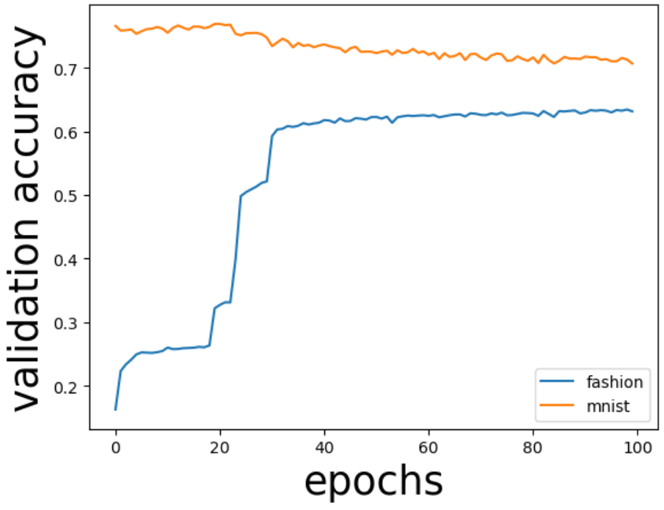
[WIP]Results of Continual Learning
Accuracy of Task 1 and Task 2 with EWC
MNIST: 68.94% Fashion MNIST: 62.35%

Slide 28
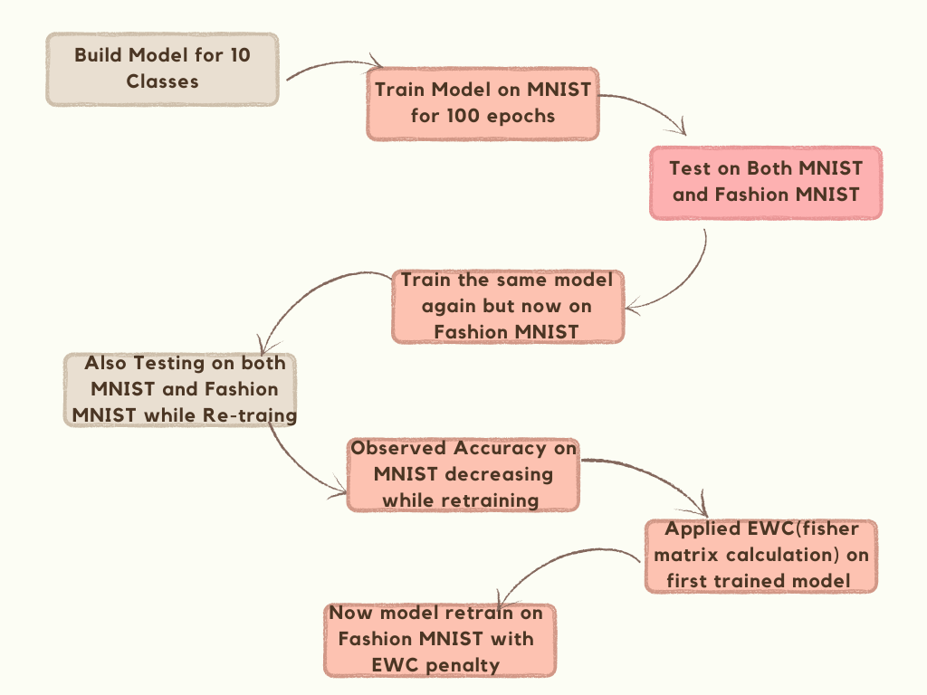
[WIP]Results of Continual Learning

Slide 29
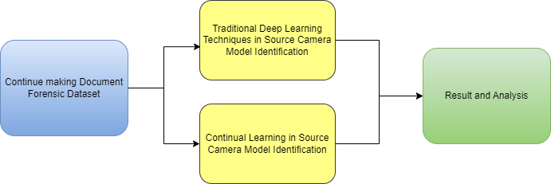
Future Work:

Slide 30
Challenges
Unavailability of same location frequently/regularly.
Unavailability of desired weather Condition every(Natural lighting).
Changing weather conditions.
People don’t want to give their device due to privacy concern.

Slide 31
References:
Kirkpatrick, J., Pascanu, R., Rabinowitz, N., Veness, J., Desjardins, G., Rusu, A. A., ... & Hadsell, R. (2017). Overcoming catastrophic forgetting in neural networks. Proceedings of the national academy of sciences, 114(13), 3521-3526.
Mai, Z., Li, R., Jeong, J., Quispe, D., Kim, H., & Sanner, S. (2022). Online continual learning in image classification: An empirical survey. Neurocomputing, 469, 28-51.
Chen, Y., Huang, Y., & Ding, X. (2017, September). Camera model identification with residual neural network. In 2017 IEEE international conference on image processing (ICIP) (pp. 4337-4341). IEEE.
Liu, Y., Zou, Z., Yang, Y., Law, N. F. B., & Bharath, A. A. (2021). Efficient source camera identification with diversity-enhanced patch selection and deep residual prediction. Sensors, 21(14), 4701.
Rafi, A. M., Tonmoy, T. I., Kamal, U., Wu, Q. J., & Hasan, M. K. (2021). RemNet: remnant convolutional neural network for camera model identification. Neural Computing and Applications, 33, 3655-3670.
Bennabhaktula, G. S., Alegre, E., Karastoyanova, D., & Azzopardi, G. (2022). Camera model identification based on forensic traces extracted from homogeneous patches. Expert Systems with Applications, 206, 117769.

Slide 32
Thank You

