Slide 1
MPCN-RP: A Routing Protocol for Blockchain-Based Multi-Charge Payment Channel Networks
Abdul Razique 2023CSM1001
Ashish Kohli 2023CSM1002
Pritam Mahajan 2023AIM1012
Vaibhav 2023CSM1019
Pradeep Dalal 2023AIM1008

Slide 2
Problem:-
Blockchain networks like Bitcoin and Ethereum face challenges regarding transaction throughput and latency due to the consensus mechanism. This mechanism requires agreement among all peers in the network, leading to slower transaction processing times and limited scalability.

Slide 3
Solution:-
Use Payment channel and Linked multiple channel network . MPCN-RP (Multi-charge Payment Channel Network Routing Protocol) is a proposed routing protocol designed to address the shortcomings of existing algorithms. It aims to find the most cost-effective path for transactions in networks with multiple charging nodes. The protocol likely considers factors such as node fees, network topology, and transaction requirements to determine the optimal route.

Slide 4
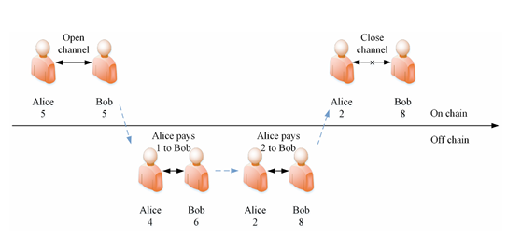
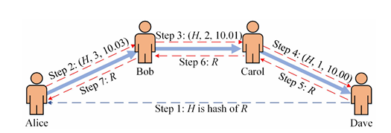
SYSTEM MODEL
A. Background
Payment Channel Network:
Hashed Time Lock Contract:

Slide 5





B. Network Model and Intermediate fees
Fixed fee:
Time value fee:
Proportional fee:
Imbalance fee:
Total fee:-

Slide 6

C. Problem Formulation

Slide 7
DETAIL CONSTRUCTION
A. Algorithm Design of MPCN-RP
Payment Request
Path Finding
Payment Execution
Update

Slide 8
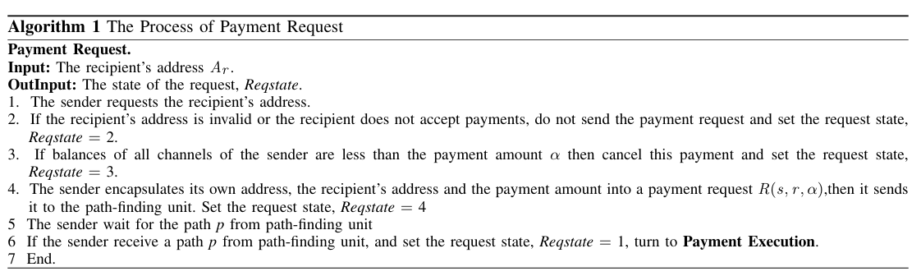

Slide 9
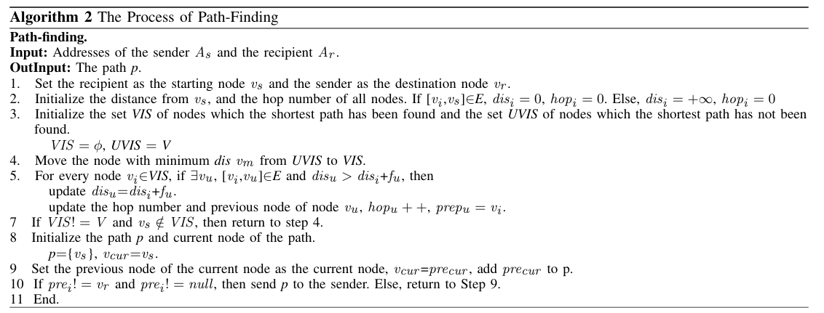

Slide 10
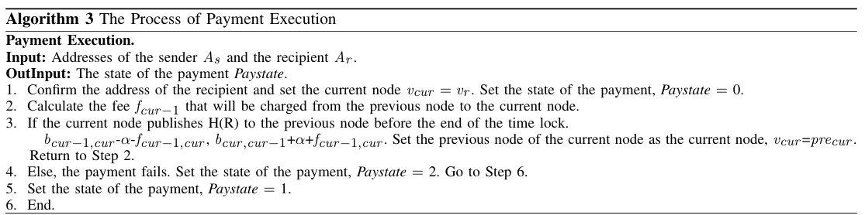

Slide 11
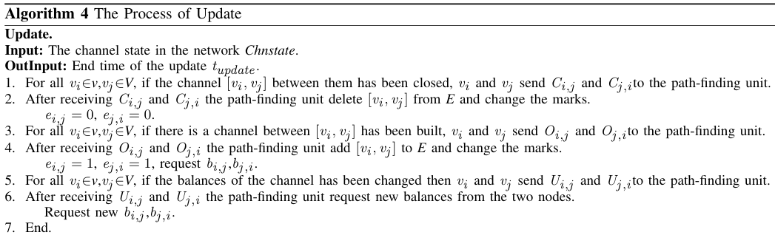

Slide 12
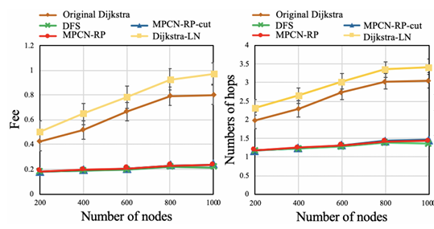
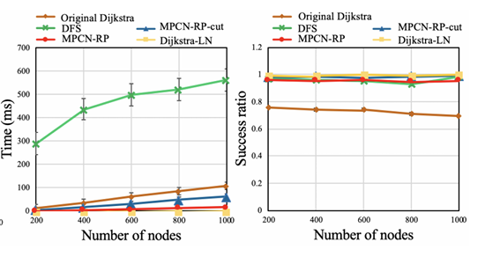
EVALUATION:

Slide 13
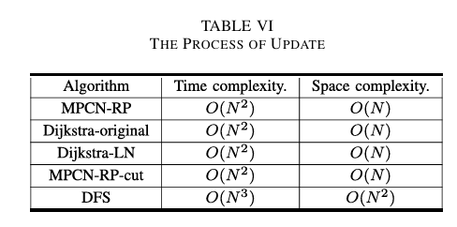
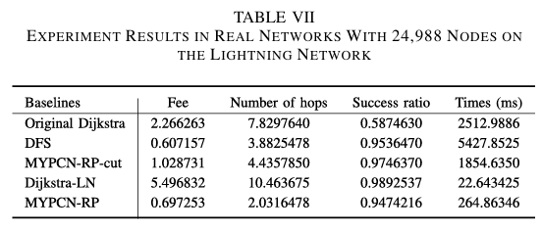

Slide 14
Cloth Simulator
We have used a cloth simulator for the payment channel network for implementing and modifying the paper. Cloth simulator is majorly written in C language and python scripting is used for compiling, running and writing or printing the outputs. For different tasks, the simulator manages different files like cloth.c, event.c…
Cloth.c is the main file which first of all take input and store it in parameter structure after it calls the network.c file to build the network, further cloth.c file paymet.c file to list all the payments in payments structure sorted by starting time, then it calls the event file to build the events like FINDPATH, SENDPAYMENT, FORWARDPAYMENT, RECEIVEPAYMENT, etc., after that the simulation starts and for FINDPATH event uses dijkstra to find the path, calculation of dijkstra uses heap for and this heap is maintained by heap.c.

Slide 15
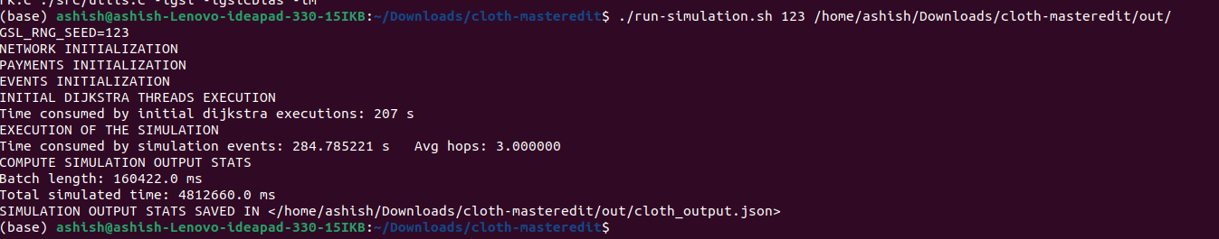
Run Simulator:-
Step 1:- make build
Step2 :- /run-simulation.sh 1243/home/ashish/Downloads/cloth-master/out/

Slide 16
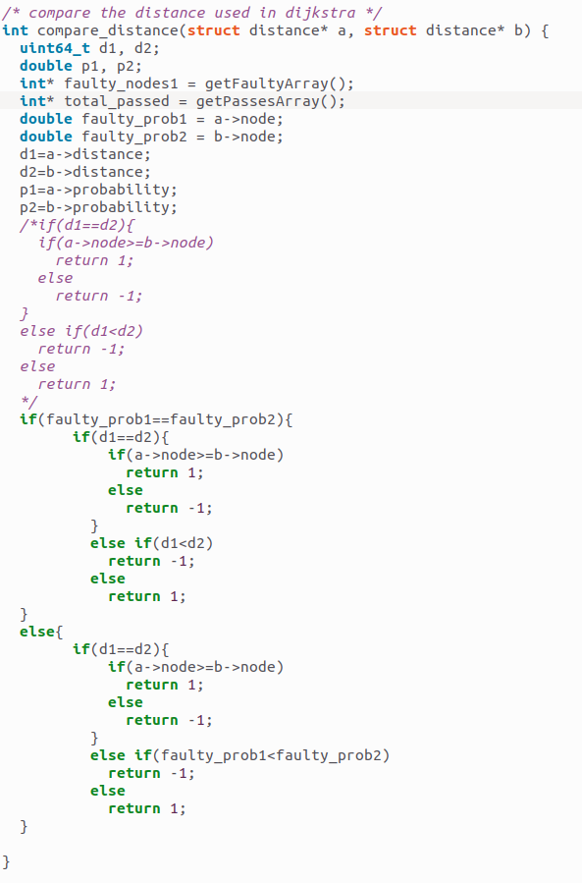
Part 2: Improvements

Slide 17
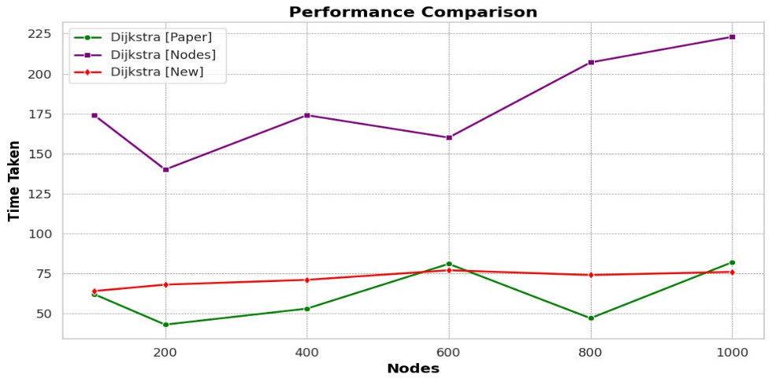
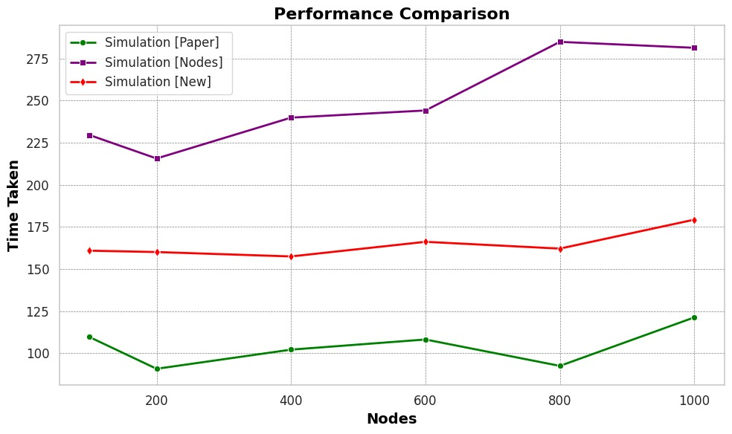
Part 3: Evaluation

