Slide 1
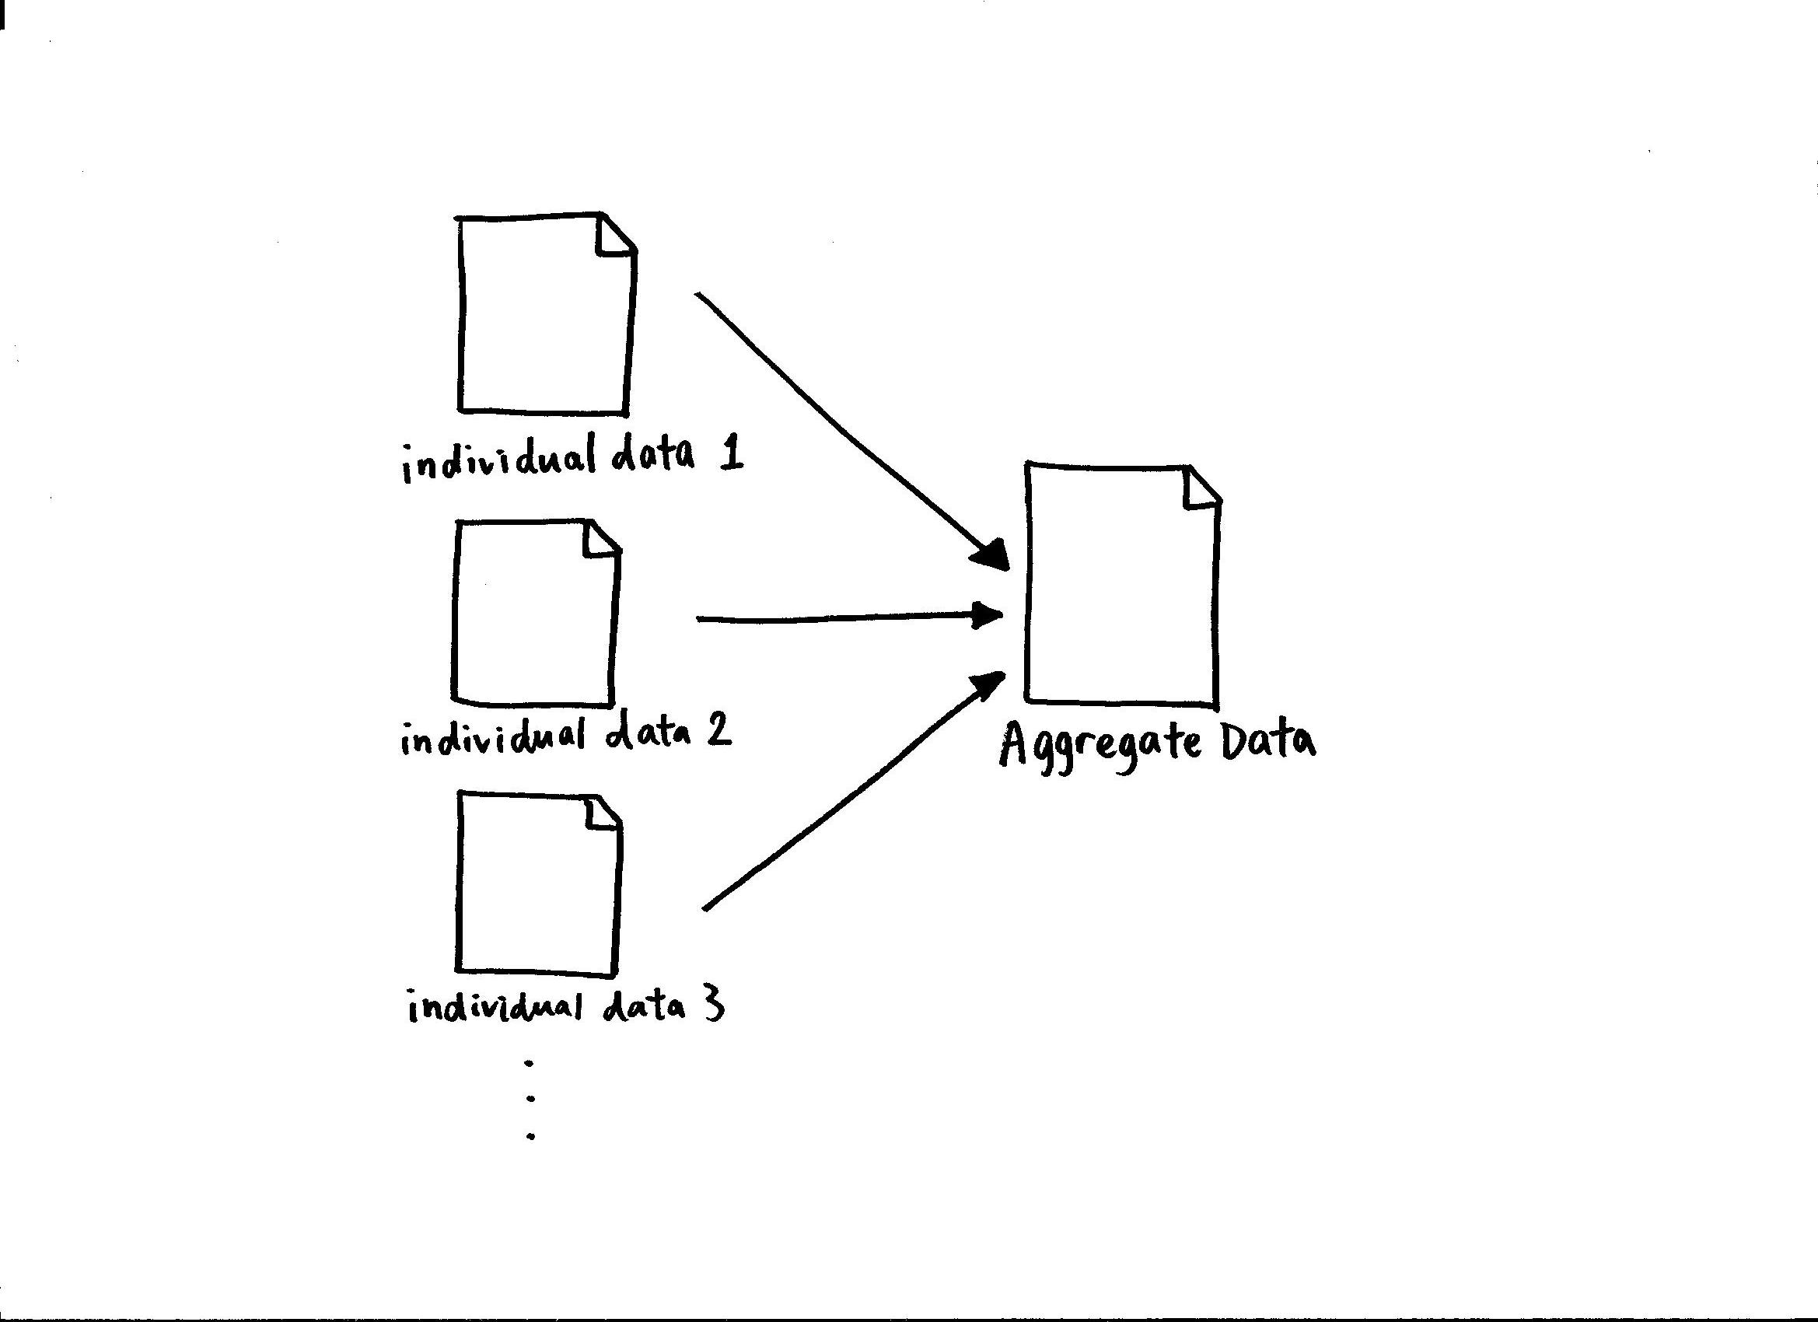
Data AGGREGATION
By : GROUP-7
P. RAZIYA (22R11A05H1)
SK. SANIA (22R11A05H6)
G. SREEJA (23R15A0517)

Slide 2
WHAT IS DATA AGGREGATION?
Aggregation in Java is a relationship between two classes that is best described as a "has-a" and "whole/part" relationship. It is a more specialized version of the association relationship. The aggregate class contains a reference to another class and is said to have ownership of that class. Each class referenced is considered to be part-of the aggregate class.
Data aggregation is any process whereby data is gathered and expressed in a summary form. When data is aggregated, atomic data rows -- typically gathered from multiple sources -- are replaced with totals or summary statistics. Groups of observed aggregates are replaced with summary statistics based on those observations.

Slide 3
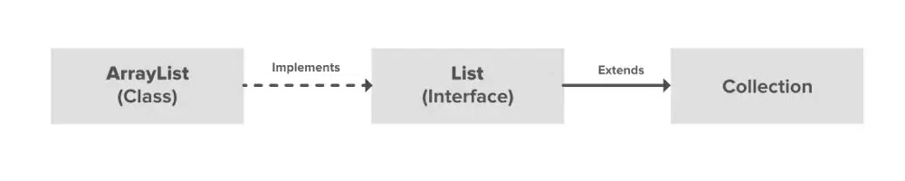
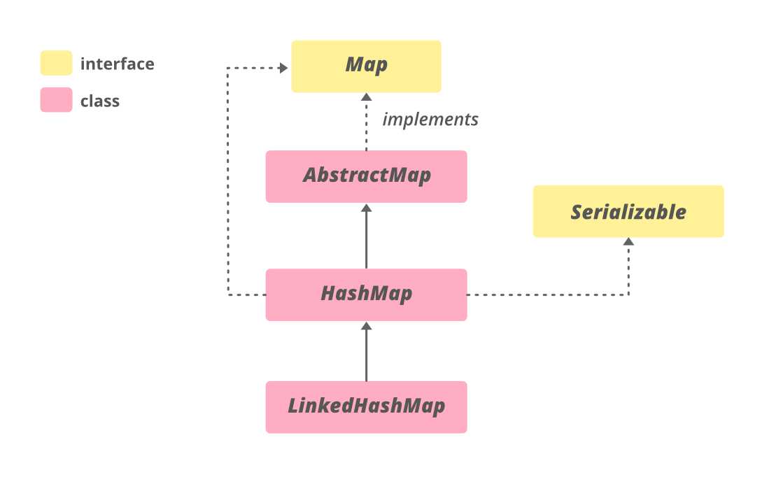
Concept used in this case studies
HASH MAP
ARRAY LIST

Slide 4
HASHMAP
Java HashMap is similar to HashTable, but it is unsynchronized. It allows to store the null keys as well, but there should be only one null key object and there can be any number of null values. This class makes no guarantees as to the order of the map.
To use this class and its methods, you need to import java.util.HashMap package or its superclass.
ARRAYLIST
ArrayList is a Java class implemented using the List interface. Java ArrayList, as the name suggests, provides the functionality of a dynamic array where the size is not fixed as an array. Also, as a part of the Collection framework, it has many features not available with arrays.

Slide 5
ARCHITECTURE
1. Class Definition
- Define CandyConsumption class with attributes and methods.
2. Data Initialization
- Create an array cc of CandyConsumption objects with specific data.
3. Data Aggregation
- Define a method aggregate to aggregate candy consumption data.
- Use HashMaps to store candy-date-consumption mapping and calculate total consumption datewise and candywise.
4. Display Aggregated Data
- Print the header line.
- Iterate through candies and dates to print consumption values.
- Print the total consumption datewise as the last line.

Slide 6
ADVANTAGES
DISADVANTAGES
Readable
Modular
Object oriented approach
Usage of Data Structures
Array size
Limited error handling
Static methods
Single Responsibility principle

Slide 7
ALGORITHM
Data Initialization:
- Create an array of ‘CandyConsumption’ and fill it with sample data representing candy consumption records and print the header line displaying columns date, candy consumption.
2. Aggregation Process :
- Initialize data structures: map(HashMap), dates(ArrayList), consumptionDatewise (HashMap-total consumption datewise), consumptionCandywise(HashMap- total consumption Candywise) and calculate total consumption.
3. After Aggregation Output:
- Print a header line for the aggregated table, displaying dates, candies, and a total column.
4. Print Total Consumption Datewise:
- Print a line displaying the total consumption datewise.

Slide 8
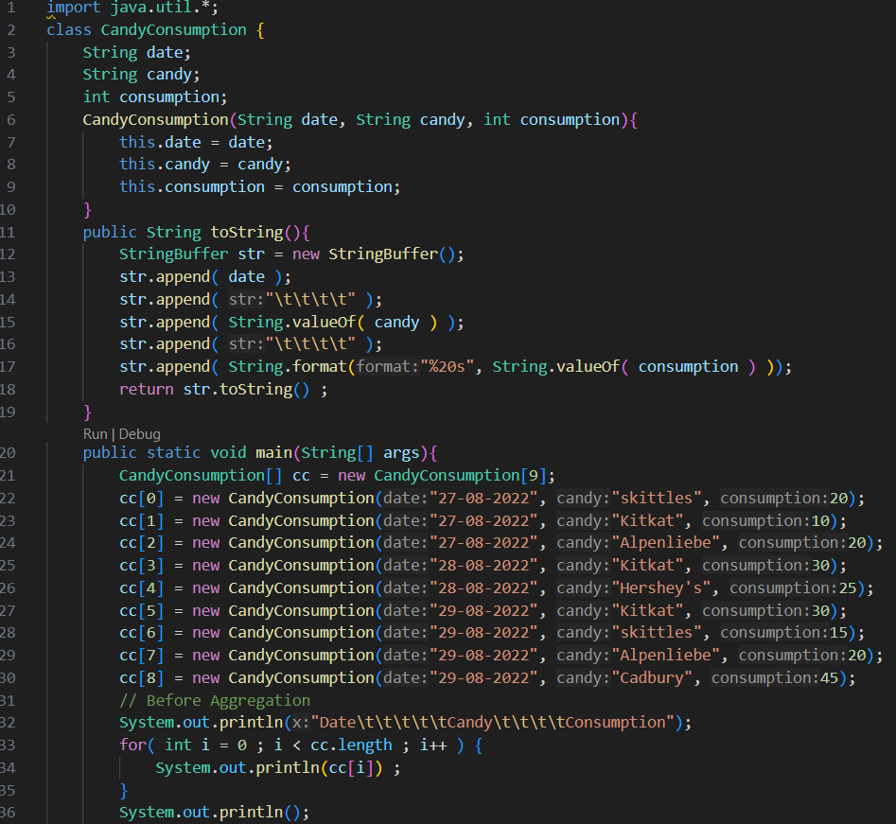
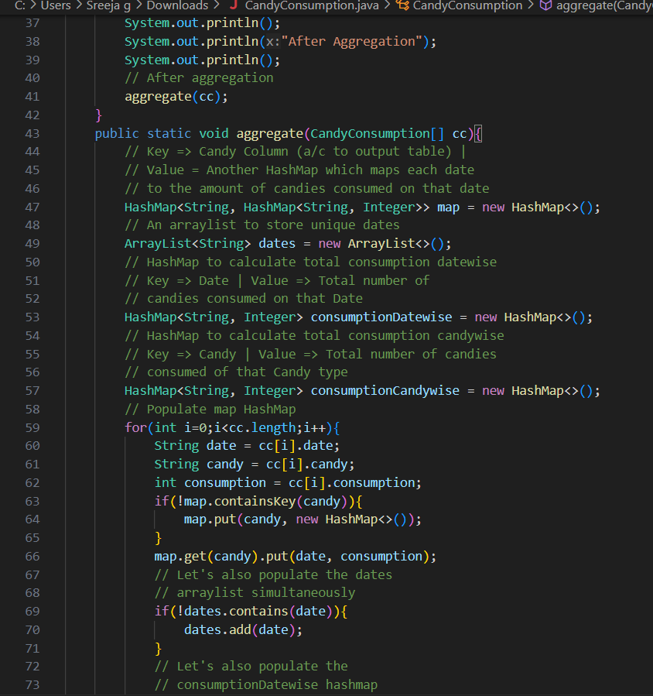
CODE

Slide 9
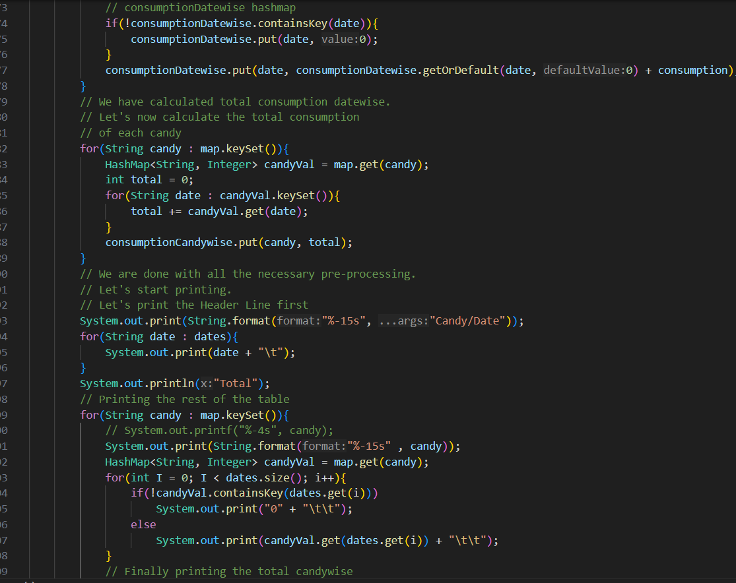
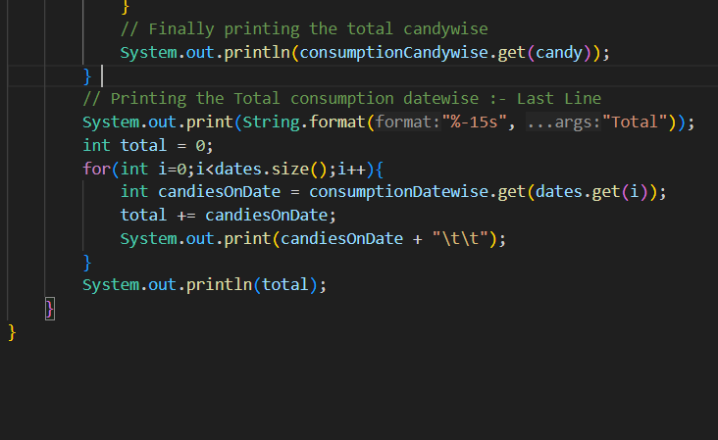

Slide 10
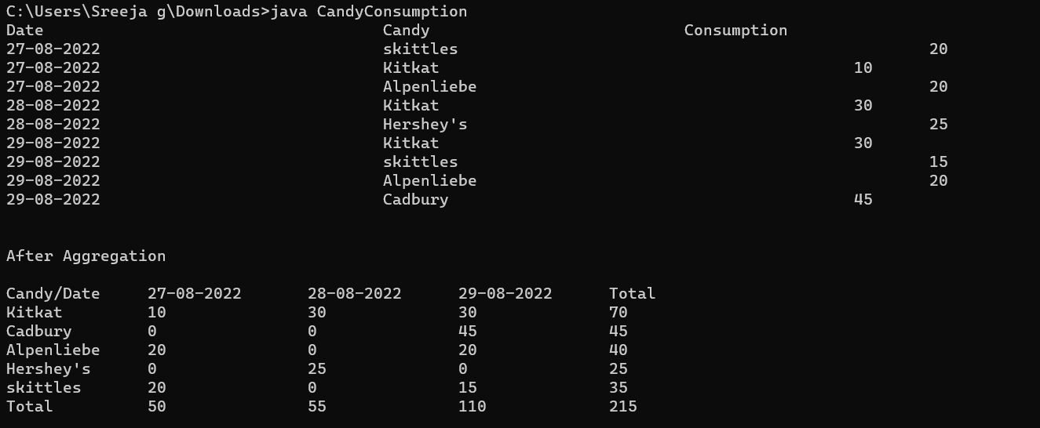
OUTPUT

Slide 11
CONCLUSION
In conclusion, the case study of candy consumption aggregation demonstrates notable strengths in terms of readability, organizational structure, and efficient data handling. The use of HashMaps for aggregation and the implementation of a class for candy consumption records contribute to a clear and modular design. Enforcing immutability where appropriate, and incorporating meaningful comments would enhance the robustness and maintainability of the program. Therefore the code successfully achieves its objective and serves as the best example for data agregation.

Slide 12
THANK YOU

