Slide 1
Case interview
16.05.2022

Slide 2
Agenda
1
Data
2
Problem and Solution
3
Results

Slide 3
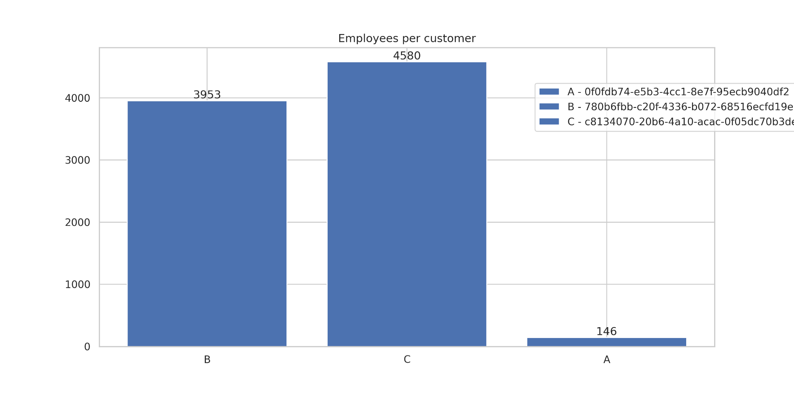
Data
Customers: 3
Period: May - July 2022
Total employees id’s: 8.5k
Unique id reservation: 7k
Unique id connection: 5.5k
Total reservations: 60k
Total connections: 35k (*2)

Slide 4
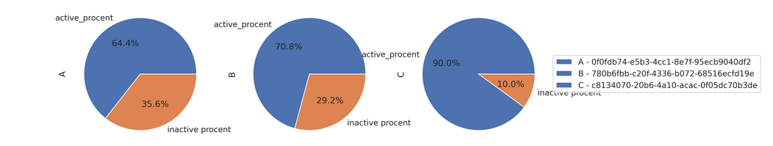
Trial period: 3 month
Table: unique id per category
customer_id | Alias | employees | reservations | connections | % of connected
0f0fdb74-e5b3-4cc1-8e7f-95ecb9040df2 | A | 146 | 94 | 128 | 87%
780b6fbb-c20f-4336-b072-68516ecfd19e | B | 3953 | 2799 | 3076 | 77%
c8134070-20b6-4a10-acac-0f05dc70b3de | C | 4580 | 4122 | 2469 | 59%

Slide 5
Agenda
1
Data
2
Problem and Solution
3
Results

Slide 6
Problem
Do the number of connections of an employee influence his decision on whether to go to the office or not?

Slide 7
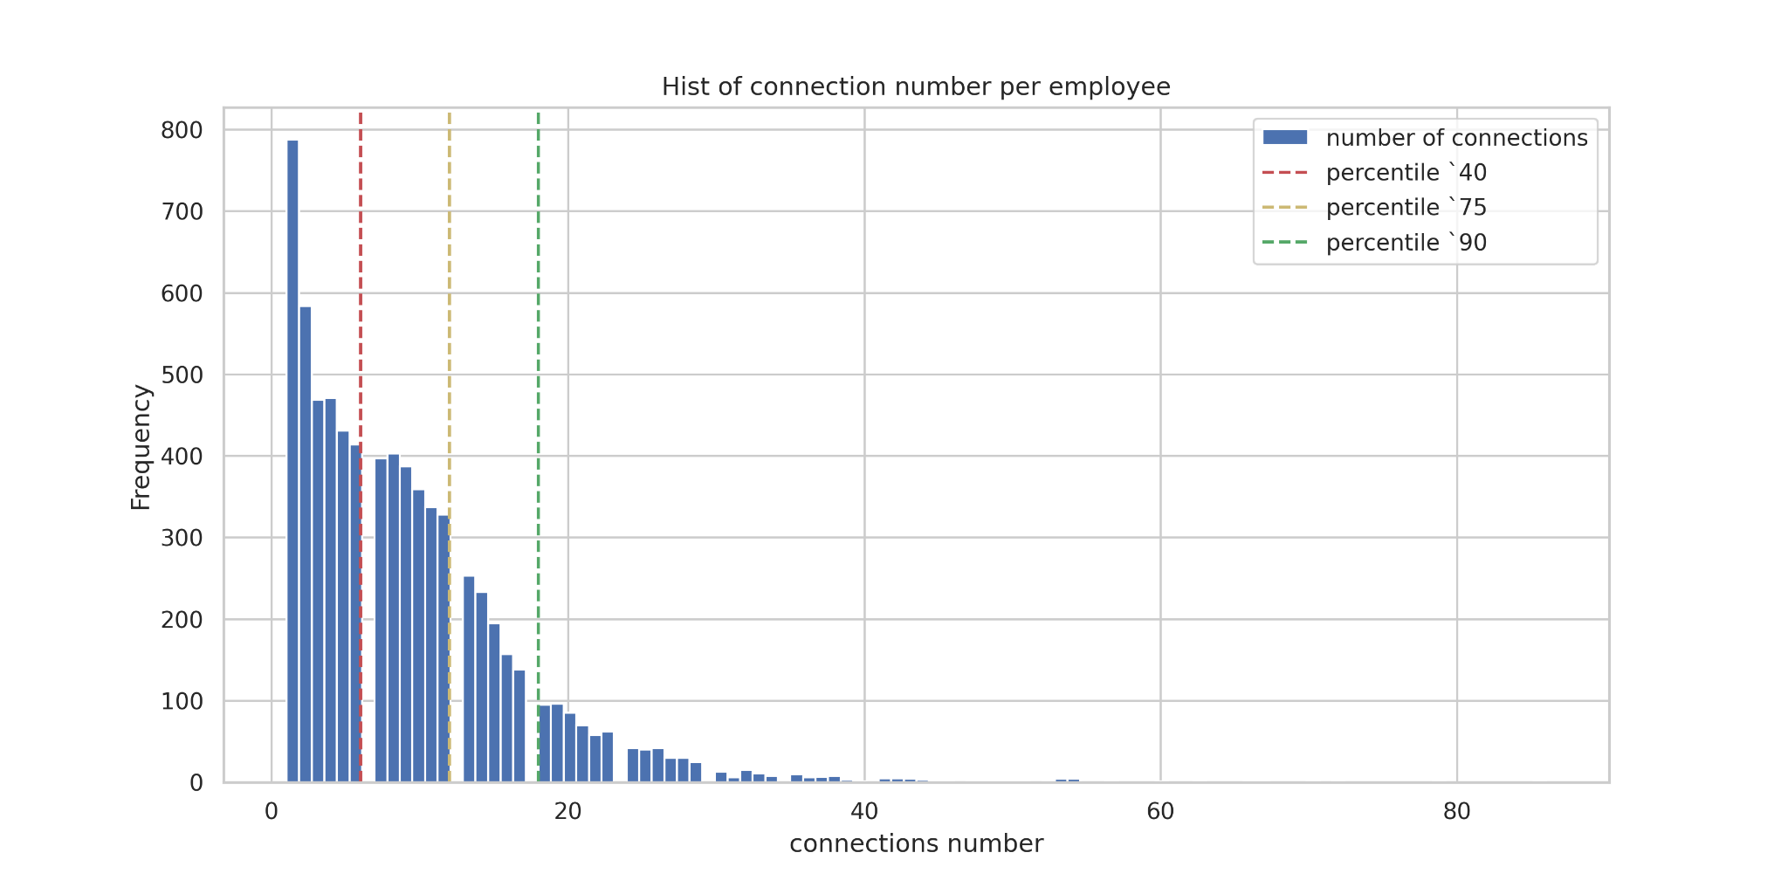
Connections
Group 1
Group 2
Group 3
Group 4

Slide 8
Problem and Hypothesis
Problem:
Do the number of connections of an employee influence his decision on whether to go to the office or not?
Observation:
It’s possible to divide users in group based on number of connections.
Hypothesis:
The more connections user in group have, the more reservations they do. Different groups gives different reservation number
Solutions:
Correlation
Statistics criteria. Two-four equal users groups
Bootstrap. Two-four unequal groups
Regression - coefficient analysis

Slide 9
Agenda
1
Data
2
Problem and Solution
3
Results

Slide 10
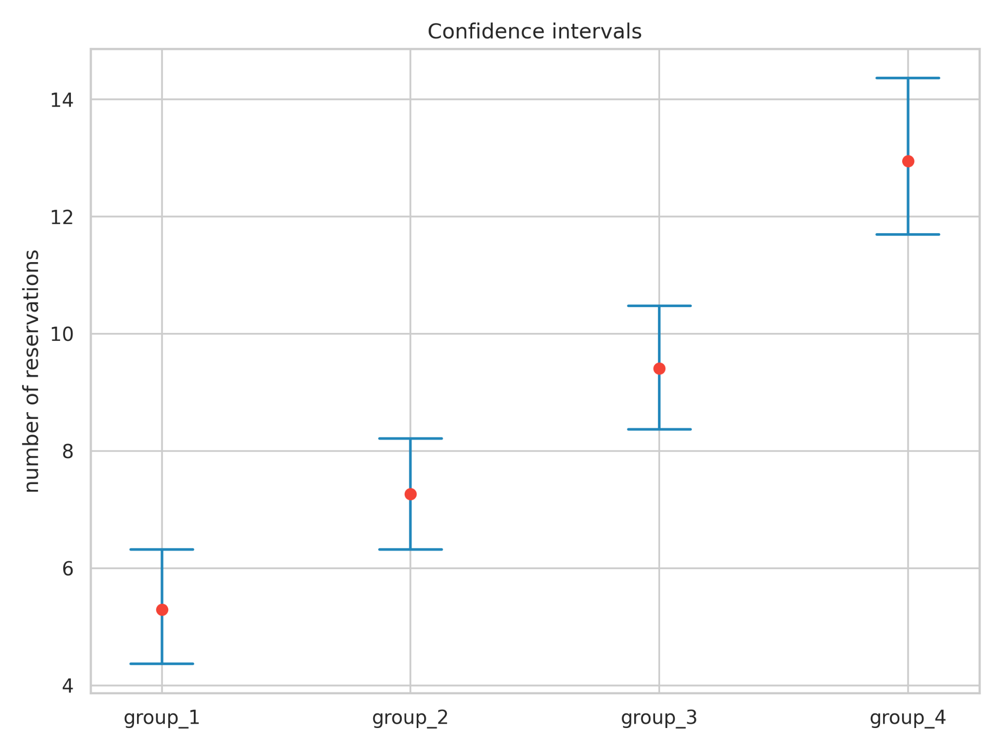
Confidence Intervals
Intervals were built based on `95 percentile.
Bootstrap 200 sampes, each 500 rows
All 4 groups do not overlapped
Group | connections | reservation | left_border | right_border | Number of employee
1 | 3.13 | 5.29 | 4.37 | 6.32 | 3157
2 | 9.37 | 7.26 | 6.32 | 8.21 | 2211
3 | 14.69 | 9.41 | 8.37 | 10.48 | 976
4 | 25.04 | 12.95 | 11.70 | 14.37 | 810

Slide 11
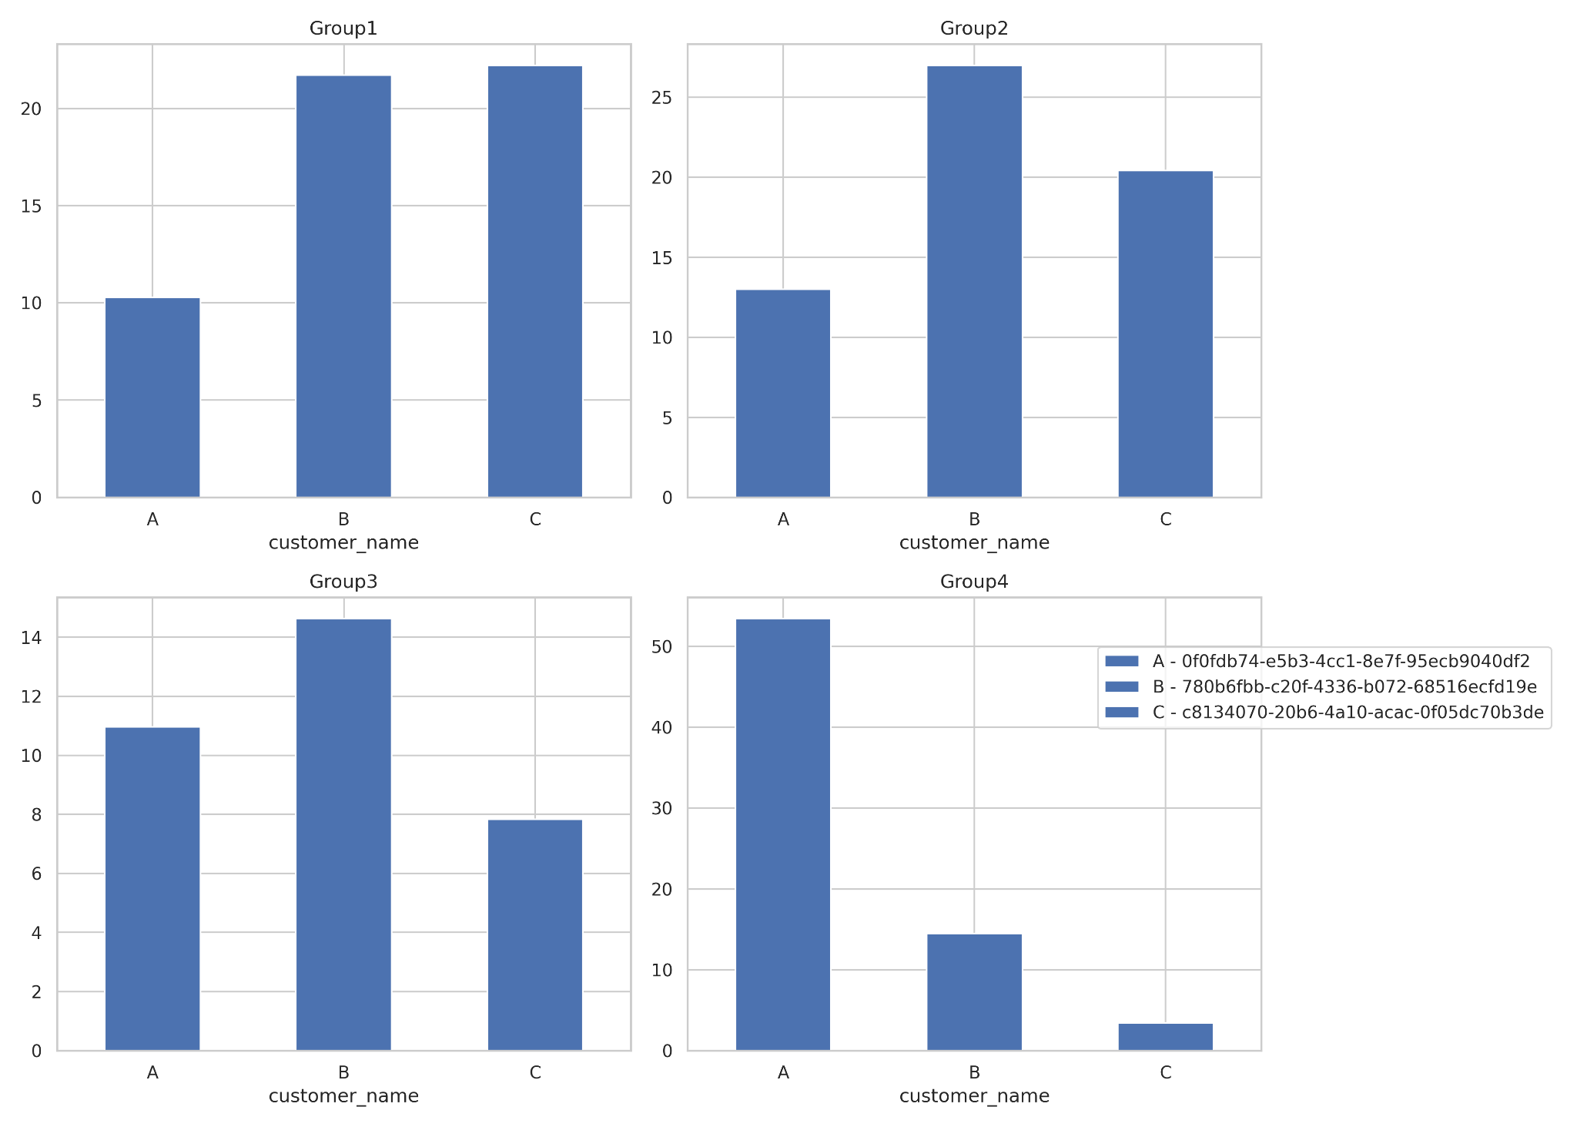
Insights: customers
A: relatively big number of connection as most of employees (~65%) on 3rd or 4th group.
B: Most of the mass of communications dedicated to this company, more in group 2 - 26%, but looks like C - group 1 22%
C : Few connections and few reservations. Almost 50% of their employees in group1 and group 2

