Slide 1
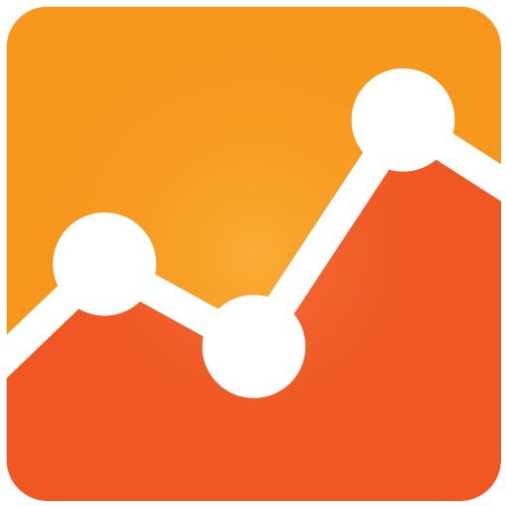

Telemetry with

Slide 2
Vision Statement
State the vision and long term direction.
Notes:
Getting the data is the easy part – what you do with it is the real matter
Identify the data that matters
Identify the trends
Take Actions
Enhance Conversion
Enhance UX
Take online business to next level
Power of web analytics
How to use online to optimize web/app

Slide 3
Today…
The first look
What can we do
How can we do
Case Study: Invoice Approval Touch
Notes:
Path
The first look
What can we do
How can we do
Case Study: Invoice Approval Touch

Slide 4
Today…
The first look
What can we do
How can we do
Case Study: Invoice Approval Touch
Notes:
Path
The first look
What can we do
How can we do
Case Study: Invoice Approval Touch

Slide 5
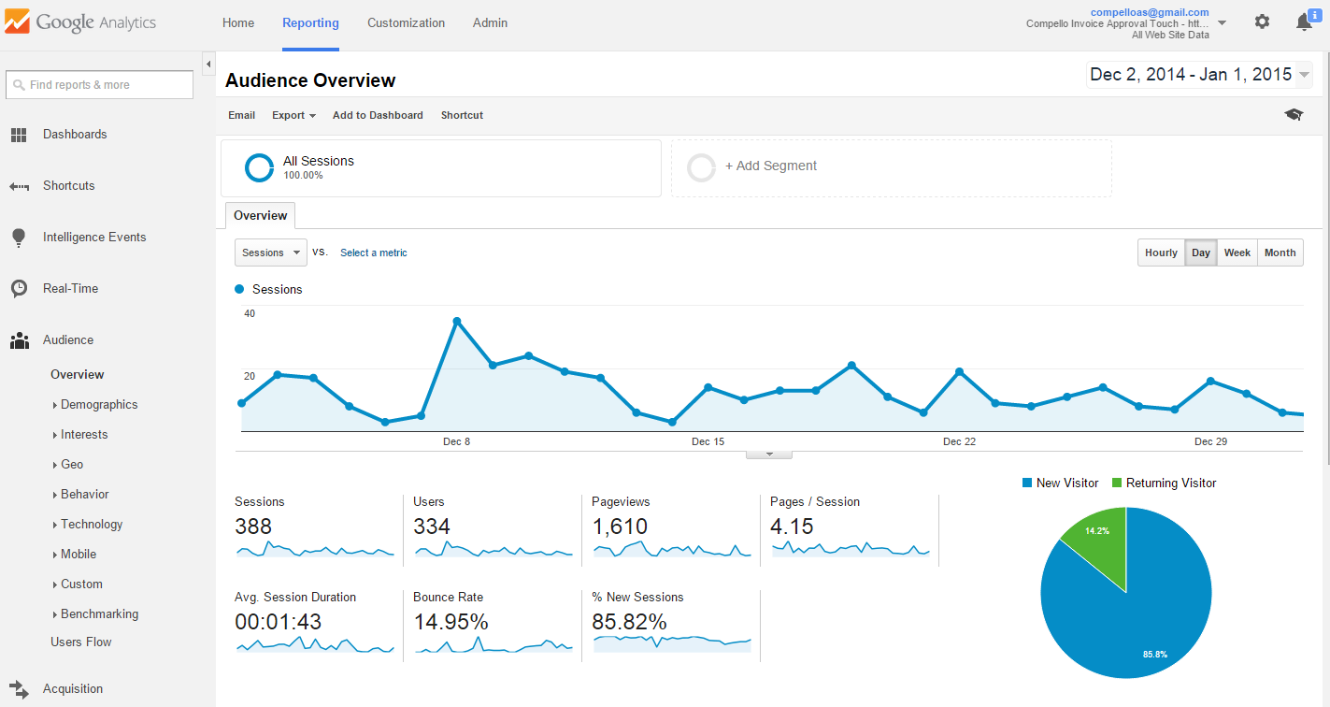
The first look
Summary of the current situation.
Use brief bullets, discuss details verbally.

Slide 6
Setting up
<script>
(function(i,s,o,g,r,a,m){i['GoogleAnalyticsObject']=r;i[r]=i[r]||function(){
(i[r].q=i[r].q||[]).push(arguments)},i[r].l=1*new Date();a=s.createElement(o),
m=s.getElementsByTagName(o)[0];a.async=1;a.src=g;m.parentNode.insertBefore(a,m)
})(window,document,'script','//www.google-analytics.com/analytics.js','ga');
ga('create', 'UA-XXXXXXX-Y', 'auto');
ga('send', 'pageview');
</script>
Sign up for Google Analytics
Get the tracking Code
Place on the website
View from the dashboard
Notes:
Sign up for Google Analytics
You will have to enter Account Name
Website Name and URL
Get Tracking Code which includes the ID
Copy paste the code on your webstite
Go to the dashboard and view analytics

Slide 7
Today…
The first look
What can we do
How can we do
Case Study: Invoice Approval Touch

Slide 8
What can we do?
Dashboard
Real Time Analytics
Audience Demography
Behavior
Custom Dimensions & Metrics
Acquisition
Conversions
Goals

Slide 9
Today…
The first look
What can we do
How can we do
Case Study: Invoice Approval Touch

Slide 10
How can we do? - Development
Create an account in Google Analytics
Integrate the app initializing code
Page view tracker
Page view in Single Page App
Tracking Events
User Timing Feature
Metrics & Dimension

Slide 11
How can we do? - Configuration
Create Dashboard
Import Dashboard

Slide 12
Today…
The first look
What can we do
How can we do
Case Study: Invoice Approval Touch

Slide 13
Invoice Approval Touch - Analytics
Accounts (Dev & test)
Dashboards
Other flows diagrams

Slide 14
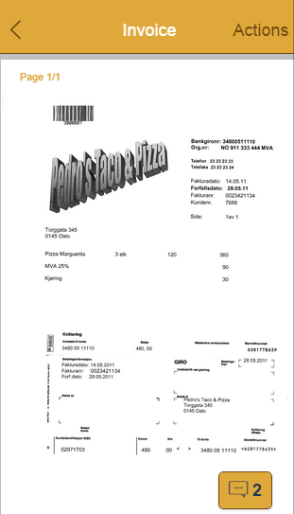
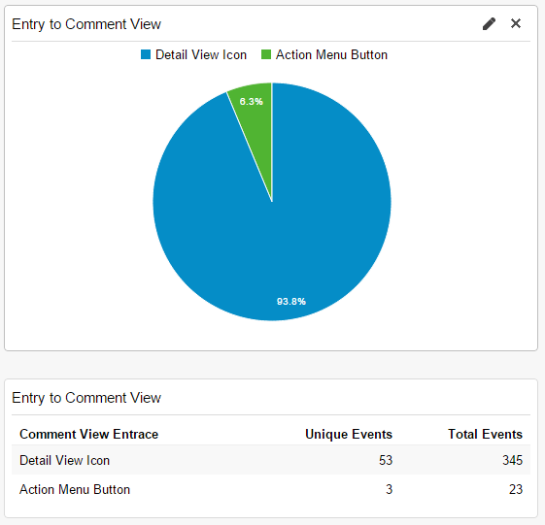
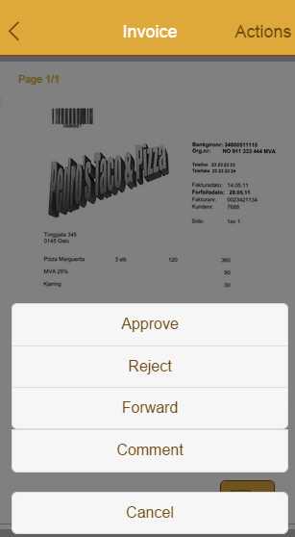
Invoice Approval Touch - Decisions
Notes:
From the user base, only 6.3% used comment button in the action menu. Therefore, the decision to remove the Comment button in action menu was taken.
https://compelloas.sharepoint.com/Development/Invoice%20Approval%20Touch%20Wiki/Analytics.aspx

Slide 15
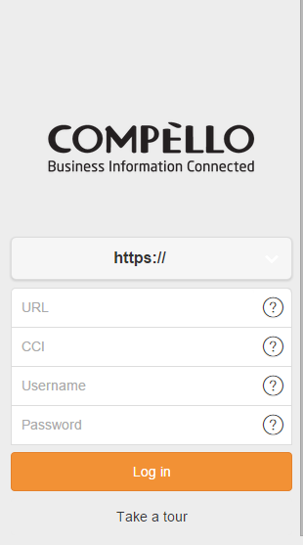
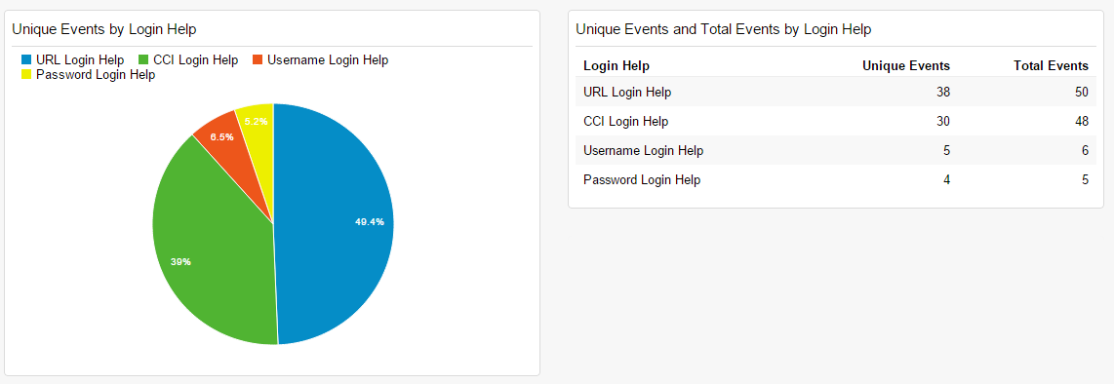
Invoice Approval Touch - Decisions
Notes:
Based on the user experience help button for username and password seems to be rarely used. Therefore, possible to take down the help buttons only for username and password fields.
https://compelloas.sharepoint.com/Development/Invoice%20Approval%20Touch%20Wiki/Analytics.aspx

Slide 16
Clarifications?

